Slide 1


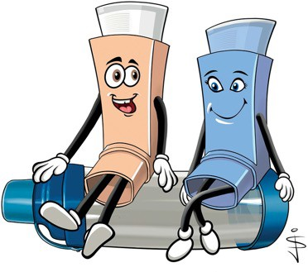
Remember: take your blue inhaler before you come into contact with any of your triggers if needed and regularly in response to symptoms if you have a cold.
Your Asthma Nurse’s name and telephone number is:
My Triggers are:
•
Asthma Management Plan For
•
•
Your doctor’s name and telephone number is:
•
•
•
•
Common Triggers are:
Best Peak Flow Date
Viruses
Changes in weather
House dust mites
Animal fur, feathers and their bedding
Foods
Exercise
Upset, distress, and emotions
Smoke – cigarettes and fires
Additional Comments:
Recommended websites www.beatasthma.co.uk
Asthma+LungUK at:
www.asthma.org.uk
https://uk-air.defra.gov.uk/forecasting/
This leaflet is intended for colour printing.
Please take this with you when you visit your doctor or asthma nurse.

Slide 2



Green zone – Good
Your asthma is under control if:
Amber zone – Warning
If you are using your blue inhaler more than 3 times per week for symptoms or you often wake at night with a cough or wheeze, arrange a review with your asthma nurse or GP.
Warning signs that your asthma is getting worse:
Red zone – Severe
you are still breathing hard and fast
you still feel tight and wheezy
you are too breathless to talk in a sentence
you are feeling frightened and exhausted
your breathing feels good
you have no cough or wheeze
your sleeping is not disturbed by coughing
you are able to do your usual activities
you are not missing school
if you check your Peak Flow, it is around your best
Other serious symptoms are:
colour changes - very pale / grey / blue
using rib and neck muscles to breath, nose flaring
you have symptoms (cough, wheeze, ‘tight chest’ or feel out of breath)
you need your reliever inhaler more than usual
your reliever is not lasting four hours
your peak flow is down by a third
BEST PEAK FLOW
Red Zone Action
Take 10 puffs of the blue inhaler via a spacer and call 999
Green Zone Action - take your normal medications
Your preventer inhaler is a
PEAK FLOW 1/3 DOWN
Amber Zone Action – continue your normal medicines AND
Asthma can be life threatening
Do not attempt to do a peak flow
Whilst waiting for the ambulance and using your spacer, take 1 puff at a time of your blue inhaler, breathing at a normal rate for 4-5 breaths, every 30 seconds.
Stay where you are and keep calm
If your child becomes unresponsive and has an adrenaline pen for allergies-use it now.
colour and is called
Take 2 puffs of the BLUE inhaler with your spacer 1 puff at a time. Keep doing this every 10 minutes if you still have symptoms up to a total of 6 puffs
You can do this every 4 hours but must make an appointment at your GP surgery within the next 24hrs even if you feel better.
If you need to do this more than every 4hrs, you must see your GP today or go to A&E
Start keeping a record of your symptoms and peak flow readings to take to the Doctor
You take puffs/sucks every morning and every night even when you are well.
Other asthma medications you take are:
Additional comments or information
IMPORTANT:
Your reliever inhaler is a
If after your 6 puffs you still have increasing wheeze or chest tightness
colour and is called
You take
puffs/sucks up to 3 times in a week
for symptoms and before exposure to your triggers (see your list) if needed.
If you are needing to use your reliever inhaler more than 3 times per week for symptoms
Move to the RED ZONE
Move to the AMBER ZONE

