Slide 1






Our Clinical and Care Professional Leadership Framework

Slide 2
Background and context
NHSE published implementation guidance on their Clinical and Care Professional Framework (CCPL) in 2021 to enable a multi-professional leadership approach to be developed within ICBs.
  The vision for ICBs is to provide multidisciplinary support, guidance and leadership at neighbourhood, place and at system levels.
Between 2013 and 2022, 8 CCGs, later 5, had been providing clinical leadership equating to 180+ GP sessions. With the development of ICBs an interim leadership arrangement was put in place until the end of 2022.
Now there is an ICB with an executive team, one single function for commissioning, oversight of programmes and the development of four places, a new clinical and care leadership framework has been established. The framework is aligned to the NHSE guidance and ensures delivery of the ICB statutory duties and priorities.

Slide 3
Background and context
The clinical and care leadership framework will bring together professionals from diverse clinical and care professional backgrounds, who will work together to facilitate joined up health and care services. It will also build upon leadership and engagement networks such as clinical networks and single profession networks which already exist in primary community, secondary and social care.
New appointments have been made to ICB senior nursing positions and four associate medical director roles as well as recruitment to ICB chief pharmacist and ICB lead allied health professional roles to support the ICB clinical and care leadership structure.
The new clinical and care professional leadership roles will differ significantly from previous CCG roles as:
  They are not executive roles
  It is intended they are suitable for clinicians and care professionals
  The post holders will report to system programme leads/place directors and be guided by them
  It is not anticipated they would hold a budget
  The focus will be on the development of high quality integrated services across place and system

Slide 4
The Clinical and Care Professional Leadership Framework

Slide 5



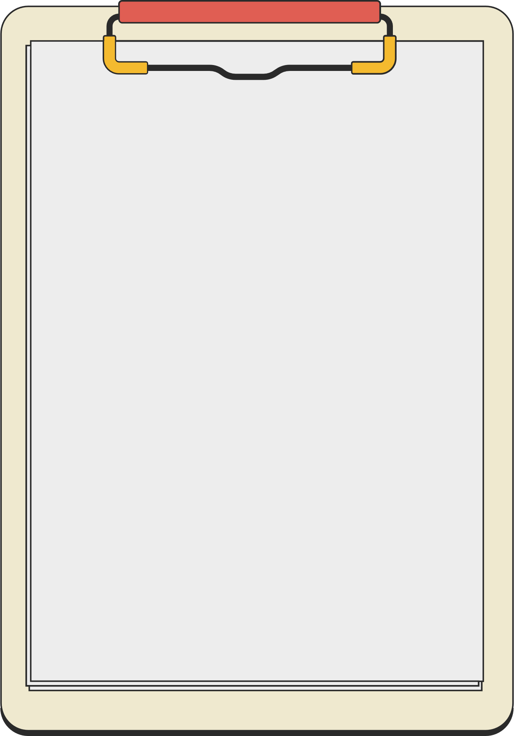
Our framework will…
1. Ensure that the full range of clinical & professional leaders from diverse backgrounds are integrated into system decision-making at all levels, supporting this with a flow of communications and opportunities for dialogue.
5. Adopt a transparent approach to identifying and recruiting leaders which promotes equity of opportunity and creates a professionally and demographically diverse talent pipeline that reflects the community served and ensures that appointments are based on ability and skillset to perform the intended function.
Our Clinical
and Care Professional Leadership Framework will:
2. Nurture a culture that systematically embraces shared learning, supporting clinical and care professional leaders to collaborate and innovate with a wide range of partners, including patients and local communities.
4. Create a support offer for clinical and care professional leaders at all levels of the system, one which enables them to learn and develop alongside non-clinical leaders and provides training and development opportunities that recognise the different kind of leadership skills required when working effectively across organisational and professional boundaries and at the different levels of the system (particularly at place).
3. Support clinical and care professional leaders throughout the system to be involved and invested in ICB planning and delivery, with appropriate protected time, support and infrastructure to carry out this work.

Slide 6
For our communities our Framework will…
Support health and social care to work together effectively | Engage with VCFSE groups to ensure that we are all working on behalf of individuals and families | Enable self care models | Encourage people to take an active role in managing their own health and wellbeing
In our neighbourhoods
Support care to be locally delivered, managed and planned | Make best use of all the expertise and staff skills available | Ensure engagement with people and communities about how best to provide care | Respect that communities know what they need best
At our place-level
Improve access by collaborating in care delivery e.g. mental health, stroke, cancer, urgent care to collectively manage vulnerable services​ | Improve services by applying a shared approach to the use of technology to improve services | Support work to ensure that as much care as possible will be delivered in local places | Ensure we spend our funds on the services patients need most
Across our system

Slide 7
System stakeholders and supporting infrastructure
Pink circles indicate new elements of the infrastructure
Individuals and their families | Community Assets and Networks District Level Health and Wellbeing Partnerships | Multi-agency care professionals delivering integrated care and populational health management in neighbourhoods | Neighbourhood Networks partnerships across VCFSE, social care, primary, community, pharmacy, dental, & mental health | Neighbourhood Leaders (e.g. PCN CDs)
Neighbourhood
Lived experience groups for co-production of priorities and service changes | Primary Care and GP Leaders Networks VFCSE Network District Council’s Network Care Providers Network | Priority Programme /topic specific care professional leads | Place Based Advisory Group | Place Based Partnership Clinical & Care Professional Lead
Place
LSC Assembly
Resident engagement on system priorities | Strategic Clinical Networks & Operational Delivery Networks Other Specialist Networks Sector Specific Networks | Priority Programme Strategic Groups - constituted by Place Functional Leads (NB places may nominate 1 to lead for all) | Collaborative System Clinical Leadership | Medical Director, ICB Chief Nurse, ICB Partner Members, ICB
Resident engagement on system priorities | Strategic Clinical Networks & Operational Delivery Networks Other Specialist Networks Sector Specific Networks | Priority Programme Strategic Groups - constituted by Place Functional Leads (NB places may nominate 1 to lead for all) | Collaborative System Clinical Leadership | Medical Director, ICB Chief Nurse, ICB Partner Members, ICB
System
Knowledge Exchange and Collaborative Learning
Notes:
Notes:
Highlight where acute clinicians fit in (consultants, specialist nurses, AHPs etc)

Slide 8

At Place
Place-Based Partnership Clinical and Care Professional Advisory Group
A cross-organisational, multi-professional clinical and professional leadership body that allows practitioners from across partners within health, care and VCFSE sectors to provide advice and guidance to the place-based leads for the activities that are required by each portfolio clinical lead.
Providing support to the clinical and professional workforce across the system
Aligning opportunities for consistent feedback and influence into ICB development
Providing joined up multi-professional leadership and strategic direction across health, care and VCFSE sectors
Sharing approaches to education and learning together and from each other

Slide 9
At system – LSC Assembly
Proposed remit:
Provision of clear strategic advice for ICB and ICP particularly related to national policy, delivery of the LSC strategy, scoping/delivery of LSC-wide transformation programmes, and the clinical and care professional workforce
Providing Clinical and Care Professional voice into the development and delivery of the LSC Health and Care Integration Strategy
Lead development of Clinical and Care Strategy for the System
Early (scoping, innovation, planning) and continual (delivery, realisation) engagement of / with clinical and professional leaders to ensure intelligence led transformation and change at all levels
Ensure broad clinical and care professional voice is present in recommendations made to the ICB for decision making
Ensure wider clinical and care professional leaders and groups are kept updated, involved and influential
Connected to formal ICB structures via the ICB medical director and director of nursing​
Members drawn from across the system, to include:
    Directors of Adult Social Services
    Directors of Children’s Services
    Directors of Public Health
    Directors of Nursing
    Medical Directors
    Midwifery leaders
    Allied Health Professional Leaders
    VCFSE leaders
    Primary Care leaders
    Place Based Clinical and Care Professional Leads

Slide 10
Clinical and care professional leadership structure – system level
System Level
Chief Digital Officer
Executive SROs
Chief Nursing Officer
Digital Lead - CCIO
Digital Lead - CNIO
Programme Directors
Medical Director
AHP Lead
Associate Medical Directors (x4)
Chief Pharmacist
Adult CHC/LD&A Lead
Women's Health Lead
Cancer Lead (Primary and Secondary)
CYP Lead
Mental Health Lead
Ambulance Lead
Urgent and Emergency Care Lead
Safeguarding lead

Slide 11
Clinical and care professional leadership structure – place level
Place Level
Director of Health and Care Integration (1 per place)
Place Based Clinical and Care Professional Lead (3 in lancs)
Place Cancer Lead
Place Digital Lead
Place Quality Lead
Place Mental Health Lead
Safeguarding lead

Slide 12
Roles within the framework
The specific roles within the framework are detailed on the following slides.
Role | Slide no.
Place based Clinical and Care Professional (CCP) Lead x 6 | 13
Clinical and Care Professional (CCP) Leads (Place) Clinical and Care Professional Cancer PBP Lead Clinical and Care Professional Digital PBP Lead Clinical and Care Professional Mental Health PBP Lead Clinical and Care Professional Quality PBP Lead Clinical and Care Professional Safeguarding PBP Lead | 14 15 15 15 16 16
Clinical and Care Professional (CCP) Leads (System) Clinical and Care Professional Adult Continuing Health Care, Learning Disabilities & Autism, and Community Services Work ICB Lead Clinical and Care Professional Cancer ICB Lead Clinical and Care Professional Children and Young People ICB Lead Clinical and Care Professional Mental Health ICB Lead Clinical and Care Professional Women’s Health ICB Lead Clinical and Care Professional Safeguarding ICB Lead Clinical and Care Professional Urgent and Emergency Care and Planned Care ICB Lead Clinical and Care Professional Ambulance ICB Lead | 17 18 18 18 19 19 19 20 20

Slide 13
Place-based Clinical and Care Professional Lead x6
Provide overall leadership to the clinical and care professional network for the (relevant) Place Based Partnership (PBP)
Act as a (Place) representative on the Lancashire and South Cumbria Clinical and Care Professional Assembly
Play a key part in creating links across all health and social care sectors including voluntary, community, faith and social enterprise organisations in the PBP, working with other members of the PBP team and act as an advocate to ensure that the needs of people and patients are at the heart of place-based plans, actively driving a shift in focus of the PBP towards improving population health.
Ensure links between all levels of care, the PBP and all clinical and care professionals and support improvements in care.
Provide clinical and care professional leadership to support the Director of Health and Care Integration, in the development and delivery of the ambitions of the ICB, ICP and PBP and the integration of health and social care.
Actively promote primary, secondary and tertiary prevention across the health and care system, and feed a clinically informed view into broader partnership work, for example, local pieces of work to improve air quality and increase active sport and leisure.

Slide 14
Clinical and Care Professional Lead (Place)
Place Leads (with specific clinical and care portfolio)
Work with the Clinical and Care Professional System Lead to ensure developments meet the needs of the Place and support the ICB strategic direction.
Oversee the quality of clinical and care services (portfolio specific) within the PBP, including sharing intelligence and working with other key partners and regulators across the PBP to improve quality of care and outcomes.
Ensure that there are effective mechanisms for anticipating, identifying, and responding to key clinical risks that could impact on the successful delivery of the strategy in their PBP. This will include engaging with system leaders from across the PBP to drive innovation, quality improvement, patient safety and population health outcomes.

Slide 15
Clinical and Care Professional Lead Roles (Place)
Clinical and Care Professional Cancer PBP Lead
The Clinical and Care Professional Cancer PBP Lead will participate in developing programmes of education to improve referral practice, increase awareness of new or evolving clinical guidance, and share best practice in relation to cancer pathways (such as FIT) within the PBP. They will work with the Clinical and Care Professional Cancer ICB Lead to ensure developments meet the needs of the Place and support the ICB strategic direction.
Clinical and Care Professional Digital PBP Lead
The Clinical and Care Professional Digital PBP Lead will provide clinical leadership to the PBP digital development, including providing insight to the members of the PBP team - acting as a bridge between clinical/non-clinical operational staff and technical staff, translating service and technical possibilities to PBP staff and patient/citizen requirements into technical specifications; providing a check and challenge to the barriers raised around the adoption of tech solutions.
Clinical and Care Professional Mental Health PBP Lead
The Clinical and Care Professional Mental Health PBP Lead will lead on overseeing quality of mental health services within the PBP, including sharing intelligence and working with other key partners and regulators across the PBP to improve quality of care and outcomes. They will ensure that there are effective mechanisms for anticipating, identifying, and responding to key clinical risks that could impact on the successful delivery of the strategy in their PBP. This will include engaging with system leaders from across the PBP to drive innovation, quality improvement, patient safety and population health outcomes.

Slide 16
Clinical and Care Professional Lead Roles (Place)
Clinical and Care Professional Quality PBP Lead
The Clinical and Care Professional Quality PBP Lead will engage partners from across health and social care, public health and wider Voluntary, Community, Faith and Social Enterprise (VCFSE) sector, who will be instrumental in sharing insight and intelligence into inform local quality matters. They will identify opportunities for improvement and concerns/ risks to quality, and develop Place level responses to support ongoing quality improvement for the local population.
Clinical and Care Professional Safeguarding PBP Lead
The Clinical and Care Professional Safeguarding PBP Lead will ensure the local delivery of the ICB Statutory Adult and Children’s safeguarding functions and statutory reviews. Although the focus of the role is Safeguarding, it will involve representing the PBP at relevant Place based forums, identifying issues of concern and sharing improvements.

Slide 17
CCP Lead Roles (System)
System Leads (with specific clinical and care portfolio)
Engage partners from across health and social care, population health, and wider Voluntary, Community, Faith and Social Enterprise sector (VCSFE) to identify opportunities for improvement
Work with colleagues to jointly develop system-level responses to challenges, risks and issues.
Work with Clinical and Care Professionals and other stakeholders across the system to ensure developments meet the needs of the Place, System and support the ICB strategic direction. Link with Place Based Partnerships (PBP) to ensure they have awareness of place level priorities and ongoing work, and support engagement at Place for PBP and system-wide work.
Oversee the quality of the clinical and care services (specific portfolio) across the ICB, identifying where developments and improvements are required, and leading project and programmes to deliver this.

Slide 18
CCP Lead Roles (System)
Clinical and Care Professional Adult Continuing Health Care, Learning Disabilities & Autism, and Community Services Work ICB Lead
The Clinical and Care Professional Adult CHC, LD&A and Community Services Work ICB Lead will engage partners from across health and social care, population health, and wider Voluntary, Community, Faith and Social Enterprise sector (VCSFE) to identify opportunities for improvement and work with colleagues to jointly develop system-level responses to challenges, risks and issues. They will work with Clinical and Care Professionals and other stakeholders across the system to ensure developments meet the needs of the Place, System and support the ICB strategic direction.
Clinical and Care Professional Cancer ICB Lead
The Clinical and Care Professional Cancer ICB Lead will participate in developing programmes of education to improve referral practice, increase awareness of new or evolving clinical guidance, and share best practice in relation to cancer pathways (such as FIT), working closely with the four Place Cancer leads and the ICB secondary care cancer lead.
Clinical and Care Professional Children and Young People ICB Lead
The Clinical and Care Professional CYP ICB Lead will link with Place Based Partnerships (PBP) to ensure they have awareness of place level priorities and ongoing work, and support engagement at Place for PBP and system-wide work. They will oversee the quality of the CYP services across the ICB, identifying where development and improvement are required, and leading project and programmes to deliver this.

Slide 19
CCP Lead Roles (System)
Clinical and Care Professional Mental Health ICB Lead
The Clinical and Care Professional Mental Health ICB Lead will lead on overseeing quality of Mental Health services within the ICB, including sharing intelligence and working with other key partners and regulators across and outside their system to improve quality of care and outcomes. They will be responsible for influencing and contributing to the ICB plans and wider system strategies of the ICB. With the aim of driving innovation in clinical outcomes, reducing health inequalities and achieving better life outcomes across the ICB. This will include engaging with system leaders from across the ICB to drive research, innovation, quality improvement, patient safety and population health outcomes from a risk-based approach across the ICB footprint.
Clinical and Care Professional Women’s Health ICB Lead
The Clinical and Care Professional Women’s Health ICB Lead will link with Place Based Partnerships (PBP) to ensure they have awareness of place level priorities and ongoing work, and support engagement at Place for PBP and system-wide work. They will oversee the quality of the Women’s Health services across the ICS, identifying where development and improvement are required, and leading project and programmes to deliver this.
Clinical and Care Professional Safeguarding ICB Lead
The Clinical and Care Professional safeguarding ICB Lead will oversee delivery of the ICB statutory Adult and Children’s safeguarding functions and statutory reviews. Although the focus of the role is safeguarding it will involve working with portfolio leads across Lancashire & South Cumbria ICB, including representing the system and portfolio at relevant forums, identifying issues of concern and sharing improvements.
Notes:
Missing UEC role and ambulance role

Slide 20
CCP Lead Roles (System)
Clinical and Care Professional Urgent and Emergency Care and Planned Care
The Clinical and Care Professional Urgent and Emergency Care and Planned Care ICB Lead will lead on overseeing and ensuring the programme has a successful Urgent and Emergency Care Network, which has wide engagement from partners. It will also provide system leadership to develop a Lancashire and South Cumbria approach to delivering several national and local policies. They will focus on the delivery of transforming access to urgent and emergency services, developing capacity in community settings and promoting multi-professional clinical and care delivery of the ICBs UEC objectives and form part of the wider network of clinical and care leaders.
Clinical and Care Professional Ambulance Lead
The Clinical and Care Professional Ambulance ICB Lead will provide strategic-level input into the commissioning of Paramedic Emergency Services, NHS 111 and Patient Transport Services, with a particular focus on transformation, quality, patient safety and clinical assurance of service delivery. The role will also ensure they are working with portfolio leads across Lancashire and South Cumbria ICB, including representing the system and portfolio at relevant forums, identifying issues of concern and sharing improvements. These responsibilities will include, review of local incident data and Serious Incident Reports and to consider and support reponses to local healthcare professional feedback and be a point of contact for local clinicians to discuss service issues or concerns.
Notes:
Missing UEC role and ambulance role

