Slide 1
Lived Experience
Rolonde Bradshaw. Team Leader ROOTS Recovery Forum.

Slide 4
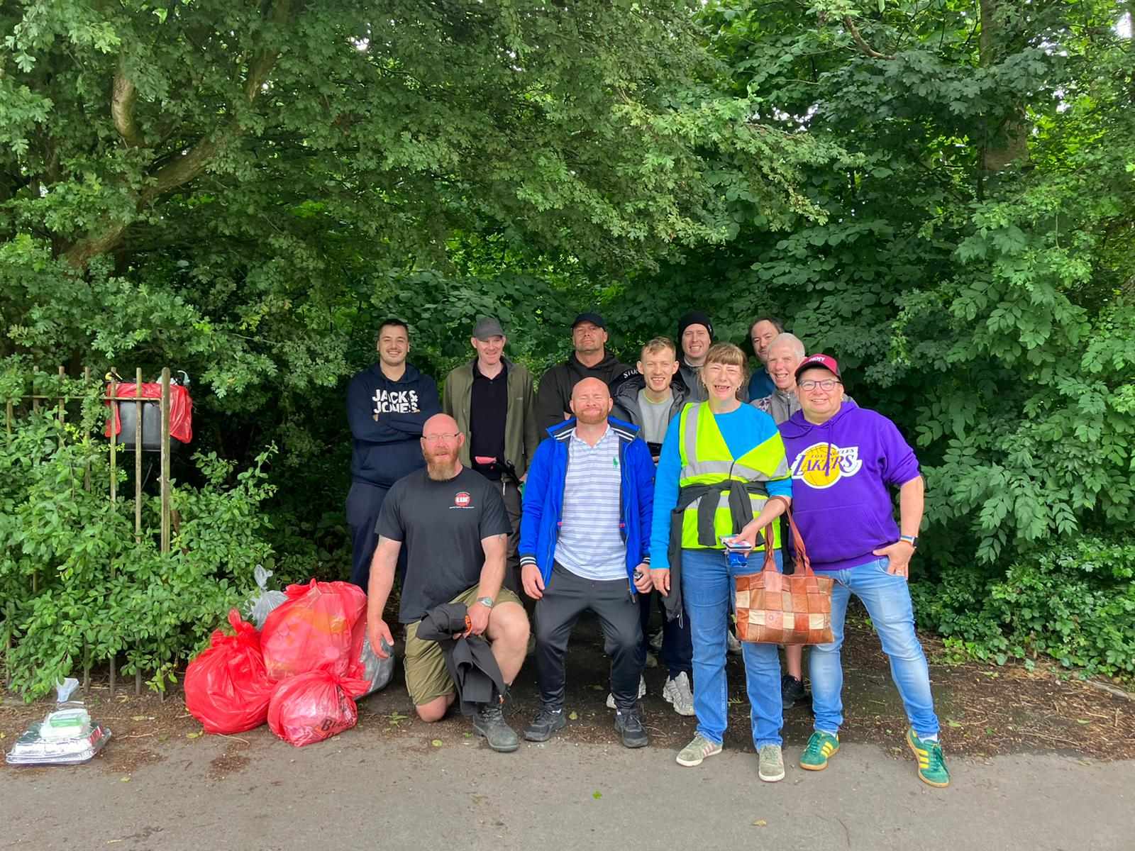
Lived Experience in our work.
In Red Rose Recovery which is a LERO…
What does Lived Experience mean in the context of this conversation?
People of Lived Experience; POLE’s

Slide 5
What do POLE’s bring to the table?
Empathy.
A reduction in barriers to engagement.
Passion and drive for the work.
Engagement skills learned ‘in the trenches’.
Dame Carol Black Review.

Slide 6
What do POLE’s bring to the table?
A different perspective to service provision.
Insight into the client’s experience.
Emotional intelligence relating to behaviours/thinking; early warning system?
Walking the walk.
Hope.

Slide 7
What are the challenges?
A need for some POLE focussed policies.
Diverging priorities.
Appropriate training.
POLE specific support.

