Slide 1


Quality
Dr Lewis Turner. CEO – Lancashire LGBT.

Slide 2

Quality
Lewis Turner
Chief Executive
www.lancslgbt.org.uk

Slide 3
Notes:
Everything we do is informed by consultation with LGBTQ+ people, beneficiary feedback, volunteer feedback
Impact reports

Slide 4


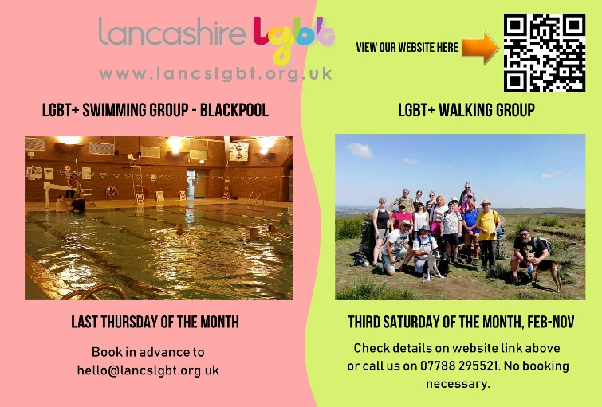




Support and Activity Groups

Slide 5

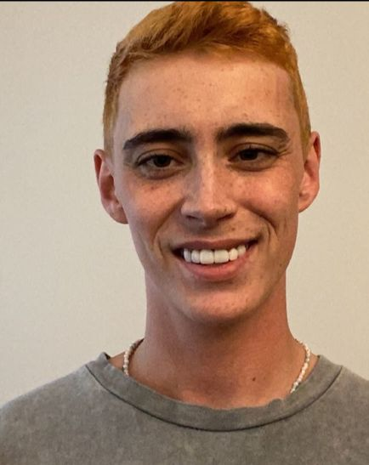
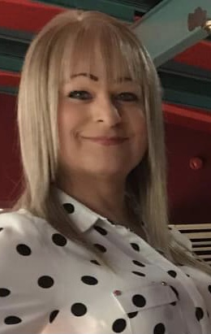
Partnership with Leeds Gender Identity Service
Hosting Gender Outreach Workers at our offices in Preston
‘Added value’

Slide 6
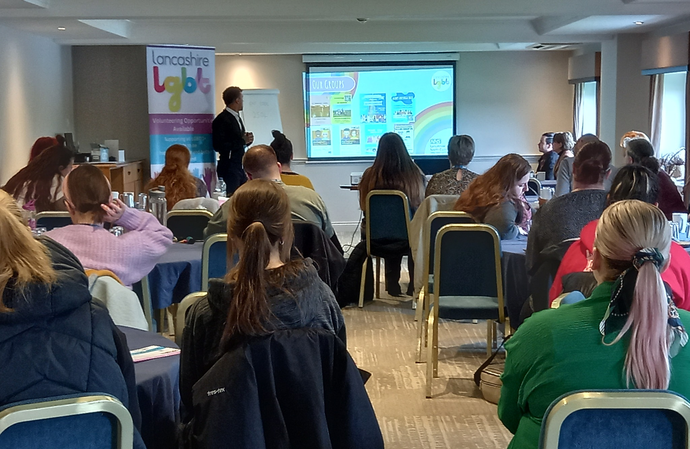


Regular Training bookings
CPD accredited training

Slide 7

NHS Lancashire and South Cumbria Mental Health Transformation: Workforce development training
Research with LGBTQ+ people who have accessed mental health services
Delivering training to mental health professionals informed by our research
Co-delivered by LGBTQ+ people who have lived experience of accessing mental health services

Slide 8

Trans and Gender Diverse Health Needs Assessment (up to end of August 2024)
Background
Project work
Lancashire LGBT role as VCFSE expert
- programming and hosting the survey
- focus groups
‘Added value’

Slide 9
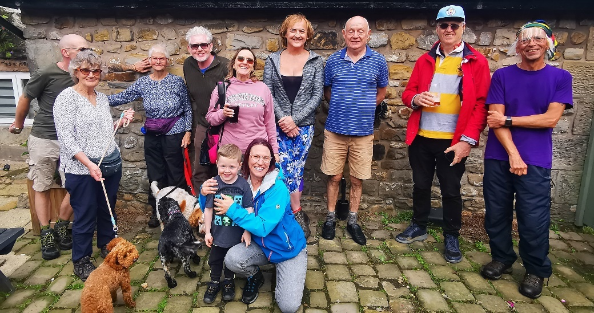
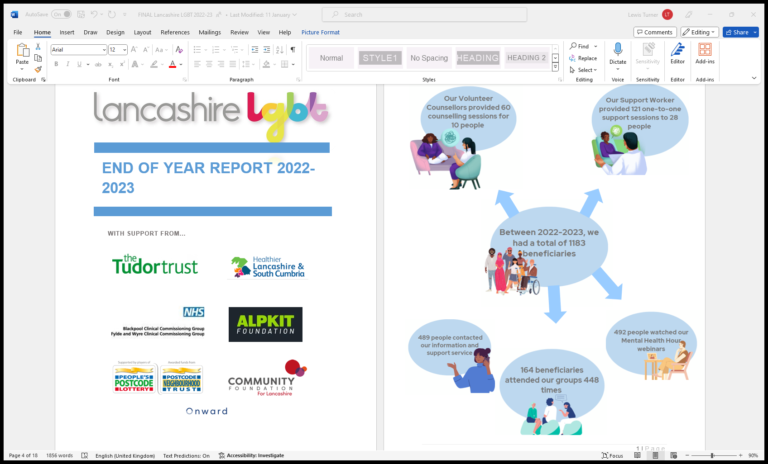
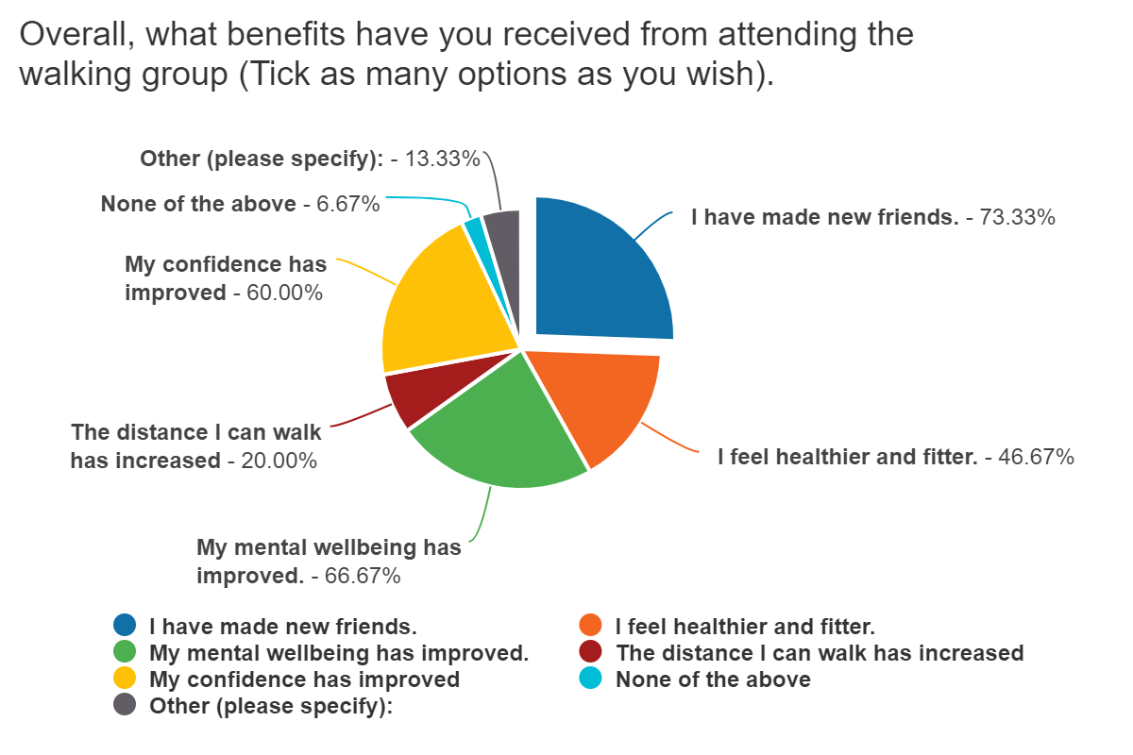
LGBTQ+ beneficiaries:
Monitoring
Measuring impact
Continuous improvement
Impact
78% reported improved mental health and well-being
94% reported improved confidence
78% reported improved self-esteem:

Slide 11
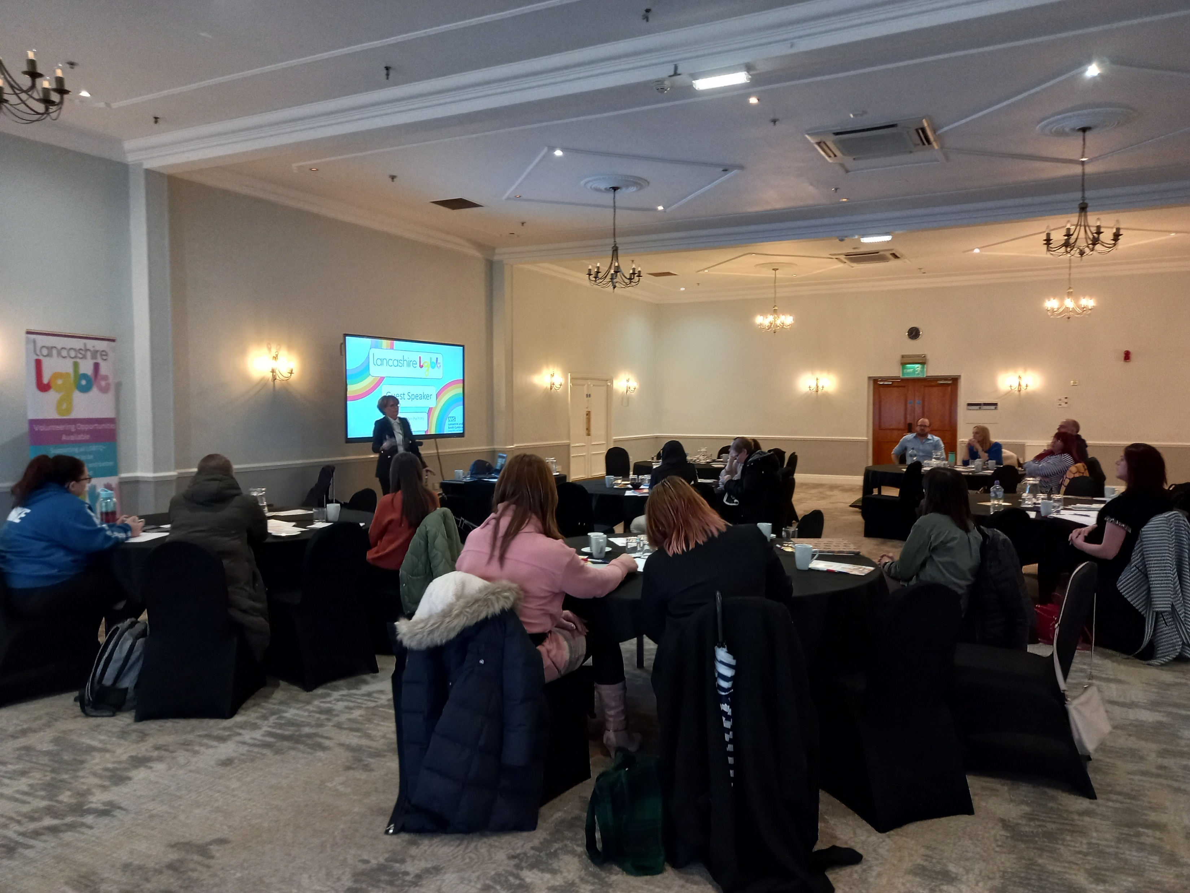
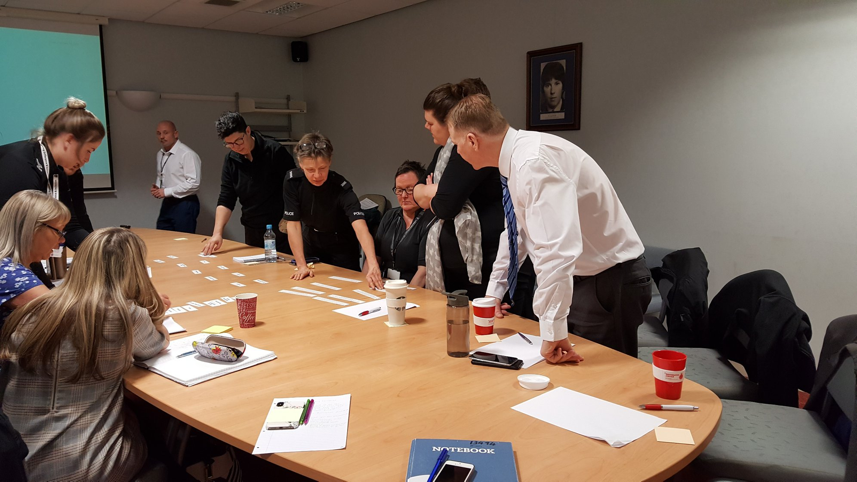
External beneficiaries
Being up to date with policy/legal landscape (Training; Consultancy)
Evaluation of all training
Continuous improvement of content
Notes:
Last year 70 sessions to 1292 people

Slide 12

Quality Mark scheme
Work undertaken:
Review of current scheme and consultation with QM holders
New membership model
New name and logo
‘Added value’

Slide 13
Notes:
Everything we do is informed by consultation with LGBTQ+ people, beneficiary feedback, volunteer feedback
Impact reports

Slide 14
www.lancslgbt.org.uk
Thank You!
Dr Lewis Turner
Chief Executive
Charity No. 1137578

