Slide 2
Agenda
1) 10.00 – 11.00.
Registration, refreshments and time for (re)connecting and networking.
2) 11.00 – 11.30.
Introduction and welcome – Tracy Hopkins.
Outline of the day – Joe Hannett.
VCFSE leads volunteering on system meetings – Various.
4) 11.30 – 12.30.
Place based Partnership update and task – Sarah James.
10-second intros to workshop sessions – Workshop hosts.
5) 12.30 – 13.00.
--- LUNCH---
6) 13.00 – 14.00
Workshops x4 (see details on next page or on Eventbrite).
7) CLOSE. Menti, evaluation, and next steps – Tracy Hopkins.
Next Assembly event – Online, Thursday 25th January 2024.

Slide 3
VCFSE Alliance representatives on ICS boards and committees. 2 mins each!
https://www.healthierlsc.co.uk/VCFSE/our-work/system-meetings

Slide 4
Lancashire and South Cumbria – Integrated Care Board (ICB).
Tracy Hopkins, Blackpool Citizens Advice – tracy.Hopkins@blackpoolcab.org.uk

Slide 5
Lancashire and South Cumbria – Integrated Care Partnership (ICP).
Angela Allen, Spring North - angela.allen@springnorth.org.uk

Slide 6
LSC ICB – Quality Committee* and People Board.
Joe Hannett, Community Futures – joeh@communityfutures.org.uk

Slide 7
LSC ICB – Provider Collaborative Board (PCB).
Helen Bingley, Mind in Furness - helenbingley1@gmail.com
Shigufta Khan, The Wish Centre - shigufta.khan@thewishcentre.org

Slide 8
LSC ICB – Public Involvement and Engagement Advisory Committee (PIEAC)
Naz Zaman, Lancashire BME Network - naz.zaman@lancashirebmenetwork.org.uk
Katie Eagan, CGL - katie.egan@cgl.org.uk

Slide 9
LSC ICB – Clinical and Care Professionals Leadership Assembly (CCPL).
Vicky Shepherd, Age UK BwD – vicky.shepherd@ageukbwd.org.uk
Dr Catherine Muyeba, CGL – catherine.muyeba@cgl.org.uk

Slide 10
LSC ICB – Blackburn with Darwen (BwD) Place Partnership.
Angela Allen, Springnorth – angela.allen@springnorth.org.uk
Garth Hodgkinson, Community CVS – garth.hodgkinson@communitycvs.org.uk
Vicky Shepherd, Age UK BwD – vicky.shepherd@ageukbwd.org.uk

Slide 11
LSC ICB – Blackpool Place Partnership.
Tracy Hopkins, Blackpool Citizens Advice – tracy.Hopkins@blackpoolcab.org.uk
David Houston, Trinity Hospice – david.houston1@nhs.net

Slide 12
LSC ICB - Lancashire Place Partnership, interim board.
Teri Stephenson, Age UK Lancashire - tstephenson@ageuklancs.org.uk
Yak Patel, LDCVS - yakpatel@lancastercvs.org.uk

Slide 13
LSC ICB - South Cumbria Place Partnership Forum.
Phil Whitley, Age UK South Lakeland - pwhiteley@ageuksouthlakeland.org.uk
Val Stangoe, St Mary’s Hospice - val.stangoe@stmaryshospice.org.uk
David Allen, Cumbria CVS - david.allen@cumbriacvs.org.uk

Slide 14
Health & Wellbeing Boards.
Colin Ranshaw, Cumbria Third Sector Network - colin.ranshaw@gmail.com

Slide 15
Population Health & Inequalities Steering Group
Angela Allen, Spring North - angela.allen@springnorth.org.uk

Slide 16
LSC - Community Mental Health Transformation Board (CMHT).
Angela Allen, Spring North - angela.allen@springnorth.org.uk
David Dunwell, Mind Lancashire - daviddunwell@lancashiremind.org.uk

Slide 17
VCFSE Assembly
The development of our Places in Lancashire and South Cumbria

Slide 18
Overview of the Session
This session will;
Give a general introduction to the four Places in Lancashire and South Cumbria
Provide an overview of the Place Integration Deal
Provide an update on the four Places;
Lancashire
South Cumbria
Blackpool
Blackburn with Darwen
Present a case study looking at place collaboration on a local level – priority wards
More importantly, give an opportunity for you all to give your views

Slide 26
A reminder of the Lancashire and South Cumbria Integrated Care Board (ICB) and voluntary, community, faith and social enterprise (VCFSE) sector Partnership Agreement
A co-produced partnership agreement between the Lancashire and South Cumbria ICB and the VCFSE sector, represented by the LSC VCFSE Alliance which establishes a framework for collaboration to reflect more ambitious ways of working.
The agreement;
Sets out the commitment to work together in partnership and meet the diverse needs of our population
Sets the conditions for effective partnership working through a joint Vision, Mission, Principles, Values and shared commitments
Creates the foundations for embedding the VCFSE sector into the ICB and creating a strong strategic partnership arrangement for the future.
Will be supported by a joint implementation plan which will be a live document
Will iterate to reflect the maturity of the relationship – reviewed in April 2024 and updated to reflect progress made

Slide 27
Our commitments
To maximise the VCFSE contribution, the ICB will…
Recognise the sectors value, incorporate its people and approaches, and invest in its services and capacity, where appropriate.
Recognise, respect, and work with the pathways established for engagement with the VCFSE.
Involve VCFSE leaders and organisations in the development of our ICB, service planning, delivery, and evaluation.
Commit to appropriate and proportionate procurement processes for the VCFSE sector.
Work to understand how we can better utilise the intelligence and data that the VCFSE sector holds to inform decision making and share data with the sector where we can.
Recognise that the VCFSE is an equal partner that sometimes has a different perspective.
VCFSE leaders and organisations will…
Focus on developing their collaborative capability, shared leadership and building trust
Develop workforce capacity and capability
Diversifying income base and creating new partnerships and collaborations within its ‘ecosystem.’
Work collectively to take a strategic lead and define our priorities based on local intelligence.
Actively participate in service design, strategic planning and prioritisation We will create volunteering opportunities, strengthening community cohesion and resilience

Slide 28
Place Updates

Slide 29
Lancashire Place Update

Slide 30
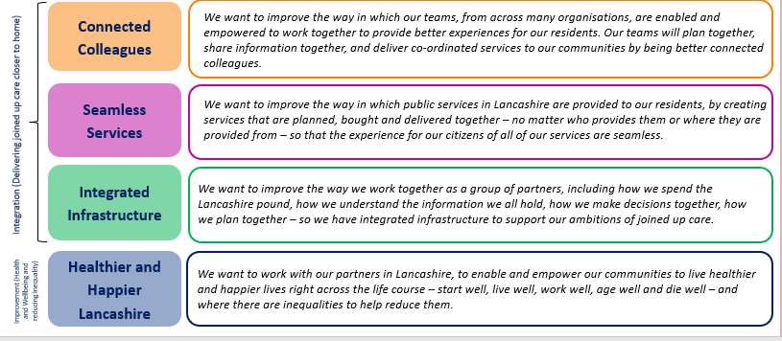
Our Place: We may be big… but we are ambitious…. We want our residents to live better lives in Lancashire
Our Place in numbers
Our delivery ambitions
1.3 million population served by 3 localities, with 12 districts and 28 PCNs

Slide 31
What have we delivered to date?
Integrated Infrastructure
Interim Lancashire Place Partnership in place and currently scoping and engaging on options for our future Place governance. We aim to identify the most suitable option by December 2023.
Established 5x Executive Oversight Groups (CEO level) across our three localities to provide the most senior partner input into delivery across our organisations and geography
Established 10x District Level Health & Wellbeing Partnerships tasked with development and delivery of local priorities
Undertaken successful joint procurement between LCC and the ICB
Brought together ICB Population Health team and LCC Public Health team who are working to a 100-day programme to establish a joint unit and work programme

Slide 32
What have we delivered to date?
Connected colleagues
Lancashire Place Leadership Team in post, including three Clinical and Care Professional Leads. Development workshop held in August to agree ways of working and priority work areas.
Established regular communication with all wider Lancashire place facing ICB Staff. Over 70 people attended a ‘Welcome to Lancashire Place’ session in September and face-to-face session planned for November
Monthly Lancashire ‘Place- Based Newsletter’ sent to all stakeholders, staff and Partners working across Lancashire
Lancashire Place Core Team is recruiting to a Lancashire Delivery Manager role throughout October meaning the team will be fully staffed
Established locality based ICB Senior Delivery Teams for all senior ICB staff who are place facing – for Central, North and East - and meet monthly

Slide 33
What have we delivered to date?
Healthier and Happier Lancashire
We have developed a vision, our delivery ambitions, and our Lancashire Place Delivery Plan
Designed a Central Lancashire Community Services Integration Programme to improve integration of physical health services in Chorley, South Ribble and Preston and a Board to oversee delivery
Seamless Services
Convened workshop with all 12 District Council CEOs to explore ‘What are the opportunities to work together differently as a Local Government family with the NHS to improve health and wellbeing outcomes for the people of Lancashire?’. Collectively agreed two work programme priorities:
1.Housing (starting with Disabled Facilities Grants
2. Leisure, Health and Activity

Slide 34
What are our next steps?
Before the end of the business year, we will have completed the following;
Engagement, decision, and implementation of our preferred Lancashire Place governance model and partnership arrangement
Development of our district level Health and Wellbeing Partnerships and agreed delivery plans and metrics for our local priorities
Agreement to a work programme with the 12 District Councils to improve health and wellbeing
Integration Deal – working to develop the Lancashire Place to receive delegations, and with the ICB and LCC on what will be delegated
Created more ICB team events and engagement mechanisms to create energy and belonging in ‘Team Lancashire’
Developed a performance framework
Started to build our wider workforce

Slide 35
Update from South Cumbria place
Thriving Communities Together
South Cumbria

Slide 36
The South Cumbria place
Our mission is to support and enable our communities to thrive, by working together with compassion, openness and respect, to improve the health and wellbeing of everyone in South Cumbria
Uniquely in the LSC ICB, the South Cumbria place is not co-terminus with any Local Authority. The South Cumbria place includes two thirds of the footprint of Westmorland and Furness Council, the southern part of Cumberland Council, and the western part of North Yorkshire Council.
Building our team
(1) Clinical and Care Professional Leads (CCPLs)
(2) South Cumbria Place Based Partnership roles
CCPL (South Cumbria)
Dr Lauren Dixon
CCPL (Mental Health)
Dr Jim Hacking
CCPL (Cancer)
Interviews
3rd October 2023
CCPL (Quality)
Recruitment starts
25th September 2023
CCPL (Digital)
Recruitment starts
25th September 2023
Place Delivery roles
Awaiting approval via vacancy control process

Slide 37
The South Cumbria approach
Resident focused
Collaborative design
Integrated delivery
A series of interactive, collaborative workshops involving partners from a wide range of sectors and organisations. We have seen sustained attendance, enthusiasm and participation which has enabled us to build relationships and develop together ‘at the speed of trust’ as new organisations have formed and as we have transitioned to a new place footprint.
Feb/Mar 2023
(pre-establishment of three new unitary councils)
Agreed interim priority workstreams aligned to existing HWB priorities
Thriving Communities
Intermediate Care
Workforce
Additional areas for development::
Childrens services and Starting Well
Mental health and wellbeing
Dying well
June 2023
Updates from 3 x workstreams
Drugs Don’t Work – focus on prescribed medicines associated with dependence or withdrawal symptoms
Local focus hubs (Cumbria Police)
Fuller recommendations and development of Integrated Care Communities
September 2023
Promoting Independence Programme (Adult Social Care)
Clinical and Care Professional Leadership & implementation of the framework in the South Cumbria place
Children and young people’s mental health and emotional wellbeing
May 2023
Co-created mission, values and behaviours
Review of place integration deal proposals
Updates from 3 x workstreams
I Care report and recommendations
July 2023
Place integration deal
Updates from 3 x workstreams
Mental health community transformation programme
Future topics will include:
Dying Well
Women’s health and wellbeing
Suicide awareness and prevention
Local implementation of the place integration deal

Slide 38
Our resident-facing work programmes
Examples of our resident-facing work programmes include:
Integrated Wellness Centre: supporting our frail elderly residents to stay well and retain their independence, with additional support for families and carers
Scoping / design work underway with a multidisciplinary team, focused on proactive caseload management (modelled on the Jean Bishop Centre Model in Hull)
Case for change in development
Team Barrow: tripartite work with national government, local government and BAE Systems on the implications and requirements associated with the expansion of BAE Systems over the coming years
Scoping work underway
I Care: identifying and supporting unpaid carers in our communities
Work undertaken by Healthwatch to engage with residents across South Cumbria
A series of recommendations being implemented via primary care, integrated care communities, and our workforce work programme
Vaccinations in care homes: supporting residents and staff in care homes with a more efficient and effective approach
Risedale Care Home is the first in the country where their own staff are vaccinating residents and staff for influenza and Covid-19

Slide 39
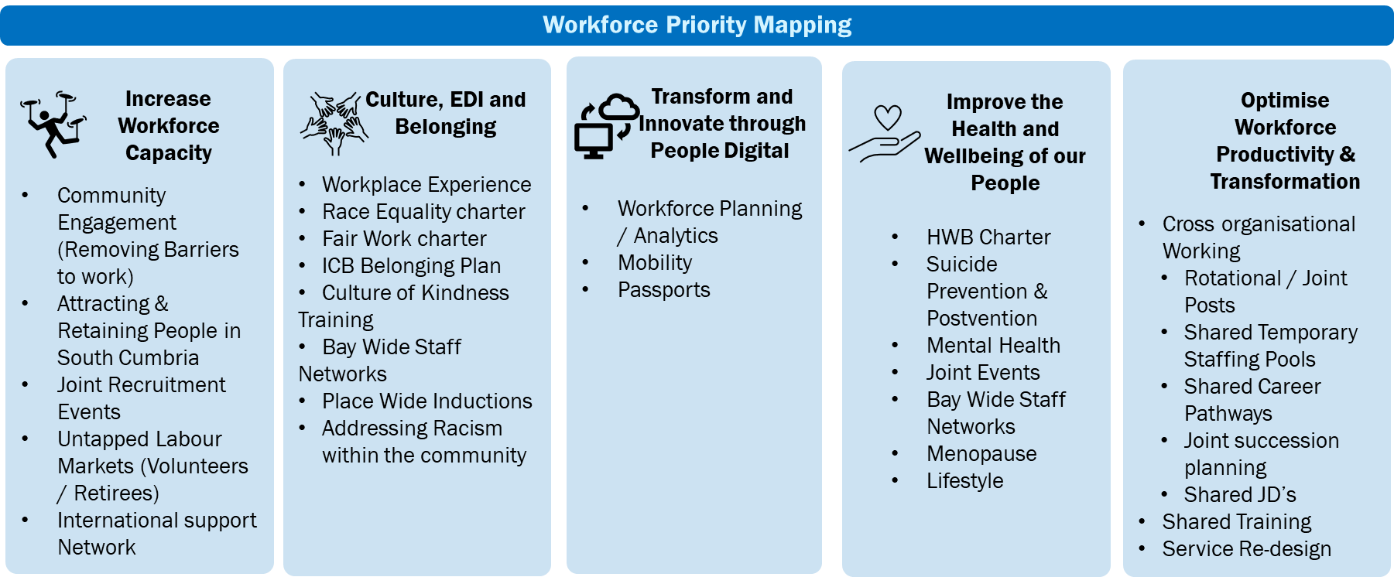
Working with our partners
Workforce: working collaboratively with partner organisations to create a workforce for the future through increasing our workforce capacity; supporting and enabling our existing workforce to thrive; working innovatively to develop joint solutions to workforce priorities; engaging with our communities to grow our future workforce.
We are leading the way with our workforce programme and have agreed our common workforce priorities for the next 12 – 24 months, with associated workplans in development

Slide 40
Blackpool Place-based Partnership update
25 September 2023

Slide 41
Our delivery journey since our last update
We said we would & we did…
We had already achieved …
Our current position …
Finalising place+ arrangements & responsibilities with our partners e.g. Primary Care
Clinical and Care Professional Leads in place
Place / Delivery plan – key areas of work & ‘big ticket’ items e.g. community services local transformation
Understanding the ask of each place in relation to delivery of the ICP strategy – alignment & mapping piece
Governance – ToR, key workstreams & new arrangements embedded
Active in Autumn event – follow on from Spring into Spring
Continuing to listen to our communities – Vaping & ‘Door knocking’ intel.
Further development of relationships via numerous dedicated sessions (‘round table’), workshops and conversations
Blackpool Place staff session – 3rd October 2023.
3 Clinical & Care Professional Leads (CCPL) in situ. Out to advert for Mental Health
Ongoing discussion with partners & colleagues regarding place+ - continuing to ensure alignment
Socialising the Place Integration Deal within and across Place – esp. LA
Delivering our Place work programmes aligned to the Priority Wards work: Claremont, Bloomfield, Talbot & Tyldesley etc. & broader with partners e.g. NWAS – Cat 3 & 4 project & workforce devs.
‘New’ partnership established building on solid foundations
Vision / ambition and priorities agreed
Agreement to draft new HWB strategy. Establishment of a T&F group to progress (alignment with place priorities, ICP strategy and JFP)
Place core team / Leadership team
Stakeholder visioning events (community services local transformation)
Spring into Spring event – fantastic feedback from partners
Further alignment with Pop. Health programme & vice versa

Slide 42
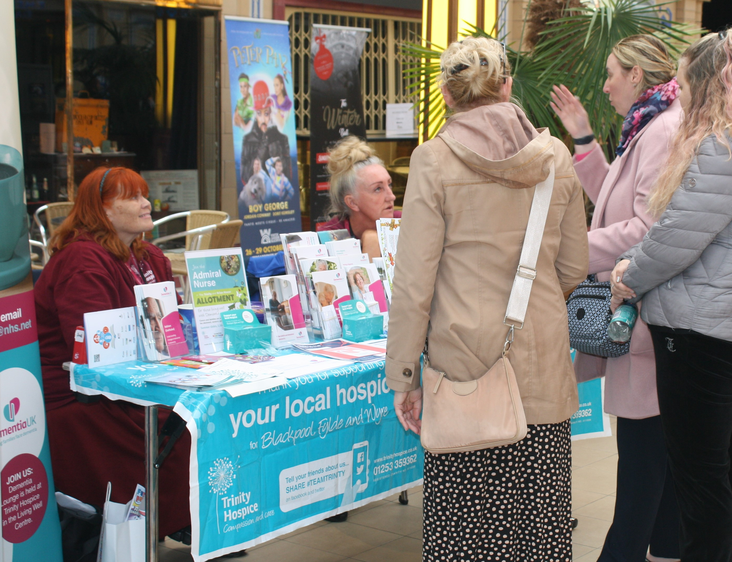
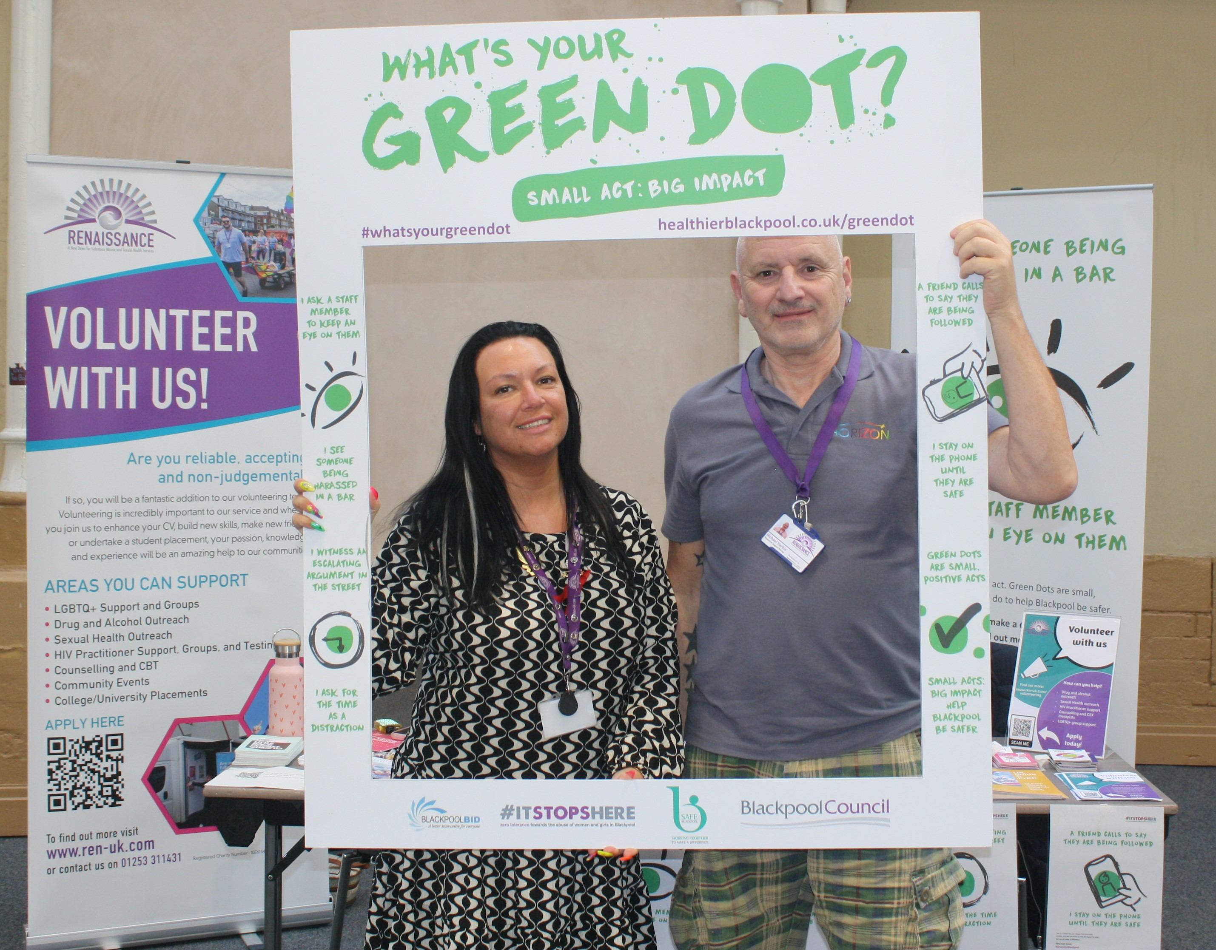
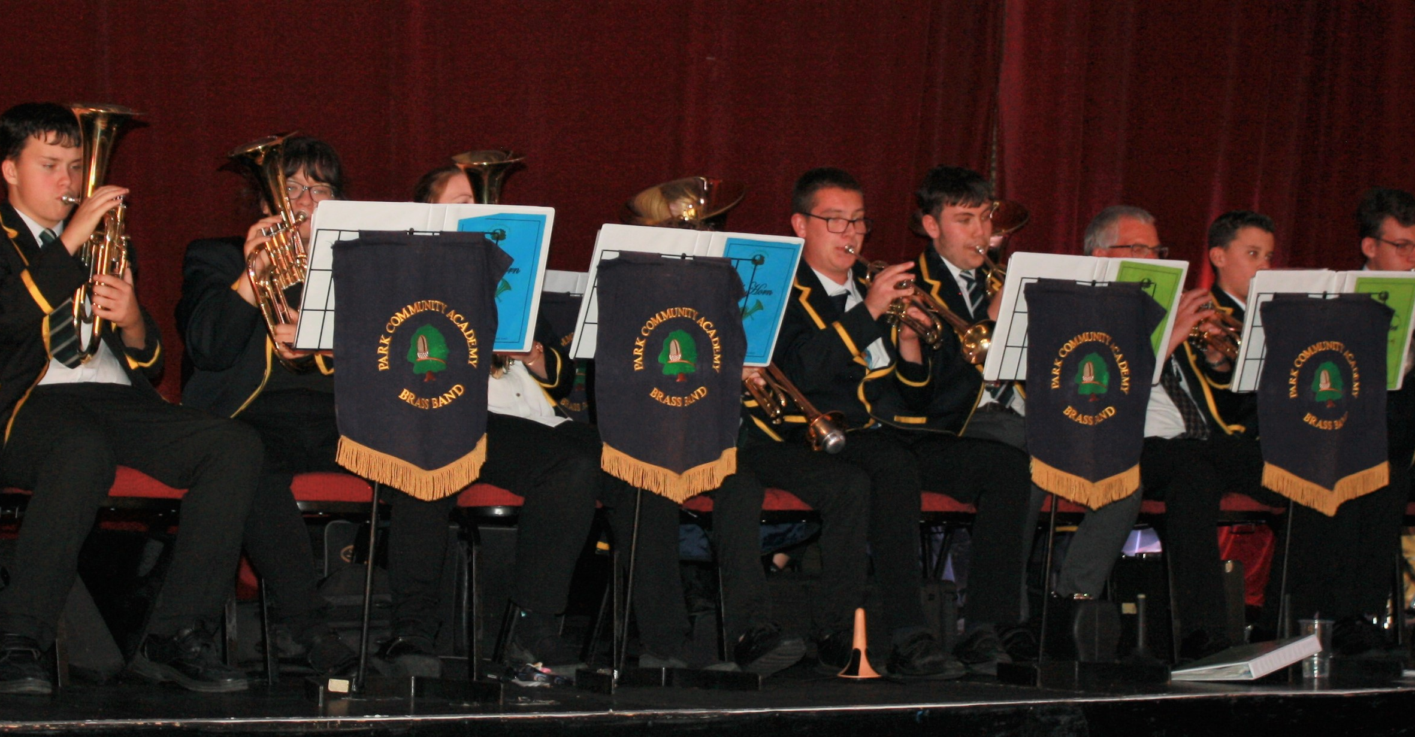
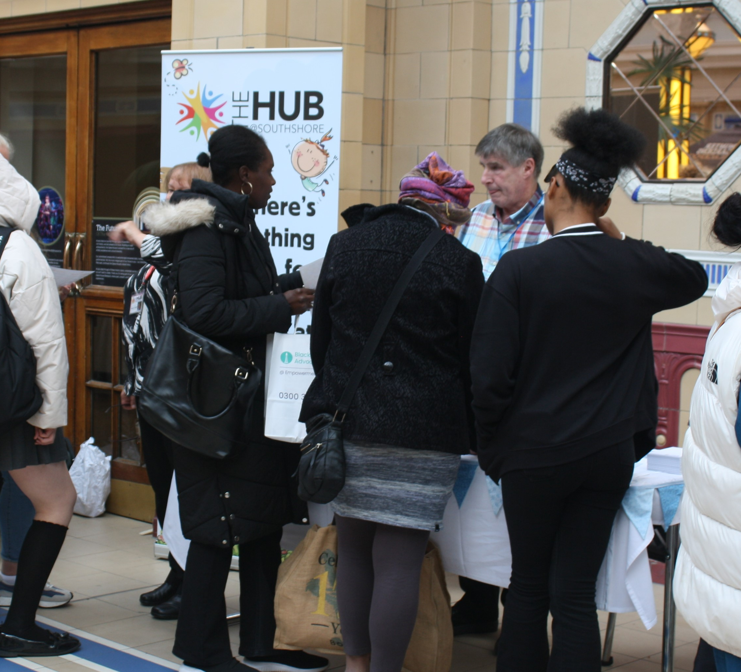
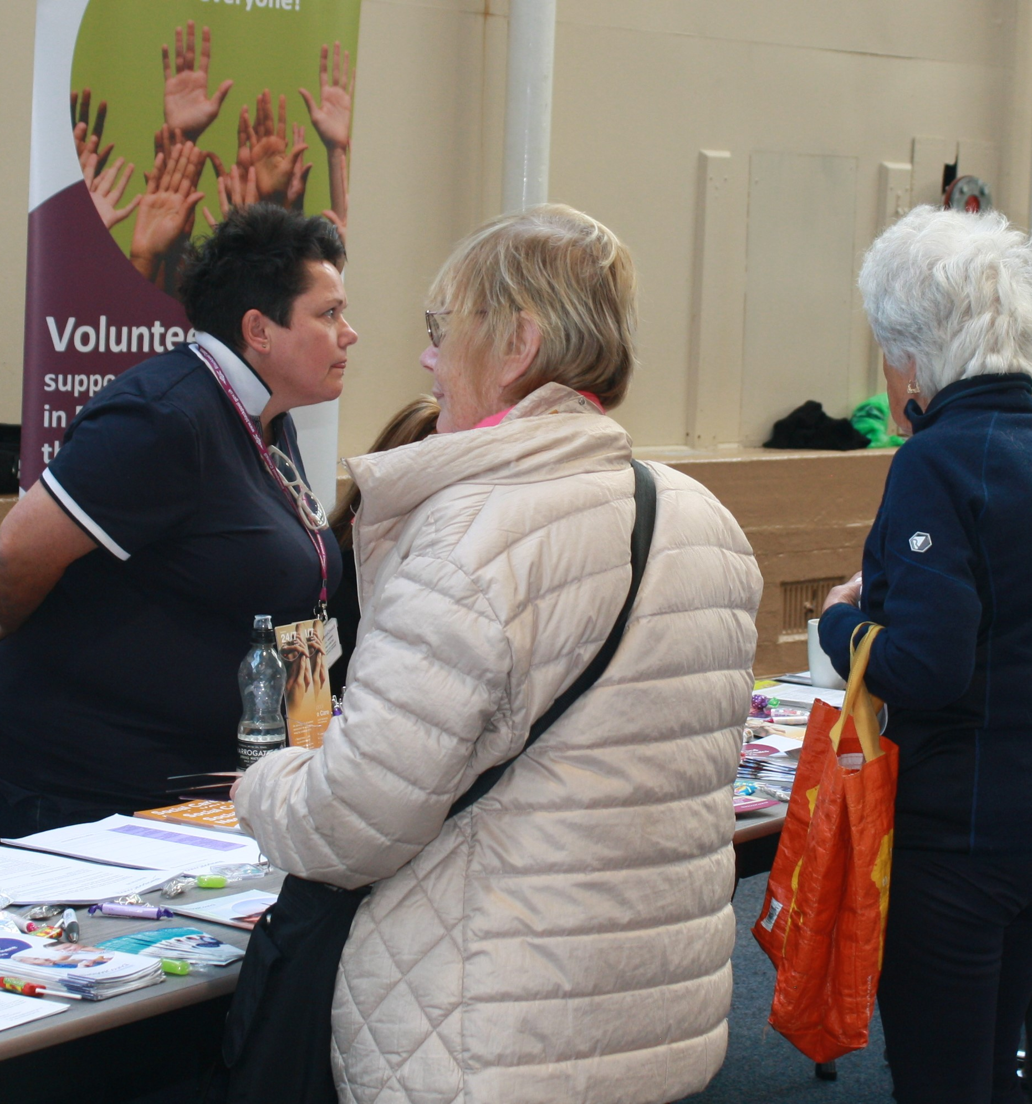
True collaboration in action
50+ organisations in attendance
Looking at things through that broader place lens
This is us
This is Blackpool Place

Slide 43
Active Blackpool
Blackpool Council Rideability Community Services
Care & Support All Age Services
The Fylde Coast Network Centre, LSCFT
Citizens
Advice Blackpool
Blackpool Music School
The whole is greater than the sum of its parts …
Volunteering Service, Trinity Hospice
Blackpool Coastal Housing
Healthy Lifestyles
Wellbeing Mental Health, Helpline & Texting Service
The Salvation
Army
Blackpool SEND
Voluntary Services, BTH
The Hub @ South Shore
Sam’s Place
Leeds Gender Identity Services
Lancashire Bluetits
Blackpool Carers Centre
Cosy Homes in Lancashire
CAMHS / Options4CYP
Groundwork
Healthwatch
Blackpool
Shelter
Lancashire
Blackpool
Fostering Team
Blackpool Healthier Minds
Leftcoast
Renaissance
FCMS
ENVECO
NW
Environmental Services
Blackpool
Better Start
Experience & Engagement Team, LSCFT
All Hallows
Church
Talent4
Care
Age UK
Lancashire
Blackpool & The Fylde College Seasiders & Fleetwood Learning Centres
New Start Blackpool Council
Blackpool
Transport
Services
BTH
Apprenticeship & widening Participation Team
SHINE Mental Health Support Team
Blackpool Council Early Help & Support Services
Disability First CIO Blackpool
Blackpool Football Club
ASC
3
Conversation
Innovation Team
Blackpool Food Bank
Shelter Lancashire
Blackpool
Family
Hubs
Blackpool
Vitaline
The Volunteer Centre
Home Start
Blackpool
Empowerment, Solace Project & Elliott’s Place
Lancashire Women
The Old Electric
Lancashire
Bluetits
Groundwork

Slide 44
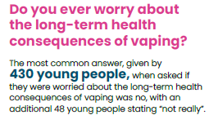
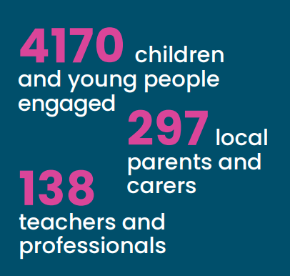
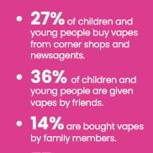
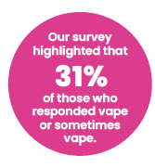
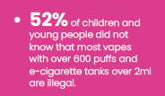
Healthwatch Blackpool - Children & Young People Vaping Report
Continuing to listen to our community…
Children and Young People’s vaping report 2023

Slide 45
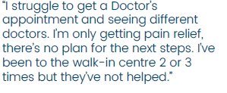
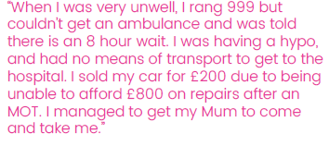
Blackpool Priority Wards
NHSE identified 5 Priority Wards in Blackpool. We started to break this down through two key lines of enquiry:
Intelligence led through a review of Non-Elective Admission (NEL) data and Ambulatory Sensitive Condition (ASC) Admission Data
Listening and engagement through Healthwatch Blackpool – ‘door knocking’ approach
Blackpool’s priority wards are:
Bloomfield
Claremont
Talbot
Tyldesley
Park

Slide 46
Delivering our ambitions for health and care integration in Blackburn with Darwen

Slide 47
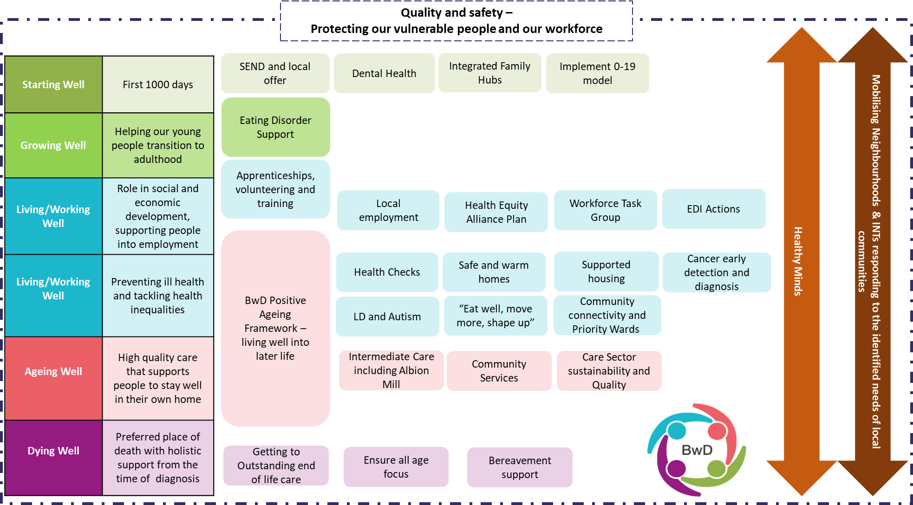
BwD Place Priorities – strategic alignment

Slide 48
Delivering with our people
Delivering for our people – life course improvements
Delivering for our people – integrated services
Developing our partnership
Setting our ambition
Our people work with us to improve health outcomes, with better quality life and a happier population
Seamless, all age, mental and physical health and social care
Support where and when people need it
A single BwD system delivering better health and care within allocated budget

Slide 49
Delivering with our people
Priority wards and dying well engagement work with communities
Community services transformation
Enhanced care at home – Intermediate Care future operating model agreed
Community services transformation
Primary care neighbourhoods
Review and re-launch integrated neighbourhood arrangements
Mental health service transformation
Aligning Community Mental Health Team developments and hubs to our neighbourhood delivery
Wider recovery and transformation
Population Health rapid improvement developing across 3 BwD wards
Health and Care Integrated Induction piloted – what integrated working means in BwD
Place development and Integration Deal delivery
Workforce
All of the above plus….
Place Based Partnership Board and Integration Leadership Team established
Commissioning and governance reviews underway, BCF next steps endorsed by PBP Board
Workforce action plan in development
Place “team” established with colleagues aligned to support BwD & Clinical & Care Professional Leads
Co-production around SEND, flu vaccinations and carers plan, family/carer panels
Partnership approach to winter planning underway including Partnership comms and flu vaccs approach
What have we been doing

Slide 50
What have we been doing

Slide 51
Population Health Rapid Improvement Programme
NHSE identified 11 Priority Wards in BwD. We started to break this down through two key lines of enquiry:
Listening and engagement through Healthwatch Blackburn with Darwen to reach +500 residents
Intelligence led through a review of Non-Elective Admission (NEL) data and Ambulatory Sensitive Condition (ASC) Admission Data
3 Priority Wards identified to focus rapid improvement programme aligned to the life course groups: Start Well (Little Harwood and Whitebirk); Live Well (Blackburn Central) and Age Well (Darwen East)
Oversight through the Place Based Partnership to understand the complexity of the wider social determinants of health and to take a “more than health” approach to delivery
Short term impact to support recovery programme – longer term impact through culture change and transformation
Delivering for our people

Slide 52
Developing a BwD Community Network

Slide 53
Community Network
Community Network Board
Developing a BwD Community Network
Community Network Board
Small focused membership, identified through expression of interest process
Meet monthly
Key vehicle for VCFSE engagement with broader sectors
Focus sector on key priorities
Will agree representation onto PBP and other key groups
Community Network
Broadest possible membership
Any group or organisation eligible to join
Meet quarterly
Networking and sharing of information
First meeting held in September

Slide 54
Case Study – Priority Wards Jonathan Bridge - jonathan.bridge@nhs.net

Slide 55
Background
The Sir Michael Marmot reports of 2010 and 2020 demonstrate a clear correlation between high levels of socio-economic deprivation and poorer health outcomes.
Summer 2020: NHS England used this key line of enquiry to undertake an analysis of “unplanned hospitalisations sensitive to ambulatory or urgent care interventions” (i.e. unplanned hospitalisations that could have been prevented with earlier intervention). Reiterated Marmot’s findings – higher socio-economic deprivation results in higher levels of unplanned hospitalisations.
The NHS England analysis also revealed that at a ward level there were some areas that had levels of unplanned hospitalisations over and above the expected correlation between socio-economic deprivation and poorer health outcomes. I.e. levels of unplanned hospitalisations were even higher than expected. Wards that met this criteria and are identified as being one of the 20% most deprived wards in England (using the ONS IMD) are identified as “Priority Wards.”

Slide 56
Methodology
Programme aims:
To identify the reasons for higher than expected levels of urgent care demand and unplanned hospital admissions from residents within priority ward areas.
To better understand the issues driving this demand through analysing available data and gathering of wider intelligence available to us
To identify opportunities for addressing this level of demand in the short, medium and long-term.

Slide 57
Outline approach
Phase one
Predominantly ‘desktop research’ to establish a better understanding of existing data sets and wider intelligence with a view to reaching an interim set of themes and hypothesis to further explore.
This first phase also included gathering wider intelligence from stakeholders through not only data but also qualitative interviews with local stakeholders to help build tacit knowledge and further insights.
Phase two
Centred on further exploring these initial themes as KLOEs for further data analysis, testing through community listening activities and wider stakeholder engagement.
Community listening activities are very much an ongoing commitment and have no stipulated end point but our initial approach to this was to feedback our findings and assumptions to compare and contrast with what residents themselves felt and experienced.
End goal being to develop a conclusive report of findings to inform a detailed action plan for appropriate short, medium and long-term interventions.
Notes:
Underpinned by local working group
Whilst this work was predominantly led by the place based population health team, we also relied upon the support and contributions of colleagues within our working group which included reps from the following partners:
Greater Preston Primary Care Network and GP practice staff (HICL, CD and managerial staff)
Preston City Council (managerial staff and local ward councillor)
VCFSE partners, most notably Community Futures, Larches and Savick Community Association, Gateway Housing plus others

Slide 58
Lea and Larches Priority Ward identified in Preston
An example of the process and learning to date

Slide 59
Contextualising the ward profile
Unplanned (Non-elective) admissions data analysis Females make up 59.6% of admissions, which is a higher percentage than many other priority wards in Lancashire & South Cumbria. Gender split in u19s is very similar, but there are significantly more females than males in both over 65s and 19-64 age groups. Highest reasons for admission across all age & gender are ‘diseases of respiratory system’ and ‘diseases of circulatory system’ (‘other signs and symptoms’ is highest individual category, but this also includes high numbers of ‘other respiratory’ and ‘other circulatory’ categories). NEL average admission rate for people tagged in Primary Care as ‘frail’ are the highest of all priority wards across Lancashire & South Cumbria; it is a relatively small cohort (26 people) but having a high impact. Only 19% of these frail patients have a care plan in place.
Wider community health – Aristotle findings
Comparing all wards of Preston District within Aristotle, Lea & Larches is identified as having:
Highest rate per 1,000 of managed LTCs
Highest rate per 1,000 of asthma.
Highest hospital admission rates per 1,000 for injuries in patients under 15 years of age (crude rate).
2nd highest rates per 1,000 for prevalence of depression and COPD, and of hospital admissions for hip fracture.
High rates per 1,000 (among top 6 of 16 Preston wards) for prevalence of hypertension, multiple comorbidities, respiratory & housing issues, rural elderly population, and atrial fibrillation.
2nd lowest rate per 1,000 of identified frail patients but has a relatively high rate of for injuries due to falls (6th in Preston).

Slide 60
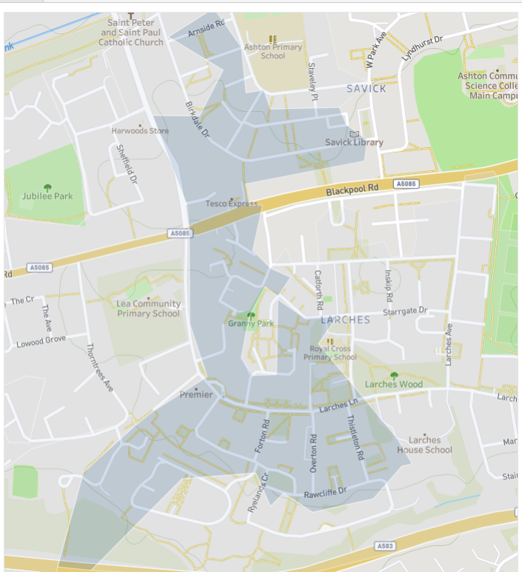
Early hypothesis
Stakeholder feedback Surprise at the priority ward status for Lea and Larches Felt efforts would be better concentrated elsewhere City Council colleagues particularly vocal on this Led to questions and further interrogation of priority ward methodology nationally. Start to build profile of the ward to help focus on issues which can’t be ignored in Lea and Larches but also help serve as comparison against other ‘top 5’ wards highlighted to us by city council colleagues. Using Aristotle we were able to drill down to a further hyper-local level for Lea and Larches. This clearly showed us that there was one smaller area in particular which was disproportionately affecting the data and likely driving the ‘priority ward’ status. This particular area included much of the Savick and Larches estates.
Notes:
Through our early engagement with partners and the building of our tacit knowledge on Lea and Larches we quickly heard from many stakeholders that they were surprised to hear of the priority ward status for this area and pointed to numerous other more visibly disadvantaged and ‘unhealthy’ communities within the city. The city council were particularly vocal in this regard.
Our own local understanding also reinforced this to some extent and so we sought to further explore the driving factors behind the priority ward status for Lea and Larches whilst not ignoring the belief that other wards had potentially greater health equity issues. We therefore set about building a profile of Lea and Larches for comparison against other wards such as St Matthews, Ribbleton, Frenchwood and Fishwick which had continually arose as more pressing areas to concentrate our efforts in discussions with the city council and others.

Slide 61
Hyper-local level lens
When looking at this hyper-local area in isolation and comparing it to ward-level data for Preston wards that have been suggested as alternate ‘top 5’ priority wards based on an expanded methodology (Ribbleton, St Matthew’s, Brookfield, Deepdale and City Centre), we can see this area in Lea & Larches has higher rates per 1,000 than those wards of: BMI Childhood obesity Complex Long-Term Conditions Multi-Comorbidities Respiratory & Housing Issues Asthma Chronic Kidney Disease
Chronic Obstructive Pulmonary Disease
Depression
Diabetes
Epilepsy
Hypertension
Mental Health
Peripheral Arterial Disease

Slide 62
Initial findings and recommendations
Better understanding of the barriers to accessing primary care including availability/ease of booking appointments and physical access to services – including transport.
Explore potential risks/impacts of continuing cost of living crisis, and consider opportunities to support communities
Explore how we can improve community knowledge and understanding of the services and support available to them, including help to overcome any barriers to access.
Develop deeper understanding of how frail patients are managed in the community and explore further relevant interventions to better manage this cohort, including falls prevention. Also consider interventions in relation to those who are vulnerable to becoming frail (prevention/early intervention)
Further explore the data in relation to female health to develop deeper understanding of drivers/causes and consider relevant interventions.
Work with partners and the local community to better understand factors that are driving high disease prevalence and admission rates in Lea & Larches, particularly in the hyper-local area around Larches and Savick estates.

Slide 63
Short-term interventions
We created a small grant fund for local community-based organisations to bid for funding from. The broad purpose was to address issues or further explore initial KLOEs gathered from our findings to date as well as also further support building community resilience and development of local capability for community support.
A funding panel was formed with representation from the ICB, City Council, Greater Preston PCN and Community Futures.
Funding was provided to four projects:
Preston Care & Repair – Healthy Homes Assessments for an identified cohort of patients with assessed frailty or diagnosed respiratory issues. Criteria for eligibility was designed with PCN HICL.
St Bernard's Community Hub – a community led project to reuse a previous church building to create a new community hub for health and wellbeing activities, encourage volunteering and increase community connectivity.
Let’s Grow Preston – a horticultural therapy project supporting local residents through lived experience as well as linking with the new community hub at St Bernard’s to recruit volunteers, build community pride and reduce isolation.
Preston Community Transport – recruitment of volunteers to develop a hared car scheme and increase capacity of existing minibus provision. Also engaging residents on longer-term transport solutions for the area.
Notes:
Very much still moving into the space of action planning with stakeholders for the medium-long term interventions through the Preston H&WB partnership.

Slide 64
IMPORTANT TO NOTE People had positive experiences of health and care across a range of settings including primary and community care, hospital services, and mental health services. The importance of eating well, exercising regularly, and having a purpose, whether through employment, volunteering, and/or social networks with friends and family, came through strongly when engaging with people who live in priority wards.

Slide 65
So what? Work is continuing in the priority ward areas to engage communities and consider short, medium and long term actions to address issues identified. The priority ward work to date has provided a framework and methodology for the district level local partnerships to consider other wards or neighbourhoods which could benefit from a structured deep dive analysis. As such, work has commenced on initial data analysis of two further electoral wards in Preston and two neighbourhoods in West Lancashire. The initial findings of this work was presented during September to help inform further discussion and next steps for each area.

Slide 66
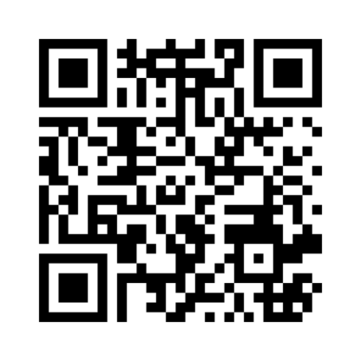
Over to you …
https://www.menti.com/alpnwtsiytz8
Code 6198 1759

Slide 67
So what …
The next few slides ask a range of questions using Menti
The feedback from these will be collated into a report, with recommended actions
This report will be circulated to;
a) VCFSE Assembly
b) Place Partnerships
for consideration and action
VCFSE Assembly - Mentimeter

Slide 68
Questions?

Slide 69
Lunch
12:30-13:00

Slide 70
Workshops

Slide 71
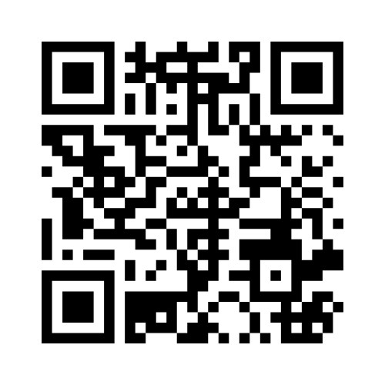
Closing
Mentimeter:
Next Steps
Code: 3108 4112

