Slide 1





Self-care
Self-care is all about finding ways to improve your physical and mental health and wellbeing.
This includes staying active, knowing how to prevent falls, checking your medication/stocking your medicine cabinet and knowing how to treat common illnesses and ailments yourself.
All of these are little things we can all do to prevent health and wellbeing issues getting to the point of needing urgent medical help.
Find more at www.healthierlsc.co.uk/winter

Slide 2



Athlete’s foot
Could last several weeks
Dry your feet properly
Wear fresh socks daily
Avoid scratching
Talc powder can help
Ask a pharmacy for antifungal medicines
Find more at www.healthierlsc.co.uk/winter

Slide 3


Back pain
Try a hot bath or speak to a pharmacy for advice about rub on painkillers
See your GP if the pain doesn’t ease after 3 days, if it moves to your chest or if you also have a fever
Seek urgent advice through NHS 111 online if you feel numb or get pins and needles or if you lose control of your bowels or urination
Find more at www.healthierlsc.co.uk/winter

Slide 4


Bites and stings
Bites and stings are usually nothing to worry about.
Soap and water will help.
Don’t use vinegar or bicarbonate of soda like those old wives’ tales say.
It’s an emergency if you have difficulty breathing, your neck or throat swell, you feel sick or feel faint or dizzy.
Seek advice if symptoms last a few days or
a large area becomes red and swollen.
Find more at www.healthierlsc.co.uk/winter

Slide 5
Chicken pox
Home remedies are often the best:
Drink plenty of fluid.
Bathe in cool water and pat skin dry (don’t rub).
Put socks on hands at night to stop from scratching.
Stay off school.
Stay away from pregnant people.
Speak to a pharmacy about antihistamines.
Don’t use ibuprofen.
See your GP if:
Skin is red, hot or painful.
Your child is dehydrated.
You’re pregnant.
Your newborn baby has chicken pox.
You have a weakened immune system.
Find more at www.healthierlsc.co.uk/winter

Slide 6

Colds
Could last 1-2 weeks
Get plenty of rest.
Eat healthy and drink plenty.
Paracetamol will help.
Seek advice if you:
Have a temperature above 38°C.
Have sharp pain in chest.
Cough up blood.
Have swelling in neck.
Find more at www.healthierlsc.co.uk/winter

Slide 7

Conjunctivitis
Conjunctivitis affects the eyes and can last up to two weeks. It’s rarely anything too serious.
Gently clean eyes with boiled water that has cooled.
Avoid rubbing your eyes.
Wash your hands regularly.
See your GP if you wear contact lenses and have red spots on your eyelids.
Symptoms last longer than 2 weeks.
Seek urgent advice if you:
Have pain in the eyes.
Become sensitive to light.
Have changes to your vision.
Find more at www.healthierlsc.co.uk/winter

Slide 8
Constipation
Eat more fibre, such as fruit and vegetables.
Drink plenty of water.
Paracetamol will help relieve pain.
Your pharmacy can recommend over the counter medicines to help.
See your GP if:
It lasts longer than 6 weeks.
Your tummy is swollen.
You are taking new medication.
You’ve been losing weight for no reason.
You notice blood in your poo.
Find more at www.healthierlsc.co.uk/winter

Slide 9
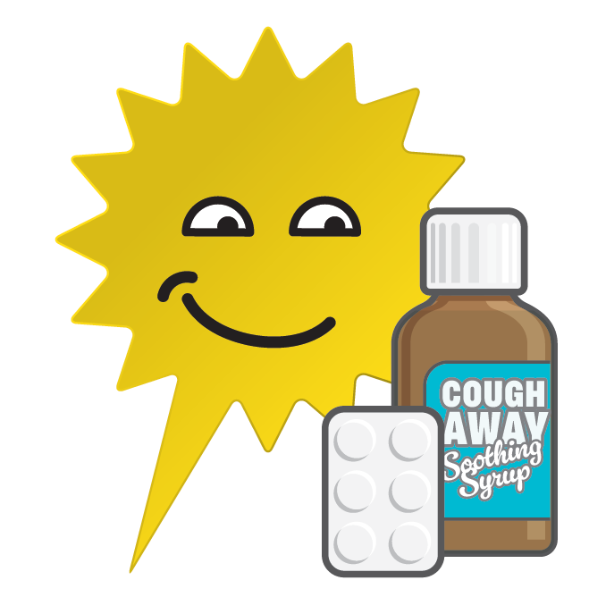
Coughs
Should only last a few weeks.
Drink lemon and honey in hot water.
Lozenges from your pharmacist will help.
See a GP if:
It does not improve after 3 weeks.
You’re losing weight for no reason.
Seek urgent advice through NHS 111 if:
You have choked on something.
You cough up blood.
You have chest or shoulder pain.
It’s difficult to breathe.
Find more at www.healthierlsc.co.uk/winter

Slide 10
Cradle cap
It’s perfectly normal.
It could last up to a year.
Use baby safe moisturisers and shampoo on the scalp.
Don’t pick the crusts or use olive oil.
See a GP if:
It does not start to clear up after a few weeks of treatment.
It spreads over the body.
The crusts bleed.
Find more at www.healthierlsc.co.uk/winter

Slide 11


Ear infections
Use painkillers and drink plenty of fluids.
In children, check for signs of other illnesses.
See a GP if you have a temperature over 38°C or there are other symptoms too.
Seek emergency help if a child also has a rash that doesn’t fade with pressure.
Find more at www.healthierlsc.co.uk/winter

Slide 12
Ear wax
It will usually work its way out.
Put a few drops of olive oil in your ear 2 or 3 times a day.
Don’t use cotton buds.
GPs don’t always see people with ear wax, but you should seek advice if it hasn’t cleared after 7 days or if you can’t hear anything at all.
Find more at www.healthierlsc.co.uk/winter

Slide 13
Fever in children
Should only last a week.
Make sure they drink plenty of fluid.
Monitor their temperature.
Use paracetamol or ibuprofen. Never both.
Seek advice from GP or NHS 111 if:
Temperature is over 38°C.
Child has difficulty moving.
Child does not respond normally.
Any swelling occurs.
Seek urgent help or go to A&E if your child has a fit or has a stiff neck or if you notice a new rash that doesn’t fade with pressure.
Find more at www.healthierlsc.co.uk/winter

Slide 14
Headaches
Should only last about 24 hours depending on the type of headache.
Drink plenty of fluid.
Avoid alcohol or caffeine.
See your pharmacy about painkillers.
See your GP or use NHS 111 online if:
They become more frequent.
You vomit.
You notice a change in your speech.
You are sensitive to light.
You have other pains.
Find more at www.healthierlsc.co.uk/winter

Slide 15
Heartburn and indigestion
It’s easy to mistake heartburn and indigestion for something more serious.
Seek advice if you:
Suffer pain or notice a swelling in your upper belly.
Also feel pain in your chest.
Vomit blood.
Feel faint.
Have a fever or weight loss.
Can last up to 2 weeks.
Avoid fatty or fried foods, carbonated drinks and caffeine.
You can buy antacids over the counter.
Find more at www.healthierlsc.co.uk/winter

Slide 16
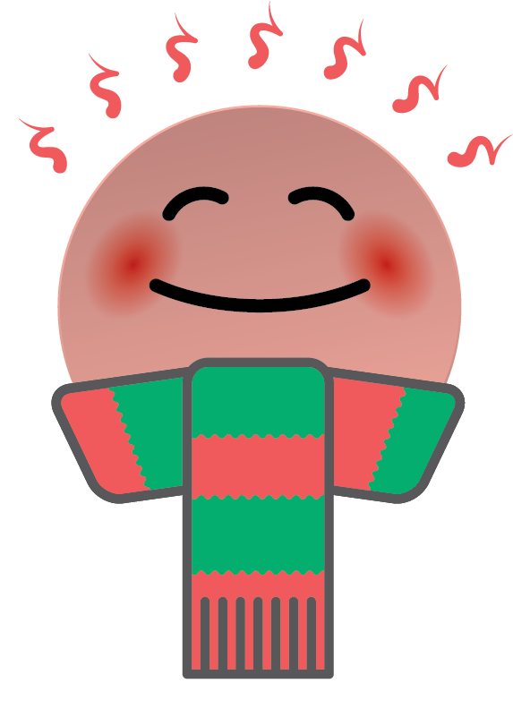

Long-term conditions
Colder weather can make long-term respiratory conditions worse.
Heat your home to at least 18°C.
Dress warmly with plenty of layers.
Keep active.
Follow your management plan.
Keep up to date with medication.
Contact your pharmacy if you want to check your medication or how to use inhalers.
Speak to your GP or nurse about your management plan or if your conditions becomes much worse. Don’t let it get so bad you need to go to hospital.
Find more at www.healthierlsc.co.uk/winter

Slide 17
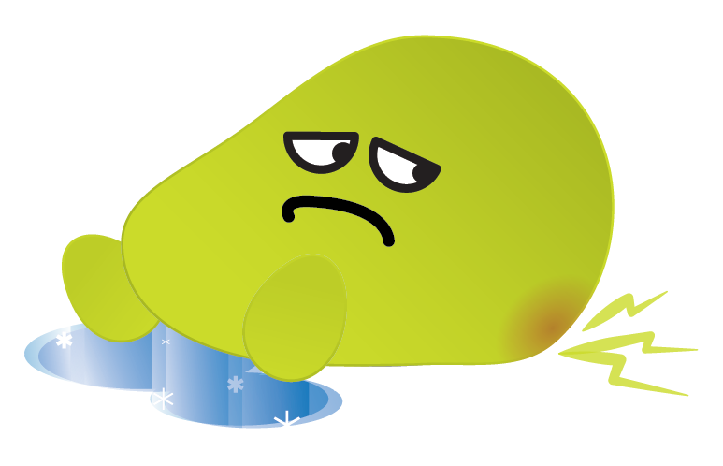
Preventing falls
If you’re a little unsteady on your feet, falling can be common but it can lead to more serious health issues. The stronger you are, the less likely you are to fall.
There are some exercises you can do to improve muscle and balance such as:
Heel rises – raising up onto your tiptoes.
Toe raises – rocking back onto your heels (hold on to something if you need to!).
One leg balances – simply stand on one leg for 10 seconds.
Walking heel to toe.
Chair stands – try sitting down and standing up 10 times in a row, without using your hands.

Slide 18
Sore throat
Eat cool, soft food and drink warm drinks.
Suck lozenges or even ice cubes.
Cheap painkillers will help. Speak to a pharmacy.
See your GP if you:
Feel no better after 2 weeks.
Get sore throats frequently.
Have a high temperature over 38°C.
Have difficulty breathing.
Seek more urgent advice through NHS 111 if you start drooling and find it difficult to swallow.
Find more at www.healthierlsc.co.uk/winter

Slide 19

Sprains and strains
It might hurt but it isn't an emergency.
Can last 6-8 weeks
Remember PRICE:
Protect the limb.
Rest.
Ice packs help.
Compression bandages add support.
Elevate.
Seek more urgent advice through NHS 111 if:
You can’t move an affected joint.
You can’t walk properly because of it.
The area is deformed or lumpy.
Find more at www.healthierlsc.co.uk/winter

