Slide 1
Making the most of primary care
Primary care services include the GP practice, pharmacy, optometry and dentistry.
Knowing how to make the most of them means you will get the most appropriate care for your need.
It might mean you are seen quicker than waiting to see a GP.

Slide 2
GP appointments
Making the most of primary care
You may not always need to see a doctor.
There are lots of different healthcare professionals who work at your GP practice and in the community.
The health navigator (receptionist) will be able to advise you on who is best to see.

Slide 3
GP appointments
Making the most of primary care
Before you visit
Listen to the advice of the health receptionist/navigator.
Arrive in plenty of time but be prepared for a short wait.
Think about booking a double appointment if you have more than one thing to discuss.
Make notes of your symptoms, how long you’ve had them, things you’ve already tried, and any questions you have before you go and take them with you.

Slide 4
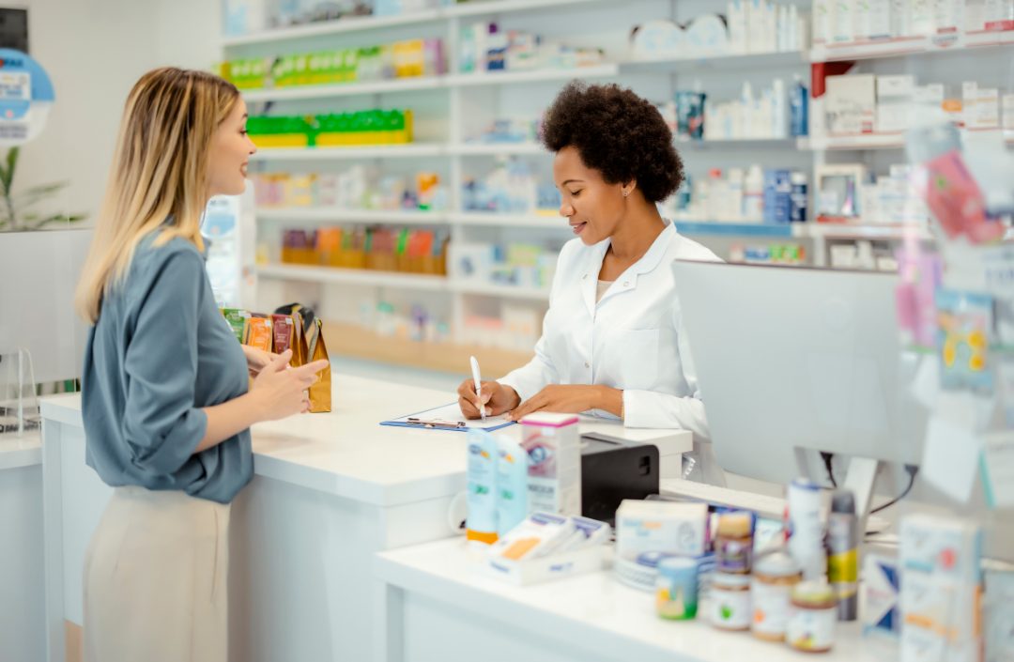
GP appointments
Making the most of primary care
Visit a pharmacy
Visit your local pharmacy if you have a minor illness like a cough, cold or sore throat.
Pharmacists are highly trained professionals who can manage minor illnesses with no need to contact the GP surgery.

Slide 5
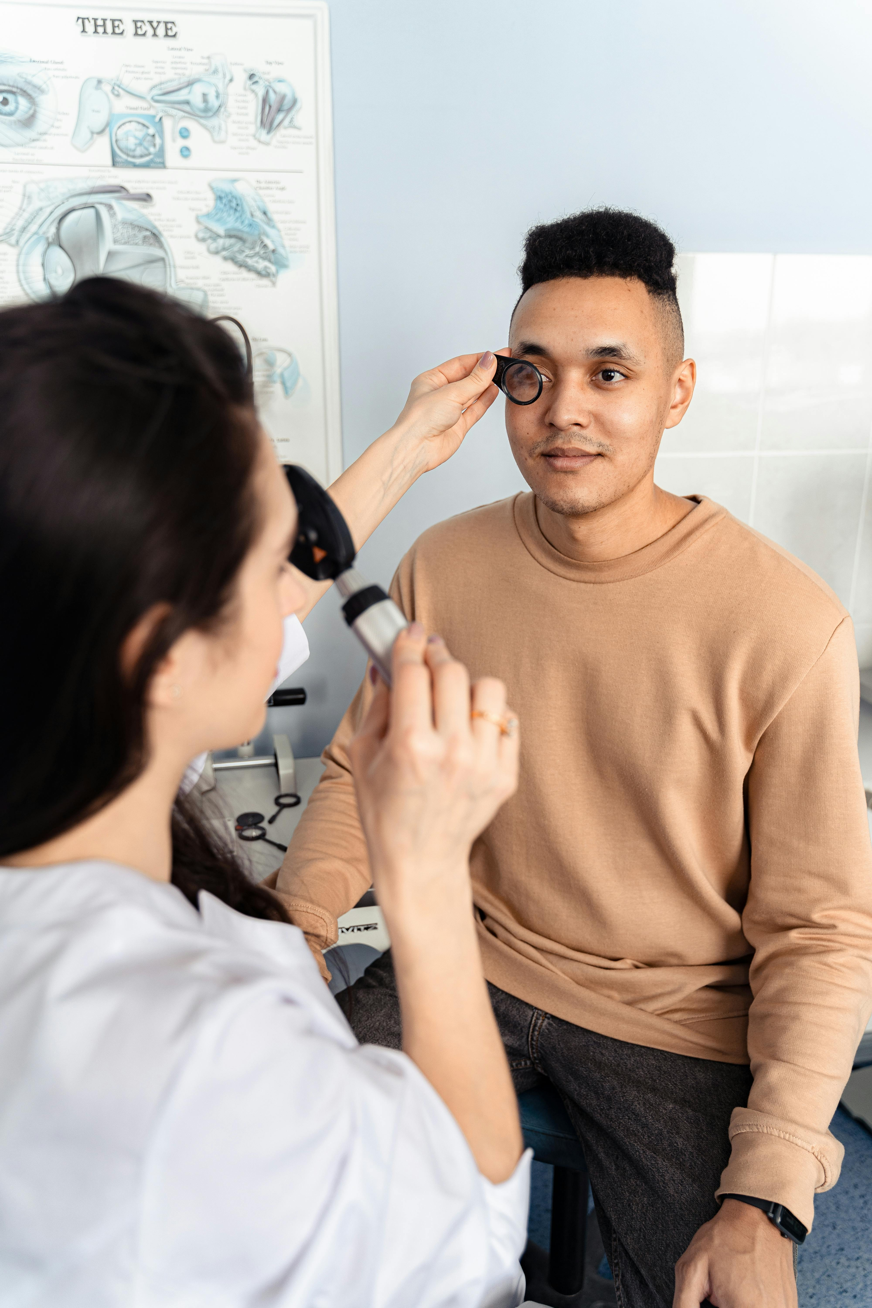
GP appointments
Making the most of primary care
Eye care
Optical practices - also known as optometry practices or opticians - are usually the first place to contact to help you maintain good eye health, or to help you with eye or vision-related symptoms.
Consult your local optical practice if you have a red or sore eye.

Slide 6
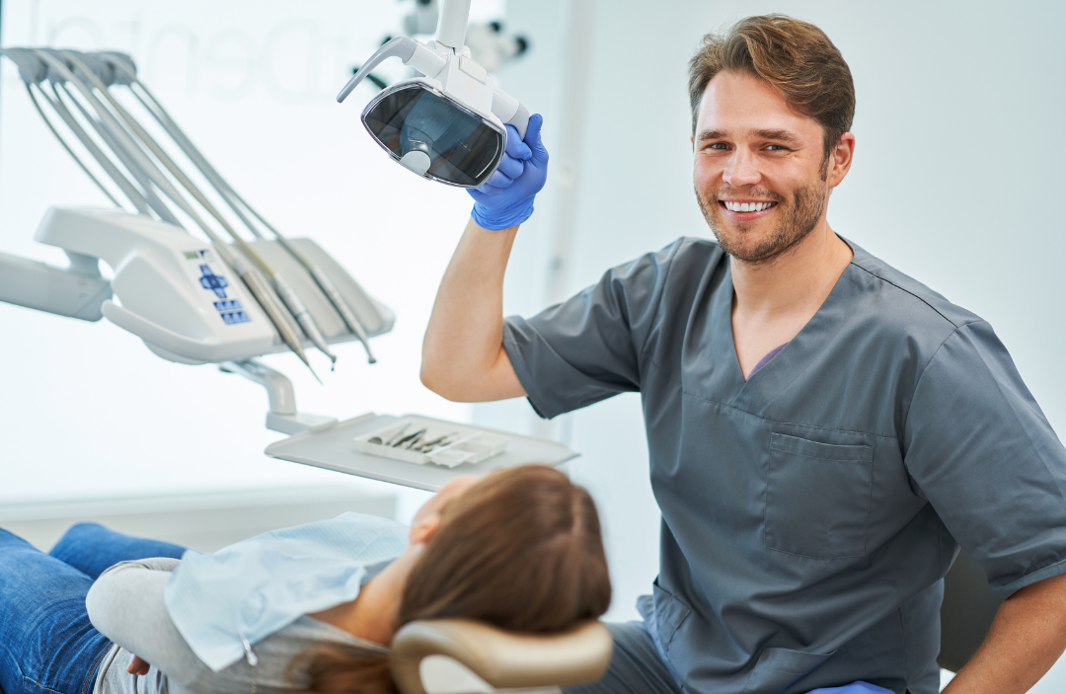
GP appointments
Making the most of primary care
Urgent dentistry
For urgent dental treatment or advice please contact your usual dental practice in the first instance.
Alternatively, the Lancashire and South Cumbria dental helpline can also provide advice, support and an appointment where required.
Call 0300 1234 010 between 8am and 9pm Monday to Friday, 10am to 5pm weekends and bank holidays.
Outside of these hours, for urgent dental support call 111.

