Slide 1
Preventing slips, trips and falls
If you’re a little unsteady on your feet, falling can be common but it can lead to more serious health issues.
There are ways you can reduce your risk of having a fall, including making simple changes to your home and doing exercises to improve your strength and balance.

Slide 2
Improve your strength and balance
Preventing slips, trips and falls
Reduce your risk of falling by improving your strength and balance.
If you’re more active, try walking or even dancing.
If not, try these simple exercises:
Rock onto your heels by raising toes (repeat a few times)
Stand on one leg & hold (repeat with other leg)
Stand up from a chair without using hands (try 10 in a row)
Rise onto your tip toes (repeat a few times)
Walk heel to toe in a straight line

Slide 3
Preventing slips, trips and falls
If you live alone
Ask someone to check in regularly either by phone or in person.
Keep a mobile phone or personal alarm with you so you can call for help if you fall.
Make sure your footwear fits properly and has plenty of grip.

Slide 4
Trips in the home
Preventing slips, trips and falls
A lot of falls result from tripping in the home.
Remove rugs or mats near stairs.
Have a night light that comes on when you move.
Mop up any spills straight away.
Remove wires, clutter and other hazards.

Slide 5
Take care when outside
Preventing slips, trips and falls
Ice and wet leaves can cause slips and falls.
WALK LIKE A PENGUIN
Bend your knees.
Walk flat footed.
Point your feet out slightly.
Take short shuffle-like steps.
Keep your arms at your side (not in pockets).
Watch where you’re going.

Slide 6
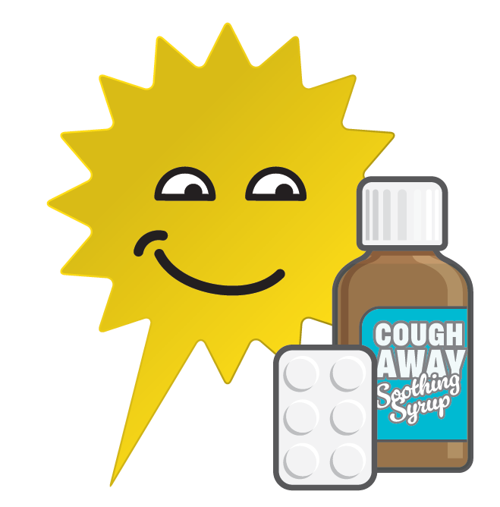
Review your medications
Preventing slips, trips and falls
Some medications can make you drowsy or dizzy which increases your risk of falling.
Visit a pharmacy for advice.

Slide 7
Regular check-ups
Preventing slips, trips and falls
Make sure your eye tests and hearing check-ups are up to date and your glasses fit properly.
Vision and hearing can impact balance and cause a fall or trip.

Slide 8
If you have a fall
Preventing slips, trips and falls
Call for help (keep a mobile phone on you).
Stay calm.
Don’t try to move straight away – check for injuries.
Stay warm – cover yourself with a coat or blanket if you can.

