Slide 1
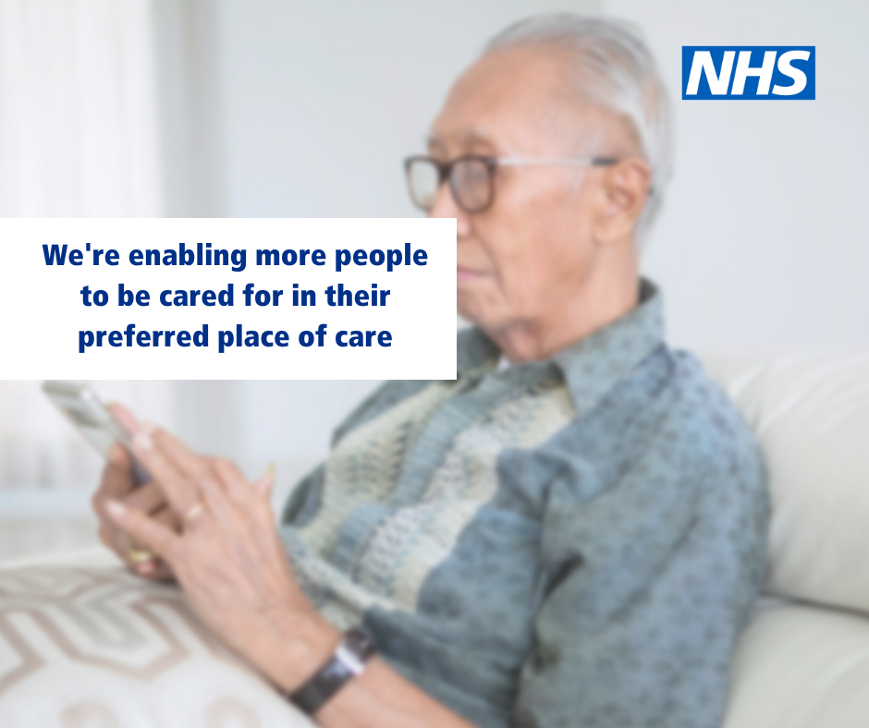
Virtual Ward patient experience August 2023

Slide 2
Virtual wards provide hospital level care at home
The acuity and complexity of the patient's condition differentiates virtual wards from other community and home-based services
It provides urgent access to hospital-level diagnostics (such as endoscopy, radiology, or cardiology) and may include bedside tests such as point of care (POC) blood tests
It provides hospital-level interventions (such as access to intravenous fluids, therapy, and oxygen)
It requires daily input from a multidisciplinary team and sometimes multiple visits and provisions for 24 h cover with the ability to respond to urgent visits, often enabled by technology
It requires consultant practitioner specialist leadership and clear lines of clinical responsibility
Defined inclusion and exclusion criteria, with defined target population and deliver a time-limited short-term intervention of 1–14 days.
VW patients have equity of access to other specialty advice as though an in-patient.
virtual ward
ˈvəːtʃʊ(ə)l wɔːd
A virtual ward is a safe and efficient alternative to NHS bedded care.
Virtual wards support patients who would otherwise be in hospital to receive the acute care and treatment they need in their own home.
This includes either preventing avoidable admissions into hospital, or supporting early discharge out of hospital.
NB: A virtual ward is not a mechanism intended for enhanced primary care programmes; chronic disease management; home intravenous or infusion services; intermediate or day care; safety netting; or proactive deterioration prevention. Wider virtual care supported services (including NHS@home) are scaling to enabling these cohorts to be increasingly supported at home / in the community,

Slide 3
Current position
A virtual ward provides a way to monitor patients at home.
Either by face to face contact with patients or via a digital system called ‘Docobo’
Notes:
Very brief introduction about what the virtual ward is and current situation

Slide 4
Patient feedback assessment
Each locality is required to provide assurance of how patients are involved in their Virtual Ward service.
 | Fylde Coast |  | Morecambe Bay |  | Central Lancs | Central Lancs | Pennine Lancs |  | West Lancs
Do you have, and issue to patients, a document detailing who to contact if symptoms worsen in or out of hours? If yes, please attach |  | patient leaflet as part of onboarding |  | Yes |  | Patient leaflet as onboarding |  |  |  | Complete
Do you have a standard process detailing patients informed consent, understanding of their care and use of equipment/digital technology |  | Rapid - recorded on EMIS FCMS - yes at triage |  | Yes |  | Yes verbal consent. No digital, loan agreement etc when live with Docomo |  |  |  | Part of on-boarding process
How do you identify unpaid Carers? How do you involve them and signpost them for support? Do you ensure there is a contingency plan for carers support. |  | via holistic assessment |  | On EMIS template, through initial assessment, referral included. |  | Part of initial assessment, via CATCH/ LCC |  | Identified via holistic assessment - IAG provided. Informal carers notified of treatment/care plan etc. with consent of patient. Onward referrals made for Carer's Assessments where required. Link in to ICAT for any additional social care requirements. |  | Further links to social prescribing and carers support needs to be considered. Some input from Patient rep, but further work required.
How do you gather patient/carer feedback? |  | F&F - general but working towards F&F specific to VW |  | Trust F&F. Cards, Compliments/Thanks, Feedback all go onto Ulysses reporting system. Patient stories via comms team |  | Included in standard trust processes - Trust F&F. Cards, Compliments/Thanks, managed by customer care team. |  | Both electronic and paper for patient and family feedback collated, Also have generalised patient feedback forms from the trust, friends and family test. |  | Further work is required to ensure this is captured consistently
Do you have a patient/carer representative on your local/PBP delivery group? |  |  |  | No |  | Presented to Patient Experience Group, further involvement to form step up pathway |  | Patient and carer feedback routinely gathered and case studies collated for the service |  | Yes there is a Healthwatch/ Carers rep
Notes:
Explain that we check for assurance that patients are involved in the service and fully informed.
Regular meetings as a system help areas that are behind to increase their patient engagement
Any areas that are falling behind are supported locally.
Healthwatch Representative on the Programme Group – Sue Edwards – links to other L&SC Healthwatch Orgs
Carers Network presentations and direct links into operational teams in each locality

Slide 5
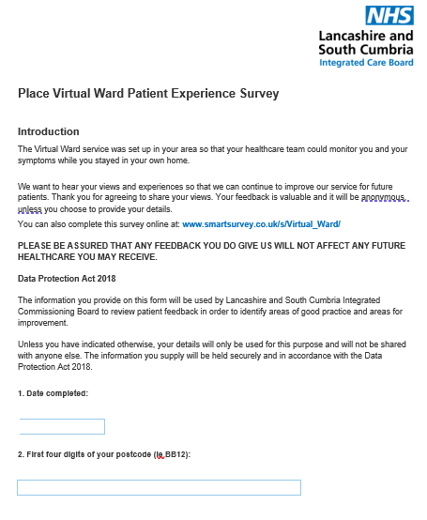
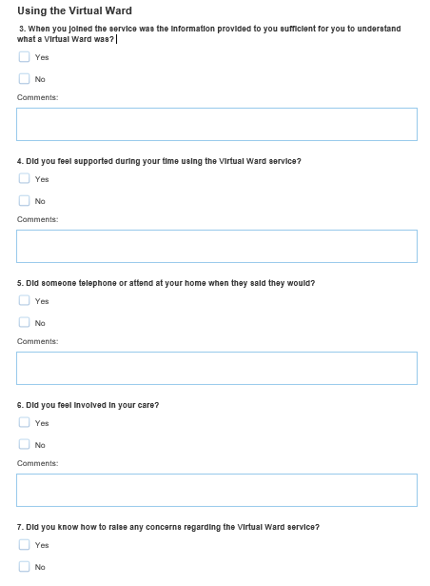
Patient Feedback
Friends & Family Test.
A standard survey has been created for providers to use with their patients.
Launched in December 2022.
Some localities use this survey and upload responses to a central survey system for recording.
Others use their own method of recording data for their own use.
Notes:
FFT doesn’t give the level of detail we want for a new service
Teams are asked to request patients complete a standardised survey either as paper copy or online
When does this request occur?

Slide 6
Survey responses to date
 | Via Docobo | Via Face to Face / survey link | Unable to attend
 | Responses | Responses | Comments
Fylde Coast | Around 18 responses, collated through FCMS Remote Monitoring | 12 Peads responses (June) ARI – awaiting responses Frailty – awaiting responses EOL – awaiting responses | Paediatric VW survey results – service specific questionnaire
Central Lancs |  | Qualitative Feedback (next slide)
Morecambe Bay | 3 responses | 0 | Problems with FFT and crossover with VW survey
Pennine Lancs | 17 responses | 4 responses | Smart survey analysis
West Lancs | 0 | 0 | No patients to survey yet, only went live recently with 2 patients
FCMS | 21 patients reported in total (see above Fylde & Morecambe) | N/A

Slide 7
Survey results – snapshot of central survey system data
The majority of respondents are from the East Lancashire area (BB postcodes) or the Fylde coast (FY postcodes).
Respondents match the expected demographics of the services that being mostly between the ages of 46 to over 85 with the majority falling in to the 76-85 bracket.
23 patients reported having a disability of some kind with the majority of these being a long-term health condition or physical impairment.

Slide 8
Use of digital tools via Docobo
Easier than I thought it would be
Thermometer was broke
Partner found it very easy.
No problems, very easy.
Good Idea. Few problems with readings at times usually in the mornings.
depending on days sometimes hands didn't work efficiently but used approx 50%. telephoned when no readings received, reassuring to me.

Slide 9
What did the service do well?
I felt it was a good idea. If you have confidence in using the equipment, it is a great way to reduce the amount of people coming through your home whilst feeling secure that a health care professional was able to monitor remotely. It gave me my privacy.
The device let you know if details required. I liked that all my details were correct. I liked that I was checked on
Everything was good.
The support and quick response.
Felt supported and when needed was there.
Everything! I was very anxious to go to hospital, the option of this service has put me at ease. I was provided with great explanations; the staff were extremely prompt when there were alerts and someone was on the phone to me very quickly which was reassuring. I had support and was reassured that there would be someone available during the night.
Smashing service 5 stars. I would give 10 if I could.
Felt the whole monitoring service worked well. Felt supported by it.

Slide 10
Other comments
Patients were also asked what could be done better. The majority saying that they couldn’t think of anything that could be improved. Two themes from those offering comments:
The timings for sending readings were not always convenient to them
The service was difficult for people with disabilities with one citing difficulty using the monitors due to their disability and one suggesting the information should be easier to read for those visually impaired.
A stand out comment:
“Cannot say enough about the service. I was having a lot of delays in getting appropriate support from my GP, the ability to monitor at home allowed me to stay home from hospital reduce my anxiety and be around for my grandchild who I have custody of. The autonomy to look after myself was a good part of the service whilst also having easy access to someone on the other side of the phone quickly who can offer support and reassurance when needed. I am a very health conscious person and knowing my baselines and being able to care for myself was a good experience for me.”

Slide 11
Qualitative results
Patient experience comments collected by LTH
Positives
Patients felt looked after
They felt supported
Staff are interactive
Things happen in real time and much quicker than going to GP (medications)
It is an easy service
Patients feel safe and secure
Like that contacted by phone
Improvements required
More information required at the start of the service (this was said several times)
Contact phone numbers not given until the day after
Blood test duplication
Require more time for explanation
Patient not realising that they have been on the VW.
Notes:
What we are doing
Onboarding information pack currently being made, once completed we shall send this to the patient information group to agree
We want to look at using a QR code to make an interactive patient information pack
Now we are recruiting to the hub we will have staff to discuss and spend more time with patients being put on the VW from the wards and ED.
Any blood duplications will have a Datix to be able to investigate what happened to help prevent in the future and working toward POC too.
Was previously discussed we are looking at using the Friends and family Test that we use in the trust which is part of our performance but when speaking to the FFT team we will be unable to use this one as it has patient information which we are unable to use and it is felt that the questions can be difficult to understand if English is not your first language.

Slide 12
Case studies
A 68 year old lady who was admitted onto the respiratory virtual ward with exacerbation of COPD not needing nebuliser therapy so admitted on the 4a pathway for monitoring. The family supported her inputting her readings and found the service really beneficial as felt Mum was being looked after.
After 48 hours of monitoring the team noticed her pulse was becoming erratic and flitting all over and high – the patient started feeling more SOB and saying needing her Salbutamol more with little effect. This was not right so we spoke to medical cover as the team were concerned she could potentially be a new onset of Atrial Fibrillation – the medical team accepted her.
48 hours later the patient was discharged back to the 4a virtual ward and had been diagnosed with AF – she had been started on bisoprolol and her pulse was settling. On being discharged the patient and family were extremely grateful as without this service this may not have been picked up. The patient had recovered well from her COPD exacerbation as well and the appropriate follow up was arranged.
"Following an episode around my bronchiectasis I attended Preston Hospital A&E. After being seen by a doctor I was then referred to the Respiratory Team and transferred to the Medical Assessment Unit where I was monitored and assessed by a member of the team. During this time I was put on a nebulizer, had my medication reviewed and had an in-depth discussion regarding my symptoms and their management. Following on from this, a decision was taken, and agreed to by myself, to continue under observation at my home via a 'virtual ward'. This involved regular contact with the team at an agreed time, every few days. During our phone conversations we were able to discuss my condition, how things were progressing and to receive advice on my management of the condition.​
The benefits of being at home rather than being admitted to hospital were, to my mind many fold. Firstly, I did not need to take up a bed when, generally speaking, my condition did not require it, given that it was observation rather than treatment that was needed. Having an agreed time when contact took place gave me the freedom to continue with my day-to-day life knowing that should anything medical arise I had a direct link to the team. Having a personal conversation gave me the opportunity to discuss my concerns and seek advice in an environment that was calm and on my terms, it made me feel valued and listened to without the distractions that might have been present on a hospital ward.​ ​Personally, may I add my thanks to the team for their professionalism and expertise during this time.​"

Slide 13
Conclusion
The service is meeting or exceeding patient expectations with the overwhelming feeling being that it is an excellent service that is easy to use and makes the patient feel reassured.
The positive experience of the service is created by the level of information provided, the friendly and supportive staff interactions with patients and the convenience and ease of use of the technology.
However, there is still only a small number of respondents to the survey compared to the number of patients that has been through the service (less than 1 per cent). Work is ongoing to ensure all services use the same method of gathering and collating data.
We should also note that there are different services such as the paediatric virtual or frailty wards. The questioning may need to be amended to identify which particular ward they have been a part of so that each service can be analysed and learning shared.

Slide 14
https://vimeo.com/776241896/ea361a4ac1
Notes:
Introductory case study video

Slide 15
Web lancashireandsouthcumbria.icb.nhs.uk | Facebook @LSCICB | Twitter @LSCICB

