Slide 1
Reading the signals Maternity and neonatal services in East Kent – the Report of the Independent Investigation
October 2022

Slide 2
Chapter 1:
Missed opportunities at East Kent - Investigation findings
The Panel has examined the maternity services in two hospitals
Timeframe of cases examined were between 2009 and 2020
202 cases assessed by the Panel
8 missed opportunities found to tackle the situation
No single shortcoming explains the poor outcomes nor individual error
Geography / demographics / distance / estate should not explain or justify the poor outcomes
Several Failures noted including:
  Failures of professionalism
  Failures of compassion
  Failures to listen
  Failures after safety incidents
  Failure in the Trust’s response, including at Trust Board level
Reading the signals Maternity and neonatal services in East Kent – the Report of the Independent Investigation October 2022

Slide 3
8 Missed opportunities
Missed Opportunity 1: Internal review and report, 2010
Missed Opportunity 2: Clinical Commissioning Group reporting to NHS England from spring 2013
Missed Opportunity 3: Care Quality Commission report and governance issues, 2014
Missed Opportunity 4: Bullying and inappropriate behaviour within the Trust and maternity services, 2014/15
Missed Opportunity 5: The Report of the Morecambe Bay Investigation, 2015
Missed Opportunity 6: Report of the Royal College of Obstetricians and Gynaecologists, 2016
Missed Opportunity 7: The death of baby Harry Richford
Missed Opportunity 8: Engagement with the Healthcare Safety Investigation Branch from 2018
Reading the signals Maternity and neonatal services in East Kent – the Report of the Independent Investigation October 2022

Slide 4
4 Key areas for action
Key Action Area 1: Monitoring safety performance – finding signals among noise
Key Action Area 2: Standards of clinical behaviour – technical care is not enough
Key Action Area 3: Flawed teamworking – pulling in different directions
Key Action Area 4: Organisational behaviour – looking good while doing badly
Reading the signals Maternity and neonatal services in East Kent – the Report of the Independent Investigation October 2022

Slide 5
Chapter 2:
The Panel’s assessment of the clinical care provided
202 cases reviewed by the panel
Had care been given to nationally recognised standards, the outcome could have been different in 97 of the 202 cases the Panel assessed (48%), and it could have been different in 45 of the 65 cases of baby deaths (69.2%).
In the 25 cases involving injury to babies, 17 involved brain damage. This included hypoxic ischaemic encephalopathy (HIE, and/or cerebral palsy attributable to perinatal hypoxia. Had care been given to nationally recognised standards, the outcome could have been different in 12 of these 17 cases (70.6%).
In the 32 cases involving maternal injuries or deaths, the Panel’s findings are that in 23 (71.9%), had care been given to nationally recognised standards, the outcome could have been different.
Reading the signals Maternity and neonatal services in East Kent – the Report of the Independent Investigation October 2022

Slide 6
Chapter 3:
The wider experience of the families
Key themes
Not being listened to or consulted with
Encountering a lack of kindness and compassion
Being conscious of unprofessional conduct or poor working relationships compromising their care
Feeling excluded during and immediately after a serious event
Feeling ignored, marginalised or disparaged after a serious event
Being forced to live with an incomplete or inaccurate narrative.
Panel conclusion: we found evidence that the prevalent culture in the Trust has tolerated and fostered the unkind, uncompassionate and intolerant behaviours sometimes experienced by women and their families
Reading the signals Maternity and neonatal services in East Kent – the Report of the Independent Investigation October 2022
Notes:
Not being listened to or consulted with
Not listening to women’s concerns/recognising warning signs
Not taking time to explain to families about decisions made
Not keeping accurate notes
Encountering a lack of kindness and compassion
Lack of basic care, kindness, compassion and understanding
Unkind/insensitive comments to families
Indifference to pain – lack of dignity – families in mixed bays with live/loss
Pressure around consent for post mortem
Being conscious of unprofessional conduct or poor working relationships compromising their care
Rude, inappropriate and offensive comments
Undermining behaviours with staff in front of women - public disagreement around plans of care / mixed messages in staff groups
Lack of handover / failure to pass on information / lack of communication
Placing blame on staff groups and colleagues with women
Feeling excluded during and immediately after a serious event
Not included in plans or when incidents occurred
Not updating families with timely plans and updates
Feeling ignored, marginalised or disparaged after a serious event
Lack of honesty and openness – lack of response to concerns and complaints
No answers when things went wrong as to why
Being forced to live with an incomplete or inaccurate narrative.
Blaming women and families when things went wrong
Not giving answers or not giving full and complete answers

Slide 7
Chapter 4:
What we have heard from staff and others
History and Structure – The Trust merged in 1999 following a local review of services, “Tomorrows Healthcare” The Trust continued to operate as 3 separate organisations. The following were cited as contributary factors to the culture within the organisation.
Poor staff morale
Engagement and leadership
Staff behaviours
Bullying, harassment and discrimination
Challenging poor consultant behaviour
Poor performance and behaviours left unaddressed
Organisational issues - culture of denial and resistance to change
A blame rather than learning culture
Lack of diversity and racial discrimination
The separate operation of the WHH and QEQM sites
Geography
External factors - facilities and infrastructure
Changes at Board and senior management level
Governance & risk management
Training compliance
Consultant rotas and availability
Reading the signals Maternity and neonatal services in East Kent – the Report of the Independent Investigation October 2022

Slide 8
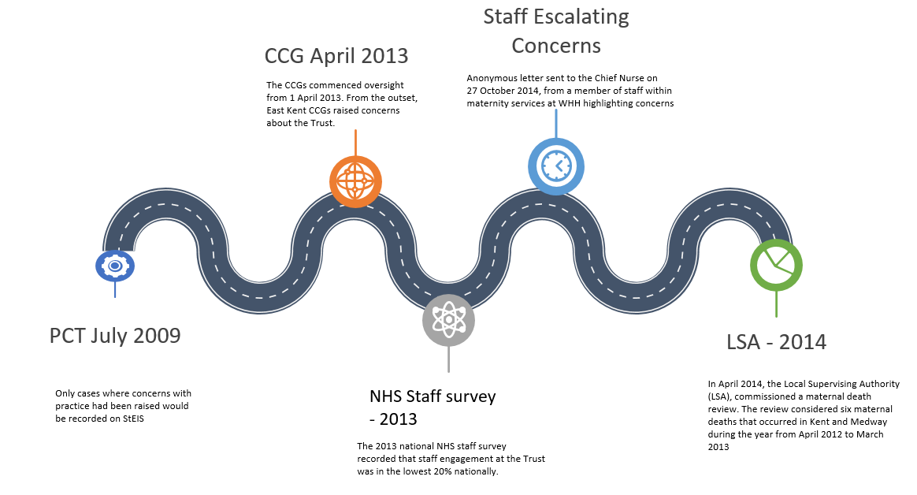
Chapter 5: How the Trust acted and the engagement of regulators
Reading the signals Maternity and neonatal services in East Kent – the Report of the Independent Investigation October 2022

Slide 9
Chapter 5: How the Trust acted and the engagement of regulators
RCM
In March 2015, the Royal College of Midwives’ Regional Officer lodged a collective grievance on behalf of midwives at the Trust. 51 staff signed this letter on 11 March 2015.
On 26 June 2015, at the Trust’s Closed Board meeting, the Medical Director (under “Confidential Items”) updated the Board on “longstanding cultural issues” in maternity services following concerns raised by staff to the CQC and the subsequent collective grievance. The situation had improved within maternity services, but further work was required.
RCOG
In 2015, the Trust commissioned the Royal College of Obstetricians and Gynaecologists (RCOG) to carry out a review and to report on a number of behavioural and performance issues, which included concerns about relationships between midwives and obstetricians
On publication, the report was dismissed and described as “a load of rubbish” by some senior obstetricians. A number of staff were also unaware of the report altogether.
The Trust informed the RCOG report reviewers of 20 areas of perceived factual inaccuracies, and submitted a narrative pointing out the lack of benchmarking around safety issues and a lack of comment about the workforce.
Upon publication of the RCOG report, the Chief Nurse of the CCGs wrote to the Trust to express concern about the quality of the serious incident investigations. Ahead of a QSG intelligence-sharing call on 22 February 2016, it was made clear that the issues were longstanding and that there was a need for positive action. The CCG sent an email to the Acting Chief Nurse at the Trust.
Reading the signals Maternity and neonatal services in East Kent – the Report of the Independent Investigation October 2022

Slide 10
Chapter 5: How the Trust acted and the engagement of regulators
CQC
August 2014 CQC overall rating for the Trust was “Inadequate”, in providing safe care and being well led, and that it required improvement to deliver effective and responsive services.
The findings of the 2014 CQC report identified a significant difference between the Board’s perception of how well the Trust was doing and the experiences of the staff.
The reaction of the Trust was one of real defensiveness and disbelief.
The improvement plan for the CQC was reported and discussed at Board level. However, the Board rarely dived into the detail of maternity and neonatal services.
February 2015, a consultant obstetrician and gynaecologist wrote to the CQC raising concerns.
March 2015, midwife raised concerns that there was a culture of bullying at the Trust, stating staff were afraid to raise concerns for fear of reprisal, and that such pressures were putting their ability to provide quality care in jeopardy.
The CQC inspected the Trust in July 2015 and rated it as “Requires Improvement”.
In August, the South Kent Coast and Thanet CCGs stated that they were undertaking further scrutiny following the receipt of a 72 hour report in relation to a maternity death SUI.
Report to Monitor and review of maternity services
Monitor was responsible between 2004 and 2016 (when it became part of NHS Improvement (NHSI)) for authorising, monitoring and regulating NHS Foundation Trusts.
Maternity services featured very little in Board discussions, despite the concerns that had been raised. Maternity services also did not feature consistently within governance sessions, and there was rarely detailed discussion about maternity and neonatal services at Board level. Issues became diluted, and their significance was not recognised as they were reported up through the chain and repeatedly summarised
Reading the signals Maternity and neonatal services in East Kent – the Report of the Independent Investigation October 2022

Slide 11
Chapter 6: Areas for action
The report highlights:
An unacceptable lack of compassion and kindness
A grossly flawed teamworking
Internal and external denial
The report has not sought to identify multiple detailed recommendations
NHS trusts already have many recommendations and action plans resulting from previous initiatives and investigations (of which this report supports)
Instead four broad areas for action have been identified
None is susceptible to easy analysis or a “quick fix”
Reading the signals Maternity and neonatal services in East Kent – the Report of the Independent Investigation October 2022

Slide 12
Key Action Area 1:
Monitoring safe performance – finding signals among noise
Recommendation 1
The prompt establishment of a Task Force with appropriate membership to drive the introduction of valid maternity and neonatal outcome measures capable of differentiating signals among noise to display significant trends and outliers, for mandatory national use.
Reading the signals Maternity and neonatal services in East Kent – the Report of the Independent Investigation October 2022
Notes:
The problem
There is a dearth of useful information on the outcome of maternity services
A large majority are process measures of dubious significance, such as caesarean section rates
The unit-level information that is available tends to be presented in the form of “league tables”. Interpretation is problematic. High-level information is used inappropriately as reassurance, taking comfort from the grouping that at least there were other trusts in the same boat.
The future
There are huge benefits to the effective monitoring of outcomes
There are two overall requirements:
1) The first is the generation of measures that are meaningful, risk adjustable and available
They must also be timely
2) The second requirement is that the measures are analysed and presented in a way that shows both the effects of the random variation inherent in all measures, and those occurrences and trends that are not attributable to random variation.
The random variation is often referred to as “noise”, and the outlying event as the “signal”.

Slide 13
Key Action Area 2:
Standards of clinical behaviour - technical care is not enough
Recommendation 2
Those responsible for undergraduate, postgraduate and continuing clinical education be commissioned to report on how compassionate care can best be embedded into practice and sustained through lifelong learning.
Relevant bodies, including Royal Colleges, professional regulators and employers, be commissioned to report on how the oversight and direction of clinicians can be improved, with nationally agreed standards of professional behaviour and appropriate sanctions for non-compliance
Reading the signals Maternity and neonatal services in East Kent – the Report of the Independent Investigation October 2022
Notes:
The problem
Caring for patients in any setting requires not only technical skills but also kindness and compassion.
The need to be professional and to listen needs to be emphasised as part of initial education and training.
Behaviour that would otherwise be challenged becomes tolerated, because “that’s the way we do things here”.
Consultants have, or perceive themselves to have, considerable freedom to act on their own responsibility without taking direction from others. stubborn, poorly behaved consultant can cause havoc in a clinical unit that imperils its performance, as well as the wellbeing of staff and patients over a prolonged period.
A trust or its medical director who attempts to intervene has few sanctions available other than dismissal, with the prospect of facing lengthy processes and a likely loss at an employment tribunal against a strong legal defence funded by a protection society.
The future
Every interaction with a patient, mother and family must be based on kindness and respect.
Professional behaviour and compassionate care must be embedded as part of continuous professional development, at all levels.
Reasonable and proportionate sanctions are required for employers and professional regulators so that poor behaviour can be addressed

Slide 14
Key Action Area 3:
Flawed teamworking -pulling in different directions
Recommendation 3
Relevant bodies, including the Royal College of Obstetricians and Gynaecologists, the Royal College of Midwives and the Royal College of Paediatrics and Child Health, be charged with reporting on how teamworking in maternity and neonatal care can be improved, with particular reference to establishing common purpose, objectives and training from the outset.
Relevant bodies, including Health Education England, Royal Colleges and employers, be commissioned to report on the employment and training of junior doctors to improve support, teamworking and development.
Reading the signals Maternity and neonatal services in East Kent – the Report of the Independent Investigation October 2022
Notes:
The problem
Nowhere is this more important than in maternity and neonatal services, but nowhere has it proved more problematic.
The lack of trust and respect between midwives and obstetric staff, and between paediatric and obstetric staff, posed a significant threat to the safety of mothers and their babies.
There is one feature of flawed teamworking that is particularly striking in maternity care: the divergence of objectives of different groups.
Rather than contributing as equal partners, midwives may be encouraged to see themselves as being “there for women”, defending them from the “medicalisation” of maternity care. This polarisation of approach and objectives cannot help but put them in conflict with obstetricians
Poor morale among obstetric trainees is a common feature and contributed significantly to the problems in the Trust’s maternity services.
The future
Stronger basis for teamworking in maternity and neonatal services, based on an integrated service and workforce with common goals, and a shared understanding of the individual and unique contribution of each team member in achieving them.
Teams who train together work better together.
Re-evaluate the changed patterns of working and training for junior doctors particular how fragmentation of work and lack of support can be avoided or mitigated.

Slide 15
Key Action Area 4:
Organisational behaviour -looking good while doing badly
Recommendation 4
The Government reconsider bringing forward a bill placing a duty on public bodies not to deny, deflect and conceal information from families and other bodies.
Trusts be required to review their approach to reputation management and to ensuring there is proper representation of maternity care on their boards.
NHSE reconsider its approach to poorly performing trusts, with particular reference to leadership.
Reading the signals Maternity and neonatal services in East Kent – the Report of the Independent Investigation October 2022
Notes:
The problem
The default response of almost every organisation subject to public scrutiny or criticism is to think first of managing its reputation
This has clearly led to denial, deflection, concealment and aggressive responses to challenge
This prevents learning and improvement, it is no way to treat families, who are heartlessly denied the truth about what has happened when something has obviously gone wrong
When a trust is in difficulties with clinical services NHSE wishes to take decisive action. One of the few levers available is the replacement of chief executives and chairs – this results in steps towards recovery being halted
The future
The need for openness, honesty, disclosure and learning must outweigh any perceived benefit of denial, deflection and concealment.
The current small risk to an organisation does not match the risk of loss of public confidence in one of its vital services.
When families experience harm, the response must be based on compassion and kindness as well as openness and honesty.
A review of the regulatory approach to failing organisations by NHSE would identify alternatives to the “heroic leadership” model, including the provision of support to trusts in difficulties and incentives for organisations to ask for help rather than conceal problems.

Slide 16
Recommendation 5
Recommendation 5 (specifically for East Kent)
The Trust accept the reality of these findings; acknowledge in full the unnecessary harm that has been caused; and embark on a restorative process addressing the problems identified, in partnership with families, publicly and with external input.
Reading the signals Maternity and neonatal services in East Kent – the Report of the Independent Investigation October 2022
Notes:
The first step in the process of restoration is for all those concerned to accept the reality of what has happened.
The time is past to look for missing commas in a mistaken attempt to deflect from findings.
The damage caused to families is incalculable, and their courage in coming forward to ensure this came to light is exemplary, but it should not have been necessary.
This must be acknowledged without further delay. Only then can the Trust embark on trying to make amends

