Slide 1

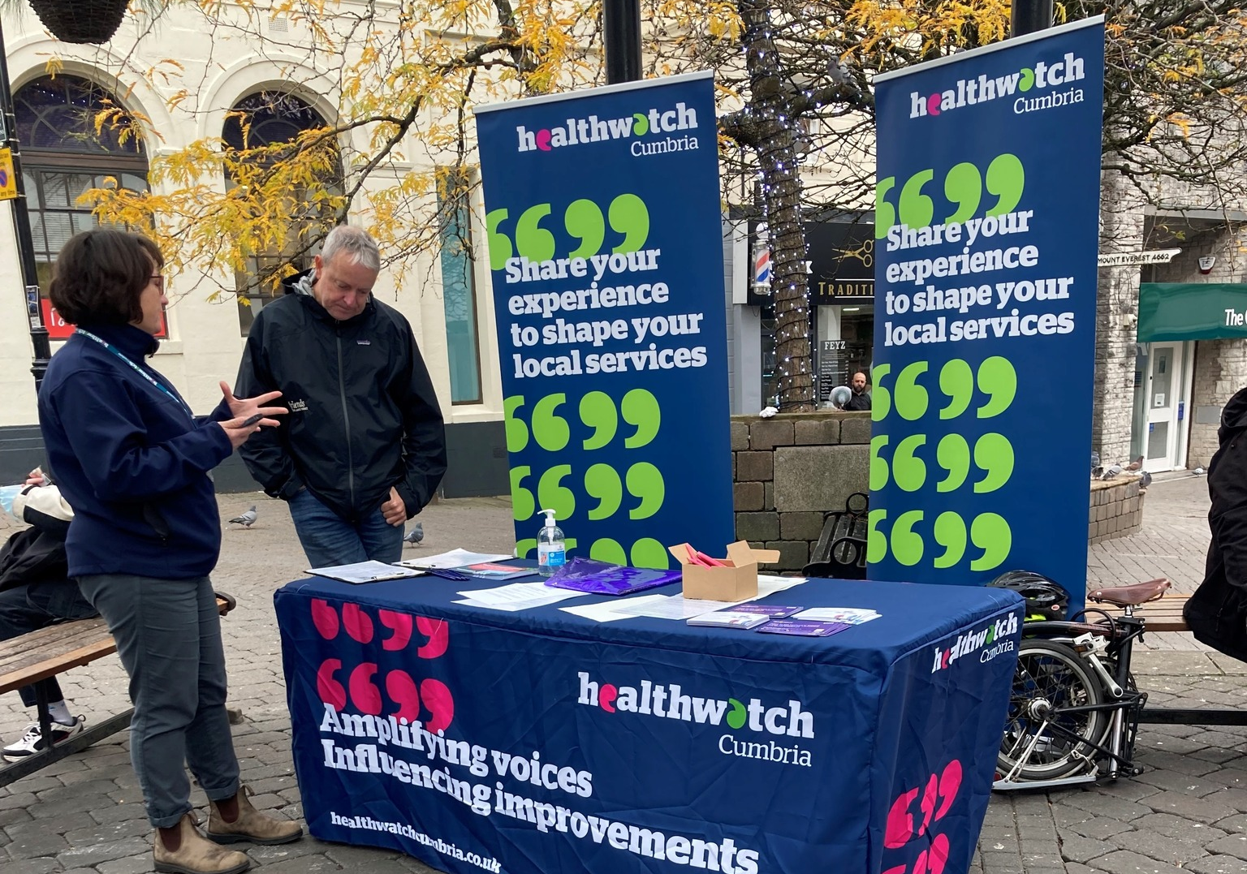

Developing Our Engagement Offer
David Blacklock, Lead CEO, Healthwatch Together

Slide 2
Healthwatch Together Supporting Engagement
  Key Principles :
  There's some great work going on
  There's lots of learning
  It has to be done at Place
  Frontline staff are great at it
  Key Challenges :
  Its very patchy –
  Quality must be improved
  Access to Engagement isn’t fair or equal
  Nowhere near enough opportunities -
  Not baked in to how we work
  Absence of citizen voice in decision making, reports and planning

Slide 3
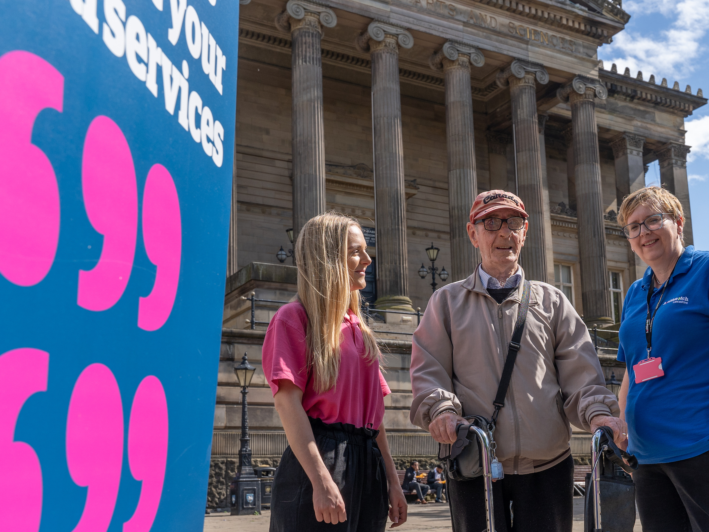
Key Messages:
Everyone has a view – can help and hinder
We need to get going
It wont be perfect
Building and sailing

Slide 4
Citizen Ambassadors Target December 2022
  Building on successful Surrey Model
  Integrate Ambassadors (Experts By Experience) throughout the system
  Recruited-Hosted-Trained-Supervised by Healthwatch Together
  Role to include:
    Supporting local engagement
    Supporting specific engagement-Diabetes/Mental Health
    Service design work
    Boards-Committees-Working Groups
    Interview panels

Slide 5
Citizen Ambassadors Target December 2022
  Initially 6 Ambassadors will be recruited
    Remuneration and costs
    Already an appetite for more-Lancashire County Council, social care
    Teams considering opportunities to involve
    Role Description drafted
    Co-produce with Ambassadors ways of working
    Work with a range of Stakeholders on working group to establish

Slide 6
Community Panel Events Target December 2022
  Recognised need to start a conversation with local people
  Build on what’s already there
  Must happen at Place and Neighbourhood level
  Bring citizens together to :
    Help us solve our problems
    Listen to concerns
    Share power and responsibility
    Inform-take people with us
  Events would be :
    Hosted by Healthwatch on behalf of ICP/ICB
    Locally focused
    Specific agenda-Goals-Outcomes

Slide 7
Community Panel Events Target December 2022
  Agreed to trial in South Cumbria – Jane Scattergood
  Must consider integration in how we run events:
    Public Health
    LA’s
    Population Health
    ICP/ICB
    Trusts
  Each event would have a Task Group to plan and deliver-Including a range of Stakeholders
  Broad citizen participation desired

Slide 8
Local Contact details
Healthwatch Blackpool, Beth Martin Project Manager Beth@healthwatchblackpool.co.uk
Healthwatch Blackburn with Darwen, Sarah Johns, Chief Officer
sarahjohns@healthwatchbwd.co.uk
Healthwatch Lancashire, Jodie Ellams, Team Leader
jodie.ellams@healthwatchlancashire.co.uk
Healthwatch Westmorland and Furness, Oliver Pearson, Manager
oliver.pearson@healthwatchcumbria.co.uk

Slide 9
Thank you
Open to Questions

