Slide 1

Primary and integrated neighbourhood care
A presentation for the ICB Public Involvement and Engagement Advisory Committee (PIEAC)
October 2022

Slide 2




What is Primary and integrated neighbourhood care?
Integrated neighbourhood care refers to primary, community and other care providers working in partnership to deliver person-centred, holistic and co-ordinated care for their local community.
Primary care refers to the following four ‘contractor groups’
General Practice 201 contracts
(Primary Medical Services) - Currently delegated from NHS England
Community Pharmacy - delegated from July 2022 424 providers
(includes Dispensing Doctors and Dispensing Appliance contractors)
Dentistry – delegated from April 2023 219 dental practices
(some providers have multiple contracts)
Eye health (Optometry) – delegated from April 2023 246 contracts

Slide 3
Primary care access - an interaction between patient and GP surgery that results in a patient accessing appropriate care.
Compared to the national trend there has been an increase in both GP Appointments (i.e. appointments with a GP) and non-GP clinical appointments provided by practices over the past four years (6.8% and 7.5% increase respectively).
This has brought the total practice appointment availability up to the national average despite having significantly higher levels of deprivation (IMD 2019 26.0 vs. 21.7) and percentage of patients over the age of 65 (19.7% vs 17.5%), both of these indicators potentially influence appointment availability by creating increasing complexity within the practice.

Slide 4
Increases in complex consultations
A significant additional factor is the increase in complexity of individual consultations. Previous pilot data has demonstrated an increase in the proportion of ‘complex’ consultations – identified as consultations with patients on 10 or more medications. Further work is required to fully explore this trend:

Slide 5
Workforce pressures and workload
Graph one
Graph two
Workforce data reveals an overall increase in the total clinical practice workforce by 5.3% (ICB). This reveals a significant reduction in FTE GP (non-trainee) across this timescale but Lancashire and South Cumbria appears to be more severely impacted (12.4% reduction vs. 5.9% reduction nationally).
Graph 2 shows a significant increase in FTE GP workload with a 21.8% increase in appointments each GP would undertake each month.

Slide 6
Summary of GP access data
 | ICB % Change 2018-2022 | National % Change 2018-2022
Registered Population | +2.6 | 3.4
GP Appointments (ICB) | +6.7 | -0.2
Non-GP Clinical Appointments (ICB) | +7.5 | +2.0
All Practice Clinical Appointments (ICB) | +7.1 | +0.9
All Practice Consultations | +10.8 | N/A
GP (non-trainee) FTE | -12.4 | -5.9
Non-GP Clinical Practice Workforce | +11.2 | +11.7
Clinical Practice Workforce | +5.3 | +5.6
GP Appointments per FTE per Month | +21.8 | +6.0
GP FTE as % FTE Practice Workforce | 35.6% | 40.9%

Slide 7
Our ambitions for patient engagement
Listen to patients, their families and carers
Improve access to primary care by increasing patient knowledge of appointment types, the range of health professionals available to support and other services offered
Manage patient expectations
Support our staff to work in an environment free from abuse
Support robust patient engagement at PCN and place through a range of tools and shared learning events
Help build capacity and capability within PCNs and place
Improve patient experience

Slide 8
Our patient insight and engagement so far - overview
Healthwatch Together UEC report
Winter 21/22
Immediate messaging based on insight
BMG research lead focus groups with primary care staff and patients on repeat attendance Summer 2022
Right Person, Right Care campaign launch
Summer 2022
Fuller stocktake workshops and PCN plans
NHS England winter plan submission including comms and engagement
21 October
Primary Care GP perceptions survey L&SC
Dec 2021
Development of Right Person, Right Care campaign
Spring 2022
National GP patient survey published
Summer 2022
Share insight.
Draft GP patient survey action plan
Summer 2022
Insight with PCNs around support requirements
Audit autumn 2022
PPG audit
Report due end October 2022 and action plan
Insight gathering
Planning and design
Launch and implementation

Slide 9
You said, we did

Slide 10
Insight – Healthwatch together – You said we did
• Promote extended access for appointments
• Improve advertising of booking methods and alternatives to GP support
• Increase the number of face-to-face GP appointments
• Reduce the amount of time patients have to wait for a GP appointment
Enhanced access is now available and being actively promoted across L&SC backed by a national campaign and local communications and engagement
Launched the Right Person, Right Care campaign. Reviewing GP websites
Appointment data shows an increase in F2F. Enhanced offer for patients who can now choose F2F and telephone
In August 2022 data shows 351k same day appointments (45%) 61k within 1 day (8%) and 143k within 2 to 7 days 18.5%). Overall there were 780k appointments in August 2022. This is an increase on June and July overall appointment numbers.

Slide 11
GP Patient perception and the Right Person, Right Care campaign launch

Slide 12
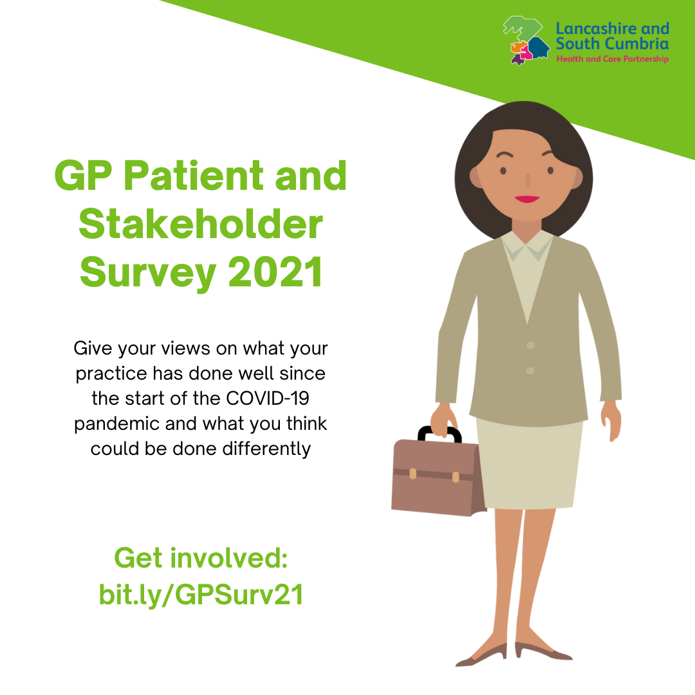
Lancashire and South Cumbria GP perceptions survey
Survey to understand how patients in Lancashire and South Cumbria perceived their GP practice
  Covered many elements including appointments, understanding of available services and the future of general practice
Largely digital survey due to need for quick mobilisation and turnaround
  Collated around 500 responses split across the five former CCG areas
Run during December 21/January 22
Used to inform a patient education communications campaign as part of the Winter Access Fund

Slide 13
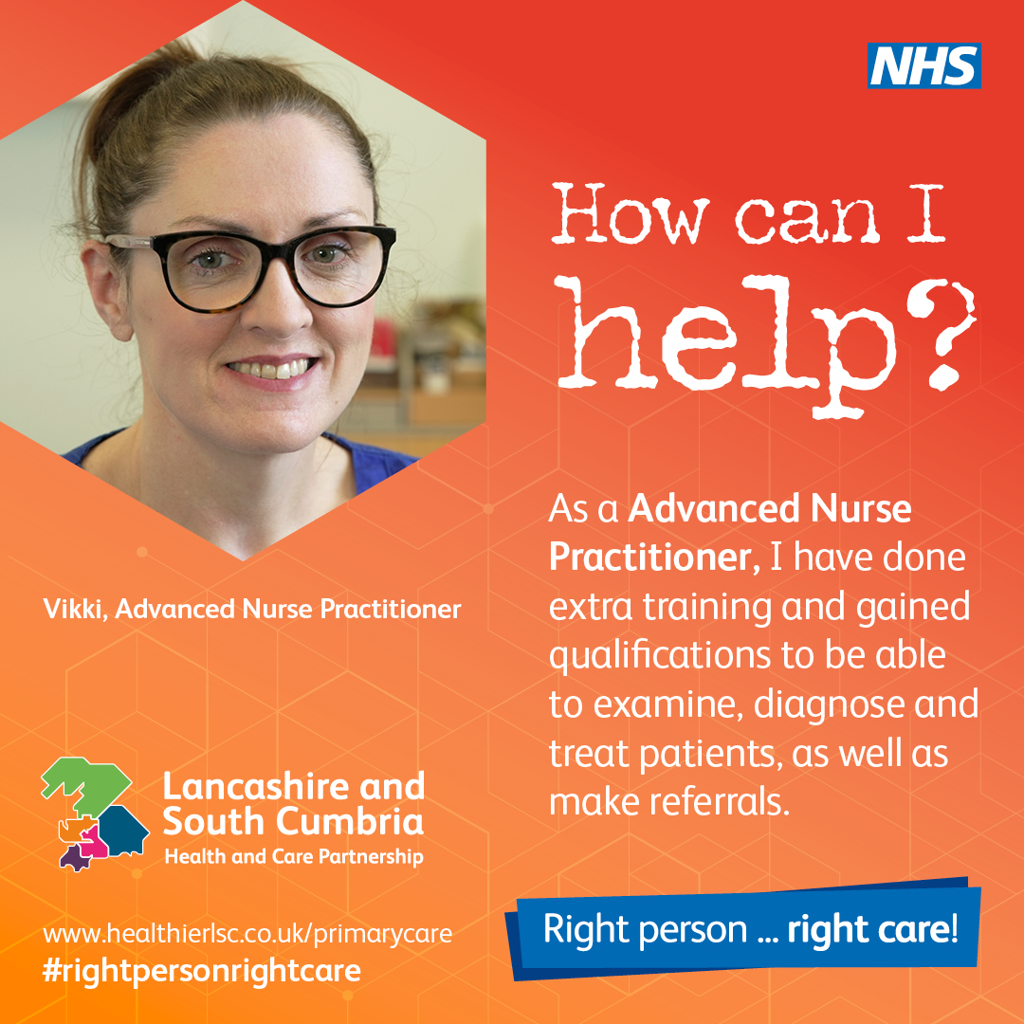
Right person, right care
Communications campaign to raise awareness of the roles of other healthcare professionals in general practice
  In the survey, 40% of respondents did not understand all services GP practices provide, yet 85% would be happy to see another healthcare professional other than their GP
Launched in August 22, campaign will continue to run with paid social media budget for circa 12 months
Broad brush to raise awareness across the patch
  Reached 95k people via paid social media by end of September
  Physical materials in over 80 practices
Impact measured by re-running survey to compare year-on-year results to questions around the understanding of the complete offer in general practice

Slide 14
GP Patient Survey – Ipsos MORI

Slide 15
GP Patient Survey 2022
Conducted by Ipsos MORI between 10 January and 11 April 2022
Results taken within the context of primary care recovery from COVID-19, winter pressures and the delivery of the booster vaccine programme
In Lancashire and South Cumbria Integrated Care System, 75,059 questionnaires were sent out, and 22,196 were returned completed. This represents a response rate of 30%.
Overall results show a downward trend in patient satisfaction.
This is a national trend and Lancashire and South Cumbria remain equal to or above the national average on all domains.
  74% described their overall experience of GP practice as ‘good or ‘very good’ (72% nationally)
  84% report receptionists as ‘helpful’ or ‘very helpful’ (82% nationally)
  70% report GP website ‘fairly’ or ‘very’ easy to use (67% nationally)
  73% of patients were happy with the choice of appointment offered. 96% of patients accepted the choice of appointment offered
  Perceptions of care during appointment remains high:
  85% report care to be ‘good’ or very good’ (83% nationally)
  82% felt their mental health needs were met and understood (81%)
  94% reported they had confidence and trust in their healthcare professional
Next steps (acknowledging downward trajectory)– finalise action plan and align with fuller and winter plan

Slide 16
Assessing patient access to GPs and core drivers of repeat attendance
Focus groups

Slide 17
Key aims
As part of our ongoing work to identify where services are not being used in the intended way, and to identify who is using these services as such; the core aim was to understand why people who may benefit from other kinds of support appear to default to GP services. The results of this research would then help alleviate some of the pressure on GP surgeries in the area, get patients to the right health professional allowing all roles of those working in primary care to be but to good use, and ensure excellent patient care across the county.
BMG were commissioned to conduct qualitative research in order to explore the views of the general public, and of those working in healthcare. The research was used to identify barriers patients faced to accessing the right services, reasons for these barriers, and then informed recommendations included in the report to support clinical operations.

Slide 18
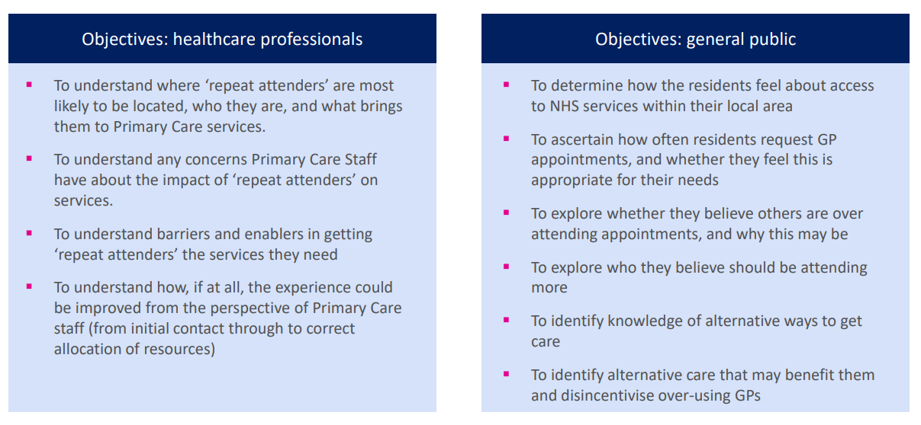
Research objectives

Slide 19
Key findings
Both patients and healthcare professionals are well aware of the concept of repeat attenders, and the negative impact they have on the wider community – other patients, the healthcare community, and the repeat attenders themselves.
However, most patients agree that they aren’t responsible for over attendance, believing instead that it is the failing of NHS systems and processes which drives this in most instances.
The majority of repeat attendance appears to be driven by a lack of continuity of care, a mistrust in the quality of alternative NHS services, and an ineffective triage system.
Because NHS systems appear to be driving much repeat attendance, it is difficult to pinpoint any specific demographic groups who are more prone to over-attendance than others.
Community and face to face healthcare (e.g., support groups for those living with a diagnosis or with another physical or mental need) does appear to have a beneficial impact, and helps to address and prevent medical issues without having to engage a GP.
However, more community care is needed before this has an impact on the number of patients attending GP surgeries, as currently there are not enough services to meet this need.

Slide 20
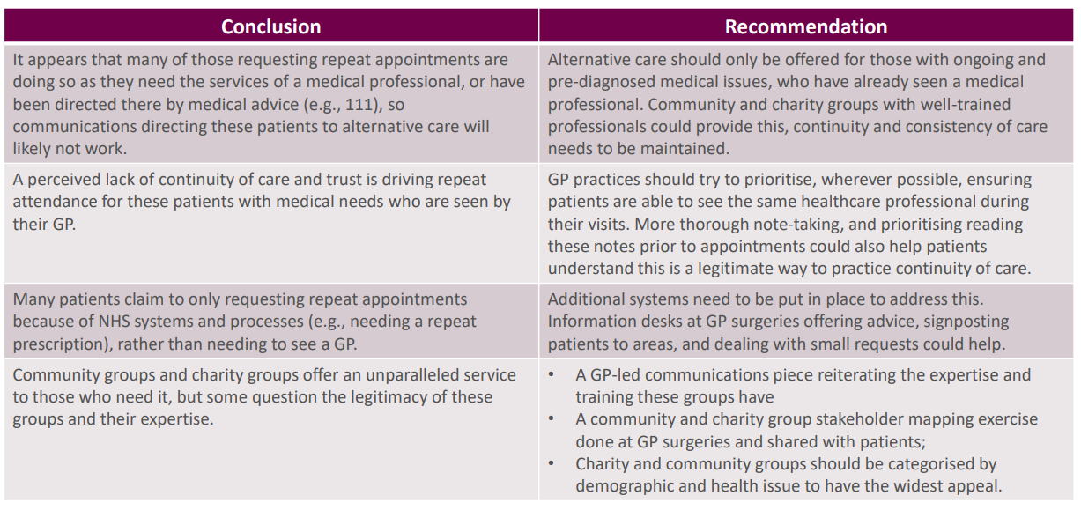
Conclusions and recommendations

Slide 21
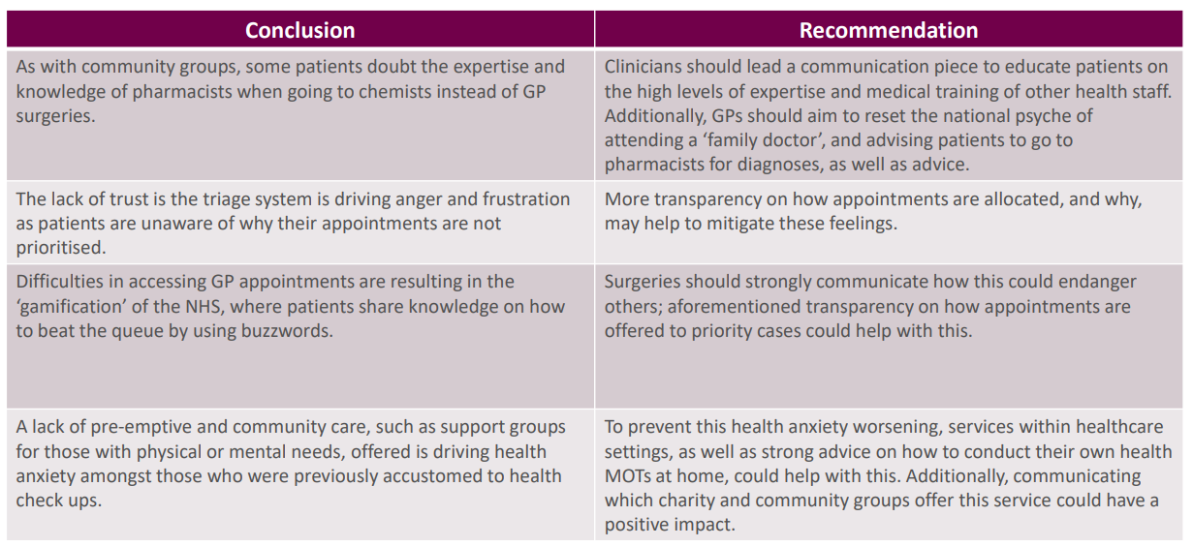

Slide 22
Patient Participation Groups

Slide 23

What is a PPG?
A group of patients registered at a practice who work with the practice to improve patient experience
Part of the GP Contract
Meet virtually or face to face (or sometimes a blend)
Support patient surveys
Analyse results
FFT
Help develop an action plan
They can also:
Support the practice with events for example flu clinics
Hold health awareness days
Support community links to the VCFSE sector
Work as a group of PPGs to support Primary Care Networks
Contribute to commissioning decisions and co-production of services

Slide 24
PPG audit and next steps
Survey audit of all GP Practices in Lancashire and South Cumbria
178 response out of 201 GP practices
Report to outline areas for improvement and development
Identify good practice – what works well
Support primary care via PPG networks, learning events, recruitment packs, patient awareness videos and a PPG charter.
Build capacity and capability at practice and PCN level

Slide 25
Supporting Primary Care Networks

Slide 26
PCN engagement to identify comms and engagement support
Creation of the ICB meant different ways of working with GP practices
More delegated responsibilities on PCNs will require promotion of services and wider engagement with local population around service design.
All PCN leads contacted and requested to have one to one or group discussion with Primary Care comms working group.
  26 PCNs arranged one to one meetings
  Also presented and had open discussions with Fylde Coast PCN network.
Discussions focussed around understanding:
  What priority the PCN puts on Communications and engagement currently
  Whether this would remain or increase in the future
  What support had the PCNs been used to in their area
  What support do they still require
  What extra support do they see they may need in the future

Slide 27
Findings
Understanding of what full and proper communications and engagement really involves was limited.
General consensus that it was a priority.
Preparing posters for waiting rooms, patient text messages, leaflets and speaking with their PPG groups were basic priority and PCNs equipped with a little support in the form of ‘how to’ toolkits.
Need to develop understanding of elements of engagement such as participatory budgeting or co-production.
Some had not conducted surveys whereas some had done extensive surveying of patients although reported having poor uptake.
This was especially the case when discussion the roles of some of the social prescribing link workers and making contacts with local VCFS groups.
Better internal and patient facing communicate about what PCNs are and how to get involved.
Need to increase skills, confidence, capacity and capability.
Support to manage social media was a priority.
Digital exclusion, speakers of languages other than English and rural isolation were noted as barriers to communications and engagement.

Slide 28
Recommendations
Provide a series of training webinars, bow to guides and toolkits on a range of subjects connected with communications and engagement, including but not limited to:
  Social media
  Empowering people and communities
  Levels of engagement from informing to co-production
  Survey writing and analysis
  Digital communications
  Audience segmentation and targeted communications
Provide Media handling support
Facilitate a wider PCN communications and engagement network for sharing ideas and opportunities.
Create editable communications materials for campaigns.
Raise awareness of PCNs
Create a series of templates for internal communications such as newsletters or FAQs for PCNs
Support for dealing with hard to reach groups, particularly those with mental health conditions or the south Asian community.

Slide 29
Next steps

Slide 30
Next steps
Listening to feedback is an iterative process – build in robust mechanisms for patient involvement
Wealth of intelligence gathered in the first year of the ICB which has already informed definitive action 9for example the right person, right care campaign)
A number of actions and crossover between priority frameworks such as winter UEC, Fuller framework, winter access to primary care, GPPS outputs. Align communications and engagement plan into coherent approach.
Commence building on existing engagement infrastructure for patients, their families and carers (PPGs)
Commence programme to build capacity and capability within primary care networks to engage effectively at all levels across PCNs and place.

Slide 31

Questions

