Slide 1

Fylde Coast ICP

Slide 2

Life expectancy is falling and falling faster in most deprived areas
Life expectancy at birth by area deprivation deciles and sex, England, 2019-20
0.95 years
1.9 years
Source: ONS

Slide 3
On average, men in Fylde live 6 years longer than men in Blackpool, for women - 3 years
Life expectancy, 2017-2019
Source: ONS

Slide 4
On average, men in Marton live 14 years longer than men in Bloomfield
Life expectancy 2015-19: Blackpool, Male
Source: ONS

Slide 5
On average, women in Stanley live 9 years longer than women in Claremont
Life expectancy 2015-19: Blackpool, Female
Source: ONS

Slide 6
On average, men in St. Johns live 9 years longer than men in Fairhaven
Life expectancy 2015-19: Fylde, Male
Source: ONS
* Data not available

Slide 7
On average, women in St. Johns live 4. years longer than women in Kirkham. South
Life expectancy 2015-19: Fylde, Female
Source: ONS
* Data not available

Slide 8
On average, men in Wyresdale live 13 years longer than men in Pharos
Life expectancy 2015-19: Wyre, Male
Source: ONS
* Data not available

Slide 9
On average, women in Piling live 13 years longer than women in Pharos
Life expectancy 2015-19: Wyre, Female
Source: ONS
* Data not available

Slide 10
Within each area, there are more than five years difference in life expectancy between least and most deprived areas
Social gradient in life expectancy, 2017-2019
Source: DHSC fingertips

Slide 11
COVID-19

Slide 12
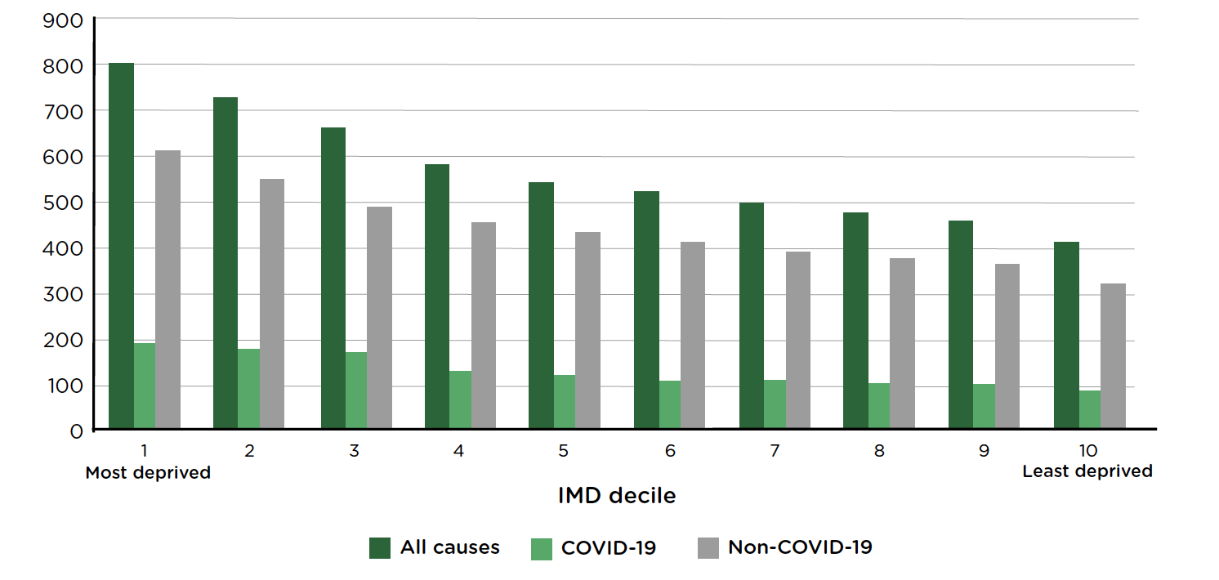
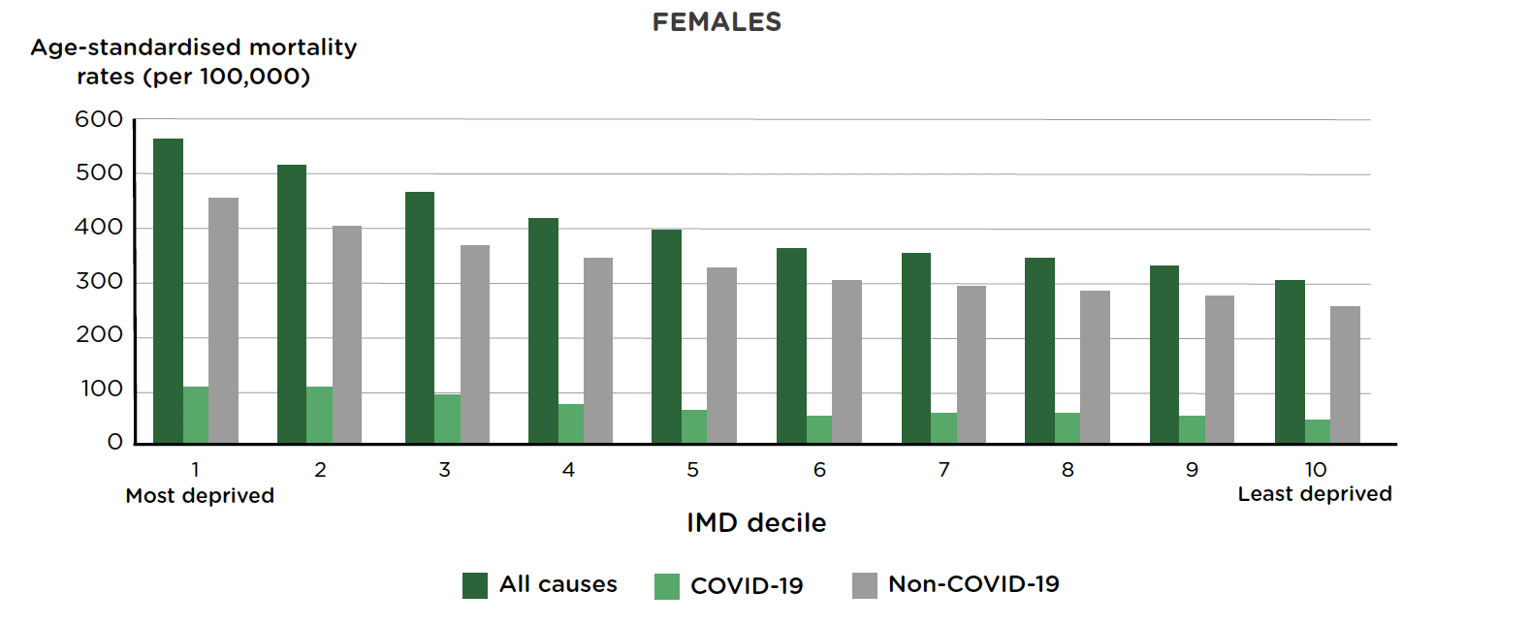
COVID-19 follows a similar trajectory to inequalities in mortality from other causes – the more deprived the area of residence, the greater the mortality from COVID-19.
Age-standardised mortality rates from all causes, COVID-19 and other causes (per 100,000), by deprivation deciles in England
Male
Female
Source: ONS. Deaths involving COVID-19 by local area and socioeconomic deprivation

Slide 13
In the four most deprived deciles in Lancashire and South Cumbria COVID-19 mortality was greater than the England and Wales average and there are sharp inequalities in the Region
Age and sex standardised COVID-19 mortality ratios by IMD 2019 deciles of MSOAs* in Lancashire and South Cumbria, March 2020 to April 2021
Source: ONS

Slide 14
There is an association between deprivation and COVID-19 mortality, but several areas have higher rates than expected for their deprivation (e.g. Blackburn, Preston)
Age-adjusted COVID-19 mortality ratio of observed to expected deaths by level of deprivation, March 2020 to April 2021, neighbourhoods (MSOAs) in Lancashire and South Cumbria

Slide 15
Age-standardised mortality rates due to COVID-19 per 100,000 people, March 2020 to April 2021
Source: ONS

Slide 16
Health

Slide 17
Women in Cumbria live 11 years longer in good health compared to women in Blackpool, for men - 10 years
Healthy Life expectancy, 2017-2019
Source: ONS

Slide 18
Mortality rate from causes considered preventable (including cardiovascular, cancer, respiratory, liver diseases), 2016-18
Directly Standardised Rate, per 100,000
Source: PHE

Slide 19
Physically in/active adults, 2019/20, percentage
Source: PHE

Slide 20
Preterm (24-36 weeks) births, 2017-2019, percentage
Source: PHE

Slide 21
Low birth weight of term babies, 2019, percentage
Source: PHE

Slide 22
Low birth weight of term babies, ward level, 2015-19 pooled percentage
Source: PHE

Slide 23
Low birth weight of term babies, ward level, 2015-19 pooled percentage
Source: PHE
*data not available

Slide 24
Low birth weight of term babies, ward level, 2015-19 pooled percentage
Source: PHE
*data not available

Slide 25
Smoking status at time of delivery, 2019/20, percentage
Source: PHE

Slide 26
Emergency hospital admissions for intentional self-harm, 2019/20, Directly standardised rate per 100,000
Source: PHE

Slide 27
The lower the ratio, the lower the likelihood someone is in hospital for intentional self-harm
Hospital stays for intentional self-harm, 2015/16 – 2019/20,
Standardised emergency admission ratio
Source: PHE

Slide 28
The lower the ratio, the lower the likelihood someone is in hospital for intentional self-harm
Hospital stays for intentional self-harm, 2015/16 – 2019/20,
Standardised emergency admission ratio
Source: PHE

Slide 29
The lower the ratio, the lower the likelihood someone is in hospital for intentional self-harm
Hospital stays for intentional self-harm, 2015/16 – 2019/20,
Standardised emergency admission ratio
Source: PHE

Slide 30
Suicide Rate, 2018-20, Directly standardised rate - per 100,000
Source: PHE

Slide 31
Estimated percentage of households that experience fuel poverty, 2018/19
Source: PHE

Slide 32
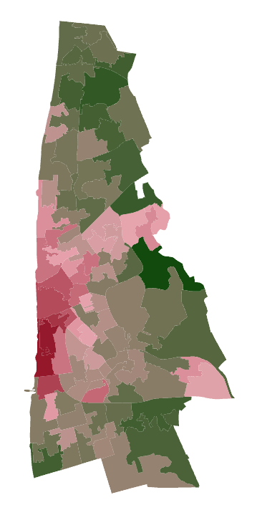
Estimated proportion of fuel poor households,
LSOA 2018/19 – Blackpool
Dark red – highest proportion
In circled area estimated 31% of households are fuel poor, 368 homes
Dark green – lowest proportion – 7.7%
Source: Lancashire Insight

Slide 33
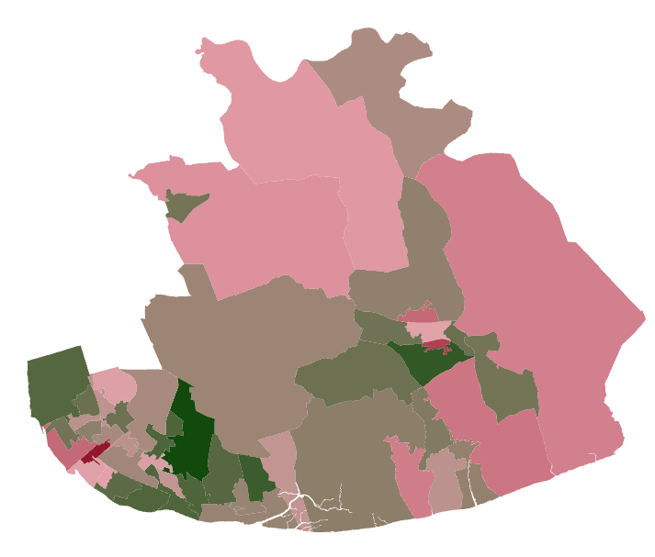
Estimated proportion of fuel poor households,
LSOA 2018/19 – Fylde
Dark red – highest proportion
In circled area estimated 21% of households are fuel poor, 164 homes
Dark green – lowest proportion, 5.8%, 63 homes
Source: Lancashire Insight

Slide 34
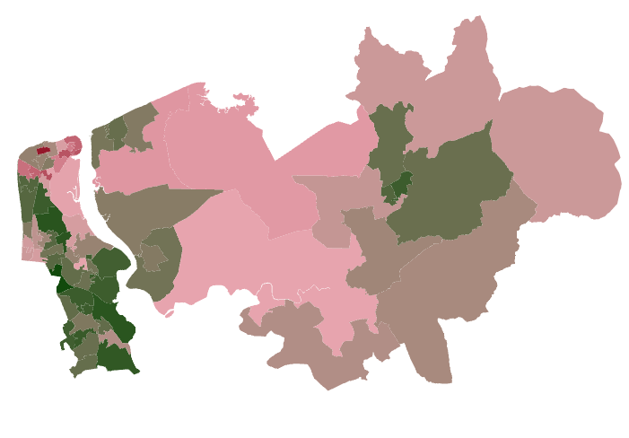
Estimated proportion of fuel poor households,
LSOA 2018/19 – Wyre
Dark red – highest proportion
In circled area estimated 26.5% of households are fuel poor, 144 homes
Dark green – lowest proportion, 39 homes
Source: Lancashire Insight

Slide 35
Hospital admissions caused by unintentional and deliberate injuries in children (aged 0-14 years), 2019/20, Crude rate per 10,000
Source: PHE

Slide 36
Hospital admissions caused by unintentional and deliberate injuries in children (aged 15-24 years), 2019/20, crude rate per 10,000
Source: PHE

Slide 37

Social determinants of health

Slide 38
Give every child the best start in life
Enable all children, young people and adults to maximise their capabilities and have control over their lives
Create fair employment and good work for all
Ensure a healthy standard of living for all
Create and develop healthy and sustainable places and communities

Slide 39
Give every child the best start in life

Slide 40
Infant Mortality Rate, 2017-19, Crude rate per 1000
Source: PHE

Slide 41
Uptake of Healthy Start Vouchers, 21/06/21 to 18/07/21, percentage
Uptake is calculated as a percentage of entitled beneficiaries over eligible beneficiaries.
Eligible beneficiaries are those who qualify to apply for Healthy Start (eg at least 10 weeks pregnant or have a child under four years old and the family gets: Income Support, or Income-based Jobseeker’s Allowance, or Income-related Employment and Support Allowance, or Child Tax Credit, or Universal Credit).
Beneficiaries become entitled once their completed Healthy Start application form has been processed and approved by the Healthy Start Issuing Unit.
Source: NHS

Slide 42
School Readiness: percentage of children achieving a good level of development at the end of Reception, 2018/19, percentage
Source: PHE

Slide 43
Pupils reaching the expected standard in Key Stage 2 reading, writing and maths, 2018, percentage
Source: DfE

Slide 44
Enable all children, young people and adults to maximise their capabilities and have control over their lives

Slide 45
Pupils eligible for FSM all perform worse than the England average, lowest scores in Blackpool, Fylde pupils not eligible for FSM outperform the national average
Average Attainment 8 Score per pupil, 2019/20, Free School Meal status
Source: DfE

Slide 46
Average Attainment 8 Score, 2019/20, Mean score
Source: DfE

Slide 47
Pupil Absence, 2018/19, percentage
Source: PHE

Slide 48
First time entrants to the youth justice system, 2019,
Crude rate - per 100,000
Source: PHE

Slide 49
Under 18s conception rate/1,000, 2018, crude rate per 1000
Source: PHE

Slide 50
Create fair employment and good work for all

Slide 51
Unemployment Apr 2020-Mar 2021; % of the economically active over-16 population (model based)
Source: ONS

Slide 52
Gap in the employment rate between those with a long-term health condition and the overall employment rate, 2019/20, percentage
Source: PHE

Slide 53
Ensure a healthy standard of living for all

Slide 54
One in five children live in absolute poverty in Blackpool, slightly more than one in ten children in Wyre and Flyde (before housing costs)
Children in absolute and relative low income families (under 16s) 2019/20, percentage
Source: PHE

Slide 55
The number of children living in poverty increases when housing costs are included
Children living in poverty measured after housing costs, 2018/19, percentage
Source: HBAI

Slide 56
Older people in poverty: income deprivation affecting older people index, 2019, percentage
Source: PHE

Slide 57
Create and develop healthy and sustainable places and communities

Slide 58
People who "often or always" felt lonely, Oct 2020 - Feb 2021, percentage
Source: ONS

Slide 59
Violence offences per 1,000 population, 2019/20
Source: PHE

Slide 60
There is no agreed definition of affordable housing, the most commonly used definition is in Annex 2 of the National Planning Policy Framework, used by local planning authorities. This definition incorporates social rent, as well as a range of intermediate rent and for-sale products but it has been criticised by e.g. the Affordable Housing Commission that “many” of these products “are clearly unaffordable to those on mid to lower incomes.”
Total additional affordable dwellings, completions 2019/20
Source: Lancashire County Council

Slide 61
Households owed a duty under the Homelessness Reduction Act, 2019/20 - crude rate per 1,000
Source: PHE

Slide 62
Average distance to nearest Park, Public Garden, or Playing Field
Source: ONS

Slide 63
Adults using sustainable travel at least three days per week, 2018/19, percentage
Source: PHE

Slide 64
Fylde Coast ICP

