Slide 1
Integrated Primary Care Performance Report
September 2026
The Integrated Primary Care Performance Report (IPCPR) is produced each month to provide the latest position of Locally Enhanced Services’(LES) and key primary care performance targets. This report focuses on LES data only.

Slide 2
Executive Summary
This iteration of the Integrated Primary Care Performance report contains an updated on LSC ICBs performance against Locally Enhanced Services only and is presented at the following committee
Primary Care Contracts Committee
September 2026 Report- Points of Note:
All 194 practices have now returned their 2026/27 Local Enhanced Services contracts and participation across the 16 established Local Enhanced Services remains high.
Long Term Conditions LES: 134 practices (69%) have now achieved more than 25% of their annual target, with 62 practices (32%) achieving more than 50%. Activity remains above planned levels.

Slide 3
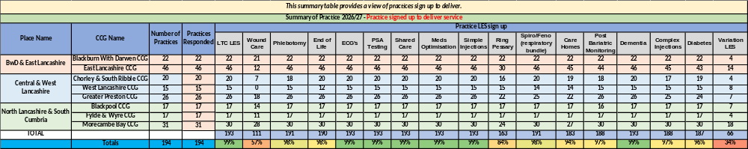
Local Enhanced Service (LES) Confirmation of Practice Participation - Aug 2026
All 194 practices have now returned their 2026/27 Local Enhanced Services contracts.
Participation across the 16 established Local Enhanced Services remains high, with 12 services achieving sign-up rates of 97% or above, including seven with sign-up rates of 99%.
66 practices (34%) have currently signed up to the Variation LES which was launched on the 1st September 2026. The Big Primary Care Conversation webinar provided practices with further information and an opportunity to ask questions about the LES. Following this, 1 further practice has signed up to the LES. Since the July IPCPR and the webinar 1 further practice has signed up to the LES, place teams continue to work with practices to encourage sign up and answerer any further questions following the webinar.

Slide 4
Local Enhanced Service (LES) Delivery Pictorial: April - August 2026
In 2026/27, the ICB continues to commission services from all LSC general practices. This is the second year of a three-year commissioning plan and, for many practices, represents a stepped change in service delivery expectations. The pictorial below provides a delivery update for each commissioned LES.
Post Bariatric Monitoring
Dementia
Complex Injections
Diabetes
Ring Pessary
Vasectomy
Spiro/FeNO
Wound Care
727
patients received their annual monitoring avoiding secondary care follow up
5,136
patients received a comprehensive assessment and medication review avoiding outpatient follow up
878
patients received an injection for osteoporosis avoiding secondary care attendance
5,822
patients received injectable therapy, thereby avoiding referral to secondary care for insulin initiation.
1,868
patients received ring pessaries, thereby avoiding referral to secondary care.
713
patients received vasectomies, thereby avoiding referral to secondary care.
Saved 405.7g of CO₂.
8,906
patients received tests as part of a holistic respiratory assessment, thereby avoiding referral to secondary care diagnostics.
25,153
patients received wound care treatment, thereby avoiding referral to community and same‑day urgent care services.
Phlebotomy
ECGs
PSA Tests
Simple Injections
End of Life Care
Long Term Conditions
544,396
individual blood test appointments were undertaken in General Practice.
28,051
patients received an ECG, avoiding referral to secondary care CDCs.
5,410
patients have been followed up for PSA monitoring, reducing the need for outpatient follow‑up.
62,253
increased injections for endometriosis and prostate cancer reduced the number of avoided outpatient appointments. Run B12 injection clinics have also been introduced.
TBC
patients with an advanced care plan.
TBC
of the patients on the palliative care register.
42,047
patients received a Holistic Health Assessment (HHA).
TBC
reduction in non‑elective admissions of patients receiving an HHA
TBC
of patients receiving an HHA offered social prescribing support.
The impact of the LES continues to differ across each place depending on historic commissioning arrangements. The consistent commissioning of the LES represents both the retention of existing impact and the delivery of new impact. The second year of the commissioning plan includes an expanded focus on outcome‑based metrics.

Slide 5
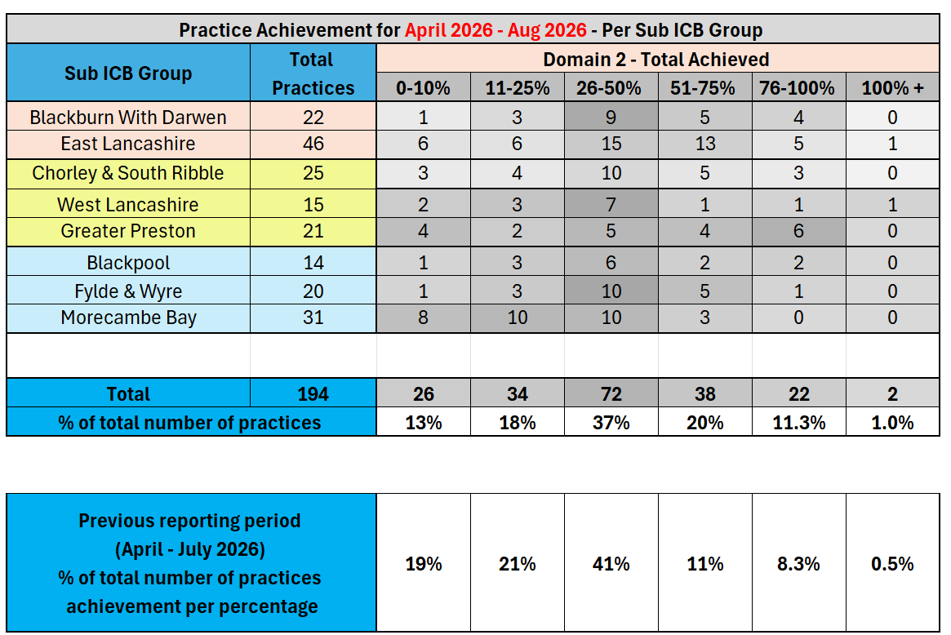
General Practice: Local Enhanced Services
Activity Metric | General Practice Local Enhanced Services: Long-Terms Condition Holistic Health Assessment (HHA) – April - Aug 2026
 | Primary Care Contracts Sub Committee / Primary Care Medical Services Group
 | Group Chair: | Peter Tinson | SRO: | Donna Roberts | Clinical Lead: | John Miles
This metric measures The number of GP practices within each Sub ICB Group that have achieved different percentages of their annual Holistic Health Assessment (HHA) delivery target for Domain 2 of the Long-Term Conditions (LTC) Local Enhanced Service (LES).
What does this tell us? The Long-Term Conditions (LTC) LES is now in its second year of delivery, with this report providing the year to date Month 5 activity position. Overall, across L&SC 134 practices (69%) have now achieved more than 25% of their annual target, with 62 practices (32%) achieving more than 50%. This performance is as expected at this point in the calendar year and show continued growth from the last reporting period. Delivery continues to vary across Sub-ICB Groups and individual practices, and activity will continue to be monitored as the year progresses.
Month 5 Position / Actions Monthly activity will continue to be monitored against annual delivery expectations and identify trends in delivery and variation across practices and Sub-ICB Groups. Ongoing engagement with practices will support consistent delivery and recording of Holistic Health Assessments. Practices with lower levels of recorded activity will be monitored as the year progresses to identify where further support or engagement may be required.
Risks:
There are 194 practices who are signed up and delivering a range of LES contracts for 2026/27.

Slide 6
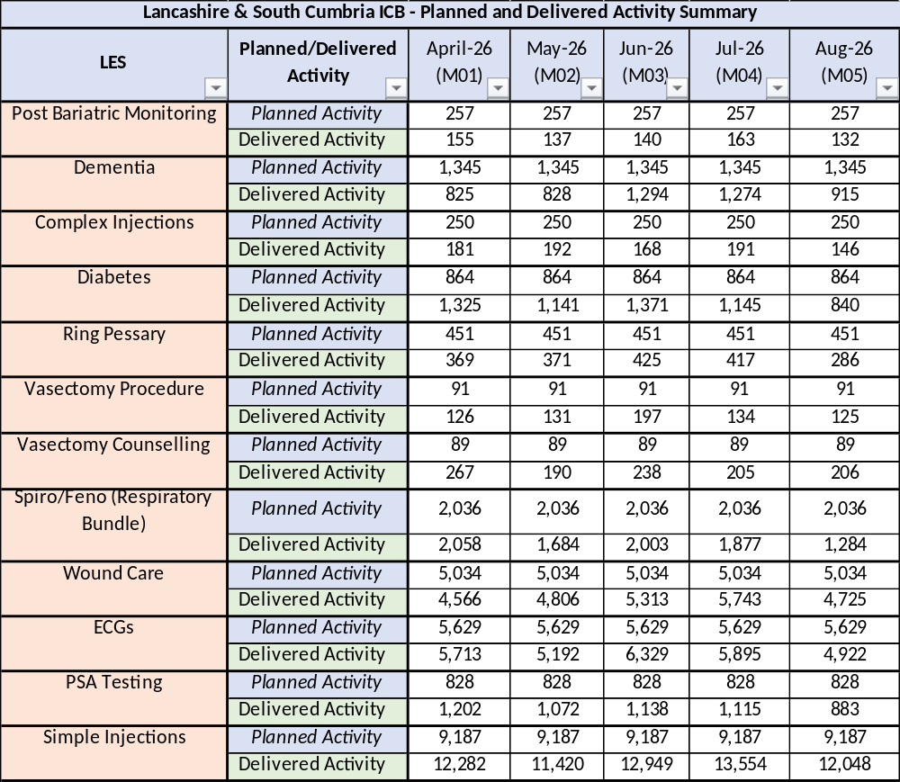
General Practice: Local Enhanced Services
Activity Metric | General Practice Local Enhanced Services: Cost and volume – April - Aug 2026
 | Primary Care Contracts Sub Committee / Primary Care Medical Services Group
 | Group Chair: | Peter Tinson | SRO: | Donna Roberts | Clinical Lead: | John Miles
This metric measures The table provides a summary of the Lancashire and South Cumbria monthly planned versus actual delivered activity for the Cost and Volume (C&V) Local Enhanced Services (LES) commissioned during 2026/27.
What does this tell us? The Cost and Volume (C&V) LES programme enables practices across L&SC to deliver a broad range of community-based services during 2026/27, supporting patients to access care closer to home and reducing reliance on secondary care services. Month 5 (August 2026) continues to show variation between planned and delivered activity across individual services. Activity remains particularly high within Simple Injections and Diabetes, while several other services are currently delivering below planned levels. The position varies further at individual practice and Place level, reinforcing the need to consider the headline activity alongside more detailed analysis of expected delivery.
Month 5 Position / Actions A detailed expected vs delivered activity review has now been completed across the LES portfolio at practice level, including comparison with equivalent 2025/26 activity, to provide further context to current delivery patterns. The review has identified several areas requiring further exploration, including significant variation between expected and delivered activity at individual practice level and a small number of potential data quality outliers. Further review is being undertaken of Diabetes and Simple Injections, where overall activity remains above planned levels. For Diabetes, this includes consideration of activity across the individual service elements and potential overlap with activity recorded through the obesity pathway for GLP1. Vasectomy activity has also been highlighted for further review following significant activity outliers within the practice-level analysis. Findings from the review have been shared with relevant colleagues and will be worked through to validate the data, understand the drivers behind variation and identify where further investigation or action is required.
Risks: Risk of over performance against diabetes, vasectomy, PSA testing and simple injections and at sub ICB level. Mitigations for this will be developed pending the outcome of the reviews mentioned above.

Slide 7
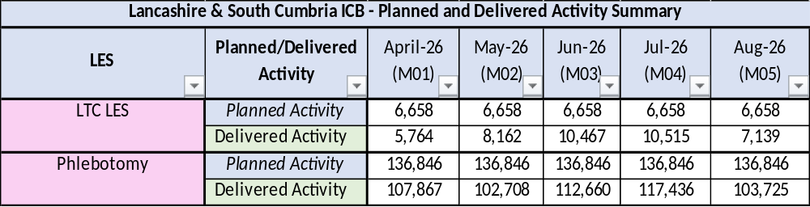
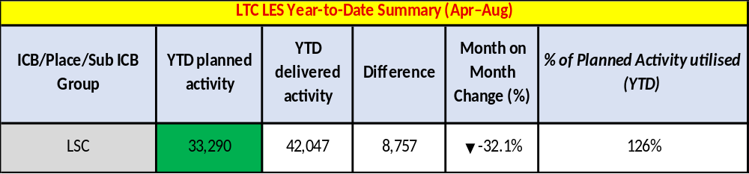
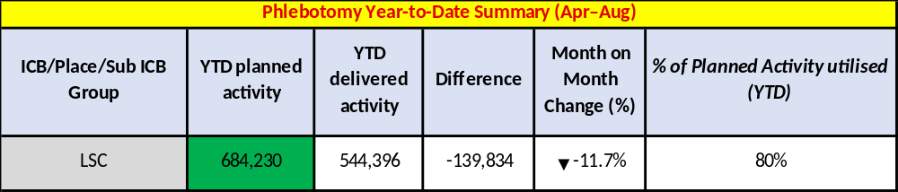
General Practice: Local Enhanced Services
Activity Metric | General Practice Local Enhanced Services: Capitated contracts April – July 2026
 | Primary Care Contracts Sub Committee / Primary Care Medical Services Group
 | Group Chair: | Peter Tinson | SRO: | Donna Roberts | Clinical Lead: | John Miles
What does this tell us? Month 5 (August 2026) activity continues to show differing delivery positions across the two capitated LESs: LTC LES cumulative activity remains above planned levels, with YTD delivery at 126% of plan. August’s activity was lower than July by -32.1% Phlebotomy cumulative activity remains below planned levels, with YTD delivery at 80% of plan. August’s activity was lower than in July by -11.7%. The decreases in activity seen in August are at least partly attributable to seasonal variation during the summer holiday period and will continue to be monitored
Actions Activity across both capitated LESs will continue to be monitored against planned delivery throughout 2026/27. Variation at individual practice level may not be visible within the overall system position and will therefore continue to be considered alongside the headline activity. The wider expected vs delivered activity review has included the capitated LESs, providing additional practice-level context to the overall position and supporting identification of areas of variation. LTC activity will continue to be monitored to understand the drivers behind sustained delivery above planned levels. Phlebotomy activity will continue to be reviewed, including practice-level variation and any factors affecting recorded activity.
Risks: LTC LES year-to-date activity remains materially above planned levels, and continued monitoring is required to understand whether this trend is sustained and any implications for the contract. Phlebotomy year-to-date activity remains below planned levels.
This metric measures The table provides a summary of the Lancashire and South Cumbria monthly planned versus actual delivered activity for the Capitated Local Enhanced Services (LES) commissioned during 2026/27.

Slide 8

Web lancashireandsouthcumbria.icb.nhs.uk | Facebook @LSCICB | Twitter @LSCICB

