Slide 1
Lancashire and South Cumbria ICB
Health inequality metrics
2025-26
In November 2023, NHS England published a Legal Statement related to the duty of ICBs to report on health inequalities under section 13SA of the National Health Service Act 2006 including that “relevant NHS bodies should publish the information on health inequalities within or alongside the organisation’s annual report”.
The purpose of this slideset is to share the information as required within the legal statement. This presentation should be read alongside the ICB’s Annual Report.​

Slide 2
Contents
Section | Page
Executive Summary | 2
Introduction | 3
Life Expectancy and Healthy Life Expectancy | 9
Cancer | 12
Cardiovascular Disease | 15
Learning Disability and Autism | 20
Maternity | 23
Mental Health | 27
Children and Young People | 31
Data Quality | 33
Elective Care | 35
Urgent and Emergency Care | 39
Primary Care | 46
Diabetes | 48
Treating Tobacco Dependency | 51
Digital Inclusion | 54
Closing slide and contact details | 56

Slide 3
Introduction

Slide 4
Purpose of this report
In November 2023, NHS England published a Legal Statement related to the duty of ICBs to report on health inequalities under section 13SA of the National Health Service Act 2006 including that “relevant NHS bodies should publish the information on health inequalities within or alongside the organisation’s annual report”.
The purpose of this slideset is to share the information as required within the legal statement. This presentation should be read alongside the ICB’s Annual Report which includes more information of the work that is underway to understand and address these inequalities.​
The NHS Constitution states that the NHS has a duty to “…pay particular attention to groups or sections of society where improvements in health and life expectancy are not keeping pace with the rest of the population”.
Almost a third of people in Lancashire and South Cumbria are identified as being within the most deprived areas of England, and the percentage of children living in poverty across Lancashire and South Cumbria is higher than the national average. This has a huge impact upon their lives and health, with challenges meeting their basic needs including their ability to feed their families, heat their homes and support their children, this means that life is very difficult.
There are also people who don’t live in deprived areas but for other reasons face significant inequalities in their health, this includes, for example, people in rural and coastal communities, asylum seekers and refugees, people experiencing homelessness, military veterans and Gypsy, Roma and Traveller communities, amongst others.
The following pages provide data to illustrate some of the areas of inequalities, however the data only tells part of the story; to truly understand health inequalities we use a combination of data, insight from listening to and working with people in their communities and a wide range of local intelligence sources.
Across the ICB there is excellent work underway to understand the inequalities our population faces and to work with our partners, health providers and the communities themselves to reduce the gaps in access, experience and outcomes between the most and least disadvantaged groups. The work described in the following pages is a snapshot of the work and more information is available in the annual report.

Slide 5
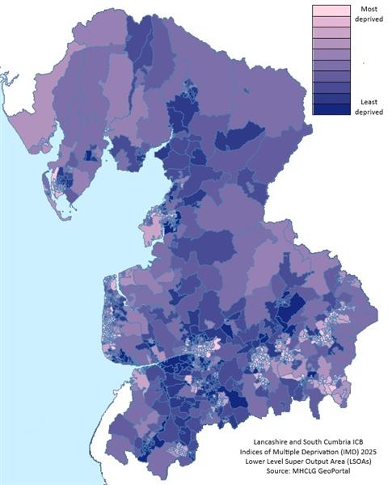
Index of Multiple Deprivation in Lancashire and South Cumbria
The Index of Multiple Deprivation (IMD) is an official measure of how relatively deprived different neighbourhoods are across England. It combines a range of factors: income levels, employment opportunities, health outcomes, education, crime rates, housing, and the living environment. Using these, each small area is given a score and rank from most deprived to least deprived. This means that the IMD score highlights which places face the greatest disadvantages (for example, lower incomes or poorer health) compared to others. The latest data was produced in 2025 and replaces the 2019 scores.
Lancashire and South Cumbria’s latest IMD 2025 data shows many areas remain highly deprived. Blackpool in particular stands out as remaining the most disadvantaged Local Authority in the country, with 7 of England’s 10 most deprived neighbourhoods located within it. This is only a slight improvement from 2019, when even more of the worst-ranked areas were in Blackpool.
Overall, almost one in three residents of Lancashire and South Cumbria lives in a neighbourhood that is among the most deprived 20% nationally. The broad picture is similar to the IMD 2019 findings. The same communities have the heaviest deprivation, with only minor shifts in relative rankings over time. This indicates that long-standing inequalities persist in our region, underlining the ongoing need to focus support on those most disadvantaged areas.
Throughout these slides, where “deprivation” or “disadvantaged” is used as descriptors, the IMD findings are what is being referred to, although it is not always possible to show whether 2019 or 2026 findings are being used.

Slide 6
Population Health Needs Assessment
In 2025, the ICB conducted a Population Health Needs Assessment for the full population of Lancashire and South Cumbria. It highlighted the diversity of our population, as well as the variety in health and poverty across the area. It also noted the vulnerable groups within the population, and the health needs and outcomes service wide. The results were used in the long-term planning for the ICB and will continue to inform how services are planned, with health inequalities considered throughout the process. Main findings regarding inequalities in health across the population included:
Long term conditions
  Many long-term conditions are more common in Lancashire and South Cumbria than across England, including hypertension at 16.7% compared with 14.8% nationally, COPD at 2.4% compared with 1.9%, and depression at 16.7% compared with 13.3%. Inequalities are particularly clear after adjusting for age, with depression and multimorbidity more than twice as high in the most deprived decile compared with the least deprived.
Risk factors
  The PHNA shows higher local levels of key risk factors that contribute to avoidable illness and mortality. Smoking prevalence is above the England average and higher in more deprived areas, while tobacco, alcohol, high blood pressure, high BMI and dietary risks are identified as important contributors to avoidable deaths.
Mortality
  Mortality is consistently higher in more deprived communities. In 2024, all-cause mortality was more than twice as high in the most deprived quintile compared with the least deprived, and COPD mortality was around five times higher.
Engagement work highlights
  Local engagement found that people in disadvantaged communities often face practical barriers to care, including poor transport, digital exclusion, low awareness of the full NHS and social care offer, and difficulty navigating complex services. This points to the need for services that are easier to access, better joined up and designed around local community need.
The full Population Health Needs Assessment can be accessed here.

Slide 7
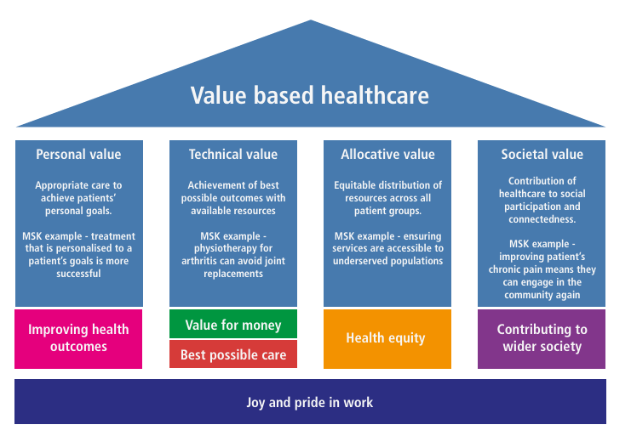
Our work
The role of Integrated Care Boards (ICBs) is to reshape the way health care is organised and delivered to prioritise the prevention of ill health, reduce unwarranted variation in outcomes and expand service provision across our communities, neighbourhoods and in our case, the Lancashire and South Cumbria footprint.
Lancashire and South Cumbria Integrated Care Board is committed to improving population health and reducing health inequalities. The ICB’s Five Year Strategic Commissioning Plan provides a medium-term strategic framework that connects national planning requirements with local delivery, articulating our ambitions and setting clear priorities for improving population health outcomes, reducing inequalities, and securing high-quality, sustainable services for the people of Lancashire and South Cumbria.
The plan has been developed in line with the priorities set out in NHS England’s Fit for the Future:10 Year Health Plan for England which signals a fundamental shift in how health and care services are planned, commissioned, and delivered. Central to this national direction are three major shifts: moving care closer to home, accelerating digital transformation, and re-orientating the system towards prevention and earlier intervention.
Value‑based healthcare sits alongside this approach. The focus is on improving outcomes for patients while using resources in the most effective way. In practice, this means directing effort towards the areas and groups with the greatest need, and making sure services deliver real benefit. This supports the wider aim of reducing variation and improving fairness across the system.
The ICB will take a strategic approach to commissioning, setting clear shared priorities and aligning resources to support them. This is intended to bring services together in a more joined‑up way, with a consistent focus on improving outcomes and reducing inequalities.
Partnership working is key. The ICB will work closely with NHS providers, local authorities, and the voluntary, community, faith and social enterprise sector. This reflects the need to address not just healthcare, but the wider factors that influence health and wellbeing.

Slide 8
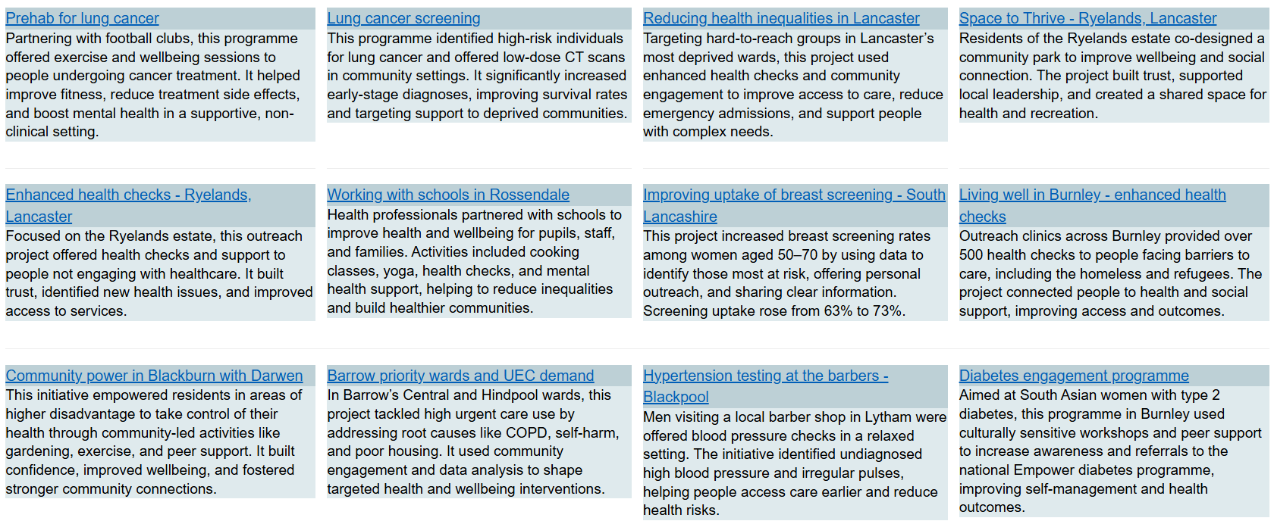
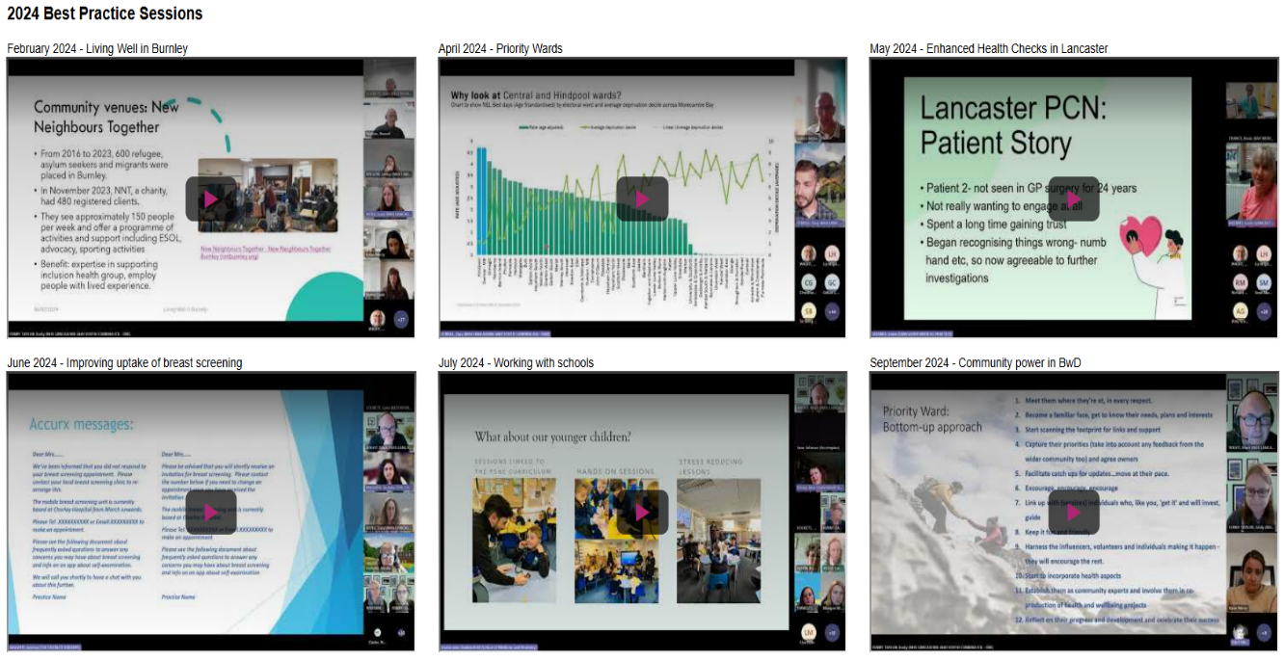
This report focuses primarily on quantitative data; however, data alone cannot explain the full picture of health inequalities. While metrics help identify where inequalities exist and which population groups are most affected, they do not explain the underlying causes or the barriers that people experience in accessing services and achieving good health outcomes.
Reducing health inequalities requires a broader population health approach that combines data and evidence with a deep understanding of lived experience. This involves working collaboratively with local communities and with voluntary, community, faith and social enterprise (VCFSE) organisations to understand the factors driving inequality, listen to community insight, and co-design solutions that reflect local needs and circumstances.
The following slides provide examples of this approach in practice. Additional case studies and examples of learning can be found through the recorded presentations here and best practice sessions available here.

Slide 9
Life Expectancy and Healthy Life Expectancy
Life expectancy and healthy life expectancy are summary measures of the health of a population. They reflect the cumulative impact of economic, social, environmental and healthcare factors throughout a person's life and are widely used to assess health inequalities. Healthy life expectancy is particularly important as it measures not only how long people live, but how long they can expect to live in good health, providing a key indicator of whether gains in longevity are being translated into improved wellbeing and quality of life.
As long-term outcome measures, they are not expected to change rapidly and therefore provide an important indicator of whether sustained action to improve health and reduce inequalities is having a lasting impact on communities.

Slide 10
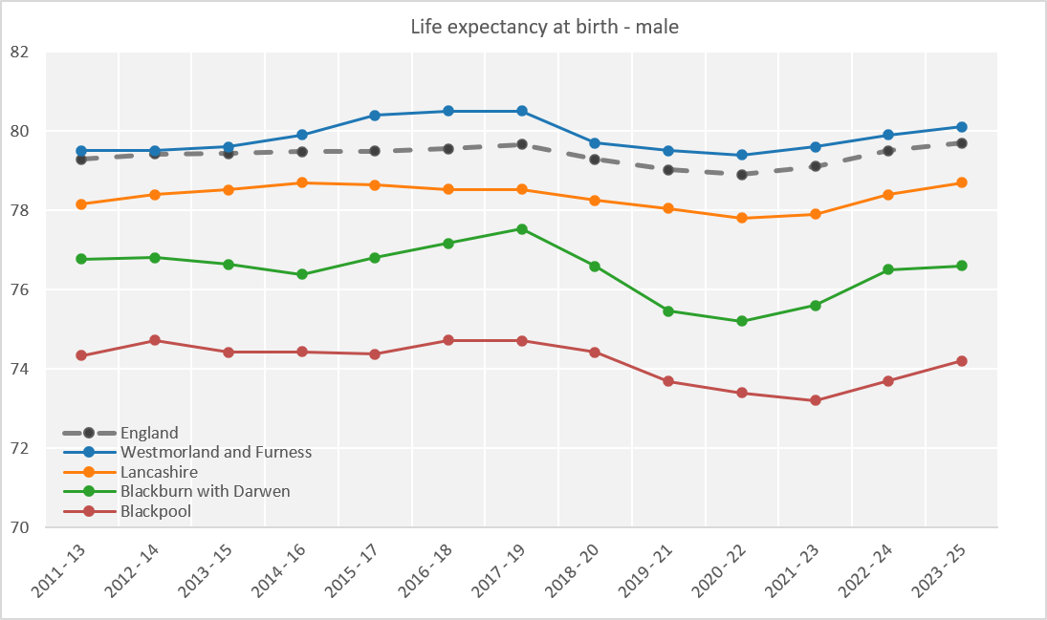
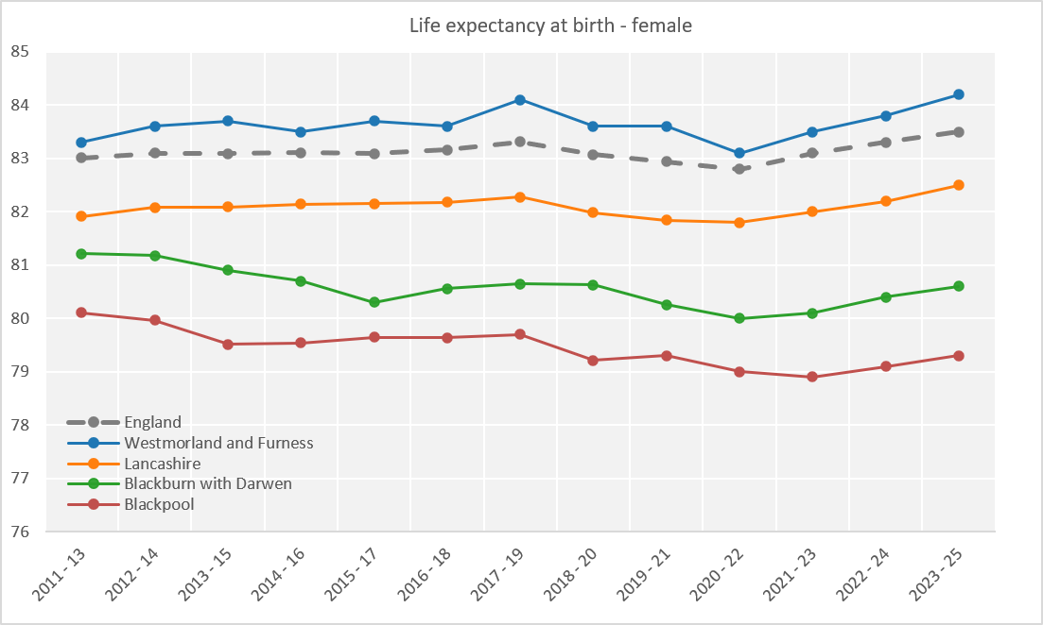
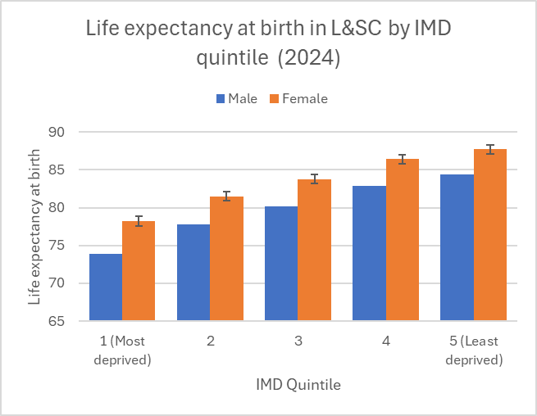
Life expectancy
Life expectancy for males and females in L&SC, by deprivation
Life expectancy for men and women is lower than the England average in Lancashire, Blackburn with Darwen and Blackpool, and slightly above average in Westmorland and Furness. From 2019 to 2022, both the ICB and England experienced a marked drop in life expectancy, reflecting the impact of the COVID-19 pandemic, with only partial recovery by 2025. The gap between local and national life expectancy persisted throughout, and the well-established female advantage in life expectancy remained evident. This pattern highlights both the acute effects of the pandemic and the enduring structural drivers of lower life expectancy in the region, such as deprivation and chronic disease burden.

Slide 11
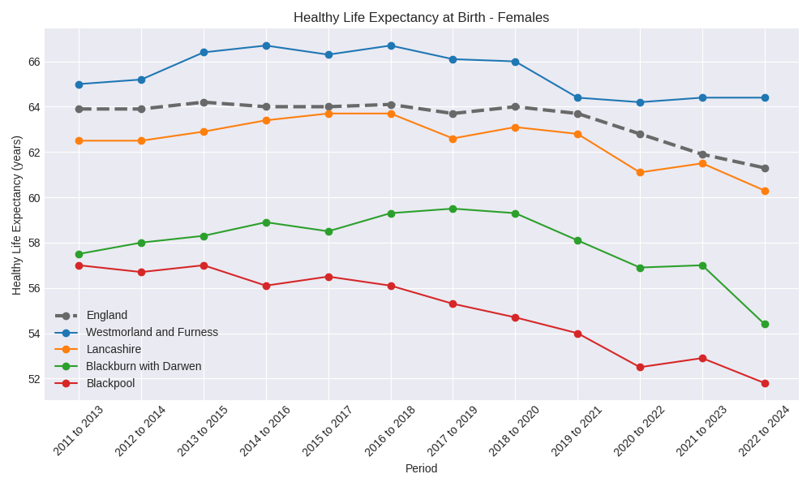
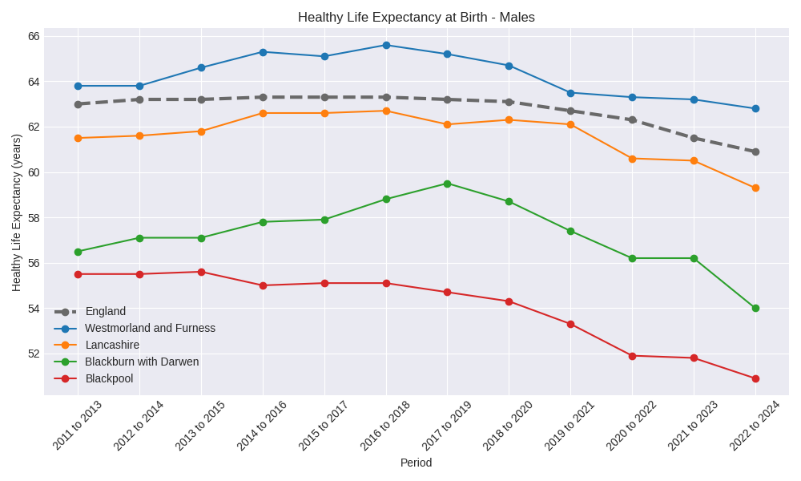
Healthy Life expectancy
Healthy life expectancy is the average number of years a person can expect to live in good health, based on current mortality rates and the proportion of people who report being in good health. It estimates not just how long people live, but how long they live free from significant ill health or disability.
Healthy life expectancy has dropped in all local authorities across Lancashire and South Cumbria in the last 10 years. Since 2021-23, the England-wide pattern of reduction in HLE is evident in all the local authorities in L&SC other than Westmorland & Furness*. Blackburn with Darwen had the biggest decrease in HLE for both men and women.
*It should be noted that L&SC only covers part of Westmorland & Furness, and so this data may not be representative of the ICB’s population in that region. There are also some elements of L&SC ICB population who reside in Cumberland and Noth Yorkshire Local Authorities.

Slide 12
Cancer
Cancer is a major contributor to premature mortality and health inequalities and is one of the five national clinical priorities within the NHS Core20PLUS5 approach to reducing healthcare inequalities. It has been identified as a priority because significant improvements in outcomes can be achieved through earlier diagnosis, particularly for people living in the most deprived communities and other underserved groups who are more likely to experience later-stage diagnosis and poorer survival.

Slide 13
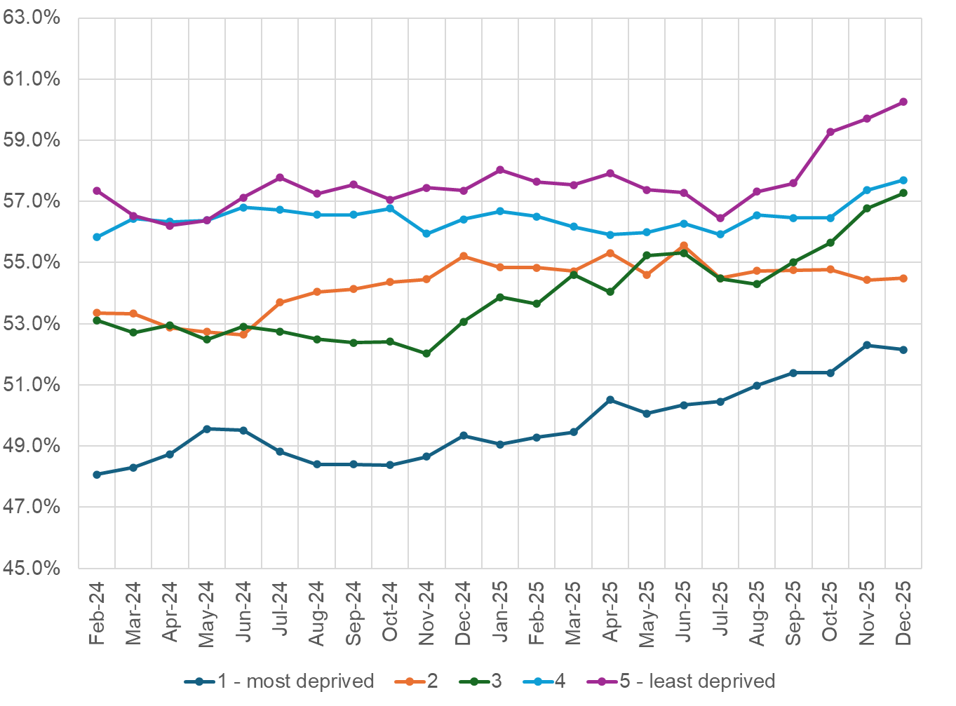
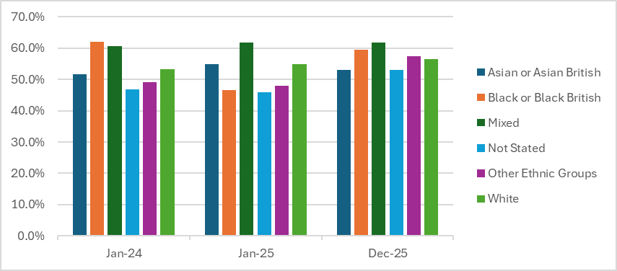
Inequalities in early diagnosis of cancer
Early Stage (1&2) Cancer Diagnoses, by Index of Multiple Deprivation (rolling 12 months data)
Early Stage (1&2) Cancer Diagnoses, by Ethnicity Group (rolling 12 months data)
Between March 2025 and March 2026, the proportion of cancers diagnosed at an early stage increased from 53.6% to 56.3%, which was the biggest increase in England for the time period. However, there are inequalities in the proportion of cancers diagnosed at an early stage, with people living in more deprived areas less likely to be diagnosed at an early stage compared with those living in less deprived areas. There was an increase in the gap in October to December 2025, due to early diagnosis rates rising in the least deprived but levelling off in the most deprived. Caution is needed in interpreting this as a real worsening of inequalities, and the ICB will continue to monitor the data to understand if this represents a true worsening or short-term variation only.
Differences are also visible between ethnic groups, with some groups consistently having a higher proportion of cancers diagnosed at stage 1 or 2 than others. White groups tend to have higher levels of early diagnosis, while Asian or Asian British and some other ethnic groups show lower levels. Although there is a gap between ethnic groups, these differences have reduced since January 2024, suggesting an improvement in equality of early diagnosis between ethnicities.

Slide 14

Inequalities in early diagnosis of cancer
Work to improve the early diagnosis of cancer throughout the year has included the implementation of recommendations from lung, pancreatic and prostate cancer learning event analyses, with a health inequalities lens applied throughout. This has included continued rollout of the pancreatic cancer toolkit, development and launch of safety‑netting resources, and pathway review work with primary and secondary care to support earlier access to diagnostics. Education activity has been delivered to primary care and partner organisations, including cancer‑specific webinars and training linked to safety‑netting and awareness, with further sessions planned.
Targeted system interventions have also been implemented to support earlier diagnosis in communities experiencing the poorest outcomes. This includes piloting Early Diagnosis Cancer Navigator roles in PCNs with the lowest screening and referral rates and highest levels of deprivation, alongside the Early Diagnosis Education Facilitator role to build cancer capability in primary care. Community‑focused work has continued through the cancer awareness champions programme and the Cancer Awareness Small Grants Scheme, supporting local engagement activity to raise awareness, improve screening uptake and encourage timely presentation, particularly within Core20Plus populations.
There was specific investment in Blackpool to investigate people's understanding of the signs and symptoms of cancer, when to seek support, and views on screening programmes. The report arising from this engagement work then informed the Magpie campaign. Recommendations from this report also prompted a pilot from one Primary Care Network to provide outreach information and drop-in sessions for people to talk about cancer concerns, with access to ringfenced suspected cancer primary care appointments. In addition, the report identified some concerns and lack of understanding around the HPV vaccine. As a result of this, communications materials aimed at Year 8 pupils and their families / carers have been co-produced by Public Health colleagues with young people.
The Cancer Alliance commissioned Magpie, a behavioural science marketing agency, to co-produce two cancer awareness campaigns designed to address health inequalities. Through “Talk. Check. Act on Cancer” and the targeted digital campaign “Check It, Don’t Chance It ”– aimed at people living in IMD 1 and 2 communities we are increasing awareness of cancer symptoms and encouraging prompt action to support early diagnosis. Into 26/27 we intend to build on these campaigns as part of our early diagnosis strategy.

Slide 15
Cardiovascular disease
Cardiovascular disease (CVD) remains one of the leading causes of premature mortality, disability and health inequality, with a substantial proportion of cases attributable to preventable risk factors. National evidence demonstrates significant variation in cardiovascular outcomes by deprivation, ethnicity, geography and wider social determinants of health, with people living in the most deprived communities experiencing a disproportionate burden of disease. The metrics presented in slides 16-19 examine key indicators across the cardiovascular disease pathway, including prevalence, risk factor management, emergency events and outcomes. Together, these measures provide insight into inequalities in both the prevention and management of cardiovascular disease, helping to identify opportunities to improve outcomes and reduce avoidable variation across Lancashire and South Cumbria.

Slide 16
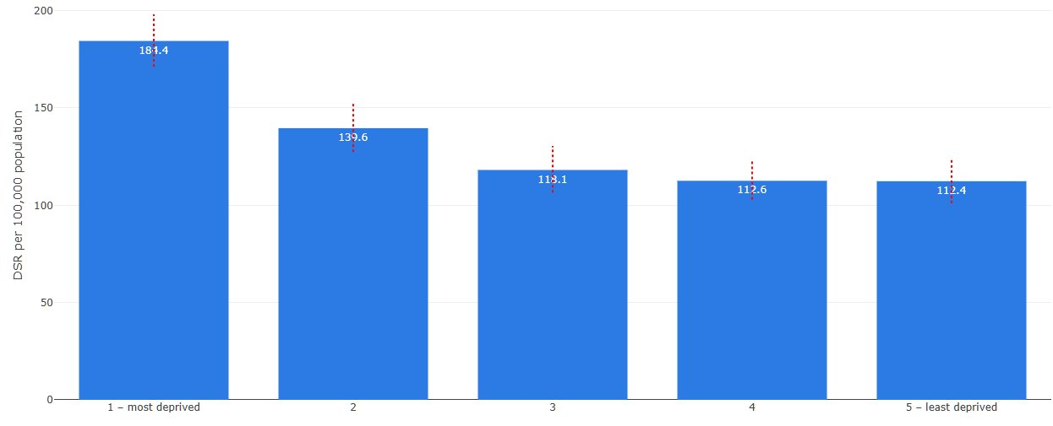
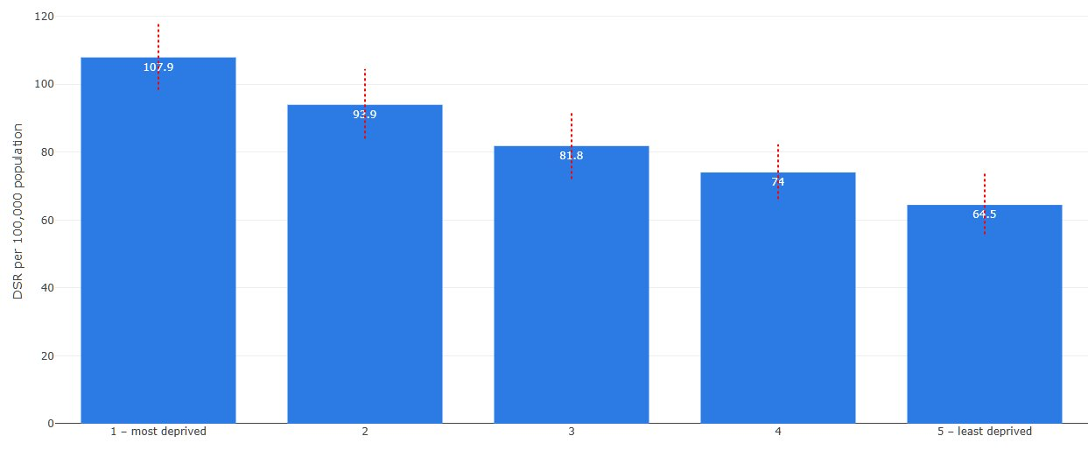
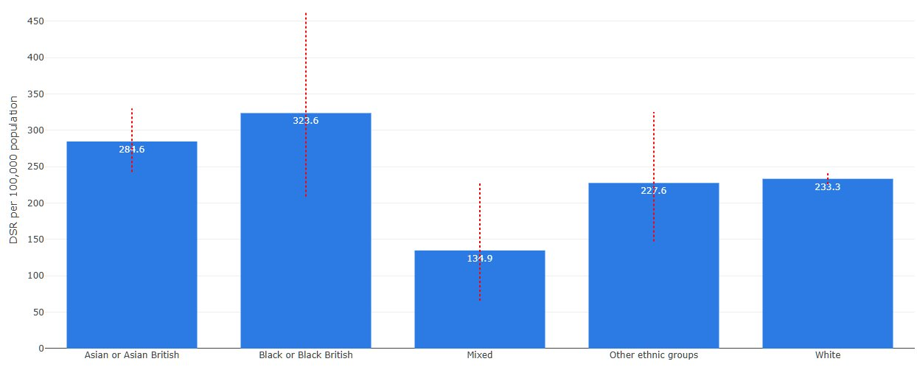
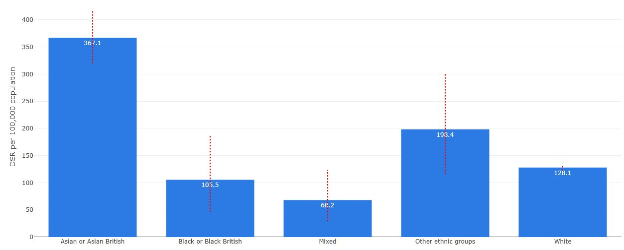
Inequalities in emergency admissions for stroke and myocardial infarction
Emergency admissions for stroke and myocardial infarction (heart attack) are among the most important outcome measures for cardiovascular disease (CVD) because they represent serious events that are often preventable through effective prevention, risk factor management and early intervention.
Emergency admissions for stroke by IMD and by ethnicity
Emergency admissions for myocardial infarction by IMD and by ethnicity
The rates of emergency admissions for stroke are highest in the most deprived areas and lowest in the least deprived, creating a strong social gradient. Admissions also vary between ethnic groups, with Black or Black British and Asian or Asian British having higher rates than White and other ethnic groups.
Emergency admissions for myocardial infarction are highest in the most deprived communities and fall steadily as deprivation decreases. There are also marked differences between ethnic groups, with Asian or Asian British groups showing the highest rates and Mixed groups the lowest.
Notes:
Add text from JW and rearrange

Slide 17
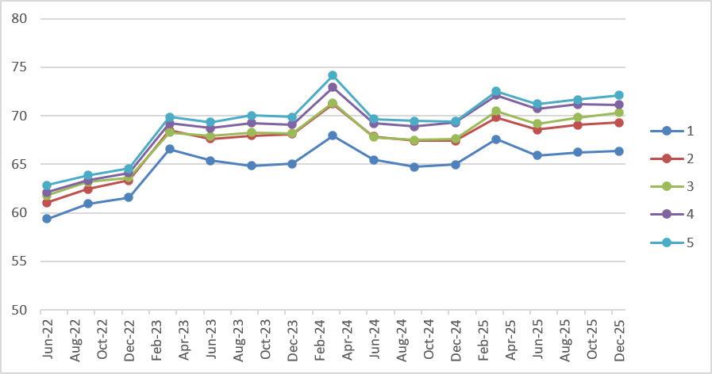
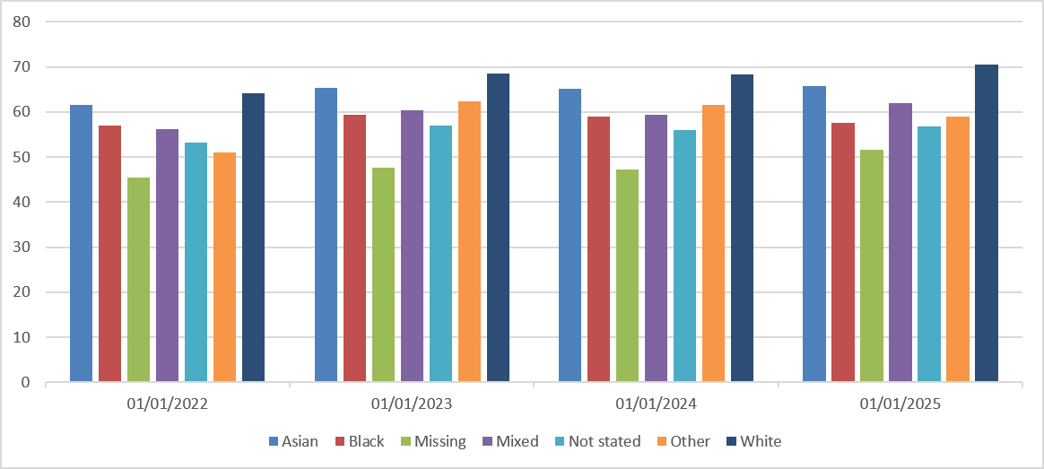
Inequalities in percentage of hypertension patients treated to target
Percentage of hypertension patients treated to target by IMD quintile
The proportion of people living in the most deprived areas who have hypertension treated to target is slightly lower than those in the least deprived areas. Similarly, treatment to target percentages are lower in people from Asian, Black, Mixed and Other backgrounds compared with people from White ethnic groups..
Over the past year, our work to improve hypertension treatment to target has included:-
Detailed monitoring of PCN-level data to keep all PCNs informed of data in their practices
Targeted work to help address areas with greatest inequalities
Sharing resources with primary care, pharmacies, VCFSE sector partners etc such as leaflets , tools etc
PCN‑level deep dives into records and data have been an effective way of improving treatment to target in parts of Lancashire and South Cumbria. Working with those PCN’s has demonstrated some significant improvements for example Millom PCN moving from around 49% to 67.8% treatment-to-traget for hypertension following targeted support, and planned roadshows and outreach in East Lancashire to address ongoing variation.
Other place‑based work focusing on areas of greatest unwarranted variation has included community‑based blood pressure case‑finding pilots, including optometry and barber‑shop models in more deprived communities, alongside work with VCFSE partners through HARRI bus roadshows. These approaches aim to reach people less likely to engage with traditional services and reduce unwarranted variation in hypertension outcomes, while ongoing use of hypertension dashboards in primary care supports continued monitoring and improvement.
Our work to improve detection of hypertension remains critical as more people in our most disadvantaged communities are likely to have undetected hypertension.
Percentage of hypertension patients treated to target by ethnicity

Slide 18
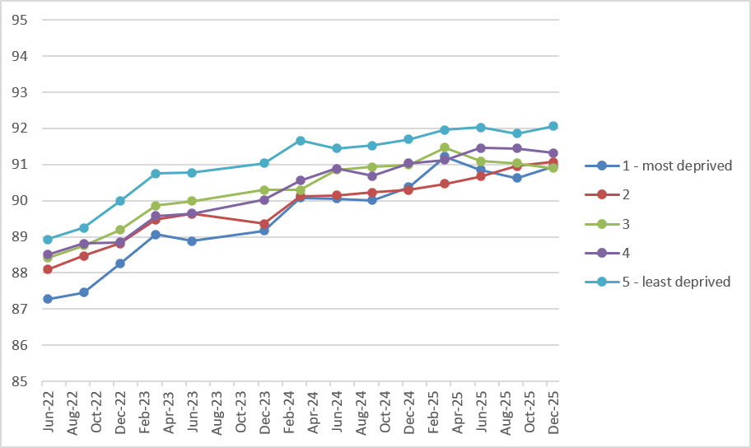
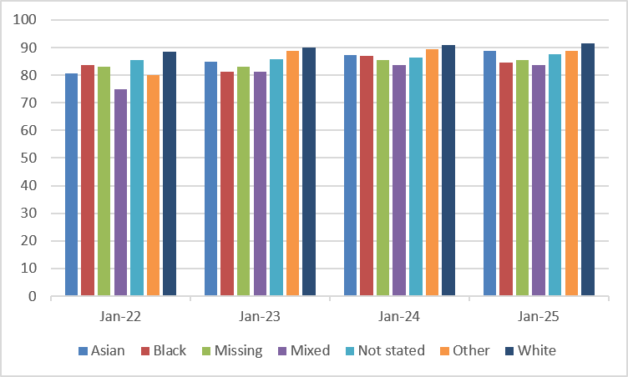
Inequalities in percentage of patients who are managed to target for atrial fibrillation
Percentage of atrial fibrillation patients treated to target, by IMD quintile
Overall, people with atrial fibrillation are managed relatively well across LSC, although there is a small but consistent inequality linked to deprivation and ethnicity.
Deprivation-related differences in atrial fibrillation management are minimal, though people in the least disadvantaged groups are managed modestly better than those in the most disadvantaged areas.
White groups have higher proportions of people with atrial fibrillation managed to target compared with several other ethnic groups, while Mixed and Black or Black British groups have lower levels. Asian groups and those with ethnicity recorded as Other or Not stated sit between these.
For atrial fibrillation treatment to target, work has primarily been through broader cardiovascular disease optimisation activity, with a focus on anticoagulation and reducing unwarranted variation.
Actions have included:-
Medicines optimisation activity, including promotion of pharmacy services such as the New Medicine Service and Discharge Medicines Service, is intended to support safer and more effective management of atrial fibrillation alongside hypertension and cholesterol work.
From an inequality perspective, activity has focused on identifying and prioritising outlier places and populations. Further activity is expected to continue into 2026/27.
Percentage of atrial fibrillation patients treated to target, by ethnicity
Notes:
NOTE – add disclaimer re axis labels
Add graph labels

Slide 19
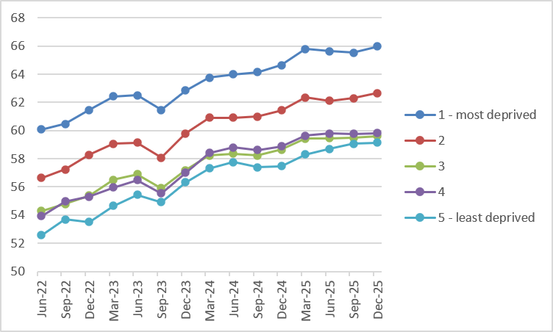
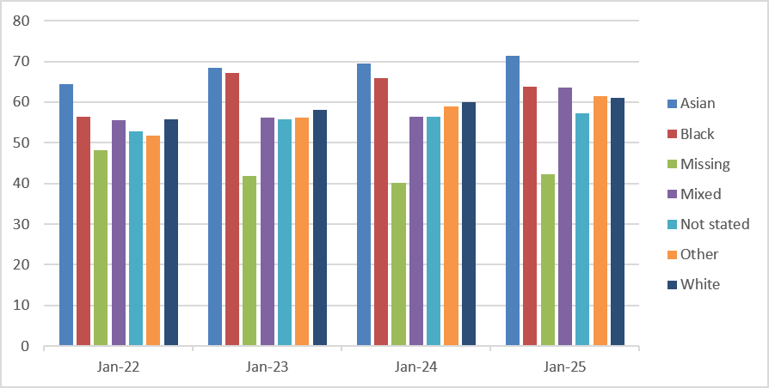
Inequalities in percentage of patients who are managed to target for cholesterol
Percentage of patients with high cholesterol treated to target, by IMD quintile
There are some differences in the proportion of people who are managed to target for cholesterol by level of deprivation. A higher percentage of people living in the most deprived areas have cholesterol managed to target than those living in less deprived areas, with the proportion gradually decreasing across deprivation quintiles and lowest in the least deprived areas.
Differences are also evident between ethnic groups. Asian groups have the highest proportions of people managed to target for cholesterol, while people with missing ethnicity have the lowest levels. White, Black, Mixed and Other ethnic groups sit between these extremes.
Action to improve cholesterol management to target has focused on embedding consistent clinical guidance, education and data‑driven support across primary care, with evolving attention to variation and inequality. Actions include:-
Secondary prevention lipid guidelines have been developed and promoted through GP communications, alongside ongoing delivery of lipid learning sessions to strengthen clinical confidence and consistency of practice.
Progress has also been made in expanding laboratory reporting pilots across trusts, with early feedback suggesting a positive impact on identification and management, although system and resource constraints have delayed full rollout.
A dashboard to support cholesterol management is established in primary care, helping practices track performance and improvement opportunities.
Percentage of patients with high cholesterol treated to target by ethnicity
Notes:
Add graph labels

Slide 20
People with a learning disability or autism
People with a learning disability and autistic people experience some of the widest and most persistent health inequalities in the population. National evidence shows poorer physical and mental health outcomes, lower life expectancy, greater barriers to accessing healthcare, and a higher risk of avoidable illness and premature mortality. The metrics presented in slides 21 and 22 examine key indicators of health and care quality for people with a learning disability and autistic people, including access to annual health checks, uptake of preventative interventions, and measures relating to hospital admissions and quality of care. Understanding performance across these indicators is essential to identifying unwarranted variation, improving outcomes and ensuring that services are equitable, accessible and responsive to the needs of these populations

Slide 21
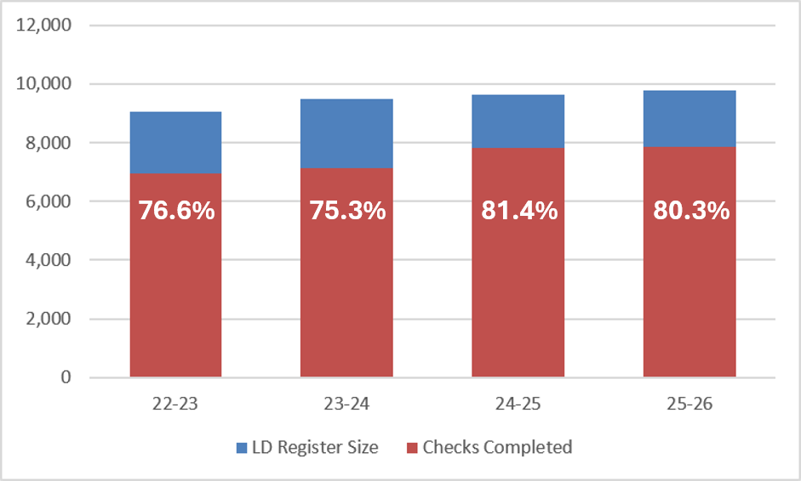
Learning disability and autism
Annual health checks
Local data suggests that the rates of annual health checks complete have been slightly lower in 2025-26 than the previous year. Please note the disclaimer below regarding this data*.
Throughout the year, there have been a range of targeted interventions aimed at improving the percentage of patients with learning disability who have had the annual health check. This includes the rollout of digital tools to support information sharing between clinicians, and the development of accessible dashboards to enable better use of health action plans and patient information. In addition, targeted programmes have been implemented to address specific barriers to uptake, such as the introduction of alternative phlebotomy approaches to support individuals with needle phobia and improve access to routine screening and monitoring.
There is continued focus on increasing awareness and identification of individuals on learning disability registers, alongside engagement activity with communities to improve understanding and access to services. Learning Disability Champions in GP practices continue to work well and pilots in other organisations, such as a Hospice are ongoing.
Increasing uptake of screening, including breast, bowel cancer and AAA screening has been a focus, with work ongoing and learning being shared with clinicians to improve uptake.
Workshops and training for GPs and other clinicians has been well received.
Delivery remains dependent on securing ongoing funding and maintaining programme capacity, with risks identified where this may limit future access to tools and interventions that support annual health checks.
Number and percentage of patients aged 14+ on GP learning disability registers who have had an annual health check
76.6%
75.3%
81.4%
80.3%
*Please note:
There are some problems with the national data for this metric, where not all checks are being included. For more detail, see the NHS Digital statement here: [Learning Disabilities Health Check Scheme - NHS England Digital
Local data has been used for this slide but there may be a slight lag in this being recorded and so it may not be completely accurate.

Slide 22
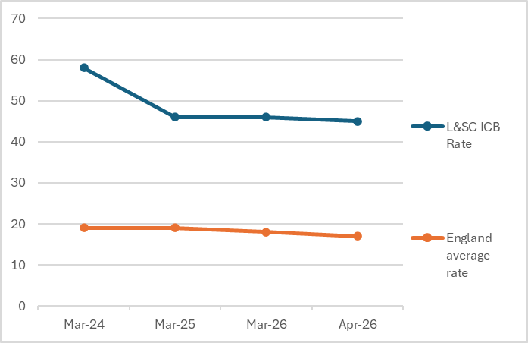
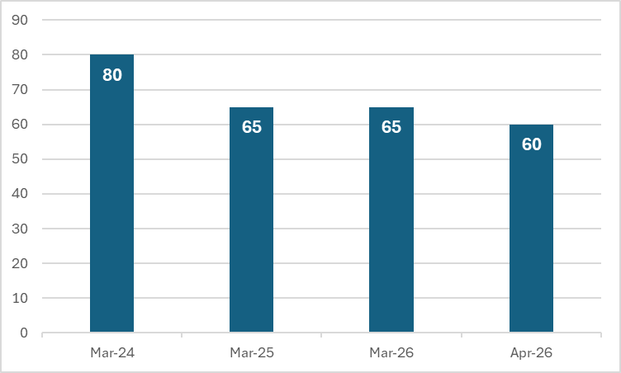
People with learning disability and autism in mental health inpatient settings
Data on people with a learning disability and autistic people in mental health inpatient settings provides an important measure of health inequalities and system performance. Nationally, reducing unnecessary inpatient admissions and supporting people to live well in their communities has been a longstanding NHS priority. Monitoring these metrics helps assess whether people are receiving appropriate, person-centred care close to home and identifies where further action may be needed to reduce inequalities and improve outcomes.
Rate per 100,000 of people in a mental health inpatient setting who have a learning disability or are autistic, in L&SC and England
Number of people in a mental health inpatient setting who have a learning disability or are autistic
The local rate of people with a learning disability or who are autistic in mental health inpatient settings is consistently higher than the England average across the whole period, despite improvement in the local number and rate compared to the England average.

Slide 23
Maternity
Maternity services are a key area for reducing health inequalities and improving outcomes. National evidence consistently shows significant variation in maternity outcomes by deprivation, ethnicity, age, geography and other inclusion health factors. The legal statement metrics presented in slides 24-26 examine inequalities across key maternity indicators, including access to antenatal care, smoking at the time of delivery, breastfeeding, and maternal and neonatal outcomes. Understanding these differences is essential for identifying where outcomes are poorest, targeting improvement activity, and ensuring that all women and babies have equitable opportunities for a healthy start in life.

Slide 24
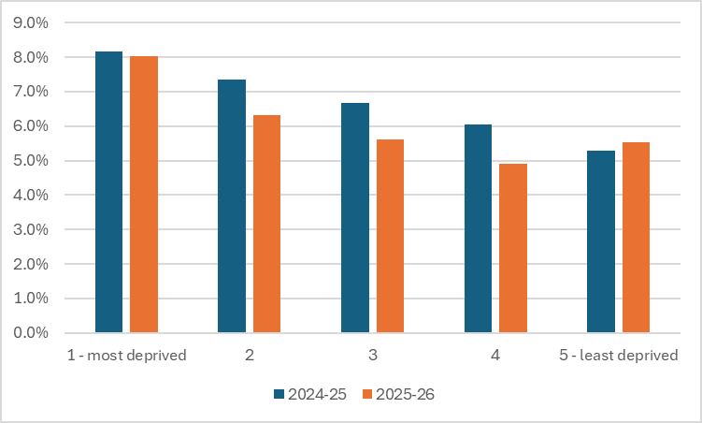
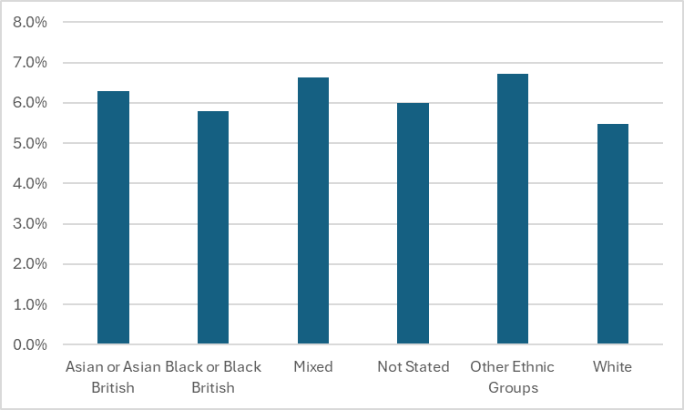
Inequalities in preterm births (under 37 weeks)
% of pre-term births in 2024-25 and 2025-26
% of Pre-Term Births, <37 weeks, by Ethnicity Group
Overall, compared to the previous year, there was a small decrease in the percentage of pre-term births (before 37 weeks), from 6.7% to 6.1%. The pattern from previous data of higher pre-term birth rate in more deprived groups continued this year, and there was a smaller year-on-year improvement in pre-term birth rates for the most deprived group compared to the middle IMD groups. There was a small increase in the pre-term birth rates in the least disadvantaged group, although the rates were still lower than in the most disadvantaged. There was minimal difference between ethnicity groups for this measure. Comparison with previous years is not possible due to low numbers of ethnicity recording points of data previously.
The ICB has focused on reducing risk factors linked to preterm birth by strengthening referral pathways for gestational diabetes, improving communication between maternity and primary care, and expanding prevention support. Work has included increasing access to smoking cessation support, vaccinations, enhanced midwifery continuity of carer (EMCoC) and genetic risk services, alongside widening community engagement and using data to target areas of greatest need. Progress continues, although some timelines have been adjusted due to workforce pressures.

Slide 25
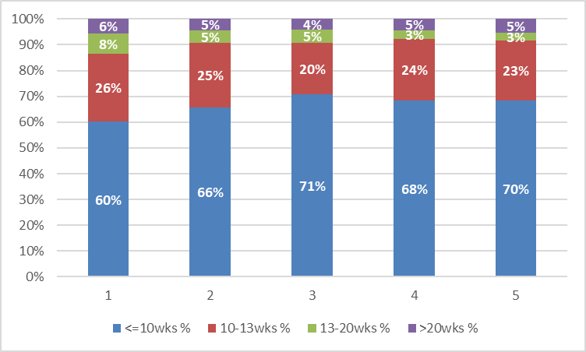
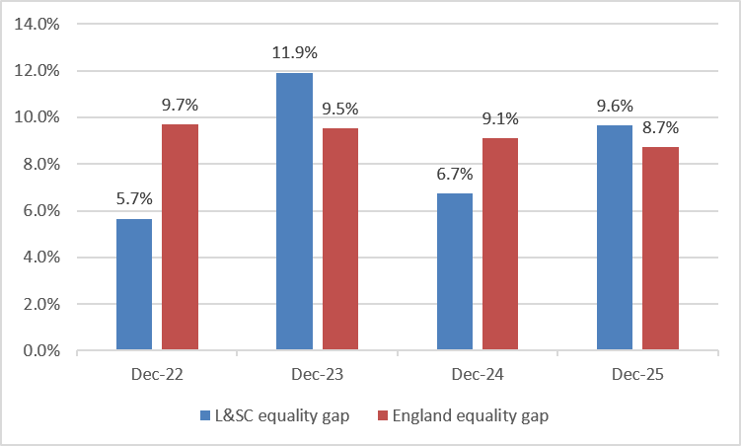
Inequalities in gestational age at booking
Gestational age at booking by IMD in L&SC in December 2025
Gap between most and least deprived quartiles for gestational age at booking
IMD Quintile
NICE guidance recommends that wherever possible, pregnant women should attend their first antenatal appointment by 10 weeks of pregnancy. This enables early identification of potential risks and ensure that care is planned according to their needs. This is particularly important for women at higher risk of adverse outcomes or with complex social factors.
People living in the least deprived areas are more likely to book their maternity care early in pregnancy, while those in the most deprived areas are less likely to do so. Later booking is more common in the most deprived groups, and this pattern is consistent across all categories. The gap between the most and least deprived groups has changed over time. The gap does not follow a steady pattern and instead goes up and down from year to year. In some years, the local area performs better than the national average, while in other years the gap is similar or wider.

Slide 26
Case studies
Lancashire and South Cumbria Infant Feeding Network
The vision of the Lancashire and South Cumbria Infant Feeding Network is that every pregnant person, new parent, infant and family receives support from maternity, neonatal, health visiting and Family Hub/early help services that are accredited under the UNICEF UK Baby Friendly Initiative (BFI) by April 2027. The network brings together infant feeding leads from maternity, community, local authority and publicly funded peer support services. Members work collaboratively to deliver the Lancashire and South Cumbria Integrated Care Board Infant Feeding Strategy. As part of this work, 25 International Board Certified Lactation Consultants (IBCLCs) have been trained and continue to receive clinical supervision and education. This has created a specialist workforce across Lancashire and South Cumbria, providing expert support for families with more complex infant feeding needs alongside universal services that are working towards BFI accreditation. The network is also involved in projects that work with local communities to improve understanding of infant feeding. This recognises that wider determinants of health influence breastfeeding rates and that improving outcomes requires action beyond implementing BFI accreditation within healthcare services alone. Case Study A mother and baby were referred to the Lancashire Specialist Infant Feeding Team by a Health Visitor. Despite support from a Midwife and Health Visitor, the mother was experiencing significant pain during feeding and felt unable to continue breastfeeding. A specialist infant feeding practitioner provided an initial virtual consultation, followed by a home visit because of the severity of the pain and the mother's emotional distress. The family had recently moved in with maternal grandparents after leaving a domestic abuse situation. Breastfeeding was particularly important to the family for cultural and personal reasons, and there were concerns about both infant feeding and maternal mental wellbeing. Specialist support delivered in the home helped to reduce pain and improve feeding. Although some supplementation with expressed breast milk was required, this was kept to a minimum. The family also attended a specialist infant feeding clinic at their local Family Hub, which operated alongside an NCT peer support group and midwifery clinic. They continued attending the peer support group long after their feeding difficulties had resolved. The mother went on to exclusively breastfeed beyond 18 months. On returning to work, she contacted the practitioner to thank the team, stating that she did not believe they would have achieved their breastfeeding goals without the tailored support provided by the Lancashire Specialist Infant Feeding Team. Case Study A transgender father expecting a second child was identified by mental health services as requiring support with infant feeding. Breastfeeding, which was the term the family chose to use, had not been discussed during their previous pregnancy, but they wished to provide human milk for their new baby. The Infant Feeding Team provided specialist, personalised support to help the family achieve their feeding goals. Support was delivered sensitively, recognising that feeding could potentially trigger feelings of gender dysphoria. The team worked collaboratively with the family, ensuring that feeding plans could be reviewed and adapted if required. This specialist approach enabled the family to make informed choices and feel supported throughout their infant feeding journey, helping them achieve the outcomes they wanted for their child.

Slide 27
Mental health
Mental health inequalities can be seen in differences in access to services, experience of care and health outcomes. In line with NHS England's health inequalities reporting requirements, this section focuses on three key indicators: physical health checks for people with Serious Mental Illness, Mental Health Act detention rates and outcomes from NHS Talking Therapies. These measures provide insight into whether different population groups are accessing care equitably and achieving comparable outcomes.

Slide 28
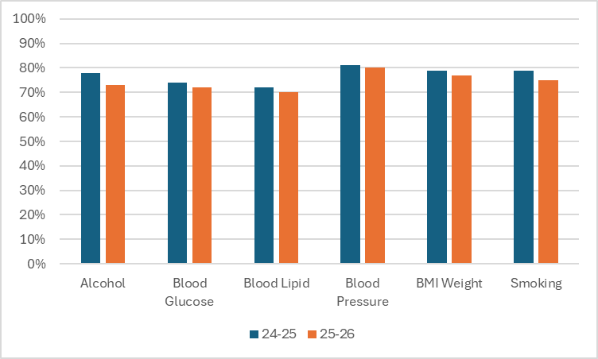
Improving health for people with Serious Mental Illness
Overall number of SMI physical health checks performed in L&SC
Physical health checks for people with serious mental illness (SMI) consist of six checks:
  alcohol consumption status
  blood glucose or HbA1c test (as clinically appropriate)
  blood pressure
  body mass index
  lipid profile
  smoking status.
There was a slight decrease from last year in the percentage of people with SMI who had all six physical health check measures completed, from 63.1% to 60.7%. Overall, the difference was mostly even across the health checks.
The ICB continues work to reduce physical health risks for adults with severe mental illness by strengthening delivery of the annual health checks programme. An outreach service is now in place to target people who have not had a check for several years, alongside activity to improve awareness and uptake. Work is also focused on supporting primary care delivery, improving data sharing between services, and using insights from routine data to direct support where it is most needed, with wider partners contributing through community‑based models.

Slide 29
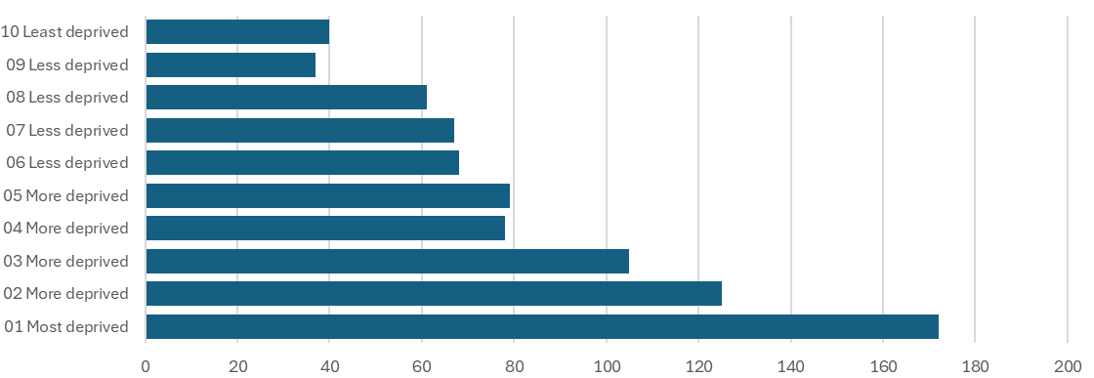
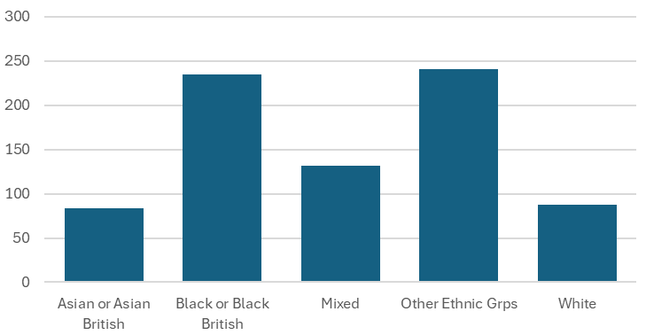
Mental Health Act Detentions
Crude rate of detention in L&SC, by deprivation
Crude rate of detention in L&SC, by ethnicity
Please note
Rates are shown as crude rates, meaning they are not adjusted for differences in the make-up of the population (such as age). This means comparisons between groups should be interpreted with some caution, as part of the variation may reflect population differences as well as differences in underlying need.
This data shows that the rate of detention under the Mental Health Act is higher in more deprived populations. Rates increase as deprivation increases, with the highest rates seen in the most deprived communities. By ethnicity, rates were higher for people who were Black or Black British, and for other ethnic groups. People who were Asian, Asian British and White had similarly low rates compared, with mixed categories being in between.
These findings are consistent with national evidence, which demonstrates persistent inequalities in Mental Health Act detention rates by both deprivation and ethnicity. The patterns seen locally therefore mirror broader national challenges and reinforce the importance of addressing the underlying drivers of mental health inequalities, including deprivation, discrimination, access to services and wider social and economic circumstances.
Notes:
** GS emailed JE 29/04/26 requesting update with latest figures or expansion to IMD / Eth if sources available
Data provided by Julie Eynon: julie.eynon@nhs.net

Slide 30
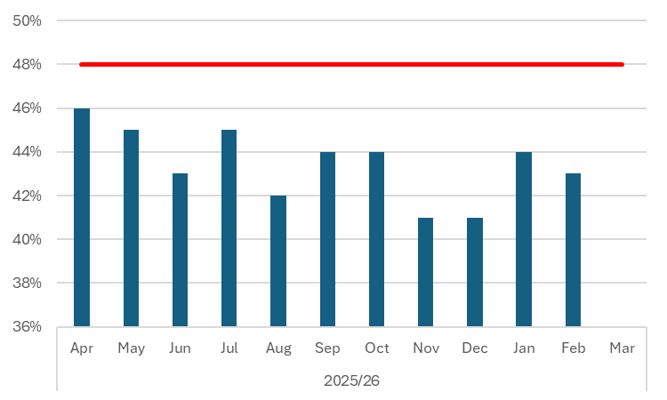
NHS Talking Therapies Reliable Recovery
(Formerly IAPT)
Percentage of patients achieving recovery with NHS Talking Therapies in L&SC
The NHS Talking Therapies team’s work on advancing mental health equalities forms part of NHS England’s commitments to reduce mental health inequalities and builds on the wider Advancing Mental Health Equalities Strategy, which was published in October 2020.
The NHS Talking Therapies programme’s work to advance equalities includes actions to reduce inequalities in access, experience and outcomes for different groups and communities in NHS Talking Therapies services.
Inequalities in access: Different groups access services differently, with underrepresentation in some services and overrepresentation in others.
Inequality in experience: Different groups report having different levels of satisfaction with the healthcare they receive.
Inequality in outcomes: Different groups receiving the same treatment also have different recovery outcomes.
For this measure, recovery refers to whether a patient who had severe symptoms of anxiety and depression has seen improvement in their condition to the point that they are no longer experiencing severe symptoms. The target for this nationally is 48%.
This target was not met through 2025/26 in L&SC, although all months were above 40%, and several close or above 45%.

Slide 31
Children and young people
Giving children and young people the best start in life is one of the most effective ways of reducing health inequalities and improving long-term health outcomes. NHS England’s Core20PLUS5 approach for children and young people identifies a number of priority areas where inequalities can have lifelong consequences, including learning disability, oral health and outcomes in early life. There are difficulties accessing data on the full range of metrics for children and young people. The following slide focuses on oral health.

Slide 32
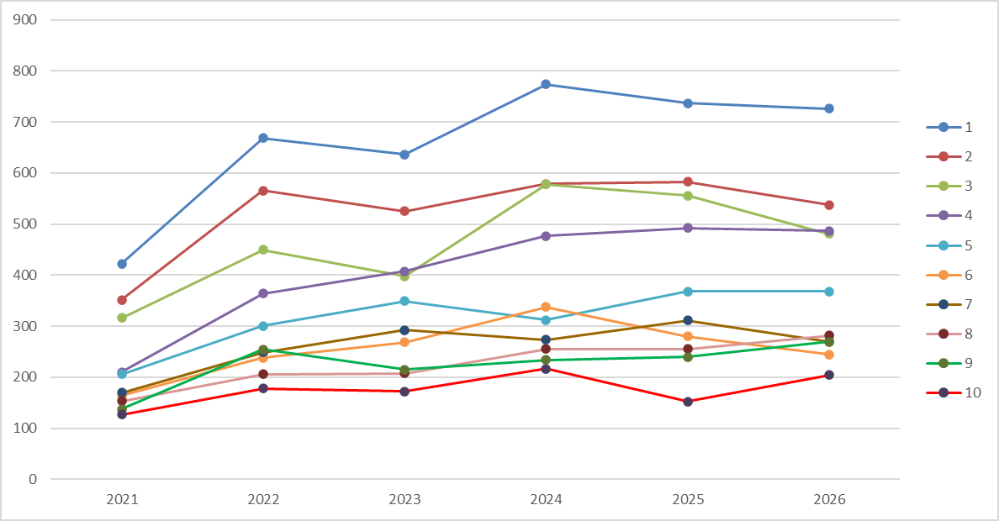
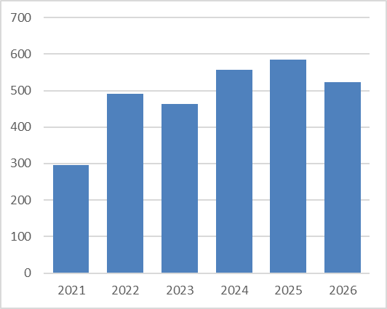
Inequalities in elective admissions of hospital-based tooth extractions for children due to dental caries
Elective admissions of hospital-based tooth extractions due to dental caries in under 18s, crude rates, by IMD.
Gap in elective admissions of hospital-based tooth extractions due to dental caries between most deprived (IMD 1) and least deprived (IMD 10)
Addressing the backlog in tooth extractions for children 10 years old and below is one of the key national priorities to address health inequalities for children, set out in the Children and Young People Core20Plus5 framework. ​In Lancashire and South Cumbria the recovery of waiting lists for dental extraction in children is an ongoing priority, and while this recovery takes place, we would expect to see continuing high levels of admissions for extractions from the most deprived 20% of the population.​
In the past year, the ICB has established an Integrated Access Pathway that prioritises patient groups based on the risk of adverse impact due to their oral health and offer care. Existing pathways for oral health in children and older adults in care homes have also been improved. The dental investment prioritisation framework was refreshed to ensure that any new investment is in the areas of greatest need.

Slide 33
Data quality
High-quality data is essential to understanding and addressing health inequalities. Reliable information on characteristics such as ethnicity, deprivation, disability and other protected or disadvantaged groups enables the NHS to identify variation in access, experience and outcomes, target resources effectively and monitor whether actions are reducing inequalities. Poor or incomplete data can mask unmet need, obscure inequalities and limit our ability to evaluate impact. Improving the completeness and quality of health inequalities data therefore remains a critical foundation for delivering equitable services and meeting NHS England's expectations on reducing healthcare inequalities

Slide 34
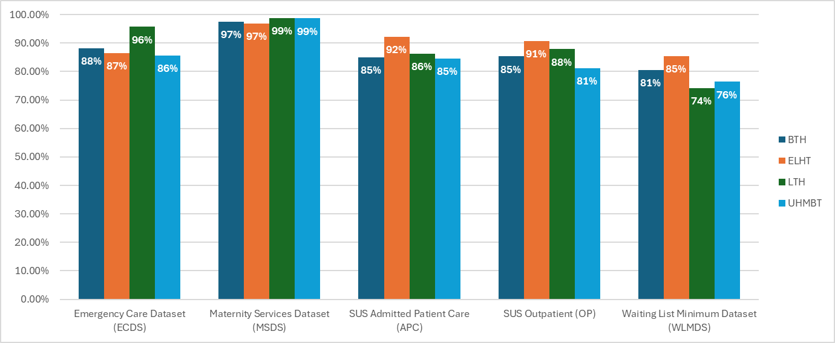
Ethnicity recording completeness
Other datasets
Coding completeness in the Mental Health Services dataset is 82.54%.
The Community Services Dataset has the lowest coding completeness amongst the major national datasets. This dataset is not commonly used with L&SC and there is little incentive to improve coding completeness.
Accurate ethnicity information helps the NHS understand whether different communities experience different health outcomes and access to care. Improving the quality of ethnicity data supports better planning, monitoring of health inequalities and more equitable services.
Across Lancashire and South Cumbria, ethnicity coding levels were broadly stable during 2025/26 compared with the previous year. Some organisations showed improvements, while others experienced small reductions. Ethnicity coding completeness was generally highest in maternity services, where all providers achieved over 95% valid ethnicity recording. Emergency care, admitted patient care and outpatient datasets also showed relatively strong performance, with most providers recording valid ethnicity information for more than four in five patients.
System integration and data sharing could improve coding completeness within provider submitted data. ICB analysis has shown that creation of a single integrated dataset could improve all data submissions for all providers, with the largest increases possible in Community Services Dataset, which could increase from 27.4% to 84.3% if patient ethnicity data was shared across organisations and clinical systems.

Slide 35
Elective care
Elective care is a key health inequalities priority because people living in more disadvantaged communities often experience poorer health, greater healthcare need and unequal access to services. Nationally, NHS England has identified reducing inequalities in access, experience and outcomes as a key priority, recognising that elective recovery should not only reduce waiting lists overall but also narrow unwarranted variation between communities.
Understanding these inequalities is complex and the data should be interpreted with caution. Higher use of elective care in certain populations may reflect greater underlying health need, however it may also reflect ease of access, or levels of health literacy or access to information. Barriers to accessing care can result in unmet need that is not visible in the data.

Slide 36
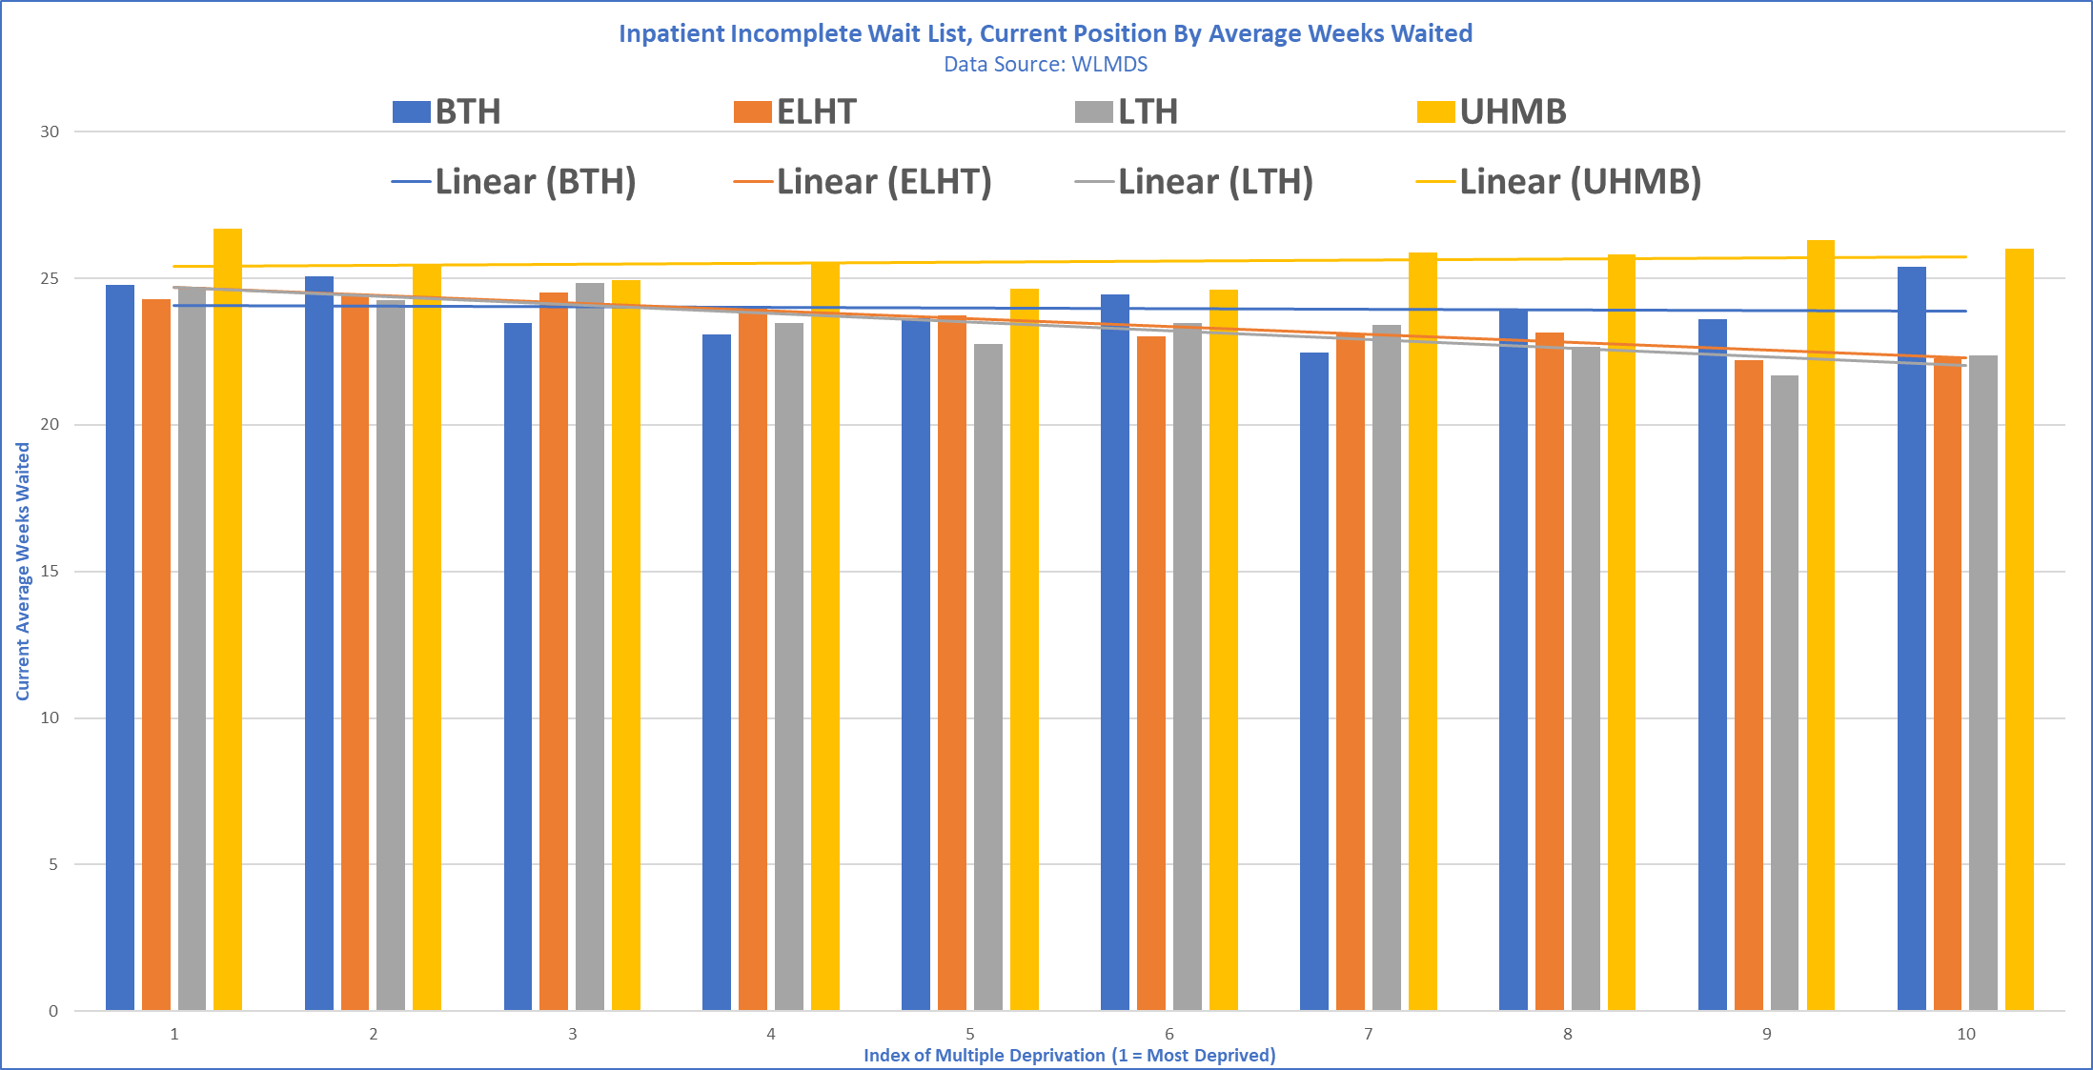
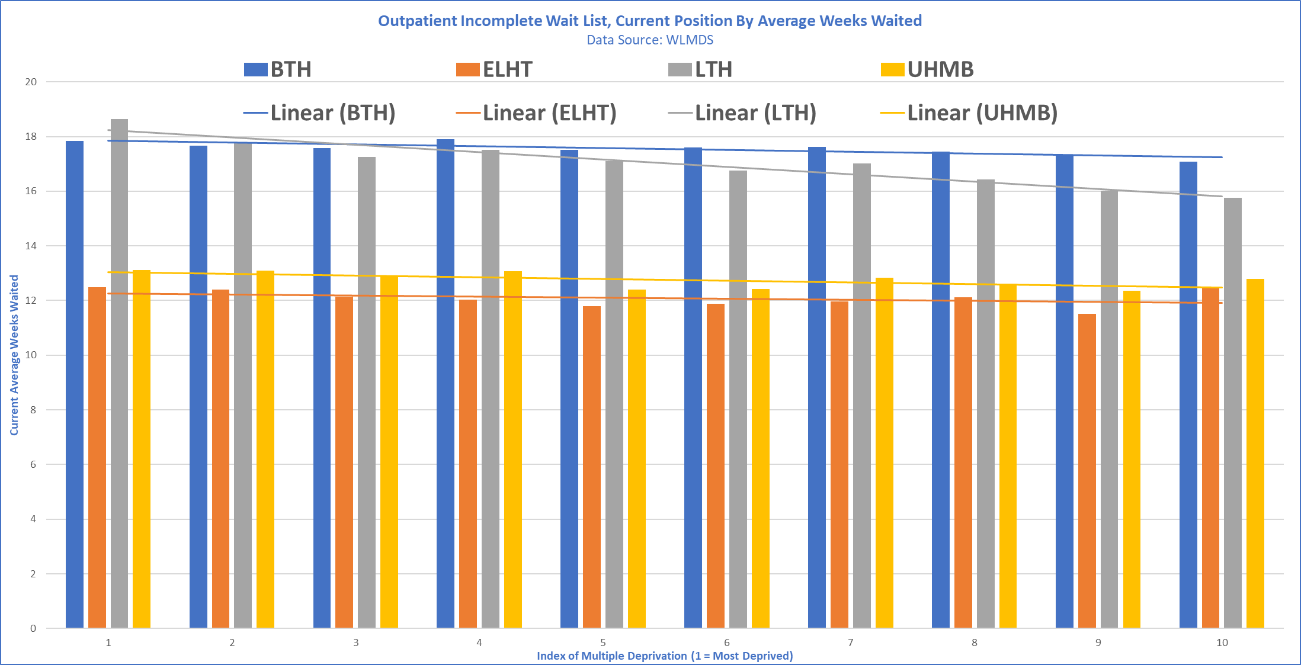
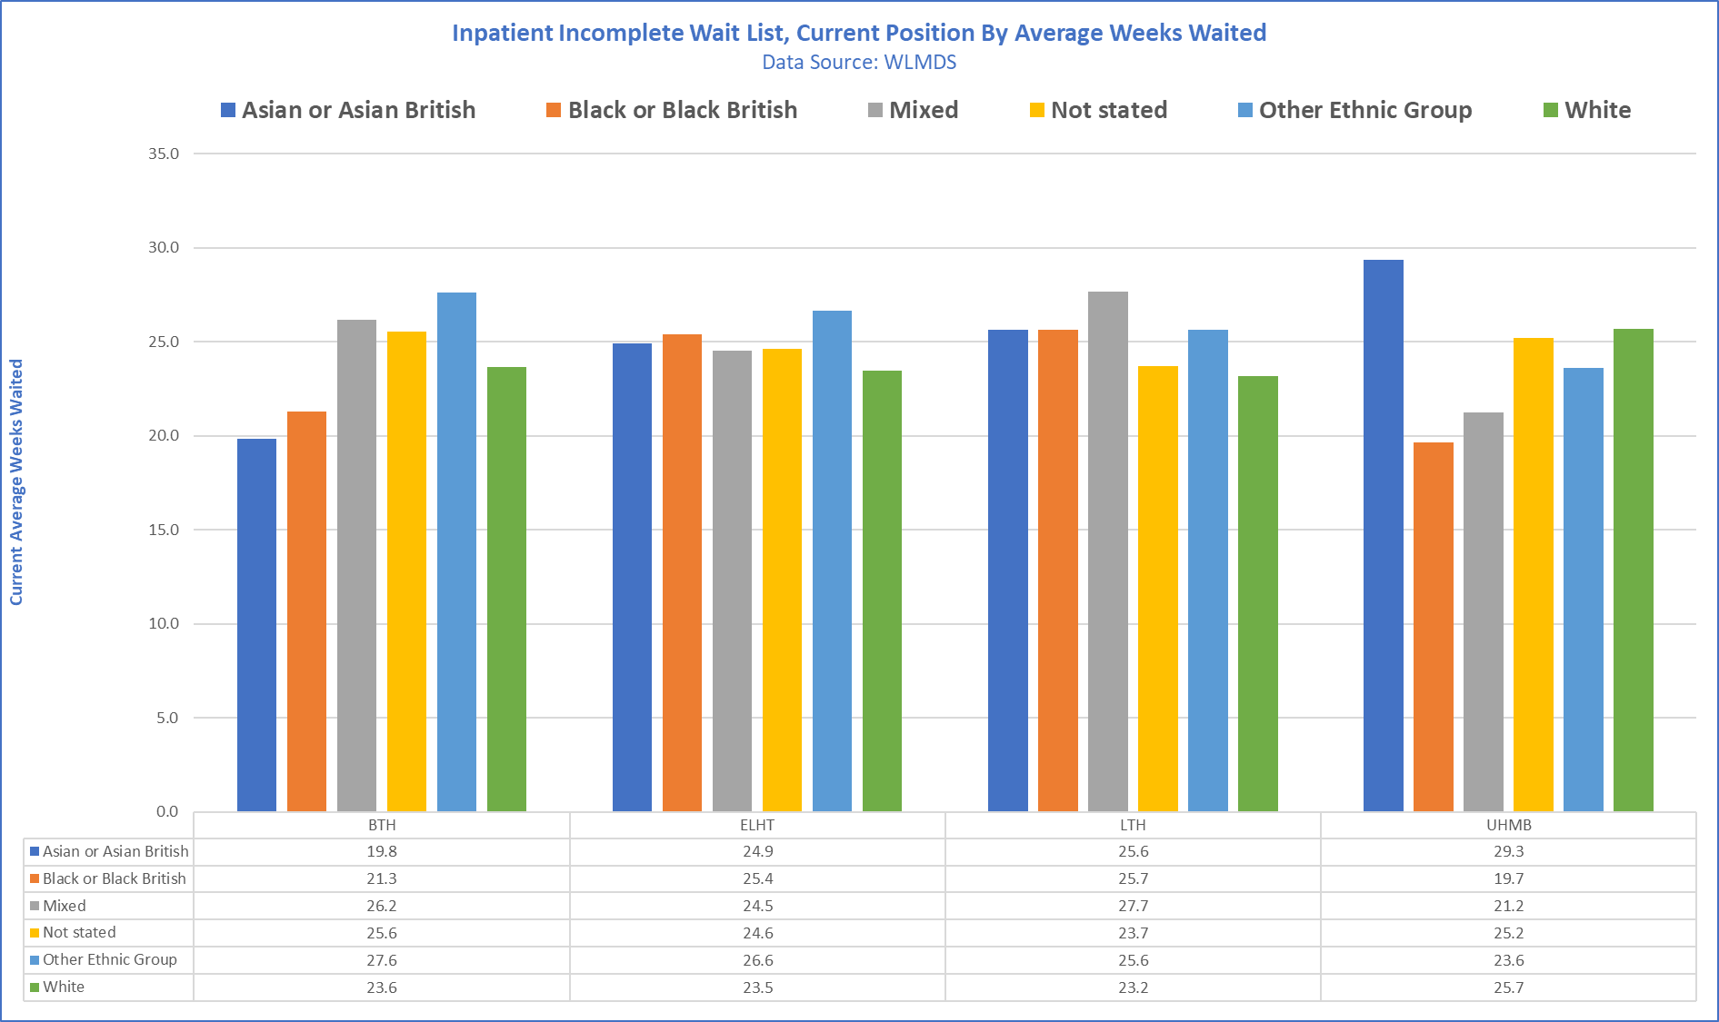
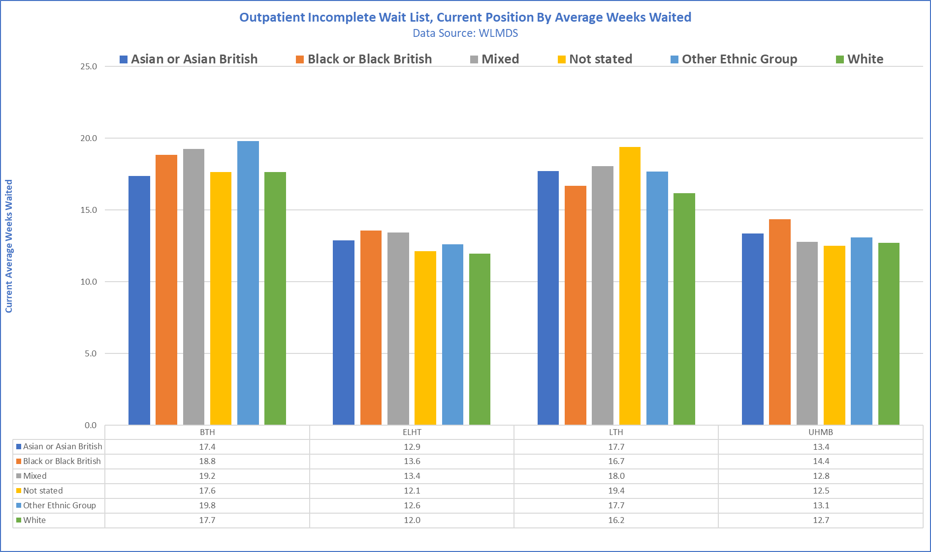
Elective Waiting Times
The following graphs illustrate at a high level the variation in average waiting times by IMD & Ethnicity across admitted & non-admitted pathways.
Work is currently underway to analyse health inequalities in elective care. The work aims to develop a robust current understanding of inequalities in access, experience and outcomes within elective care, review evidence and practice across the country and establish a sustainable approach to analysis and reporting that can be embedded within routine performance and commissioning processes.
IMD
Ethnicity

Slide 37
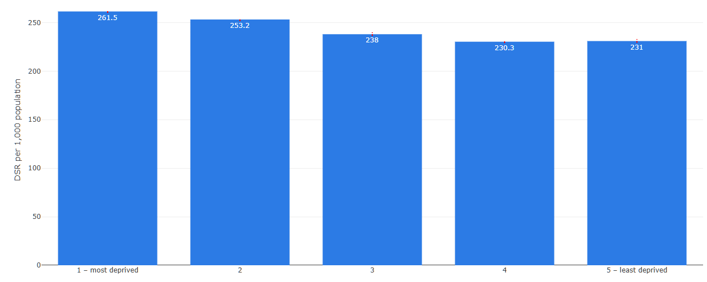
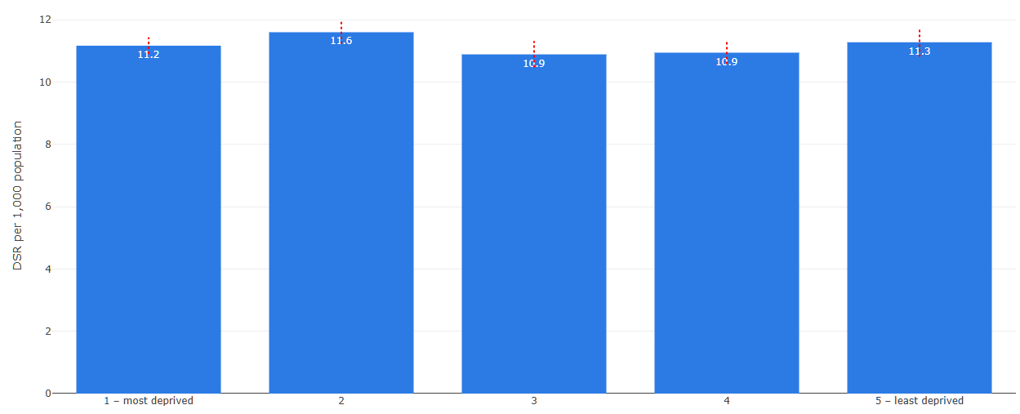
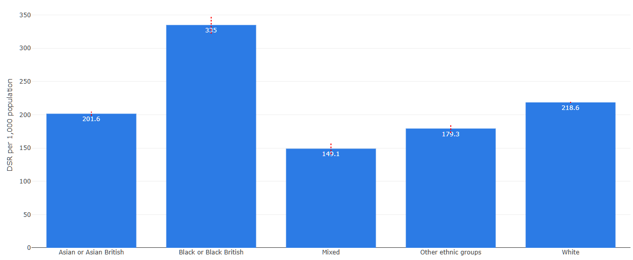
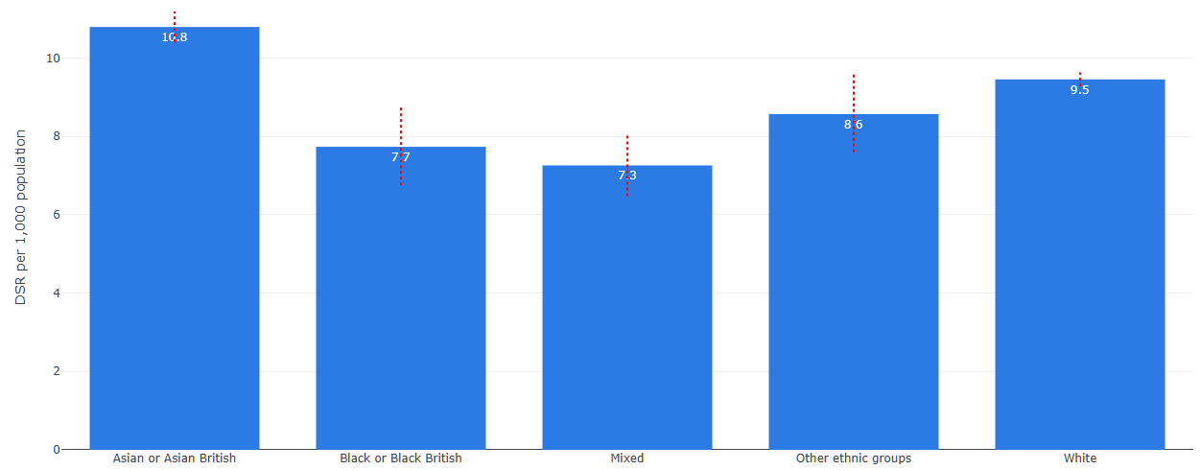
Elective Admissions in adults and children
Directly Standardised Rate (DSR) per 100,000 population
Elective admissions in adults per 100,000. Directly standardised rate, by IMD.
Elective admissions in under 18s per 100,000. Directly standardised rate, by IMD.
Elective admissions in adults per 100,000. Directly standardised rate, by ethnicity.
Elective admissions in under 18s per 100,000. Directly standardised rate, by ethnicity.
Rates of elective admissions in the most deprived areas were higher than rates in the least deprived areas, with a gradual decrease as deprivation reduces. Black and Black British populations had higher rates of elective admissions compared to all other ethnic groups, with mixed and other being the lowest.
For under 18s, elective admission rates were broadly similar across deprivation levels, with only small differences between the most and least deprived areas. Asian and Asian British having higher elective admission rates than others and mixed ethnicity groups being lower.

Slide 38
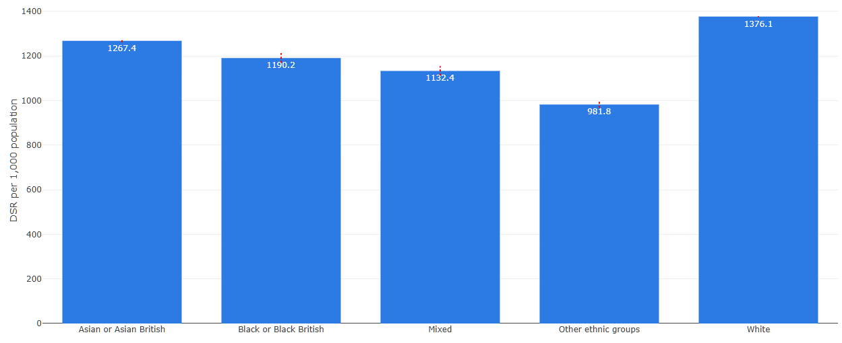
Elective Recovery, Outpatient Attendances
Directly Standardised Rate (DSR) per 100,000 population
Outpatient services are often the main gateway to planned care and play an important role in determining whether people are able to access diagnosis, treatment and ongoing management. Nationally, NHS England has highlighted the importance of understanding inequalities across the whole elective pathway, including access, experience and outcomes. Differences in outpatient attendance rates may reflect variation in underlying need but can also be influenced by factors such as referral patterns, transport, digital exclusion, health literacy, caring responsibilities and the ability to attend appointments.
Data on outpatient attendances was not available by deprivation groups.
From the data available, white population groups had the highest outpatient attendance rates, with other ethnic groups being the lowest.

Slide 39
Urgent and Emergency Care
People living in the most deprived communities are significantly more likely to attend emergency departments, experience emergency admissions and require urgent treatment for conditions that could often be prevented or managed earlier. These inequalities reflect wider differences in health, access to care and the social determinants of health. Reducing avoidable urgent and emergency care demand is therefore central to improving population health outcomes and narrowing health inequalities.

Slide 40
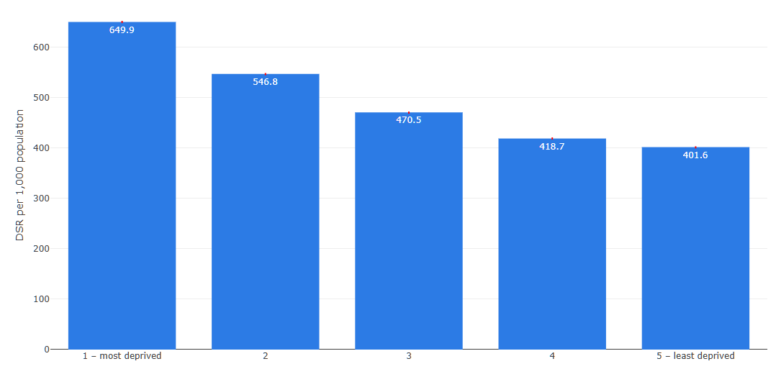
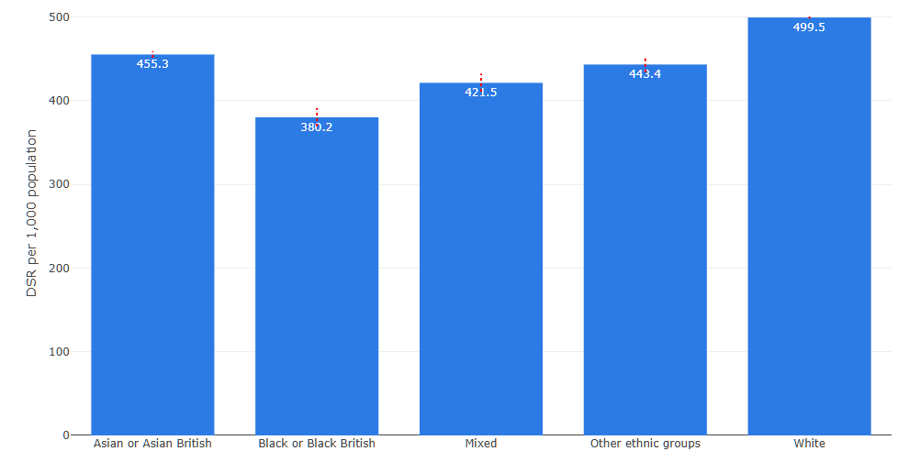
Emergency Attendances
Directly Standardised Rate (DSR) per 100,000 population
Emergency attendances per 100,000. Directly standardised rate, by IMD.
Emergency attendances per 100,000. Directly standardised rate, by ethnicity.
There was a notable difference in emergency attendance rates by deprivation, with people living in the most deprived areas attending emergency care more often than those in less deprived areas. Rates steadily decreased as deprivation improved. This was the case despite standardisation of the groups. As the case study describes, this is a consistently known pattern both nationally and locally. Differences are also visible between ethnic groups, with White and Asian or Asian British having the highest attendance rates, and Black or Black British having the lowest.

Slide 41
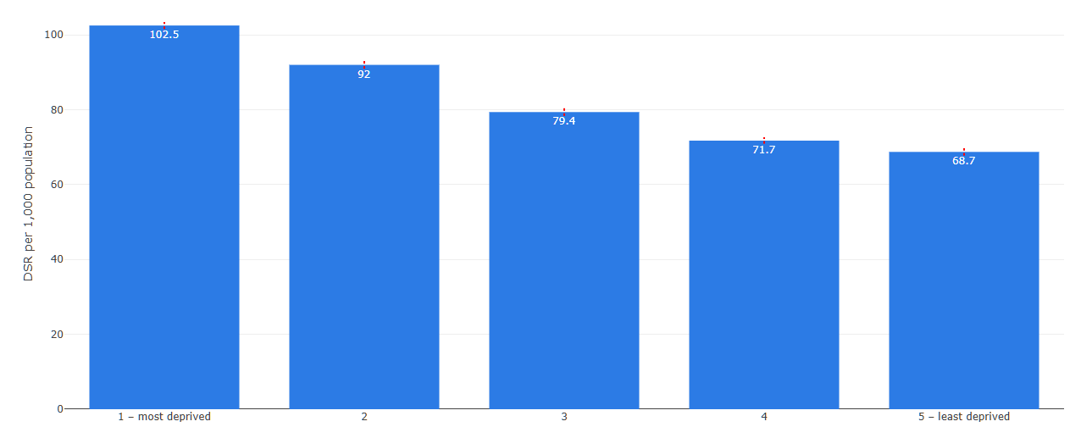
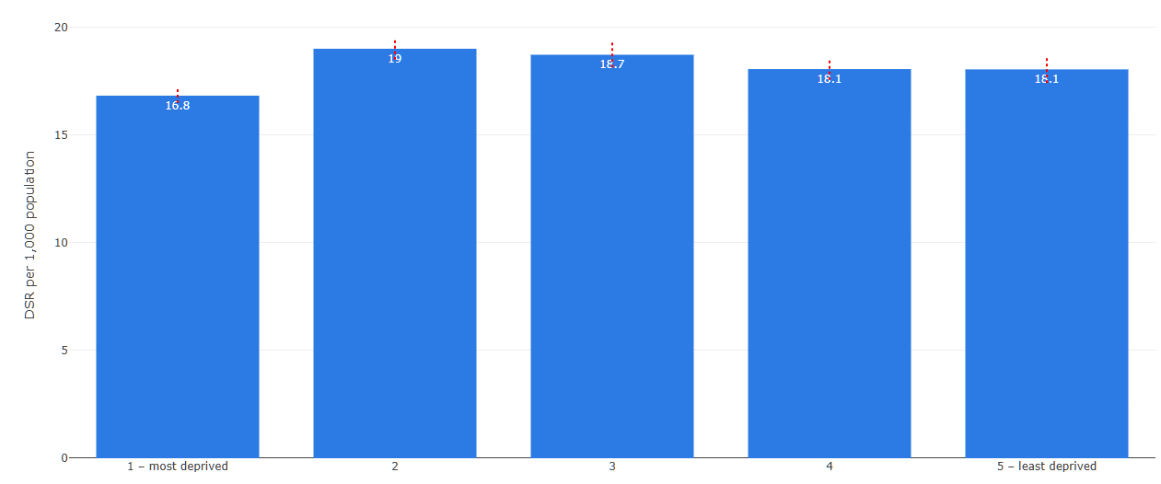
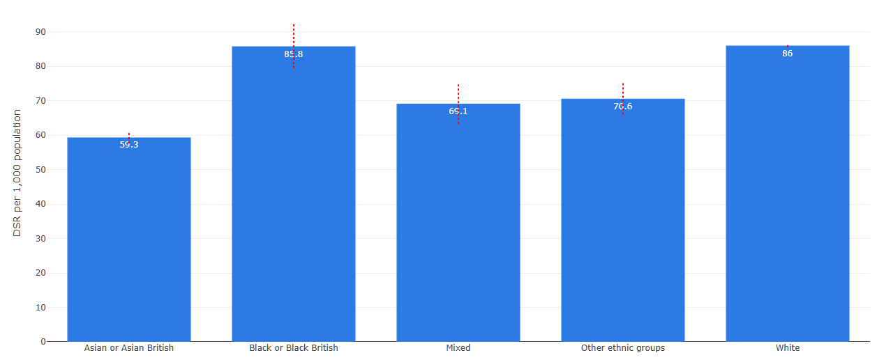
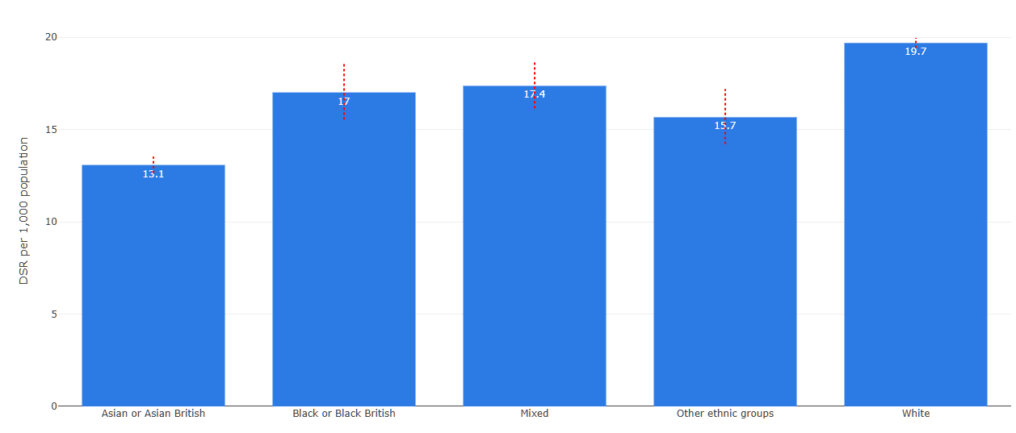
Emergency Admissions
Directly Standardised Rate (DSR) per 100,000 population
Emergency admissions in adults per 100,000. Directly standardised rate, by IMD.
Emergency admissions in under 18s per 100,000. Directly standardised rate, by IMD.
Emergency admissions in adults per 100,000. Directly standardised rate, by ethnicity.
Emergency admissions in under 18s per 100,000. Directly standardised rate, by IMD.
Emergency admission rates among adults show a clear pattern by deprivation, with higher rates in the most deprived areas and progressively lower rates in less deprived areas. Differences are also evident by ethnicity. Asian or Asian British groups show lower rates compared with White and Black or Black British groups.
Emergency admission rates for children and young people were broadly similar across levels of deprivation, with no clear pattern in the differences between deprivation groups. Some ethnic groups show higher emergency admission rates than others, as Asian or Asian
British children had the lowest rates, and White children the highest.

Slide 42


Non-elective bed days and median time in ED
Non-elective bed days (per 100,000) occupied by asthma, chronic obstructive pulmonary disease and community-acquired pneumonia, adjusted for age, by IMD
Inequalities in median time in emergency department by IMD, adjusted for age and provider
Number of bed days occupied due to asthma, COPD and CAP broken down by IMD decile showed that there was a higher number of bed days from these causes from the more deprived areas. There was a similar pattern year-by-year for each decile.
The median time spent in the emergency department varies across deprivation levels since 2021. All deciles follow a similar pattern, with waiting times rising to a peak in 2023 and then falling. More deprived groups consistently have a longer median time in the emergency department compared to the least deprived.

Slide 43


Addressing the drivers of urgent and emergency care demand
Male and female life expectancy by ward in Blackpool
Poverty, economic inactivity, housing challenges and lower educational attainment are key drivers of health inequalities. These factors contribute to higher rates of long-term conditions, poorer healthy life expectancy, increased risk factors such as smoking, and greater likelihood of people reaching health crisis.
Analysis of Urgent and Emergency Care data alongside health outcomes data in Blackpool show a clear correlation between lower life expectancy and age standardised Emergency Department attendances, suggesting a need to understand the drivers for this and to focus interventions in the central Blackpool wards.
The ICB initiated a “test and learn” programme within priority central Blackpool wards (Claremont and Bloomfield, with Park, Talbot and Tyldesley to follow, aimed at delivering proactive preventative care to populations more likely to experience health crisis. This programme consists of integrated outreach and delivery of healthcare and wider support services, and is delivered by VCFSE, PCN and community health services working in partnership.
The following slide escribes this work in more detail.
The learning from the “Test and learn” programme in Blackpool is being harnessed to inform an LSC-wide approach to delivering targeted demand management in the PCNs with the highest deprivation.
Across Lancashire and South Cumbria, the UEC and Population Health Teams have commenced work to review how we embed population health approaches into UEC commissioning in line with the LSC UEC strategy 2024 – 2029. Actions agreed include:
Developing a PHM approach within each UEC Delivery Board – commencing with providing a breakdown of UEC demand by IMD decile at each Delivery Board
Understanding the impact and scalability of targeted interventions within UEC – starting with priority wards work, LTC LES implementation and targeted demand management
Working with partners to understand and collaborate on wider determinants of health – for example, in using the CVFSE UEC funding to address wider determinants at the point of health crisis
Age standardised ED attendances by ward in Blackpool

Slide 44

Proactive Care in Blackpool
Proactive Care is a multidisciplinary outreach model developed in Blackpool’s priority wards to improve health outcomes and reduce preventable hospital use by addressing both healthcare needs and the wider determinants of health, including housing, income and social isolation.
Initially piloted in Claremont ward in 2025 and subsequently expanded to Claremont and Bloomfield through a test-and-learn approach, the model combined data-led case finding, clinical outreach, community engagement, door knocking, social prescribing and twice-weekly multidisciplinary team (MDT) huddles. Early evaluation demonstrated the benefits of proactive outreach, with a targeted COPD cohort achieving a 40% attendance rate among people who had previously not responded to invitations, alongside support from community nursing, occupational therapy and wellbeing services for residents with complex clinical and social needs. In Claremont alone, community engagement officers knocked on 576 doors, speaking directly with 174 residents and providing ongoing support to 55 people.
Phase 2 expanded the model across Claremont and Bloomfield, reaching 1,812 households through community outreach and a further 237 higher-risk residents through targeted engagement. The evaluation found that the programme successfully identified hidden and unmet need among people who were often poorly served by traditional services. Rather than viewing declined offers of support or missed appointments as failure, the programme used this information to understand barriers to engagement and redirect residents towards more appropriate clinical, community and voluntary sector support. MDTs and brokerage functions played a critical role in coordinating care, connecting residents to housing, welfare, safeguarding and community services, and addressing the wider factors driving poor health and avoidable demand.
The strongest outcomes were achieved when residents were matched to community-based, relationship-led services, where engagement was sustained and missed appointments were uncommon. Overall, the evaluation concluded that Proactive Care improved the system’s ability to identify, understand and manage complex demand through earlier intervention, better pathway matching and coordinated support. The programme was judged to provide good value for money, with evidence of potential future cost avoidance through earlier identification of need, reduced duplication, improved coordination across organisations and prevention of crisis demand, supporting the case for expansion across all five priority wards.

Slide 45


Lancaster PCN Health Inclusion and Enhanced Health Checks
Lancaster PCN’s Health Inclusion and Enhanced Health Check approach provides a different example of how focusing on people who are least likely to access services through usual routes can help avoid those people having a health crisis and needing urgent care.
This project focused on supporting people living were not accessing routine care and were identified as being likely to experience poor health outcomes. Through this work, 164 patients received individual Health Inclusion contact or an Enhanced Health Check, including 57 people at the highest levels of need. A review of five patients identified significant physical, mental health and wider social needs, with diagnoses made, treatment given, referrals completed and wider community support put in place.
The evaluation of the initiative estimates that avoiding likely escalation into unscheduled care for five patients could represent a potential system cost saving of £170,091, while also improving access, prevention and support for people who are often least well served by traditional models of care.
As a result of the work, the PCN have developed the “Patient Reach Model” which identifies and gives value to the time spent building trust, supporting people into care and bringing services closer to them.
Potential escalated intervention | Potential system cost saving (total)
See and convey NWAS (4)​ | £1,668​
A&E attendance (5)​ | £2,225​
Non elective hospital bed (4)​ | £136,952​
Excess bed day (1)​ | £29,246​
Total​ | £170,091​
Patient Reach Model

Slide 46
Addressing health inequalities in primary care
The Long Term Conditions Locally Enhanced Service was redesigned to place greater emphasis on reducing health inequalities. The programme provides additional support and funding to general practices to identify people at greatest risk of poor outcomes, understand the causes of health inequity, and take a more proactive and personalised approach to care. This has enabled the development of new models of support, including the Holistic Health Assessment approach described on the following slide.

Slide 47
Holistic Health Assessments (HHA) as part of the Long Term Condition LES
Since May 2025 the ICB has commissioned General Practice to provide a Holistic Health Assessment for individual patients with a Long Term Condition who have an additional risk linked to either hospital admission and/or health inequality markers.
This approach specifically focuses on a cohort of patients who are at heightened risk due to their needs but are not supported through other proactive schemes.
The Holistic Health Assessment aims to identify unmet needs that are contributing to the patient’s condition and their clinical care. Typically these patients will receive an additional 20 minute practice appointment with a member of the practice team to talk about things like loneliness, care or housing difficulties, falls and mobility, dental/medication/vision or cancer screening concerns.
Over the course of 2025-26 a total of 95,775 of these assessments were delivered across all practices in the ICB. Within this group of at-risk patients who have been assessed it is estimated that at least 1500 non-elective admissions have been prevented.
There has also been a focus on reviewing and updating the recording of ethnicity records for this cohort – increasing the coding completeness to 96%.
The delivery of this programme is continuing into 2026-27, aiming to reproduce the numbers and effectiveness and link the work into wider integrated and neighbourhood working.
Place | Long Term Conditions Service Holistic Health Assessment (HHA) undertaken
East Lancashire and Blackburn with Darwen | 33621
Greater Preston and Chorley & South Ribble | 20749
Fylde and Wyre and Blackpool | 19002
Morecambe Bay | 16262
West Lancashire | 6141
Totals | 95775

Slide 48
Diabetes
Diabetes is a key health inequalities priority because outcomes, access to treatment and quality of care vary significantly by deprivation, ethnicity and wider social disadvantage. People living in the most deprived communities and many ethnic minority groups experience higher rates of diabetes, poorer outcomes and greater risk of complications. Focused action can reduce unwarranted variation in care and improve outcomes for populations experiencing the greatest inequalities.

Slide 49


Type 1 Diabetes
Variation in Type 1 diabetes patients receiving all 8 care processes
% Patients with Type 1 Diabetes Receiving All 8 Care Processes, by IMD
To manage diabetes more effectively we need to improve identification, deliver the 8 care processes (HbA1c measurement, blood pressure measurement, cholesterol level measurement, urine albumin measurement, kidney function measurement, foot surveillance, BMI measurement, and smoking status assessment), and deliver evidence-based treatment. Failure to do this leads to worse outcomes, including long-term complications such as cardiovascular disease, renal failure, and amputations.
Type 1 diabetes is frequently diagnosed in childhood or adolescence and requires life-long engagement and management. People in lower socio-economic groups face greater barriers in terms of access to services, experience and outcomes.
The charts show inequalities in the proportion of people with Type 1 diabetes receiving all eight recommended care processes. The percentage of people living in the most deprived areas who receive all elements of care was consistently lower than those in the least deprived areas. Differences are also evident between ethnic groups. Mixed and Other ethnic groups show lower proportions receiving all eight care processes, as do Asian or Asian British groups.
% Patients with Type 1 Diabetes Receiving All 8 Care Processes, by Ethnicity Group

Slide 50


Type 2 Diabetes
Variation in Type 2 diabetes patients receiving all 8 care processes
% Patients with Type 2 Diabetes Receiving All 8 Care Processes, by IMD
In Lancashire and South Cumbria, achievement of the eight key care processes is consistently higher for people with Type 2 diabetes compared to those with Type 1 . This is partly due to differences in service models and due to the differing pathways.
The variation by IMD is less for type 2 diabetes than type 1 diabetes. There is still some variation present, with a slightly smaller percentage of people living in the most deprived areas who received all elements of care than those in the least deprived areas.
There were wider differences between ethnic groups. White groups had higher levels of complete care compared with most other ethnic groups, while Mixed and Other ethnic groups show lower levels. Asian or Asian British and Black or Black British groups also receive all eight care processes less often than White groups.
The Primary Care Diabetes Local Enhanced Service supports more consistent and equitable diabetes care across Lancashire and South Cumbria, with a focus on delivering care closer to home. It brings together person‑centred care, prevention and self‑management, alongside improved coordination across services. Practices are required to complete annual reviews, including all eight key care processes, to support early identification and management of risk. The ICB also works with NHS England to improve uptake of the National Diabetes Prevention Programme by targeting promotion to groups with lower referral and participation rates, helping to reduce inequalities in diabetes outcomes.
% Patients with Type 2 Diabetes Receiving All 8 Care Processes, by Ethnicity Group

Slide 51
Treating Tobacco Dependency
Tobacco dependency is a major driver of health inequalities. Smoking prevalence is significantly higher among people experiencing deprivation, severe mental illness, homelessness, unemployment and other forms of social exclusion. As the leading modifiable risk factor for ill health and premature mortality, smoking is estimated to account for approximately half of the gap in life expectancy between the most and least deprived communities. Recognising its impact across maternity outcomes, mental health, respiratory disease, cancer and cardiovascular disease, NHS England has identified smoking cessation as a Core20PLUS5 priority and a critical intervention for reducing health inequalities.
The ICB works closely with Local Authorities who commission community smoking cessation services. Our joint Tobacco free Lancashire and South Cumbria Strategy 2023-2028 provides the system-wide framework for reducing smoking prevalence and tobacco-related harm across Lancashire and South Cumbria.
As part of this joint approach, the ICB commissions Treating Tobacco Dependency Services in all the Trusts within Lancashire and South Cumbria to support people who are inpatients and people who are pregnant.

Slide 52


Treating Tobacco Dependency
Smokers provided with care plans to support a quit attempt that are recorded as having quit smoking, by deprivation
The proportion of smokers who were provided with a care plan and subsequently recorded as having quit smoking varies across deprivation groups, and the most deprived group appears to have a higher recorded quit rate than several other groups. However, the number of smokers differs considerably between deprivation groups, and small changes in the number of successful quits may have a disproportionate impact on percentages in some cohorts.
There is a similar issue for the percentage of maternity smokers referred to a specialist tobacco dependence treatment service, as the small numbers within individual cohorts can again mean small differences can have a large impact on the percentage. Performance may also be influenced by variation in local service delivery arrangements and provider-level factors.
Tobacco dependency work remains a key part of the ICB's prevention and health inequalities agenda, working closely with the Local Authorities. A new role of Tobacco Control Strategic Partnerships Lead has been jointly funded by the ICB and Local Authorities to lead this work across communities and NHS settings.
During 2025/26 the ICB has undertaken a review of commissioning of Tobacco Dependency Services for inpatient and maternity resulting in recommissioning the tobacco dependency treatment services across all trusts with a focus on improving consistency, quality and equitable access across Lancashire and South Cumbria. Longer-term funding for tobacco dependency services has been agreed and contracts are being amended to reflect a more equitable and outcome-focused approach. This will help provide greater stability for service delivery and increase opportunities for continuous improvement and local partnership working.
Maternity smokers who are referred to an in-house tobacco dependence treatment service who are identified as non-smokers at 36 weeks, by deprivation

Slide 53


Treating Tobacco Dependency
Smokers who are identified in hospital that who are provided with tobacco dependence interventions to support a quit attempt, by deprivation
Smokers who are identified in hospital that who are provided with tobacco dependence interventions to support a quit attempt, by ethnicity
IMD quintile
The proportion of hospital smokers who were identified and provided with tobacco dependence interventions is broadly similar across most deprivation groups, although the least deprived group appears higher than the others. As the data does not provide information about cohort sizes or statistical confidence, it is not possible to determine whether these differences represent genuine variation or are the result of normal fluctuation within relatively small groups.
The proportion of hospital smokers who were identified and provided with tobacco dependence interventions does have some variance between ethnic groups, however there are quality issues with the data. Some ethnic groups may contain relatively small populations, and the variance may fall within normal limits. The lower rate observed for Black or Black British groups may warrant further exploration to understand whether there are barriers to access or engagement with tobacco dependence interventions.

Slide 54
Digital inclusion
Digital exclusion is a lack of access to digital technology and the internet, due to broader social inequalities. It can compound health inequalities by exacerbating challenges with access to healthcare, skills and capability to navigate and use services, and the general resources needed to lead a healthy life.
The adoption of digital technologies by both patients and staff has significantly increased over the last few years and will likely accelerate with the shift from analogue to digital outlined in Fit for the Future: 10 Year Health Plan for England.
However, the benefits of this shift to digital are not accessible for everyone. A percentage of households still do not have home internet access, many people can no longer afford broadband packages due to rising costs, many adults lack foundation-level digital skills and a significant percentage of people who are offline feel that the NHS is one of the most difficult organisations to interact with.
Digital exclusion is a lack of access to digital technology and the internet, due to broader social inequalities. It can compound health inequalities by exacerbating challenges with access to healthcare, skills and capability to navigate and use services, and the general resources needed to lead a healthy life.

Slide 55




Digital inclusion
Some particular groups face a higher risk of being digitally excluded. These groups also generally face a higher risk of health inequalities. They include older people, people in more socio-economically disadvantaged groups, socially excluded groups (including people experiencing homelessness, people seeking asylum and people in contact with the justice system), disabled people and people with life-impacting conditions, people living in areas with inadequate broadband and mobile data coverage and people less fluent in understanding the English language.
Analysis using the Digital Exclusion Risk Atlas (DERA) suggests the highest risks align closely to areas in IMD deciles 1 and 2 and are concentrated in parts of Blackpool, Blackburn with Darwen, Burnley, Hyndburn, Pendle, Preston, West Lancashire and Morecambe. However rural areas of South Cumbria, North Yorkshire and Ribble Valley that are amongst the least deprived face additional challenges related to connectivity and access.
Digital exclusion can limit access to healthcare, reduce health literacy and self-management, and increase social isolation. As healthcare becomes increasingly digital, addressing digital exclusion is essential to reducing inequalities and improving outcomes across Lancashire and South Cumbria.
In 2025/26 the ICB has been involved in discussions with colleagues from other NW ICBs and NW NHSE to more clearly understand the risks of digital exclusion and to consider what action can be taken with system partners to address the risks of digital exclusion.
Further work is underway to:-
Address the risk of digital exclusion in commissioning decisions, especially those involving the adoption of a digital solution; and
Ensure a robust process for assessing the risk of digital exclusion through incorporating it into our new Integrated Impact Assessment (IIA)
DERA composite measure for LSOAs in Lancashire and South Cumbria (Source: Digital Exclusion Risk Atlas (DERA))
Index of Multiple Deprivation in Lancashire and South Cumbria (Source: Digital Exclusion Risk Atlas (DERA))

Slide 56
For more information see lancashireandsouthcumbria.icb.nhs.uk telephone 0300 373 3550 or email lscicb.contactus@nhs.net

