Slide 1

Referral Variation Plan
DRAFT VERSION 1
Peter Tinson, Director of Primary and Community Commissioning, 18 May 2026

Slide 2

Referral Variation – introduction and contents
This slide deck considers referral variation and includes recommendations and a plan to explore variation and identify and progress improvement opportunities:
  Referral measurement
  Drivers of referral variation
  Other variation related work
  Best practice referral analysis
  An improvement approach
  Current data availability and usage plus a Variation LES
  A quick win?
  Exploration and improvement support
  Future phases of variation work
  Specialties for PCN focus
  Responsibilities on a page
  Impact analysis
  Key risks
  Summary of recommendations
  Plan on a page
  Appendices
  Relevant extracts of current General Practice and PCN contracts

Slide 3
1. Measurement
Referral variation can be measured in several ways, including:
Crude Referral Rates
Age-Sex Standardisation
Morbidity & Deprivation Weighting
Specialty Specifc
Initially this plan focuses on standardised referral rates by specialty pending enhanced analysis
Recommendation 1
ICB Business Intelligence colleagues produce standardised and weighted referral analysis no later than end June 2026

Slide 4
2. Drivers
Referral variation is driven by a complex mix of factors, including:
  Population demographics and health needs – differences in local morbidity rates and socio-economic deprivation
  Clinical thresholds – differences in individual clinician risk tolerance and thresholds for specialist intervention
  Resources – differences in practice, wider primary care, community and Tier 2/ intermediate services
  Knowledge – referrer usage of the above services and their impact

Slide 5
3. Other related work
In addition to this plan there are several other pieces of work which support improved referral management:
Clinical policies
A&G
Interface Groups
This plan
SPOAs
Tier 2
Services
These pieces of work have separate project plans but form part of the wider demand management programme and associated governance arrangements

Slide 6
3. Other General Practice related work
There are also several wider General Practice variation pieces of work, including:
Proactive
Proactive +
Reactive
Prioritised programme of practice visits, including exploring wider variation. Informed by ICB GP dashboard
Proposal being developed for more intensive diagnostic and support for geographically grouped challenged practices
Immediate practice improvement oversight and support. Typically triggered by ICB, CQC, or FTSU concerns
The proactive practice visits (66 planned in 2026/27) form part of the plan on a page later in this slide deck

Slide 7

4. Analysis
Best analysis practice suggests:
Context Matters
Use as a Tin Opener
Analysis must align with local population health data to distinguish warranted variation (based on patient need) from unwarranted variation (differences in clinical behaviour)
Referral rates should act as an investigative starting point to prompt deeper clinical reviews, peer discussion and shared learning
Reviewing clinical variation will help identify opportunities to share best practice and better manage patient need
Recommendation 2
All partners use consistent improvement-based language to describe this work – it is not about performance

Slide 8
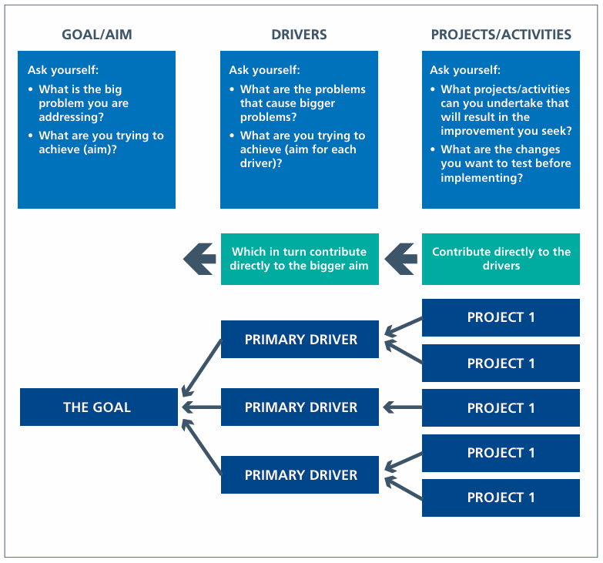
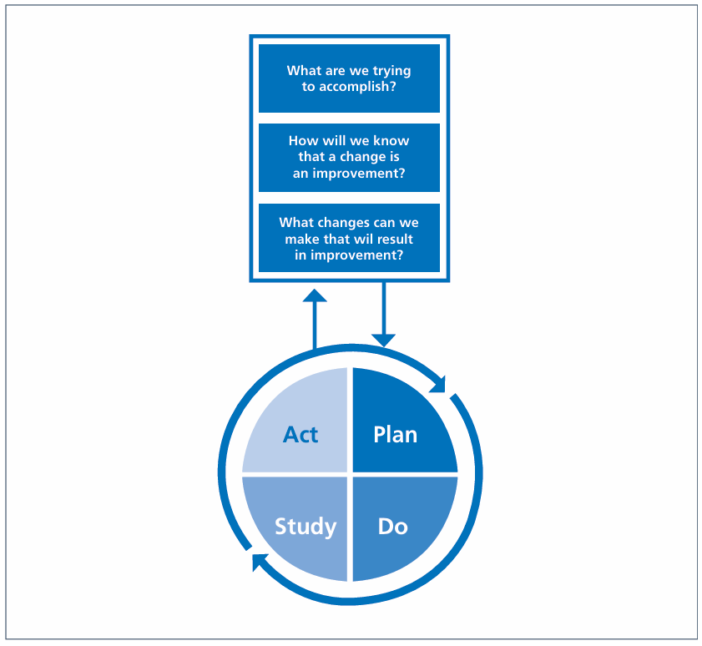
5. Improvement approach
Recommendation 3
Driver diagrams and PDSA cycles are used to explore comparative referral information and identify opportunities for Practice, PCN, Place and System delivery

Slide 9
6. Current data availability and usage
Referral data is currently extracted from the national e-Referral Service (e-RS)
This data includes all referrals made via e-RS and therefore includes Tier 2/intermediate services
It is therefore important than any referral analysis distinguishes between these services (which practices have been encouraged to refer to) and secondary care services
This also presents an opportunity to better understand comparative practice utilisation of Tier 2/intermediate services and where there is a ‘lost opportunity’ to increase utilisation
Recommendation 4
ICB Business Intelligence colleagues produce by no later than end of June 2026 a comparative analysis of practice utilisation of Tier 2/intermediate services which forms part of the plan on a page later in this slide deck

Slide 10
6. Current data availability and usage
Since January 2026 comparative referral data has been provided to practices via a simple tool on the GP intranet
This tool includes referral data by number and rate, speciality and Practice, PCN, Place and System
It also includes guidance and a form for feeding back comments about the practice comparative position and suggestions about Tier 2/intermediate services, training, education or other
It is apparent that few practices are accessing this self-service tool and even fewer have provided any feedback
Appendix 1 and 2 identify the current national NHS England General Practice contract and PCN contract requirements to engage in discussions about variation
They are open to significant interpretation and do not provide a basis upon which to constructively engage with practices

Slide 11

6. Current data availability and usage
Recommendation 5
ICB Primary and Community Commissioning Team reprioritises existing LES funding to commission a Variation LES from practices
The LES would require practices to engage in the exploration of variation (initially commencing with referrals) using the driver diagram and PDSA improvement approaches
A detailed specification has already been developed and support in principle has been received from the LMC and detailed feedback is expected during the week commencing 18 May 2026
The clinical and non-clinical time required to undertake the associated activities has been assessed and costed. It equates to £7,000 per practice per year (a total cost of £1.3m)
Subject to feedback and sign off the LES would be launched during June 2026

Slide 12
7. A quick win?
Recent discussions with GP leaders have identified that there is a lack of knowledge of the existing Tier 2/intermediate service offer
Recommendation 6
ICB Planned Care, Primary Care and Communications colleagues:
  Produce a summary of the existing Tier 2/intermediate service offer no later than the end 19 June 2026
  Communicate the summary no later than 30 June 2026 via:
    Weekly ICB GP newsletter and intranet
    LMC weekly brieflet
    A Big Primary Care Conversation webinar

Slide 13
8. Exploration and improvement support
To maximise the impact of the recommended reprioritised investment in a Variation LES it is critical that practices and PCNs are provided with support to explore variation and use the improvement approach to identify, deliver and monitor actions. The ICB does not have the capacity to provide this support
Recommendation 7
ICB Primary and Community Commissioning Team, using the existing identified budget, produce and negotiate by 12 June 2026 a detailed specification for the General Practice Confederation (of Federations) to:
  Design, co-ordinate and facilitate PCN based peer review of practice comparative referrals using the improvement approach and specialties for PCN focus later in this slide deck
  Support practices/PCNs develop action plans and monitor impacts
  Produce monthly reports to the ICB of progress, impacts, learning and issues for escalation
  Recommend to the ICB any system wide improvement actions and work with ICB to progress
  Work with Trusts and the Primary Care Training Hub to progress any education/training actions
  Provide practices/PCNs and the ICB primary care team with business intelligence support to further interrogate variation data and develop routine reports
  Explore, propose and deliver plans to use AI to generate practice/PCN report KLOE

Slide 14
9. Phasing
The immediate focus of this plan is on referrals, recognising both that they are a major driver of system cost and that there is a lead in time (potentially of 4 months or more) to any realisable impact considering the already received referral demand (outpatient waiting list)
Later exploration and improvement phases will focus on pathology and diagnostics subject to the receipt of comparable data from provider colleagues
2026/27
2027/28
Referrals
Q2 & Q3
Pathology
Q4 & Q1
Diagnostics
Q2 & Q3

Slide 15
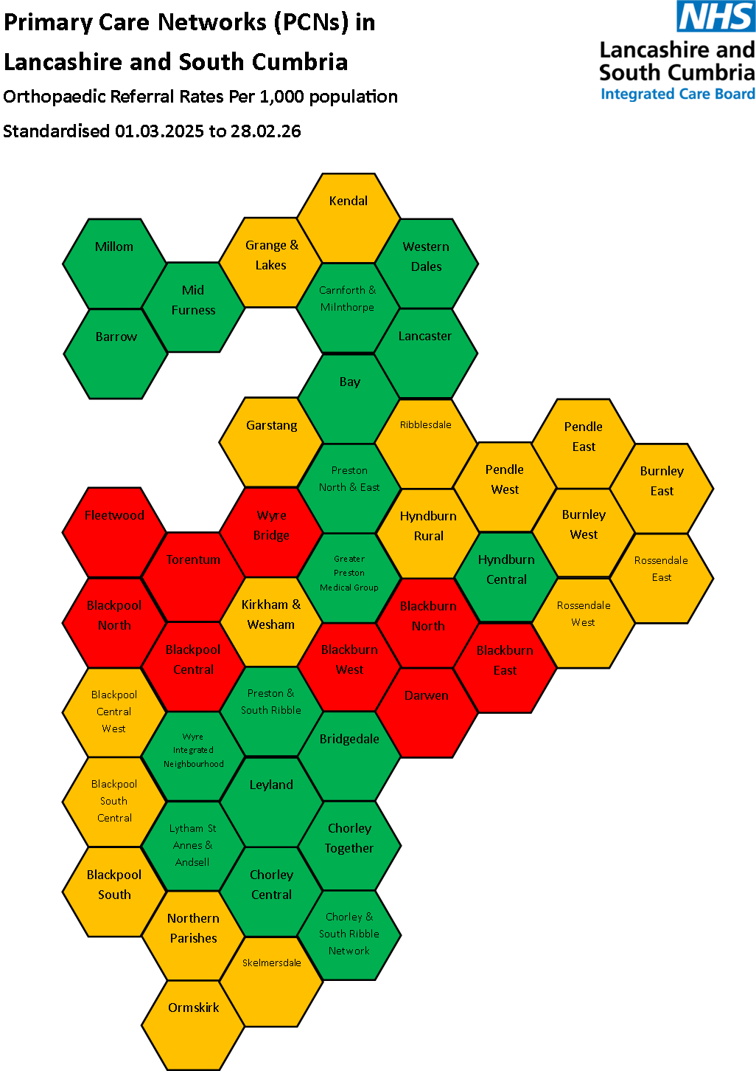
10. Specialties for PCN focus
The existing General Practice referral tool includes PCN standardised referral rates per 1,000 population for each specialty
The population health PCN hexagon maps provide a useful tool to show comparative rates and identify which specialties PCNs and groups of PCNs should focus on
As an example, the hexagon map for Orthopaedics is shown (red denotes higher referral rates)
Recommendation 8
ICB Primary and Community commissioning team produces hexagon maps for all ‘runner’ specialties by 23 May 2026

Slide 16
11. Responsibilities on a page
Activity | Practice | PCN | Trusts | Confederation | ICB | Training Hub
Proactive Visits | Engage in visits including variation exploration and action planning | Not included in current visit programme | Where relevant engaged in any actions | Currently no role | Lead and co-ordinate programme | Practices may be signposted to existing training
Referral Variation | Engage in peer exploration of variation and improvement approach |  | Provide data to enable exploration | Design, co-ordinate and lead PCN peer review | Commission Variation LES
 | Develop and deliver action plan |  | Engage in delivery of relevant place wide actions | Support practices/PCNs develop and monitor action plans | Commission improvement support from Confederation
 | Engage in education and training |  | Work with Training Hub to respond to education/training actions | Support ICB to progress system wide actions, including shared learning | With support from Confederation progress system wide actions, including shared learning | Respond to education/training actions
 | Identify opportunities for optimising use of existing Tier 2/intermediate services and ideas for new services
 | Use locally agreed referral pathways

Slide 17
12. Impact analysis
A reliable assessment of the potential impact is dependant upon the receipt and review of practice/PCN action plans
It was noted earlier that there is also a lead in time (potentially of 4 months or more) to any realisable impact considering the already received referral demand (outpatient waiting list)
Recommendation 9
By 29 May 2026 ICB Business Intelligence colleagues produce an analysis of the potential impact of the ‘red’ hexagon PCNs for each specialty reducing referral rates to their population footprint (Trust catchment) median by January 2027

Slide 18
13. Delivery risks
The risks of delivering this plan will be included in the plan risk log. They include:
  Attractiveness of the Variation LES to practices
  Capacity and capability of the Confederation to provide support
  Lead in time to realise the impact of action plans
  Unknown impact of SPOA implementation
  Potential ongoing BMA national contract dispute and any related actions
  Capacity of the ICB Business Intelligence team and Primary and Community Commissioning team to progress the recommendations

Slide 19
14. Summary of recommendations
ICB Business Intelligence colleagues produce standardised and weighted referral analysis no later than end June 2026
All partners use consistent improvement-based language to describe this work – it is not about performance
Driver diagrams and PDSA cycles are used to explore comparative referral information and identify opportunities for Practice, PCN, Place and System delivery
ICB Business Intelligence colleagues produce by no later than end of June 2026 a comparative practice utilisation of Tier 2/intermediate services which forms part of the plan on a page later in this slide deck
ICB Primary and Community Commissioning Team reprioritises existing LES funding to commission a Variation LES from practices
ICB Planned Care, Primary Care and Communications colleagues produce and communicate a summary of the existing Tier 2/intermediate service offer no later than 30 June 2026
ICB Primary and Community Commissioning Team, using the existing identified budget produce and negotiate by 12 June 2026 a detailed specification for the General Practice Confederation (of Federations) to provide exploration and improvement support
ICB Primary and Community commissioning team produces hexagon maps for all ‘runner’ specialties by 23 May 2026
By 29 May 2026 ICB Business Intelligence colleagues produce an analysis of the potential impact of the ‘red’ hexagon PCNs for each specialty reducing referral rates to their population footprint (Trust catchment) median by January 2027

Slide 20
15. Plan on a page – phase 1 - referrals
Theme | May | Jun | Jul | Aug | Sept | Oct | Nov | Dec
Variation LES | Draft LES Internal feedback LMC feedback Sign off | Launch LES Practice webinar Provider briefing | PCN peer review and action planning | PCN peer review and action planning | PCN peer review and action planning | PCN peer review and action planning
Confederation Support | Draft specification Internal feedback Confederation feedback Sign off | Plan and prioritise peer review sessions | Support ICB with any system wide actions Continuous process improvement Monitor action plan delivery and impacts Monthly ICB report | Support ICB with any system wide actions Continuous process improvement Monitor action plan delivery and impacts Monthly ICB report | Support ICB with any system wide actions Continuous process improvement Monthly ICB report | Support ICB with any system wide actions Monitor action plan delivery and impacts Monthly ICB report Commence planning for phase 2 – pathology | Continue to monitor action plan delivery and impacts Planning for phase 2 | Continue to monitor action plan delivery and impacts Planning for phase 2
Business Intelligence | Monthly data tool update Produce PCN hexagon maps Produce impact assessment | Monthly data tool update Standardised and weighted referral analysis Produce Tier 2 report Produce Tier 2 service offer summary | Monthly data tool update | Monthly data tool update | Monthly data tool update | Monthly data tool update | Monthly data tool update | Monthly data tool update

Slide 21
Appendix 1. Variation – national contract changes
NHS England has included several amendments in the national General Practice contract to support demand management
Embedding Advice and Guidance
14. We will amend the contract to embed the current Advice and Guidance Enhanced Service funding within core practice funding. Practices will be required to use Advice and Guidance prior to or in place of a planned care referral where clinically appropriate and to follow locally agreed referral pathways, including single point of access models once introduced. Advice and Guidance has shown clear value in supporting timely specialist input, reducing unnecessary referrals and ensuring patients receive timely care in the most appropriate setting. Alongside this, NHS England is asking trusts to work towards achieving national operational processing standards, to ensure the consistent and timely provision of specialist advice across pathways. The Advice and Guidance Enhanced Service will be retired
Requirement for practices to engage with ICB support
22. We will amend the core practice contract to require practices to engage with support from their ICB where unwarranted variation has been identified in contractor performance. This includes where practices are not meeting their requirement to see all clinically urgent patients on the same day or are at risk of contractual breach.
These amendments are included for information only. An improvement mindset and way of working will be adopted to explore and understand variation and identify any improvement opportunities

Slide 22
Appendix 2. Variation – national PCN contract
The NHS England PCN contract includes several requirements which support demand management:
5.4 Data, analytics and monitoring
A PCN must share non-clinical data between its members in certain circumstances.
The data to be shared is the data required to:
a) support understanding and analysis of the population’s needs;
b) support service delivery in line with local commissioner objectives; and
c) support compliance with the requirements of this Network Contract DES
specification.
A PCN must:
a) benchmark and identify opportunities for improvement;
b) identify variation in access, service delivery or gaps in population groups with
highest needs; and
c) review capacity and demand management across the PCN, including sharing
appointment and, where available, digital telephony data for the PCN to action
(this could be achieved through using the GP workload tool or other similar
tools), and the PCN must monitor, share and aggregate relevant data17 across
the Core Network Practices to enable it to carry out these requirements.
Again, the above is included for information only and an improvement mindset and way of working will be adopted

