Slide 1

Integrated Primary Care Performance Report
February 2026

Slide 2
Executive Summary
The Integrated Primary Care Performance Report is produced each month to provide the latest position against key strategic primary care published performance metrics. The report contains the most recent data available at the time of writing, and it should be noted that this can vary between metrics.
The report consists of a Summary and Benchmarking table (slide 2) followed by a more detailed overview of each metric displayed on a separate pages.
The IPCPR, and the metrics contained within, is aligned to several committees and groups within the ICB.
Groups:
  Committees:
    Primary Care Contracts Sub Committee
    Quality & Outcomes Committee (QOC). N.B. - The QOC receives the 3A’s report which includes a summary of the IPCPR and the full IPCPR is appended. The QOC also receives extracts and details of any metrics/performance areas as escalated by the Primary Care Quality Group (figures / reports would not go automatically for information).
For the February 2026 report the following should be noted:
Following the updated alternate months reporting schedule, February’s IPCPR report is limited to GP LES performance data.
The next month’s report will contain the full data set. The Primary and Community Care Team have not been made aware of any concerning deterioration in any of the metrics omitted from this report.
February 2026 Report- Points of Note:
GP LES Long Term Condition Holistic Health Assessments (slide 3); 86% of practices have delivered more than 50% of their annual target, a 12.% increase from last month. This is within expectations for this point in the year.
GP LES Cost and Volume: The Long Term Condition LES is performing well against the annual target of 76,608 and has delivered 97% (74,494 Holistic Health Assessments) of their annual target by January 26.
Primary Care Services Medical Services Group Medicines Safety Group Primary & Integrated Neighbourhood Care Transformation Programme Group Primary Services Dental Group | Primary Care Quality Group Antimicrobial Stewardship Committee (not a formal ICB committee) Primary Ophthalmic Group Pharmaceutical Services Group

Slide 3
Local Enhanced Service (LES) Delivery Pictorial – Lancashire & South Cumbria
January 2026
In 2025/26 the ICB consistently commissioned from all LSC general practices. It is the first year if a three-year commissioning plan and for many practices a stepped change in service delivery expectations. The pictorial below provides a delivery update for each of the LES commissioned.
Post Bariatric Monitoring
Dementia
Complex Injections
Diabetes
Ring Pessary
Vasectomy
Spiro/FeNO
Wound Care
1,247
patients received their annual monitoring avoiding secondary care follow up
9,219
patients received a comprehensive assessment and medication review avoiding outpatient follow up
1,342
patients received an injection for osteoporosis avoiding secondary care attendance
8,405
patients received injectable therapy, thereby avoiding referral to secondary care for insulin initiation.
2,758
patients received ring pessaries, thereby avoiding referral to secondary care.
889
patients received vasectomies, thereby avoiding referral to secondary care.
Saved 508kg of CO₂.
15,105
patients received tests as part of a holistic respiratory assessment, thereby avoiding referral to secondary care diagnostics.
33,792
patients received wound care treatment, thereby avoiding referral to community and same‑day urgent care services.
Phlebotomy
ECGs
PSA Tests
Simple Injections
End of Life Care
Long Term Conditions
880,288
individual blood test appointments were undertaken in General Practice.
42,058
patients received an ECG, avoiding referral to secondary care CDCs.
8,363
patients have been followed up for PSA monitoring, reducing the need for outpatient follow‑up.
105,910
increased injections for endometriosis and prostate cancer reduced the number of avoided outpatient appointments. Run B12 injection clinics have also been introduced.
6985
patients with an advanced care plan.
0.8%
of the patients on the palliative care register.
74,494
patients received a Holistic Health Assessment (HHA).
9%
reduction in non‑elective admissions of patients receiving an HHA
5%
of patients receiving an HHA offered social prescribing support.
The impact of the LES differs in each place depending on the historic commissioning arrangements. The consistent commissioning of the LES represents both the retention of existing impact and new impact. The second year of the LES commissioning plan includes an expansion of outcome‑based metrics.

Slide 4
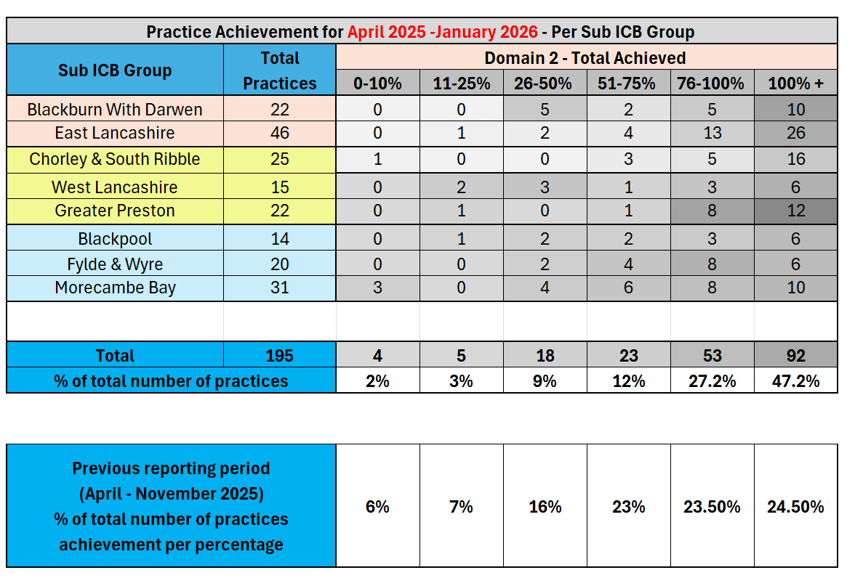
General Practice: Local Enhanced Services
Activity Metric | General Practice Local Enhanced Services: Long-Terms Condition Holistic Health Assessment Initial Delivery, January 2026
 | Primary Care Contracts Sub Committee / Primary Care Medical Services Group
 | Group Chair: | Peter Tinson | SRO: | Donna Roberts | Clinical Lead: | John Miles
This metric measures The number of GP practices in each sub-ICB grouping who have achieved respective percentages of their target holistic health assessments (Domain 2 of the ICB’s new Long-Terms Condition Local Enhanced Service).
What does this tell us? Holistic Health Assessments (HHA) – Q3 Delivery Update (2025/26) Delivery of Holistic Health Assessments (HHAs) under the Long-Term Conditions (LTC) Local Enhanced Service (LES) is progressing well into the third quarter of 2025/26. 86% of practices have delivered more than 50% of their total annual target by the end of Dec 2025 and shows exceptional delivery by practices across Lancs & South Cumbria. A total of 74% of practices, have achieved over 75% of their annual target. The number of practices reporting to have only achieved 0-10% of their target has reduced to 4. A reduction of 6 practices from the previous month. Overall, this level of activity is in line within expectations for this point in the year. Regular updates on LES performance are also received by Primary Care Medical Services Group, the Acute Trusts’ contract monitoring meetings, Finance and Contracting Committee and Board.
Actions: Initial Delivery Progress: The delivery of HHAs under the LTC LES is progressing well. Other LES activity data is provided in the next 2 slides and shows a comprehensive overview of the LES performance across 13 LES contracts. General Practice Local Enhanced Services – Sign-Up Status Summary Sign-Up Rates: The sign-up figures for all LESs across the ICB remain unchanged from last month, with an average sign-up rate of 96% across GP practices in Lancashire and South Cumbria (LSC). Service Coverage Oversight: The LES Oversight Group continues to monitor and address population gaps in service delivery. While this is primarily managed at place level, system-wide working groups have been established to focus on specific areas, including wound care and ring pessary.
Risks: Ongoing Monitoring: Delivery will continue to be closely monitored to ensure equitable access to commissioned services across the population. Supportive Engagement::Multiple meetings have taken place with practices and the Local Medical Committee to jointly review the LES programme performance and delivery and as a result a range of actions have been implemented including coding changes which has shown an improvement in reporting. An engagement plan is in place for implementation during Jan – March 2026.

Slide 5
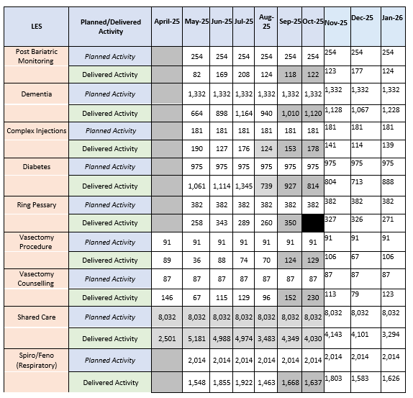
General Practice: Local Enhanced Services
Activity Metric | General Practice Local Enhanced Services: Cost and volume, January 2026
 | Primary Care Contracts Sub Committee / Primary Care Medical Services Group
 | Group Chair: | Peter Tinson | SRO: | Donna Roberts | Clinical Lead: | John Miles
The below table provides a summary of the Lancashire and South Cumbria monthly planned versus actual delivered activity per LES contract which began in May 2025 with one specialist practice-specific LES contracts beginning in May 2025 e.g. vasectomy.
What does this tell us? The table shows the LES contracts which are delivered on a cost and volume basis by practices across Lancashire and South Cumbria. There is a 96% sign up to the delivery of the routine LES contracts for 2025/26. Routine LES activity has steadily increased towards planned levels in the first ten months, of the year. Activity compared to planned levels currently ranges from 60-100%. It is acknowledged that some LES contracts are new in some places and a ‘ramping up’ of activity was expected in the first 10 months of delivery with some activity taking place on an annual basis in the later part of the year. The LES programme activity is reviewed on a monthly basis with actions plans and dedicated sub- groups in place to oversee contract performance and ensure delivery against targets.
Actions: Service Coverage Oversight: The monthly LES Oversight Group and operational groups continue to monitor and support equitable service delivery. While this is primarily managed at place level, system-wide working groups continue to focus on specific areas, including wound care, phlebotomy and ring pessary. Supportive Engagement: Multiple meetings have taken place with practices and the Local Medical Committee to jointly review the LES programme performance and delivery and as a result a range of actions which have been implemented. Mid point review: A mid point review has been completed and provides a summary of activity against plan at practice level to enable practices to review their performance and address any delivery issues at practice/PCN level.
Risks: There is a risk to ongoing monitoring of delivery due to Business Intelligence Team capacity.

Slide 6
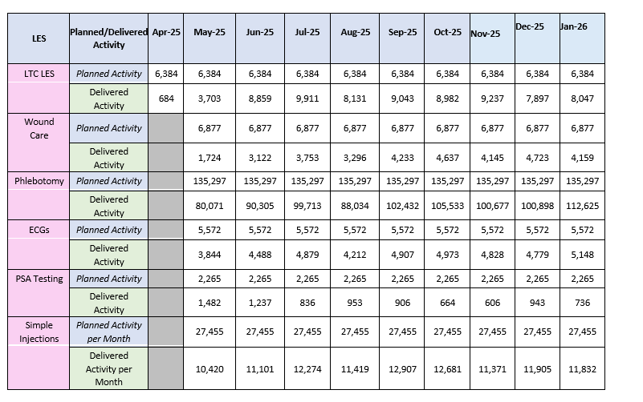
General Practice: Local Enhanced Services
Activity Metric | General Practice Local Enhanced Services: Capitated contracts, , January 2026
 | Primary Care Contracts Sub Committee / Primary Care Medical Services Group
 | Group Chair: | Peter Tinson | SRO: | Donna Roberts | Clinical Lead: | John Miles
The below table provides a summary of the Lancashire and South Cumbria monthly planned versus actual delivered activity per capitated LES contract. These contracts are new contracts rolled out across Lancs & South Cumbria from May 2025 onwards.
What does this tell us? The table shows the LES contracts which are delivered on a capitated budget basis by practices across Lancashire and South Cumbria. The Long Term Condition LES is performing well against the annual target of 76,608 and has delivered 97% (74,494 Holistic Health Assessments) of their annual target by January 2026. The activity is increasing month on month for wound care, phlebotomy ECG's and simple injections as they embed across practices signed up to deliver. Some issues relating to practice coding for these contracts is being rectified through data sharing/webinars with practices and the LMC. Planned activity levels are being reviewed for the PSA testing contract. The majority of these contracts are being newly delivered equitably across Lancs & S. Cumbria and therefore local referral pathways and shift of activity from the acute trust is being closely monitored.
Actions: Service Coverage Oversight: The monthly LES Oversight Group and operational groups continue to monitor and support equitable service delivery. While this is primarily managed at place level, system-wide working groups continue to focus on specific areas, including wound care, phlebotomy and ring pessary. Supportive Engagement: Multiple meetings have taken place with practices and the Local Medical Committee to jointly review the LES programme performance and delivery and as a result a range of actions have been implemented including coding changes which has shown an improvement in reporting. Mid point review: A mid-point review has been completed and provides a summary of activity against plan at practice level to enable practices to review their performance and address any delivery issues at practice/PCN level.
Risks: There is a risk to ongoing monitoring of delivery due to BI capacity.

Slide 7

Web lancashireandsouthcumbria.icb.nhs.uk | Facebook @LSCICB | Twitter @LSCICB

