Slide 1
Executive Summary
The Integrated Primary Care Performance Report is produced each month to provide the latest position against key strategic primary care published performance metrics. The report contains the most recent data available at the time of writing, and it should be noted that this can vary between metrics.
The report consists of a Summary and Benchmarking table (slide 2) followed by a more detailed overview of each metric displayed on a separate pages.
The IPCPR, and the metrics contained within, is aligned to several committees and groups within the ICB.
Groups:
  Committees:
    Primary Care Contracts Sub Committee
    Quality & Outcomes Committee (QOC). N.B. - The QOC receives the 3A’s report which includes a summary of the IPCPR and the full IPCPR is appended. The QOC also receives extracts and details of any metrics/performance areas as escalated by the Primary Care Quality Group (figures / reports would not go automatically for information).
For the January 2026 report the following should be noted:
The reduced performance reported in December for Units of Dental Activity delivered as a proportion of all units of dental activity contracted and Urgent Dental Appointments: Performance in December is attributed to delays in recording activity and submissions by the NHS Business Service Authority (BSA). Both these indicators report lower than expected planning levels, with UDA activity delivery approximately 85k less than expected and 38k lower when compared to the same period in 2024/25.
January 2026 Report- Points of Note:
General Practice LES: long term condition holistic health assessment initial delivery: A total of 48% of practices, have achieved over 75% of their annual target, This is an increase of 15% between Oct to Nov 25 and the number of practices reporting to have only achieved 0-10% of their target has reduced to 11. A reduction of 5 practice from the previous month.
GP CQC ratings: There has been an increase to six practices rated as ‘inadequate’ or ‘requires improvement’ by the CQC
Primary Care Services Medical Services Group Medicines Safety Group Primary & Integrated Neighbourhood Care Transformation Programme Group Primary Services Dental Group | Primary Care Quality Group Antimicrobial Stewardship Committee (not a formal ICB committee) Primary Ophthalmic Group Pharmaceutical Services Group

Slide 2
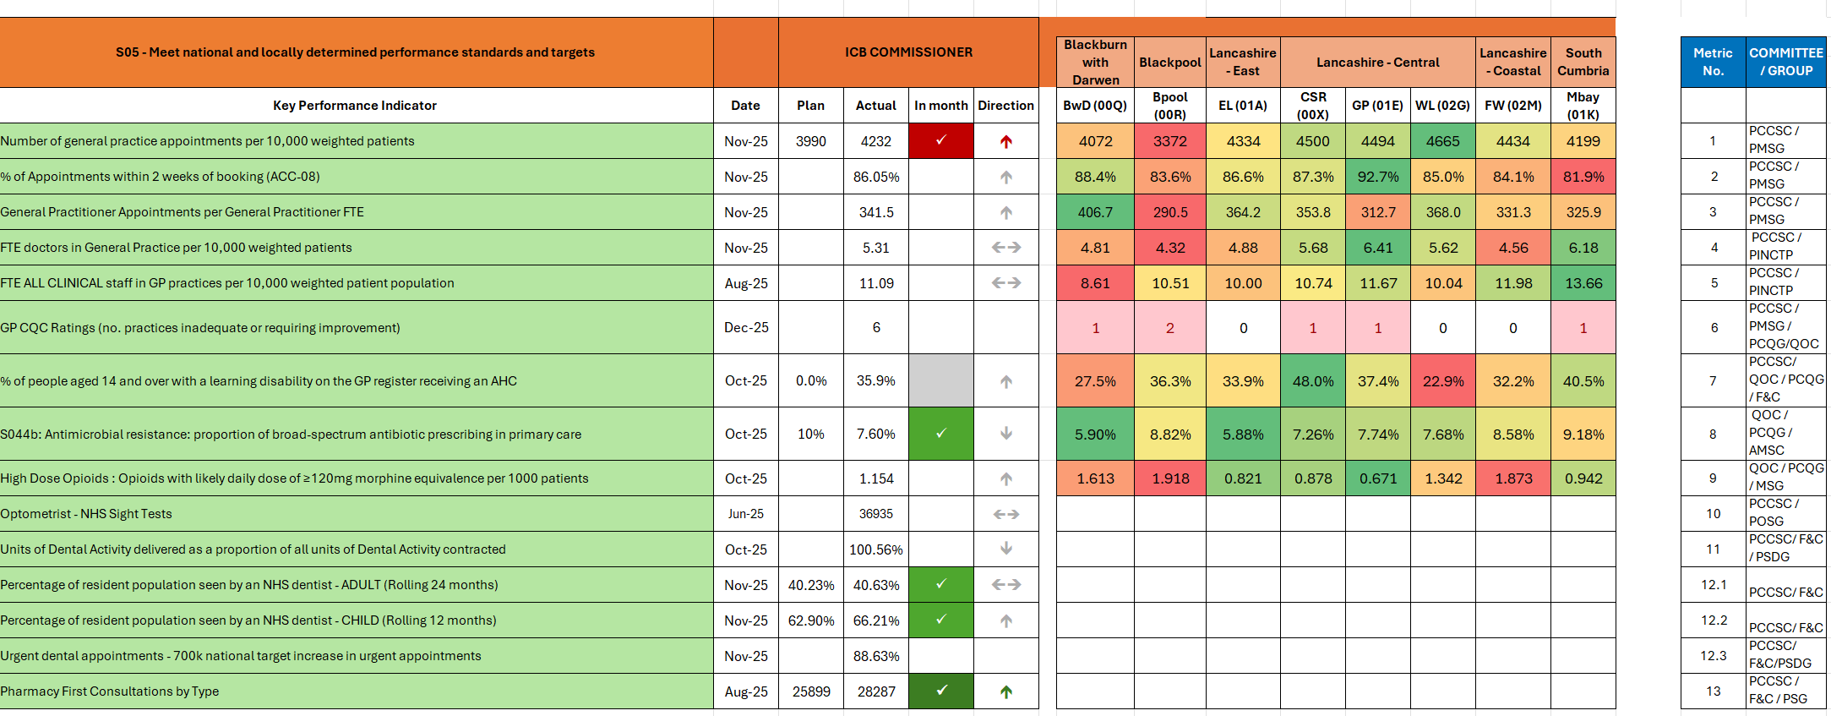
Primary Care Metric Summary and Benchmarking
* The place-level colour coding shows the range of Sub ICB performance per metric;(except for metric 7); green denotes the strongest performing place and red the poorest performing, a linear colour gradient is used to show the variability between these two values. For metric 7 (S044b: broad-spectrum antibiotic prescribing) the color coding denotes how far away a place is from the 10% target, anything above 10% is denoted as red.
Committee / Group Acronym Key
PCCSC | Primary Care Contracts Sub Committee | QOC | Quality and Outcomes Committee | EC | Executive Committee
PCMSG | Primary Care Medical Services Group | PCQG | Primary Care Quality Group | F&C | Finance & Contracting
PSDG | Primary Services Dental Group | POSG | Primary Ophthalmic Services Group | PSG | Pharmaceutical Services Group
PINCTPG | Primary & Integrated Care Transformation Programme | MSG | Medicines Safety Group
 |  | AMSC | Antimicrobial Stewardship Committee

Slide 3
Local Enhanced Service (LES) Delivery Pictorial – November 2025
In 2025/26 the ICB consistently commissioned LES from all LSC general practices. It is the first year of a three year commissioning plan and for many practices represented a stepped change in service delivery expectations. The pictorial below provides a delivery update for each of the LES commissioned.
Post bariatric monitoring
Dementia
Complex injections
Diabetes
Ring pessary
Vasectomy
Spiro/FENO
Wound Care
811
patients received their annual monitoring avoiding secondary care follow up
6,259
patients received a comprehensive assessment and medication review avoiding outpatient follow up
1,058
patients received an injection for osteoporosis avoiding secondary care attendance
5,864
patients received injectable therapy thereby avoiding referral to secondary care for insulin titration
2,079
patients received ring pessaries thereby avoiding referral to secondary care
714
patients received vasectomies thereby avoiding referral to secondary care
saved 408kg of CO2
11,725
patients received tests as part of a holistic respiratory assessment thereby avoiding referral for secondary care diagnostics
23,965
patients received wound care treatment thereby avoiding referral to community and same day urgent care services
Phlebotomy
ECGs
PSA Tests
Simple Injections
End of Life Care
Long Term Conditions
666,139
individual blood test appointments were undertaken in General Practice
31,568
patients received tests avoiding referral to secondary care or CDCs
5,815
patients have been followed up for PSA monitoring reducing the need for outpatient follow up
81,037
patients received injections for endometriosis and prostate cancer reducing the number of associated outpatient appointments. Plus B12 injections shifted from community services to practices
8,970
patients with an advanced care plan
60%
of the patients on the palliative care register
53,117
patients received a Holistic Health Assessment (HHA)
10%
reduction in non-elective admissions for patients receiving an HHA
4.4%
of patients receiving a HHA offered social prescribing support
The impact of the LES differs in each place depending on the historic commissioning arrangements. The consistent commissioning of the LES represents both the retention of existing impact and new impact. The second year of the LES commissioning plan includes an expansion of outcome-based metrics.

Slide 4
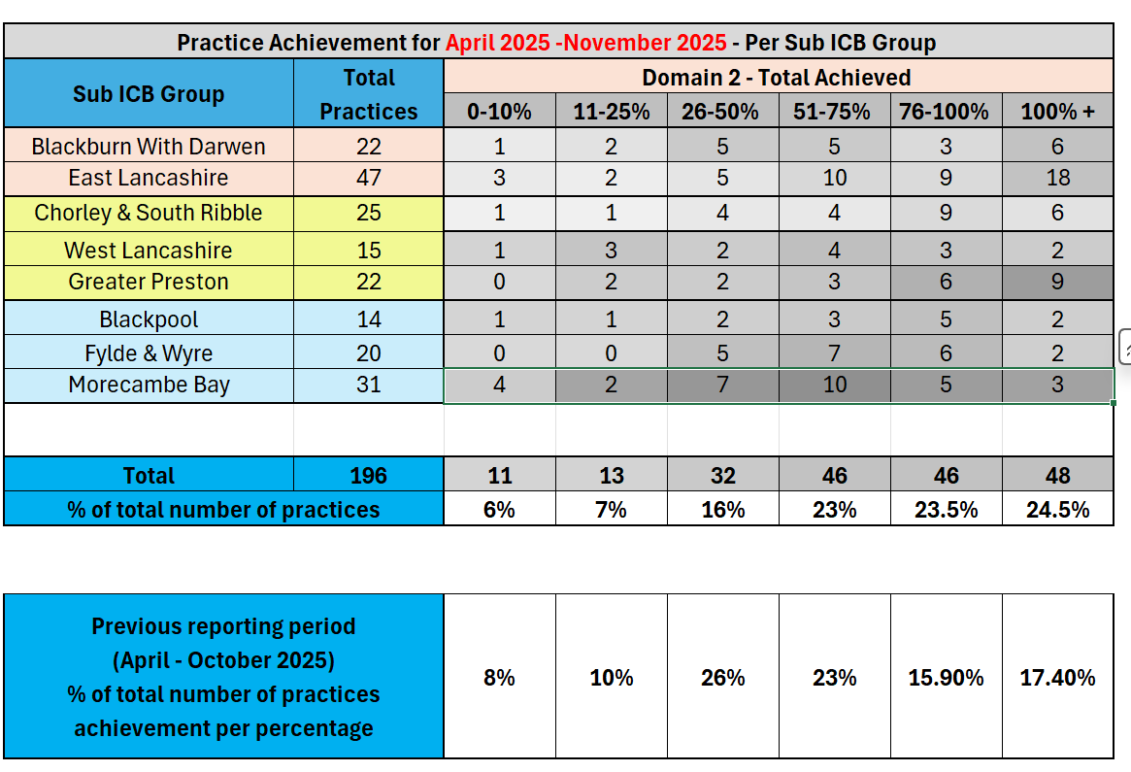
General Practice: Local Enhanced Services
Activity Metric | General Practice Local Enhanced Services: Long-Terms Condition Holistic Health Assessment Initial Delivery 2025
 | Primary Care Contracts Sub Committee / Primary Care Medical Services Group
 | Group Chair: | Peter Tinson | SRO: | Donna Roberts | Clinical Lead: | John Miles / Felicity Guest
This metric measures The number of GP practices in each sub-ICB grouping who have achieved respective percentages of their target holistic health assessments (Domain 2 of the ICB’s new Long-Terms Condition Local Enhanced Service).
What does this tell us? Holistic Health Assessments (HHA) – Q3 Delivery Update (2025/26) Delivery of Holistic Health Assessments (HHAs) under the Long-Term Conditions (LTC) Local Enhanced Service (LES) is progressing well into the third quarter of 2025/26. 71% of practices have delivered more than 50% of their total annual target by the end of Nov 2025 and shows exceptional delivery by practices across Lancs & South Cumbria. A total of 48% of practices, have achieved over 75% of their annual target, This is an increase of 15% between Oct to Nov 25. The number of practices reporting to have only achieved 0-10% of their target has reduced to 11. A reduction of 5 practice from the previous month. Overall, this level of activity is in line within expectations for this point in the year. Regular updates on LES performance are also received by Primary Care Medical Services Group, the Acute Trusts’ contract monitoring meetings, Finance and Contracting Committee and Board.
Actions: Initial Delivery Progress: The delivery of HHAs under the LTC LES is progressing well. Other LES activity data is provided in the next 2 slides and shows a comprehensive overview of the LES performance across 13 LES contracts. General Practice Local Enhanced Services – Sign-Up Status Summary Sign-Up Rates: The sign-up figures for all LESs across the ICB remain unchanged from last month, with an average sign-up rate of 96% across GP practices in Lancashire and South Cumbria (LSC). Service Coverage Oversight: The LES Oversight Group continues to monitor and address population gaps in service delivery. While this is primarily managed at place level, system-wide working groups have been established to focus on specific areas, including wound care and ring pessary.
Risks: Ongoing Monitoring: Delivery will continue to be closely monitored to ensure equitable access to commissioned services across the population. Supportive Engagement::Multiple meetings have taken place with practices and the Local Medical Committee to jointly review the LES programme performance and delivery and as a result a range of actions have been implemented including coding changes which has shown an improvement in reporting. An engagement plan is being drafted during Jan for implementation in Jan – March 2026.
* There are 196 practices who are signed up and delivering a range of LES contracts for 2025/26. The Long Term Condition (LTC) LES has temporarily had 195 practices due to a change of practice leadership and procurement in a single practice in Morecambe. This practice has since contracted to deliver the LTC LES and therefore their activity is now being counted moving forwards.

Slide 5
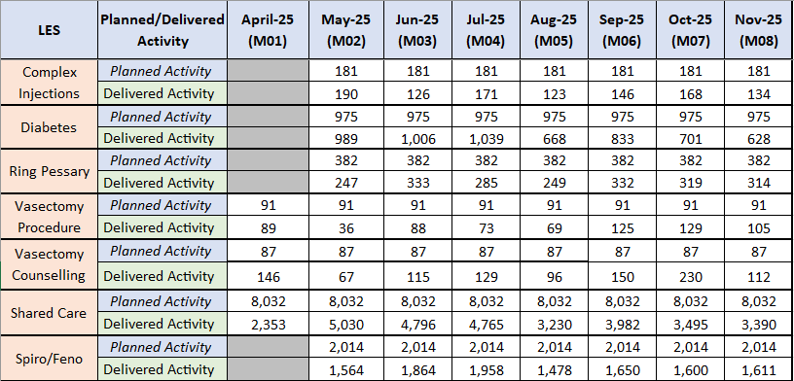
General Practice: Local Enhanced Services
Activity Metric | General Practice Local Enhanced Services: Cost and volume
 | Primary Care Contracts Sub Committee / Primary Care Medical Services Group
 | Group Chair: | Peter Tinson | SRO: | Donna Roberts | Clinical Lead: | John Miles / Felicity Guest
The below table provides a summary of the Lancashire and South Cumbria monthly planned versus actual delivered activity per LES contract which began in May 2025 with one specialist practice-specific LES contracts beginning in April 2025 e.g. vasectomy.
What does this tell us? The table shows the LES contracts which are delivered on a cost and volume basis by practices across Lancashire and South Cumbria. There is a 96% sign up to the delivery of the routine LES contracts for 2025/26. Routine LES activity has steadily increased towards planned levels in the first seven months, of the year. Activity compared to planned levels currently ranges from 60-100%. It is acknowledged that some LES contracts are new in some places and a ‘ramping up’ of activity was expected in the first 7 months of delivery with some acivity taking place on an annual basis in the later part of the year. The LES programme activity is reviewed on a monthly basis with actions plans and dedicated sub- groups in place to oversee contract performance and ensure delivery against targets.
Actions: Service Coverage Oversight: The monthly LES Oversight Group and operational groups continue to monitor and support equitable service delivery. While this is primarily managed at place level, system-wide working groups continue to focus on specific areas, including wound care, phlebotomy and ring pessary. Supportive Engagement: Multiple meetings have taken place with practices and the Local Medical Committee to jointly review the LES programme performance and delivery and as a result a range of actions have been implemented including coding changes which has shown an improvement in reporting. Mid point review: A mid point review has been completed and provides a summary of activity against plan at practice level to enable practices to review their performance and address any delivery issues at practice/PCN level. The Data Quality Team have also providing practices with individualised data reports and webinars to enable practice to review their coding and activity.
Risks: There is a risk to ongoing monitoring of delivery due to Business Intelligence Team capacity.

Slide 6
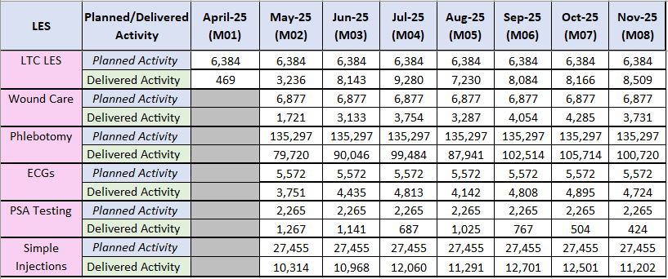
General Practice: Local Enhanced Services
Activity Metric | General Practice Local Enhanced Services: Capitated contracts
 | Primary Care Contracts Sub Committee / Primary Care Medical Services Group
 | Group Chair: | Peter Tinson | SRO: | Donna Roberts | Clinical Lead: | John Miles / Felicity Guest
The below table provides a summary of the Lancashire and South Cumbria monthly planned versus actual delivered activity per capitated LES contract. These contracts are new contracts rolled out across Lancs & South Cumbria from May 2025 onwards.
What does this tell us? The table shows the LES contracts which are delivered on a capitated budget basis by practices across Lancashire and South Cumbria. The Long Term Condition LES is performing well against the annual target of 76,608 and has delivered 70% (53,207 Holistic Health Assessments) of their annual target by November 25. this is a 12% increase from the previous month. The activity is increasing month on month for wound care, phlebotomy ECG's and simple injections as they embed across practices signed up to deliver. Some issues relating to practice coding for these contracts is being rectified through data sharing/webinars with practices and the LMC. Planned activity levels are being reviewed for the PSA testing contract. The majority of these contracts are being newly delivered equitably across Lancs & S. Cumbria and therefore local referral pathways and shift of activity from the acute trust is being closely monitored.
Actions: Service Coverage Oversight: The monthly LES Oversight Group and operational groups continue to monitor and support equitable service delivery. While this is primarily managed at place level, system-wide working groups continue to focus on specific areas, including wound care, phlebotomy and ring pessary. Supportive Engagement: Multiple meetings have taken place with practices and the Local Medical Committee to jointly review the LES programme performance and delivery and as a result a range of actions have been implemented including coding changes which has shown an improvement in reporting. Mid point review: A mid-point review has been completed and provides a summary of activity against plan at practice level to enable practices to review their performance and address any delivery issues at practice/PCN level. The Data Quality Team have also providing practices with individualised data reports and webinars to enable practice to review their coding and activity.
Risks: There is a risk to ongoing monitoring of delivery due to BI capacity.

Slide 7
General Practice: Appointments
Activity Metric | 1. Number of general practice appointments per 10,000 weighted patients : November 2025
 | Primary Care Contracts Sub Committee / Primary Care Medical Services Group
 | Group Chair: | Peter Tinson | SRO: | Donna Roberts | Clinical Lead: | Dr Lindsey Dickinson / Dr John Miles
What does this tell us? In November, general practice delivered 853,450 appointments, bringing the year‑to‑date total to 4,053,076—slightly below the same period last year (-6,403, -0.09%). The ICB’s plan was set higher than last year’s delivery based on NHSE feedback, and current year to date performance is -1.4% (-100.6k), however this is an improving position over the last two months. L&SC offers fewer general practice appointments per head of population than the national average (-15.7%) and is just below the regional average (-1%), but delivers a higher proportion of face‑to‑face appointments (69.2% in November compared with 62.9% nationally). General practice workforce and recruitment pressures continue; L&SC has fewer FTE doctors per 10,000 weighted population than national averages. Despite this, the proportion of GP appointments in L&SC (November, 42.9%) remains close to the national rate (just 1.1% below).
Actions: GP Improvement Programme (GPIP): Two practices have withdrawn from the GPIP programme due to pressure on capacity and demand, leaving 14 practices still participating. All remaining practices have completed the diagnostic phase, identified priority projects, and begun implementing action plans focused on improving access. 2025/26 Capacity and Access Improvement Payment (CAIP): PCNs continue to be supported with CAIP achievement. So far, 18 PCNs (43%) have declared for the Supporting Modern General Practice (MGP) Access domain, and 16 PCNs (38%) have declared for Risk Stratification for Continuity of Care, with seven of these awaiting final sign-off. Online Consultations (OC): Following the national launch of Online Consultations (OC) in October, the ICB is monitoring compliance and supporting one practice to enable OC throughout core hours by the week ending 30 January 2026. A new OC section has also been added to the GP intranet, providing locally developed ‘Top Tips’ and additional guidance. 2026/27 planning: GPAD plans for the next 3 years have been modelled and developed based on workforce predictions and historic trends. MGP Implementation Practice Survey: Feedback from 48 practices who received the 2024/25 MGP Transition Support Funding has been reviewed, offering useful insight into the approaches taken and the challenges they encountered.
Risks: It is not possible to quantify or fully monitor OC data as not all OC systems’ data is captured in GPAD, therefore these appointments are ‘hidden’ from this data set. For the year-to-date national data indicates that 4.1% of LSC appointments were held via video conference/Online, compared to 7.7% nationally, but the value is thought to be higher due to missing data.
This metric measures: The data is collated from general practice appointment data (GPAD), remains listed as 'experimental' by NHSE. It provides an incomplete measure of activity for individual GP practices. Changes in activity levels in practices may be impacted by both changes in demand and capacity. Month to month changes are frequently influenced by seasonal changes in activity, annual trend data is more helpful to provide a longitudinal comparison.
November 2025
National | North West | LSC
5024 | 4278 | 4233

Slide 8
General Practice: Appointments
Activity Metric | 2. % of appointments within 2 weeks of booking [ACC-08 Appointment types] : November 2025
 | Primary Care Contracts Sub Committee / Primary Care Medical Services Group
 | Group Chair: | Peter Tinson | SRO: | Donna Roberts | Clinical Lead: | Dr Lindsey Dickinson / Dr John Miles
This metric measures: This data is collated from practice appointment data, is currently listed as 'experimental' by NHSE. The data has previously been part of a Primary Care Network (PCN) performance metric, this use has been discontinued and in 2024 exception reporting was introduced that potentially will make longitudinal assessment of the data difficult. It can provide an assessment of access but this use is significantly impacted by levels of deprivation within a practice population (areas of lower deprivation typically have more appointments booked <2 weeks). N.B. The national contractual incentive for ACC-08 was removed for general practices in 2024/25, and as a national ICB metric for 2025/26.
What does this tell us? In November 2025, 86% of appointments in the eight specified categories were offered within two weeks, a slight improvement from the previous period (+0.3%). Half (50.6%) of these appointments were offered on the same day; below the national average of 53.8% There remains variations at sub-ICB (and lower) levels with same day appointment rates ranging from 41.3% to 57.3%, reflecting differing operating models, seasonal pressures and population needs.
Actions: A review and possible redesign of the Integrated Urgent Care model is underway, aiming to improve same‑day access for patients who do not require continuity of care. Subject to procurement, the revised model is planned for mobilisation by 1 April 2027. The proportion of appointments within 14 days and same day are considered as part of the proactive visit process.
Risks: This data (as it also uses GPAD as its basis) does not include GP online consultations data for some L&SC practices as this is dependent upon the online consultation software provider. Therefore, this activity does not reflect the full appointment activity undertaken as it is ‘hidden’. There is no national target for ICB or practices for this metric. There is no national modelling or expectations of the impact of OC and MGP on these metrics.
November 2025
National | North West | LSC
87.9% | 88.1% | 86%
10 Year Health Plan : Access
NHS App: By 2028, patients will be able to see who is involved in their care, communicate with professionals directly, draft and view their care plans, book and hold appointments and leave feedback. AI-powered online advice will be built into the App.
Digital telephony will be used to ensure all phones are answered quickly. Those who need it, will get a digital or telephone consultation for the same day they request it.

Slide 9
General Practice: Appointments & Workforce
Activity Metric | 3. General Practitioner Appointments per General Practitioner FTE : November 2025
 | Primary Care Contracts Sub Committee / Primary Care Medical Services Group
 | Group Chair: | Peter Tinson | SRO: | Donna Roberts | Clinical Lead: | Dr Lindsey Dickinson / Dr John Miles
This metric measures: This metric is built from GP appointment data being linked with NHS GP workforce data. It provides an approximation of workload intensity for individual GPs. There is not a current benchmark or defined limits for appropriate workload intensity. This metric is helpful to monitor medium term workload trends. The metric is limited by not capturing all General Practitioner activity.
What does this tell us? The number appointments provided per full-time-equivalent (FTE) General Practitioner across L&SC in November 2025 is 341.5. This is higher than the North West average though lower than the national average. There are variations by sub-ICB (and PCN / Practice) with GPs in Blackburn with Darwen (BwD) undertaking 406.7 and West Lancs undertaking 368 appointments per FTE GP, significantly higher than the ICB, regional and national average. BwD GPs are undertaking around 65 appointments per FTE GP more than the L&SC average, whilst GPs in Greater Preston are undertaking around 29 appointments fewer per FTE GP than the L&SC average.
Actions: The Primary Care Team has noted the challenges faced by PCNs in recruiting under the ARRS scheme, which does not allow flexibility in the use of funding to top up the allowable wage offer. ICB workforce development manager, facilitated by the training hub remaining in place for 2025/26 to support practices and PCNs with recruitment, this includes the recruitment of GPs both traditionally and via the ARRS scheme. A paper regarding the future funding of the Training Hub is being considered by CRG on 06.02.2026. The ICB’s work to support practices with Access and the new ICB’s Local Enhanced Services (LES) will also support this indicator’s performance during 2025/26.
Risks: Given the predictions in workforce as the primary driver of capacity there is assessed to be a risk that demand will continue to exceed capacity for the new financial year. This will create potential challenges in the quality of care, sustainability of service delivery and access to general practice. There is a risk that GP practices may not recruit additional GPs to work in general practice as the costs of running a practice are increasing, putting pressure on their budgets and affecting their recruitment plans. There are concerns the National Insurance increases for employers may also negatively affect practices’ staffing costs and finances and therefore their decisions to recruit. This data also uses GPAD data as its basis which is nationally recognised to be experimental. There is no national modelling or expectations of the impact of OC and MGP on these metrics.
November 2025
National | North West | LSC
355.3 | 335.2 | 341.5

Slide 10
General Practice: Workforce
Activity Metric | 4. FTE Doctors per 10,000 weighted patients : November 2025
 | Primary Care Contracts Sub Committee / Primary and Integrated Neighbourhood Care Transformation Programme Group
 | Group Chair: | Peter Tinson | SRO: | Donna Roberts | Clinical Lead: | Dr Lindsey Dickinson / Dr John Miles
This metric measures: The data is obtained from monthly NHS workforce returns and provides an assessment of the number of full time equivalent (FTE) General Practitioners covering a population. Is an indicator of General Practitioner capacity within the populations.
What does this tell us? The national GP workforce data for November 2025 shows an increase in the number of full-time-equivalent (FTE) doctors per 10,000 patients (1%). However, this is not mirrored regionally and within LSC where a decrease in the number of FTE doctors per 10,000 weighted patients (of -1% and -1%) has been found. The increase in the numbers of FTE doctors has been seen across the country but overall, the proportion of GPs per population remains lower in LSC than regional and national levels. There is local sub-ICB variation with Blackpool, Fylde & Wyre, and Blackburn with Darwen areas continuing to see the lowest number of GPs covering their populations. This data does not include recently qualitied GPs employed under the expanded Additional Roles Reimbursement Scheme (ARRS) scheme, these posts are captured in ARRS roles data. To date 49.25 GPs have been employed through the ARRS scheme.
Actions: Further analysis of the August LSC data is to take place to further understand the differences in increases between national and regional rates. Previously ARRS funding was separated into 2 funding streams for GPs and other clinical staff. ARRS funding has now been combined into one funding stream. The data will be reviewed to understand if this impacts on recruitment. The ARRS scheme now allows for greater flexibility in funding, time is needed to understand if this flexibility has an impact on recruitment levels. ICB workforce development manager, facilitated by the training hub remaining in place for 2025/26 to support practices and PCNs with recruitment, this includes the recruitment of GPs both traditionally and via the ARRS scheme. A paper regarding the future funding of the Training Hub is being considered by CRG on 06.02.2026.
Risks: Given the predictions in workforce as the primary driver of capacity there is assessed to be a risk that demand will continue to exceed capacity for the new financial year. This will create potential challenges in the quality of care, sustainability of service delivery and access to general practice. There is a risk that GP practices may not recruit additional GPs to work in general practice as the costs of running a practice are increasing, putting pressure on their budgets and affecting their recruitment plans. There are concerns the National Insurance increases for employers may also negatively affect practices’ staffing costs and finances and therefore their decisions to recruit.
Nov 2025
National | North West | LSC
6.30 | 6.09 | 5.35
10 Year Health Plan focus: Workforce
Thousands more GPs will be trained

Slide 11
General Practice: Workforce
Activity Metric | 5. General Practice FTE Clinical Staff by Group per 10,000 weighted patients : November 2025
 | Finance and Contracting Committee / Primary and Integrated Neighbourhood Care Transformation Programme Group
 | Group Chair: | Peter Tinson | SRO: | Donna Roberts | Clinical Lead: | Dr Lindsey Dickinson / Dr John Miles
This metric measures: The data is obtained from monthly NHS workforce returns and provides an assessment of the number of clinical staff working within general practice across a population. It includes General Practitioners, Practice Nurses and individuals providing direct patient care (the latter focusing on ARRS or other allied health professionals working within practice). It doesn't include workforce employed directly by PCNs or other Primary Care Providers. It Is an indicator of General Practitioner, Nurse and Direct Patient Care Staff capacity within the populations.
What does this tell us? Across all staff groups, L&SC has a lower full time equivalent (FTE) workforce than national average. The number of FTE nurses in general practice per 10,000 weighted patients is higher in L&SC than the North West and nationally. All other Direct Patient Care (DPC) FTE staff per 10,000 weighted pts. Are slightly below national averages. There are significant variations at sub-ICB level with Blackburn with Darwen highlighted as having the lowest FTE total workforce per 10,000 patients, which is predominantly caused by their lower number of FTE Nurses and DPC staff. The overall general practice workforce figures have also been positively impacted by the increase of GPs as reported on the previous slide
Actions: Previously ARRS funding was separated into two funding streams for GPs and other clinical staff. ARRS funding has now been combined into one funding stream. The data will be reviewed to understand if this impacts on recruitment. The ARRS scheme now allows for greater flexibility in funding, time is needed to understand if this flexibility has an impact on recruitment levels. ICB workforce development manager, facilitated by the training hub remaining in place for 2025/26 to support practices and PCNs with recruitment, this includes the recruitment of GPs both traditionally and via the ARRS scheme. A paper regarding the future funding of the Training Hub is being considered by CRG on 06.02.2026. Further clinical staff may be required within general practice following significant investment through the new Local Enhanced Services (LES)
Risks: Given the predictions in workforce as the primary driver of capacity there is assessed to be a risk that demand will exceed capacity for the financial year 2025/26. This will create potential challenges in the quality of care, sustainability of service delivery and access to general practice. There is a risk that GP practices may not recruit additional GPs as the costs of running a practice are increasing, putting pressure on their budgets and affecting their recruitment plans. There are concerns the National Insurance increases for employers may also negatively affect practices’ staffing costs and finances and therefore their decisions to recruit. SDF funding for the visa support sponsorship is not available for 2025/26.
November 2025
National | North West | LSC
11.78 | 10.82 | 11.17

Slide 12
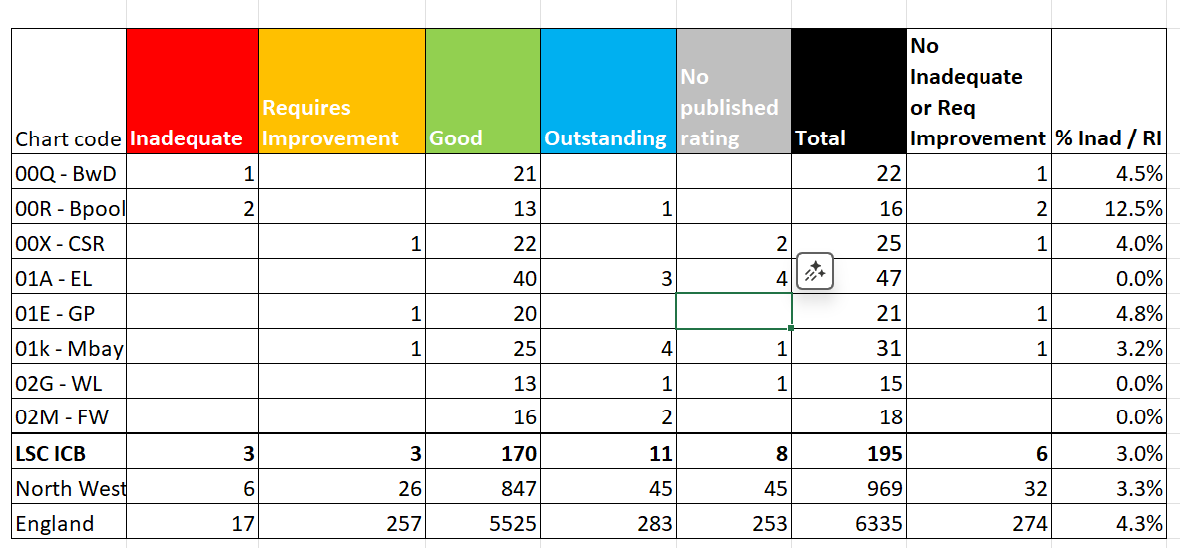
General Practice: CQC Ratings
Quality Metric | 6. GP CQC Ratings (no. practices inadequate or requiring improvement) : December 2025
 | Primary Care Contracts Sub Committee & Quality & Outcomes Committee / Primary Care Medical Services Group & Primary Care Quality Group
 | Group Chair: | Peter Tinson & Kathryn Lord | SRO: | Peter Tinson | Clinical Lead: | Dr Lindsey Dickinson
This metric measures: The data is provided by the Care Quality Commission (CQC) following inspections or review of GP surgeries. The focus on inadequate or requiring improvement ratings across the five CQC domains is an indicator of quality of service provided.
What does this tell us? The majority of L&SC practices (181/195) are rated as ‘good’ or ‘outstanding’. Six practices are currently below the expected standard: three rated inadequate (two in Blackpool, one in BwD) and three rated requires improvement (one each in Chorley & South Ribble, Greater Preston, and Morecambe Bay).
Actions: The ICB’s primary care and quality teams continue to engage with practices rated as inadequate or requires improvement to identify improvements, seek delivery assurance and where relevant provide support: Within Chorley & South Ribble (CSR): one practice ‘requires improvement’ The practice is currently receiving a quality review by the CQC. The ICB conducted a visit in June 2025 and a reactive quality assurance visit on the 16 October 2025, at which assurance was provided that the practice have responded to the issues raised by CQC. There are no actions outstanding. The practice is awaiting a CQC reinspection, date awaited. The place team remain in contact with the CQC and the Local Medical Committee (LMC) to determine how the ICB can offer further support. Within Morecambe Bay (Mbay): one practice ‘requires improvement’ The practice has completed all actions and are awaiting a reinspection from CQC, date awaited. Within Blackpool (Bpool): two practices ‘inadequate’ Practice 1 – placed in special measures following an ‘inadequate’ rating at their assessment in Apr/May 2025. The ICB conducted a reactive quality assurance visit in August 2025 and were assured that the practice were addressing the CQC’s concerns. The practice has formally responded to the CQC report and ICB visit, responding to all concerns. A CQC reinspection is planned, date awaited. Practice 2 – The practice responded to the CQC’s key lines of enquiry (KLOEs) and actions identified at the ICB visit in October 2025. The ICB is reviewing the document of evidence submitted by the practice in November and December ahead of further visit scheduled for February. Within Blackburn with Darwen (BwD): one practice ‘inadequate’ Following an inspection in July 2025 a practice within BwD has been rated as inadequate. Place Team are working with the practice to produce an action plan that addresses all concerns, and monitoring meetings will be established to oversee implementation. The LMC are also supporting. Within Greater Preston (GP): one practice ‘requires improvement’ The practice was rated Requires Improvement in October 2025 following an inspection in June. The ICB has visited and confirmed that previous recommendations and KLOEs have been addressed, so no further visit or action plan has been required. The practice continues to receive support from the ICB’s Safeguarding team and People’s Directorate .
December 2025. Number and percentage of practices rated by the CQC as inadequate or requiring improvement:
National | North West | LSC | BwD | Bpl | CSR | EL | GP | MB | WL | FW
274 (4.3%) | 32 (3.1%) | 6 (3.0%) | 1 (4.5%) | 2 (12.5%) | 1 (4%) | 0 | 1 (4.8%) | 1 (3.2%) | 0 | 0
December 2025. Overall Practice CQC Ratings:
Risks: There is a risk that the practices do not meet the requirements of the CQC inspection reports however this is mitigated through the involvement of the ICB and other bodies, such as the Local Medical Committee (LMC), in liaising with the practices and providing support.

Slide 13
General Practice: Checks
Quality Metric | 7. % of people aged 14 and over with a learning disability on the GP register receiving an AHC: October 2025
 | Primary Care Contracts Sub Committee & Quality & Outcomes Committee / Primary Care Quality Group & Finance and Contracting Committee
 | Group Chair: | Peter Tinson | SRO: | Debbie Wardleworth | Clinical Lead: | Dr Lindsey Dickinson / Dr Felicity Guest
Actions: A programme of activity to support access to specialist eye care (Easy Eye Care service) has been delivered by the service, the Primary Care Network (PCN) and Learning Disability & Autism (LD&A) teams to encourage uptake. This has included enhancing the link on the LD&A and Lancashire & South Cumbria Foundation Trust (LSCFT) webpages to enable optician searches; dissemination to advocacy and Learning Disability (LD) partnership boards and key partners. Optical checks and Audiology checks remain part of the health check prompt and training offer. 43 practices are part of the LD champion co-produced model, with roll-out phased to enable the team to support during the highest quarter of AHC delivery. Enhanced support is being offered to champion practices with excellent examples of promotion being seen in practice newsletters. Increased signed up from Barrow practices. LD champion model rollout to Hospices. Easy read welcome pack developed and authorised. Targeted work to improve uptake of national cancer screening programmes. Over 1,855 people with LD, parents and carers have attended AHC workshops to demonstrate health checks, 365 people attended mens' health and womens health workshops and 76 attended lung health workshops. These continue to be effective in reducing barriers to attendance, and empowering people with a LD to question their health check. Cultural sensitivity passport developed. TAP – Touch Activated Phlebotomy (MB) pilot rollout. Funding request to be submitted from ICB (LD&A) Performance in Quarter 1 is always low across the ICB, as the majority of health checks are completed in Qs 3&4. ICB dashboard provides monthly data at practice and PCN level, allowing us to identify areas of concern and respond accordingly. This allows us to monitor trends and changes in practice delivery and has supported the identification and rectification of practices delivering by telephone; with larger DNAs and low invites
Risks: Without ongoing messaging and work with practices and staff, lived experience and advocacy group, there is a risk that performance may always reduce to below target. Without constant communication and work with wider health colleagues to deliver key health messages in an accessible format, people with an LD will continue to be disadvantaged, and experience avoidable mortality. Without the ICB investment and Business Intelligence (BI) team support to collate and produce monthly LD AHC dashboard,, and separate data searches targeted activity to address quality issues cannot continue. LD register validation in Blackpool is not undertaken by the health facilitation team but by the Community Learning Disability Team (CLDT) who are connected to the LD&A team to share data, trends and practice data to shape activity. Since January 2025 each month LD&A team share data including practices of concerns, and this is proving fruitful. One practice, in the Fylde and Wyre area, has declined to share data. Risk of GP practices disengaging with the process due to AHC not being part of QOF
This metric measures: Annual Health Checks (AHC) being undertaken for patients on the Learning Disability register is a key focus for quality of care. This data is collated via the General Practice Extraction Service (GPES) every six months. This is a cumulative target which increases month on month and is aiming to achieve 75% by March 2026.
October 2025
National | North West | LSC
38.7% | 40.4% | 35.9%
10 Year Health Plan focus: Learning Disabilities
Individuals with learning disabilities die about 20 years earlier on average. Care from a neighbourhood team will improve their life outcomes through more holistic, on-going support.

Slide 14
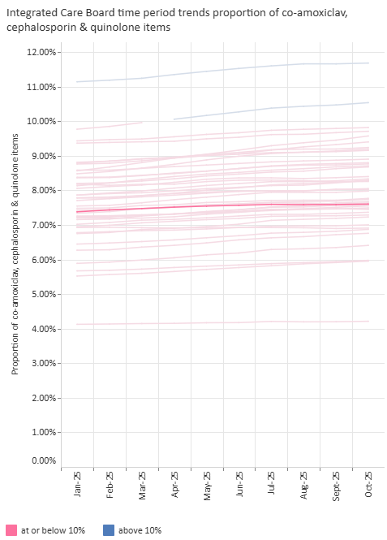
General Practice: Prescribing
Quality Metric | 8. S044b: Antimicrobial resistance: proportion of broad-spectrum antibiotic prescribing in primary care: 12 months to October 2025
 | Quality & Outcomes Committee / Primary Care Quality Group & Antimicrobial Stewardship (AMS) Committee
 | Group Chair: | Kathryn Lord | SRO: | Andrew White | Clinical Lead: | Dr Felicity Guest
What does this tell us? L&SC continues to perform well on this metric in aggregate reporting with a result of 7.6% for the most recent 12 months against a maximum threshold of 10% There is variation at sub-ICB, PCN and practice levels, with the Morecambe Bay area seeing the highest proportion of prescribing of these antibiotics at 9.18%.
Actions: The national Antimicrobial Resistance (AMR) 5 year national action plan, ‘Confronting antimicrobial resistance 2024 to 2029’, targets:- optimise the use of antimicrobials reduce the need for, and unintentional exposure to, antibiotics An Antimicrobial Stewardship (AMS) Committee has been set up across the System to support how we manage AMS, including in primary care. The membership represents all providers in the System. An action plan has been developed through the AMS Task and Finish Group is being delivered at Place, supported by the local Medicines Optimisation (MO) teams. AMS volume and Broad spectrum indictors are no longer part of the National target but are still important to support and deliver the national action plan for reducing the risk of AMR and C.diff, it is recommended by T&F group that these indicators remain in the MO LES. There is a new national indicator for the number of children <10years old who have taken an antibiotic in the last rolling 12 months to be <27%. It is intended that this will form part of the MO LES. Fidaxomicin is expensive and community pharmacies do not keep stocks and treatment can be delayed. Fidaxomicin is a formulary item for the treatment of C.diff in restricted circumstances and is available through community pharmacy, advice has gone out to community pharmacy on how to order in hours and out of hours in a timely manner. The impact of this will be monitored over the next 6 months to understand the impact on access and appropriateness of prescribing.
Risks: Although broad spectrum antibiotics are important to monitor in relation to the risk of C.diff and antimicrobial resistance, it should not be viewed in isolation. Therefore, the NAP also requires us to monitor the overall volume which has a direct impact on future residence. The new children’s indication also needs to be given high attention due to the impact on residence but also risk of other chronic disease such as; asthma, food allergy, hay fever and intellectual disability.
This metric measures: This data is collated from prescribing data and indicates quality of prescribing through responsible antibiotic stewardship. It measures the proportion of co-amoxiclav, cephalosporin and quinolone items prescribed; antibiotics linked to a higher incidence of C.difficle. A lower number represents more appropriate and higher quality prescribing.
October 2025
LSC
7.6%
LSC’s performance (bold line) compared to the other ICBs in the county →
The number of practices in LSC below and above the threshold:
LSC Totals | No. Practices | % Practices
At or below 10% | 174 | 88.3%
Above 10% | 23 | 11.7%

Slide 15
General Practice: Prescribing
Quality Metric | 9. High Dose Opioids : Opioids with likely daily dose of ≥120mg morphine equivalence per 1000 patients: October 2025
 | Quality & Outcomes Committee / Primary Care Quality Group & Medicines Safety Group
 | Group Chair: | Kathryn Lord & Nicola Baxter | SRO: | Andrew White | Clinical Lead: | Faye Prescott
This metric measures: This data is collated from prescribing data and indicates quality of prescribing through responsible prescribing of high dose of opioids per 1000 population. Provides an insight into prescribing and clinical quality. The definition of high dose is above 120mg morphine equivalent per day. There is little evidence that long term prescribing above this dose is helpful, and risk of harm is present.
What does this tell us? The L&SC October 2025 position for the prescribing of high doses of opioids is 1.154 per 1,000 patients which remains above the national average of 0.935. An increase in prescribing of high dose opioids has increased in LSC since the previous reporting period (+14%, 1.014). This is mirrored nationally (+19%, 0.779) The prescribing of high doses of opioids is highest in Blackpool, Fylde & Wyre and Blackburn with Darwen. 3 sub ICB areas (Chorley & South Ribble, Greater Preston and East Lancashire) are below the national average Since April 2024, there are 99 more people on opioids within LSC ICB;
Actions/ updates : ICB wide Community Of Practice (COP) event held on 22nd October. Over 150 LSCICB health care professionals attended. Guest speakers NHSE advisor, Police Controlled drug liaison officer and trauma informed trainer. Positive feedback provided post event. COP event post event feedback requested further work with acute trusts is needed to support the appropriate use of opioids within LSCICB population. ICB clinical lead met with pain specialist from Lancashire Teaching hospital and the specialist is keen to review RAG status of pain medication, lower the opioid dose to further from 80mg MEDD in primary care, link with COP and work to set up MDT within the trust and primary care. Barrow ICC is working on hosting a flipping pain event in coming months and inviting occupational health colleagues from large employer organisation, community pharmacists, work well team and wider health and social care staff.
Risks: Severe shortage (up to 50% or usual supply) of co-codamol 30/500mg tablets – Mid Feb – June 26. May cause substantial patient, pharmacy and prescriber disruption. Mitigations communicated in advance to review patients to reduce where possible and to supply separate paracetamol and codeine where ongoing need confirmed. Opportunity to reduce the long-term burden and risk of high opiate prescribing.
October 2025:
National | LSC
0.925 | 1.154
← Line graph of LSC’s monthly performance(blue line) compared to England (orange line) since June 2019
Comparison of Place level performance against LSC ICB (dark grey) and England (orange line) →

Slide 16
Optometry: Activity
Activity Metric | 10. Optometrist NHS Sight Tests: June 2025
 | Primary Care Contracts Sub Committee / Primary Ophthalmic Services Group
 | Group Chair: | Dawn Haworth | SRO: | Dawn Haworth | Clinical Lead: | Tom Mackley
NOTE : Metric data has not been updated due to national reporting delays; previous month’s update shown below in grey for information only. Narrative has been updated.
This metric measures: The total number of NHS general ophthalmic service (GOS) sight tests carried out in Lancashire and South Cumbria per month. This data will be subject to seasonal variation. NHS sight tests are free for restricted cohorts of the population which include children, people in full time education, those over 60years, those receiving certain benefits, and those with/a family history of specific health and eye conditions.
What does this tell us? The monthly volume of NHS sight tests has remained relatively static over the past 12 month period, with the number of tests being undertaken usually lying between 35,000 and 40,000 per month. In June, the number of sight tests performed increased (2%) from the previous month and remains in line with the 12-month average.
Actions: The ICB is developing a local Sight Test Access Improvement Programme to improve access to NHS sight tests for eligible residents of Lancashire and South Cumbria. As part of the programme a number of local initiatives are being developed:-​ Homeless population – shelters within Blackburn with Darwen, East Lancs and Blackpool have provided eye tests. ​ ‘Easy Eye Care’ – promotes sight tests for patients with learning disabilities and autism​ and the service is continuing during 2025 / 26. The contract for the Easy Eye Care​ initiative (which promotes sight tests for patients with learning disabilities and autism​) has been renewed until March 2026. Special Schools – subject to Exec approval, implementing the national programme to make sight tests available for all pupils attending special schools following launch by the national team Reducing Inequalities – benchmarking geographies across the Lancashire and South Cumbria to promote sight tests in populations where uptake is low.​ There is a communications and engagement workstream as part of the programme which will develop material to support patients accessing eyesight tests (subject to available funding)
Risks: Due to a national issue no current data is available. No issues have been noted by the Optometry group in relation to provision of services. The focus of many of the above initiatives is on reducing health inequalities, and therefore the impact on improving access to NHS sight tests across the whole L&SC population may be minimal. The sight tests in special schools​ initiative has been launched by NHSE. The current GOS sight test provision allocation does not cover all special schools​​. Awaiting agreement from ICB Executives to proceed with procurement.
LSC NHS Sight Tests, current month June 2025: | 36,935
10 Year Health Plan focus: Optometry and Eye Health
Improvements in Optometry services and eye health will be achieved by:
Local diagnosis of glaucoma, diabetic retinopathy, Acute Macular Degeneration (AMD)
Improved access through community diagnostic hubs.
Integration with Neighbourhood Health Centres and MDTs

Slide 17
Dental: Activity
Activity Metric | 11. Units of Dental Activity delivered as a proportion of all Units of Dental Activity contracted : October 2025
 | Primary Care Contracts Sub Committee & Finance & Contracting Committee / Primary Services Dental Group
 | Group Chair: | Amy Lepiorz | SRO: | Donna Roberts | Clinical Lead: | Shane Morgan
NOTE : The graph has not been updated due to national data issues. An explanation of this is given in the narrative.
How are we performing? The cumulative delivery year-to-date (YTD) position to December 2025 is 95% of phased contracted activity. This is reflecting a decline in performance from a break-even in October when performance was 100.6%. Performance is lower than the expected planning levels, with UDA activity delivery is now approximately 85k less than expected and 38k lower when compared to the same period in 2024/25, this reduced performance is attributed to delays in recording activity reported by the BSA, the ICB has been advised the issues is close to being resolved, but the reported activity in the last two periods is lower than we would have expected.
Actions: The ICB’s local Dental Access and Oral Health Improvement Programme was developed to enhance its understanding and management of oral health for LSC, and includes local and national initiatives :- Child Access and Oral Health Improvement Care Homes support Urgent Dental Care pathway Integrated Dental Access Pathway to provide patient with additional Treatments required following Urgent Care and for non- emergency urgent care Additional access to routine care is also offered through a specific pathway to patients in prioritised groups to ensure their oral health does not impact or prevent treatment for other conditions. As part of the 2025/26 planning round a phased trajectory has been submitted outlining the expected volumes over the year.
Risks: The focus of many of the above initiatives is on reducing health inequalities, and therefore the impact on improving dental access across the whole L&SC population may be minimal. The demand on the services are higher than pre-pandemic levels as the oral health of many patients declined during COVID due to restricted access during the pandemic, as a result many patients require more clinical time and a greater number of appointments to make them orally fit. Ongoing challenges in NHS Dental clinician recruitment and retention could further impact upon access to Dental Services and there is a risk that there will not be enough staff to deliver the core and additional / advanced services. The ending of the New Patient Premium initiative was originally identified as a risk but the impact on the levels of activity delivered is seemingly negligible. The BSA delays in processing FP17 submissions is impacting on the ICB performance.
This metric measures: The graph details the number of delivered Units of Dental Activity (UDA) in 2024/25, compared to phased trajectory of UDA delivery within the financial year.
LSC | October 2025 | 100.6%
 | December 2025 | 95%

Slide 18
Dental: Activity
Activity Metric | 12.1 Number of unique patients seen by an NHS dentist – adults (Resident Population): November 25
 | Primary Care Contracts Sub Committee / Finance & Contracting Committee
 | Group Chair: | Amy Lepiorz | SRO: | Donna Roberts | Clinical Lead: | Shane Morgan
This metric measures: The number of unique adult (over 18 years) patients (i.e. individual patients) seen by an NHS Dentist on a 24 month rolling basis as a percentage of the total adult (over 18 years) population.
What does this tell us? It is the ICB’s plan for 40.6% of the adult resident population to have seen an NHS dentist by March 2026. The number of unique adult seen by an NHS Dentist on a 24 month rolling basis as a percentage of the total adult population remains the same as the previous reporting period (40.6%). This exceeds the Q3 milestone.
Actions: The ICB has developed a local Dental Access and Oral Health Improvement Programme to enhance its understanding and management of oral health for the population of Lancashire and South Cumbria. As part of the programme a number of local initiatives have been developed to improve access for adults as follows: Care Homes support to increase the numbers of elderly patients accessing dental services. Urgent Dental Care pathway to increase access to approximately 20,000 additional appointments. Integrated Dental Access Programme to support patient with additional treatment needs following Urgent Care, patients who are not urgent but require treatment within 7 days, and specific patients who are within prioritised groups to ensure their oral health does not impact or prevent treatment for other conditions. A review of the data set adopted has been undertaken to ensure consistency and accuracy of data.
Risks: The risks for this indicator are as detailed on the previous slide (metric 14.) The increased number of repeat appointments for adults with complex dental issues arising during the covid pandemic are still impacting upon the performance of this metric. The end of the New Patient Premium programme implemented national may impact on the levels of access.
Adults | Q3 Milestone = | 40.2% | Nov 25 Actual = | 40.6%
10 Year Health Plan focus: NHS Dentistry
Shift from UDA to outcome/prevention-based contracts

Slide 19
Dental: Activity
Activity Metric | 12.2 Number of unique patients seen by an NHS dentist – children (resident Population): November 2025
 | Primary Care Contracts Sub Committee / Finance & Contracting Committee
 | Group Chair: | Amy Lepiorz | SRO: | Donna Roberts | Clinical Lead: | Shane Morgan
This metric measures: The number of unique child (under 18 years) patients (i.e. individual patients) seen by an NHS Dentist on a 24 month rolling basis as a % of the total child (under 18 years) population.
What does this tell us? It is the ICB’s plan for 63.03% of resident children to have seen an NHS dentist by March 2026. In November 2025, 66.2% of children had seen an NHS dentist within the past 12 months which exceeds the quarter 3 milestone and the March 2026 target.
Actions: The ICB’s Dental Access and Oral Health Improvement Programme includes specific work streams for children's services this includes: Child Access and Oral Health Improvement commencing October 2024 Additional access to routine care is also offered through a specific pathway to patients who are within prioritised group (namely looked after children) to ensure their oral health does not impact or prevent treatment for other conditions. The Primary Dental Services Statement of Financial Entitlements (Amendment) (No2) Directions 2022 (SFE’s) also applies to children’s dental services. A review of the data set adopted for this indicator has been undertaken to ensure the consistency and accuracy of data.
Risks: The risks for this indicator are as detailed on the previous slide (metric 14.)
Children | Q3 Milestone = | 62.9% | Nov 25 Actual = | 66.2%
10 Year Health Plan focus: NHS Dentistry
Focus on prevention e.g. children and tooth extractions

Slide 20
General Practice: Local Enhanced Services
Activity Metric | 12.3 Urgent Dental Appointments – 700k National Target increase in urgent appointments: September 2025
 | Primary Care Commissioning Committee / Finance & Contracting Committee / Primary Services Dental Group
 | Group Chair: | Amy Lepiorz | SRO: | Donna Roberts | Clinical Lead: | Shane Morgan
NOTE : The table below details a significant reduction in activity, this is due to national data issues due to delays in recording activity reported by the BSA
This metric measures: The number of Urgent Dental appointments delivered by NHS Dentists compared to the baseline and phased trajectory. The government has pledged to increase the number of urgent dental appointments nationally by 700,000 per annum for the term of the parliament, the LSC proportion of this is 20,822 appointments. The ICB is required to increase Urgent Appointments form the annual baseline activity of 137,157 appointments to 157,979.
What does this tell us? The cumulative reported position of the ICB is reporting an under performance against the targeted activity levels at 82.46%, a large decrease from the previously reported positions. The low levels of activity delivered in recent months is largely attributed to issues reported by the BSA regarding delays in processing FP17 submissions an issue that started in November and impacting on the last two months of reported activity..
Actions: The ICB’s local Dental Access and Oral Health Improvement Programme was developed to enhance the understanding and management of oral health. It contains access initiatives designed to achieve the additional urgent appointment target including the Urgent Dental Care Pathway and the Integrated Dental Access Pathway (IDAP) for additional treatments following Urgent Care. The scope of the new target is wider than the traditionally defined ‘Urgent Care’ (which was treatment within 24 hours) and now includes unscheduled care, or patients requiring treatments within 7 days. The following actions will support the performance against this metric: commissioned additional capacity to support delivery of the NHSE increased targets. The initial expression of interest (EOI) was oversubscribed, those not successful have been asked if their EOI can be kept on file should the ICB need to reapproach them to secure additional provision. The Local Dental Network (LDN) has convened an urgent care provider network to discuss the urgent care pathway and receive feedback commissioned additional call handling service capacity to manage increased demand and management of patients into the new IDAP service. The LDN has also supported the development of prioritised call handling to ensure those with greatest and immediate need are reviewed first. To support the delivery of urgent dental care NHSE have introduced the national urgent dental care incentive (UDCI) scheme (running from 25 September 2025 to 31 March 2026), which aims to incentivise eligible dental providers to provide more unscheduled care to patients in 2025/26. LSC has developed a comms campaign which will help to promote this initiative.
Risks: The NHSE set target for LSC Urgent Dental Appointments/population is one of the highest nationally, there is a risk that the patient demand for services does not match the national target. The additional targeted activity has been phased to align with the introduction of additional call handling capacity, delays in recruiting new call handling staff will impact on access rates. The dental team are working with call handling to try and ensure there are no empty slots Ongoing challenges in NHS Dental clinician recruitment and retention could further impact upon access to Dental Services and there is a risk that there will not be enough staff to deliver the core and additional advanced services. BSA has reported issues and delays in processing FP17 submissions, highlighted in the low activity reported in recent moths, these issues are expected to be resolved in January 2026.
LSC | December 2025 achievement = 49.14% | Cumulative YTD achievement = 82.46%
Month | *Baseline Target | Additional Appt Target | *Monthly Target | **Monthly Delivery | % Achieved | Cumulative Achieved %
Apr ‘25 | 11,430 |  | 11,430 | 11,486 | 100.5% | 100.49%
May ‘25 | 11,430 |  | 11,430 | 11,208 | 98.1% | 99.27%
Jun ‘25 | 11,430 |  | 11,430 | 11,388 | 99.7% | 99.39%
Jul ‘25 | 11,430 | 2,313 | 13,743 | 12,171 | 88.56% | 96.29%
Aug ‘25 | 11,430 | 2,313 | 13,743 | 11,078 | 80.61% | 92.8%
Sept ‘25 | 11,430 | 2,313 | 13,743 | 12361 | 89.94% | 92.28%
Oct ‘25 | 11,430 | 2,313 | 13,743 | 12428 | 90.43% | 92%
Nov ‘25 | 11,430 | 2,313 | 13,743 | 11239 | 81.78% | 89.41%
Dec ‘25 | 11,430 | 2,313 | 13,743 | 6753 | 49.14% | 82.46%
Jan ‘26 | 11,430 | 2,313 | 13,743
Feb ‘26 | 11,430 | 2,313 | 13,743
Mar ‘26 | 11,430 | 2,318 | 13,743
YTD | 34,290 | 20,822 | 34,290 | 69,660 | - | -
* There have been changes to the national reporting profiles, as NHSE has requested month by month profile trajectory changes. The ICB’s overall target remains the same and for this internal monitoring the monthly trajectory will remain the same to allow for clearer reporting.
**Dental practices have 6 weeks to submit FP17’s detailing dental activity. Therefore, the data for the last 2 months reporting periods are subject to change.

Slide 21
Community Pharmacy: Activity
Activity Metric | 13. Pharmacy First Consultations by Type : August 2025
 | Primary Care Contracts Sub Committee / Finance & Contracting Committee / Pharmaceutical Services Group
 | Group Chair: | Amy Lepiorz | SRO: | Amy Lepiorz | Clinical Lead: | Amy Lepiorz
This metric measures: The activity of the Pharmacy First Service (PFS). PFS enables patients to be referred into CP for an urgent repeat medicine supply and minor aliments consultation. Patients can also access, by either direct approach or healthcare professional referral, treatment for any of the seven clinical conditions; acute otitis media, impetigo, infected insect bites, shingles, sinusitis, sore throat, uncomplicated UTIs. The Pharmacy First Consultation data reflects the number of paid claims made for CP consultations. The data is published by NHSBSA and is in the public domain on the NHSBSA website (Dispensing contractors' data | NHSBSA).
What does this tell us? The growth in the number of CP consultations for the seven clinical pathways has levelled off, with the most recent data showing that 8,591 consultations were carried out in August 2025. Minor illness referrals have been running at around 5,000 referrals per month for the past 7 months but have tailed off in August. This is possibly due to seasonal variations. Blood Pressure checks have a steady growth. Similarly, oral contraception consultations are also increasing.
Actions: The ICB has developed a local Pharmacy Access Programme to support integration and use of the CP advanced services. Key opportunity to increase uptake is via GP referrals which remains varied. Significant work has taken place to ensure pharmacy contractors are consistently able to provide the service with LPC support, focus has now shifted to looking at those GP practices with low referral rates as part of the over-arching GP variance work. Where there is no Community Pharmacy PCN lead, the LPC are filling this gap. Comprehensive communications and engagement has taken place with the public and this will continue as part of a business as usual communications programme/
Risks: The clinical lead has retired and the ICB is unable to recruit to the post therefore the programme is currently without clinical leadership. Prioritisation of primary care programmes has taken place, meaning decreased support from place colleagues due to competing pressures. Potential to link in with medicines optimisation team and utilise the LES to ensure GP referrals continue and increase. Current Community Pharmacy Contractual Framework (CPCF) negotiations between NHSE and CPE may affect the delivery of the service based on the outcomes of the negotiations. Discrepancies found in data reporting on the NHSE planning submission. L&SC ICB use verified claims data which has a time lag due to the claims going through a validation process however NHSE use unverified data which has not been through a validation process. There is an approximate 8% variation in the verified claims data and unverified data, with the unverified data reporting more activity. August is the most up to date verified claims data available to the ICB.
Activity Type | August 2025 | % Total | YTD
Clinical Pathway Consultation | 8,591 | 30.4% | 45,641
Minor illness Consultations | 3,418 | 12.1% | 22,339
Urgent medicine supply | 5,371 | 19% | 26,474
Blood Pressure Checks | 8,074 | 28.5% | 49,049
Oral Contraception Consultation | 2,833 | 10% | 13,382
Total | 28,287 |  | 156,885
Plan | 25,899 |  | 128,260
Variance | 2,388 |  | 28,625
% Delivery | 109.2% |  | 122.3%

Slide 22

Web lancashireandsouthcumbria.icb.nhs.uk | Facebook @LSCICB | Twitter @LSCICB

