Slide 1
Impact assessment guidance
Outline process and criteria for
Detailed processes to outline the criteria and key steps required when undertaking impact assessments for changes within the ICB
Version 0.1 (22nd October 2025)

Slide 2
Introduction
This document outlines how quality impact assessments are undertaken and managed within Lancashire & South Cumbria Integrated Care Board.
It outlines the key stages through the process whilst guiding on specific stages to ensure effective assessments are undertaken.
The five key steps of undertaking an impact assessment include:
Identification of the need for an impact assessment
Conducting an impact assessment
Cross functional review and scrutiny
Approval
Monitoring and management of identified mitigating actions
The impact assessment process has been defined and explained using standard process mapping methods – in doing so it is aimed to provide a consistent and simple step-by-step guide on how to navigate through the process.
Process mapping icon key:
Start of a process or predefined part of a process
Decision point routing to specific outcomes
Process step
End point of a process
Pre-defined or sub-process
Supporting guidance notes (aligned to specific process steps)

Slide 3
Determining the need for an impact assessment
Consider inclusion of a slide that provides guidance on the need and importance of undertaking impact assessments
Mandated requirement to conduct Quality and Equality & Diversity
Other impact assessments
  Sustainability
  Data protection

Slide 4
Conducting an impact assessment
The corresponding steps articulate the required elements for completion when undertaking an impact assessment
Service change / proposal identified
Supporting guidance notes (aligned to specific process steps)
Develop basis of scheme and the proposed change
Defining the scheme description alongside current and desired future state to provide insight into the rationale for change
Identifying the key service leads and sponsors for the change forms part of usual change governance.
In line with new guidance from NHSE, identify wider stakeholders to engage with as part of the impact assessment process. This will ensure that broader insights of potential impacts are captured, understood and mitigated.
Identity key leadership roles
Identify wider stakeholders to engage on change
Stage one assessment is focussed on determining if there are positive, negative or neutral impacts.
Undertake stage 1 assessment
Scoring of current risks (consequence & likelihood)
Collate evidence to determine how impacts will be demonstrated
Negative impacts?
Undertake stage 2 assessment
Identification of mitigating actions
Submission of QIA to PMO enacting review process
Yes
No
Revision of risk scoring based on identified mitigations

Slide 5
3. Cross functional review and scrutiny
4. Approval
Completed QIA submitted
to PMO for review / approval
Supporting guidance notes (aligned to specific process steps)
A single workflow tool is in place provides a clear and transparent process for each of the review stages (PMO / Quality / Exec)
For reference purposes an extract of the QIA kanban is provided in slide 8)
QIA reviewed for accuracy and correctness by PMO
Feedback provided to author with required amends, resubmitted pending changes
Amends required?
Approval status recorded on Verto with mitigating actions progressed through a defined process (step 5 – on following slide)
Yes
Feedback provided to author with required amends, resubmitted pending changes
No
QIA added to Verto Kanban board to initiate review process
Yes
Yes
Proceed to appropriate Executive Sign-off
Quality
Amends required?
No
Review by Chief Nurse & Chief Medical Officer
Amends required?
No
Approved
Domain-based reviews undertaken
Sustainability
Management of mitigating actions
Standardised review stages are in place to incorporate wider impact assessments (EHIIRA and Sustainability) within governance processes
Equality, Diversity & Inclusion (EHIIRA)

Slide 6
5. Monitoring and management of identified mitigating actions
Approved impact assessment with identified risk mitigations
Supporting guidance notes (aligned to specific process steps)
PMO to link with assessment lead to ascertain if the identified and agreed risk mitigations are already in place and being monitored on the ICB’s Functional Risk or Corporate Risk Registers (BAF)
Validation that any existing risk mitigations accurately reflect the approved mitigations stipulated within approved QIA
Functional and Corporate Risk Registers are housed within Verto
PMO establish appropriate function and clarify if risks are already recorded
In place?
Yes
No
Management and monitoring of existing identified risks conducted in accordance with ICB risk management policy
Local functional groups assume responsibility with any reporting requirements met to agreed forum, group or committee
Addition of risk and mitigations to functional risk register
Confirm timeframe for monitoring and reporting arrangements
Monitor and report risk management progress to agreed forum
Continued monitoring and action against risk mitigations
Review to close?
Yes
Closure of risk management process – no further action
Agreed to closure of risks will be undertaken through local functional review groups and reported
No

Slide 7
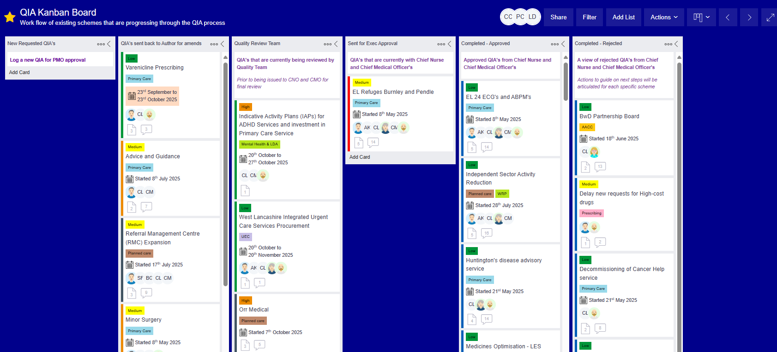
Appendix A: QIA kanban board

Slide 8
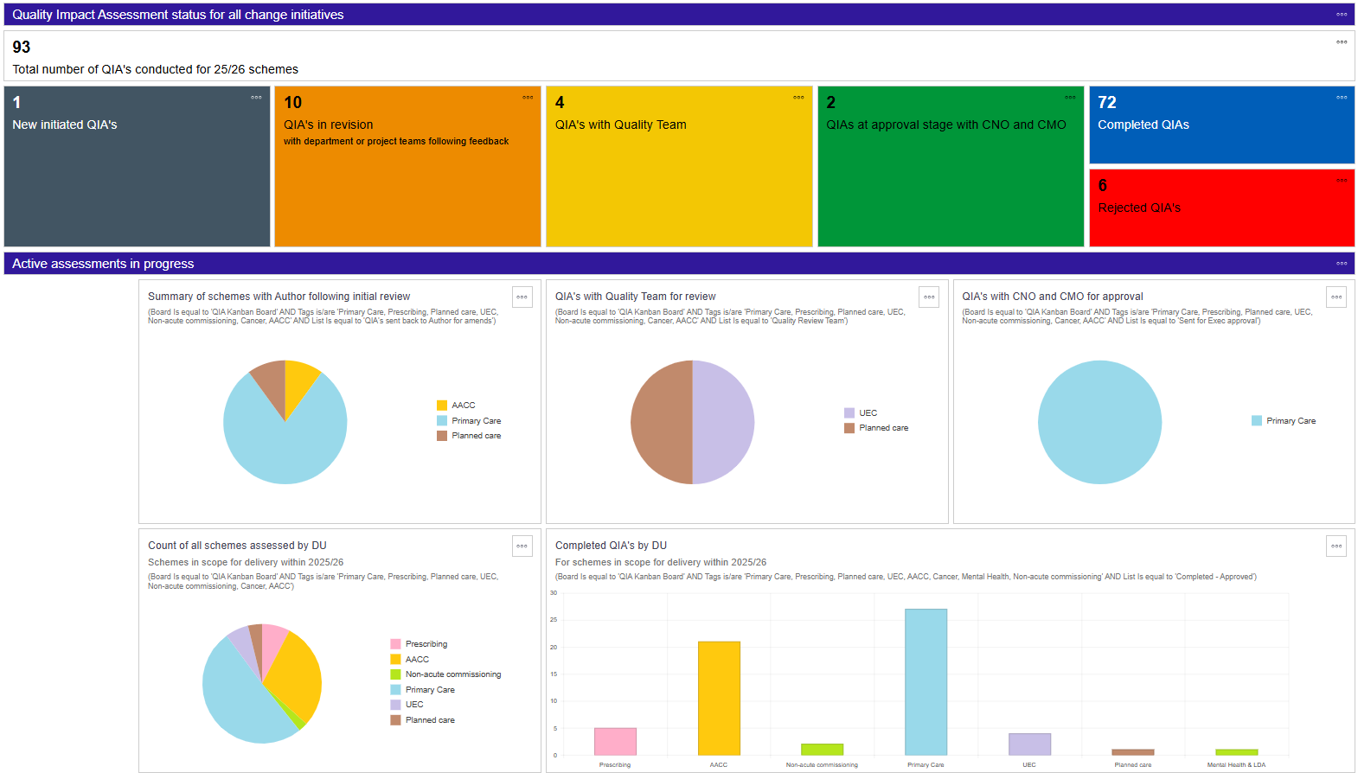
Appendix B: QIA reporting dashboard

Slide 9
Appendix C: ICB Change Delivery Lifecycle
Appropriate use of tools and documentation throughout the lifecycle has been determined to provide clarity on the minimum set guidance on what may be required at each stage. Applicable tools are categorised based on how they support specific outcomes for each stage.
Project Controls
Lifecycle
Idea / Proposal
Opportunity
Plans in progress
Fully developed
Delivered
Realisation of benefits
Gateway check points denoted throughout cycle
0
1
2
3
4
A proportionate and flexible approach will be adopted to ensure appropriate use of tools without slowing down change.
For example, appropriate business case (type of business case dependent on complexity) usage will only be sought where financial investment or clinical consultation processes are required
Definition
Plan on Page
Comms plan
PID
PDD
Closure
Programme plan
Stakeholder map
RACI
Planning
RAID log
Delivery Plan
Risk & Issue logs
Assurance
Impact Assessments
(QIA, EIA, Sustainability)
Tools developed at ‘opportunity’ stage will be reviewed at each gateway
Lessons learned
PIR
Business Case
High level SOC
OBC
FBC
Benefits
Identification
Delivery plan
Realisation

