Slide 1

Integrated Primary Care Performance Report
May 2025

Slide 2
Executive Summary
The Integrated Primary Care Performance Report is produced each month to provide the latest position against key strategic primary care published performance metrics. The report contains the most recent data available at the time of writing and it should be noted that this can vary between metrics.
The report consists of a Summary and Benchmarking table (slide 3) followed by a more detailed overview of each metric displayed on a separate pages.
The IPCPR, and the metrics contained within, is received/considered by several groups and Committees within the ICB:
  Groups:,
  Committees:
    Executive Committee
    Primary Care Contracts Sub Committee
    Quality & Outcomes Committee (QOC). N.B. - The QOC receives the 3A’s report which includes a summary of the IPCPR and the full IPCPR is appended. The QOC also receives extracts and details of any metrics/performance areas as escalated by the Primary Care Quality Group (figures / reports would not go automatically for information).
    Although the Finance and Contracting Committee does not routinely receive this report the Committee receives the same metric data and a summary narrative within its own reports.
For the May 2025 report the following should be noted:
May 2025 Report- Points of Note:
The number of general practice appointments increased in February by 27,825 and LSC’s cumulative total from April 2024 – February 2025 is now 191,243 above plan.
The Acute Respiratory Infection (ARI) Hub scheme ceased at the end of March delivering a total of 82,400 appointments (94% of its planned activity) and achieving its objectives of increasing capacity in the System, treating individuals with mild to moderate chest infections and reducing attendance at Accident & Emergency departments.
Following a CQC review of quality at a practice within Chorley & South Ribble, the practice has been upgraded to requires improvement from inadequate.
The units of dental activity delivered as a proportion of UDA’s reduced in January and February below planned levels. . The cause of this is unclear but will be reviewed in greater detail when the finalised March activity data is available.
January 2025 saw the highest number of Community Pharmacy clinical pathway consultations (8,966) delivered in LSC since the start of the service in January 2024, it is noted that activity levels have been starting to increase since November.
Primary Care Services Operational Group | Primary Care Quality Group | Medicines Safety Group
Antimicrobial Stewardship Committee (not a formal ICB committee) | Primary & Integrated Care Transformation Programme Group

Slide 3
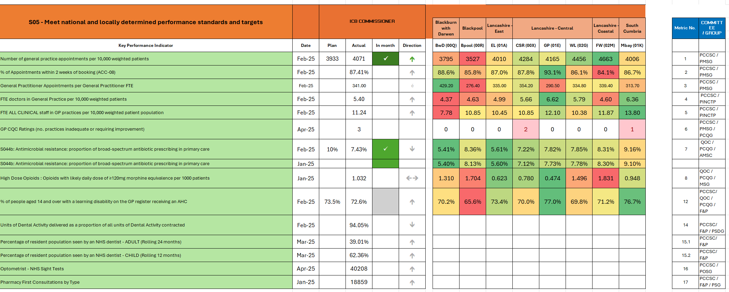
Primary Care Metric Summary and Benchmarking
* The place-level colour coding shows the range of Sub ICB performance per metric;(except for metric 7); green denotes the strongest performing place and red the poorest performing, a linear colour gradient is used to show the variability between these two values. For metric 7 (S044b: broad-spectrum antibiotic prescribing) the color coding denotes how far away a place is from the 10% target, anything above 10% is denoted as red.
Committee / Group Acronym Key
PCCSC | Primary Care Contracts Sub Committee | QOC | Quality and Outcomes Committee | EC | Executive Committee
PCSOG | Primary Care Services Operational Group | PCQG | Primary Care Quality Group | F&PC | Finance & Performance
PINCTPG | Primary & Integrated Care Transformation Programme | MSG | Medicines Safety Group
 |  | AMSC | Antimicrobial Stewardship Committee

Slide 4
General Practice: Appointments
Activity Metric | 1. Number of general practice appointments per 10,000 weighted patients : February 2025
 | Primary Care Commissioning Committee / Primary Care Medical Services Group
 | Group Chair: | Peter Tinson | SRO: | Donna Roberts | Clinical Lead: | Dr Lindsey Dickinson / Dr John Miles
This metric measures: The data is collated from general practice appointment data (GPAD) , is currently listed as 'experimental' by NHSE. It provides an incomplete measure of activity for individual GP practices. Changes in activity levels in practices may be impacted by both changes in demand and capacity. Month to month changes are frequently influenced by seasonal changes in activity, annual trend data is more helpful to provide a longitudinal comparison.
What does this tell us? Over Dec, Jan and Feb general practice appointments remained broadly in line with plan (blue line). February’s appointment rates, although reduced from the previous month (LSC -11%), are in line with plan, which mirrors the regional and national patterns. N.B. October and November’s activity was elevated due to the influenza vaccination programme timing. Overall, for the year to date (Apr-Feb), over 10.2M general practice appointments have been delivered, which is 191,243 above plan(darker blue bar). It remains that due to workforce and recruitment pressures L&SC has fewer FTE doctors per 10,000 weighted population than national averages. Despite this 43.5% were GP appointments, just 1.5% below the national rate.. Relatedly L&SC offers fewer general practice appointments per head of population than the national (-15%) average. L&SC is however above the national averages for the proportion of face-to-face appointments (68.7%, compared to 64.2%).
Actions: For 2025/26, extending access is a major focus of the newly published national GP Contract. Funding streams including QOF and CAIP are to be streamlined with funding channeled into improvements to patient access through increased online booking from October 2025. The ICB continues to promote the modern general practice model to GPs which will increase the proportion of appointments carried out on-line and by calls. 2025/26 work plans are in development which will support delivery of national requirements and build upon general practices' progress of implementing modern general practice and improving access. This includes work included identifying practices who are outliers in terms of their access and experience performance data and implementation of modern general practice and supporting 18 practices to be part of the 2025/26 GP Improvement Programme (funded by NHSE). Where practices are identified as a negative outlier but unsuitable/unable to participate in GPIP alternative support will be considered as part of the ICB's reactive/proactive support pathways. Acute Respiratory Infection Hubs established to increase primary care capacity have now ceased (further information and data provided overleaf). The scheme's objectives of treating individuals with mild to moderate chest infections and reducing attendance at Accident & Emergency departments were achieved.
Risks: It is not possible to quantify due to online consultations data not captured in GP Appointment Data (GPAD), therefore these appointments are ‘hidden’ from this data set.
December 2024
National | North West | LSC
4567 | 3880 | 3907
January 2025
National | North West | LSC
5328 | 4551 | 4573
February 2025
National | North West | LSC
4786 | 4085 | 4071

Slide 5
General Practice: Appointments
Activity Metric | 1.a. Number of Acute Respiratory Infection Hub appointments: March 2025
 | Primary Care Commissioning Committee / Primary Care Medical Services Group
 | Group Chair: | Peter Tinson | SRO: | Donna Roberts | Clinical Lead: | Dr Lindsey Dickinson / Dr John Miles
  The Acute Respiratory Infection (ARI) Hubs scheme finished at the end of March 2025, and in total delivered 82,400 appointments and delivering 94% of planned activity.
  Variation in activity demonstrates that the scheme was demand driven and responded to local pressures as they occurred; the Hubs used their ability to flex capacity to respond to surge pressures bringing forward activity planned for March into December and January. This is reflected in the overperformance of some services. Fylde Coast and Lancaster area hubs were the first hubs to move scheduled activity from March at the request of system colleagues. The data demonstrates a significant reduction in demand in March 2025.
  The majority of patients attending are diagnosed with respiratory infections with smaller numbers diagnosed with chronic obstructive airways/pulmonary disease (COAD/COPD) exacerbation or tonsilitis.
  The initiative achieved planned objectives of treating individuals with mild to moderate chest infections and reducing attendance at Accident & Emergency departments.
Sub-ICB Area | Provider (key partners in delivery) | Total Planned Appointments (Sep 2024 - Mar 2025) | Most recent Month’s Activity (March 2025) |  |  |  | Total Scheme Activity (Sept 2024 - March 2025)
 |  |  | Plan | Actual | Variance |  | Plan | Actual | Variance
Blackpool | Bloomfield Medical (Whitegate Drive HC) | 7,986 | 232 | 232 | 0 | 0% | 7,787 | 6,602 | -1,185 | -15%
BwD | Local Primary Care/ELMS (Blended model) | 8,686 | 1,122 | 1,117 | -5 | 0% | 8,686 | 8,726 | 40 | 0%
East Lancs | East Lancashire Alliance (Blended) | 19,720 | 2,653 | 2,442 | -211 | -8% | 20,225 | 19,842 | -383 | -2%
Fylde & Wyre | FCMS (PCN-based, practice spokes, Fleetwood HC) | 7,522 | 1,167 | 903 | -264 | -23% | 7,577 | 5,582 | -1,995 | -26%
 | WREN PCN (PCN-based, practice spokes) | 3,149 | 0 | 0 | 0 | 0% | 2,715 | 3,042 | 327 | 12%
West Lancashire | OWLS / Out of Hours West Lancashire CIC | 5,873 | 1,407 | 37 | -1,370 | -97% | 6,125 | 4,487 | -1,638 | -27%
Chorley & South Ribble | Bridgedale PCN (PCN based, practice spokes) | 1,764 | 408 | 237 | -171 | -42% | 1,979 | 1,512 | -467 | -24%
 | Chorley Central (PCN based, practice spokes) | 2,680 | 437 | 0 | -437 | -100% | 3,226 | 2,322 | -904 | -28%
 | Leyland (PCN based, practice spokes) | 2,282 | 476 | 6 | -470 | -99% | 2,246 | 1,678 | -568 | -25%
 | Chorley & South Ribble PCN (PCN based, practice spokes) | 2,660 | 376 | 62 | -314 | -84% | 1,489 | 2,048 | 559 | 38%
Greater Preston | Preston South Ribble PCN (PCN based, practice spokes) | 1,286 | 146 | 0 | -146 | -100% | 1,334 | 1,140 | -194 | -15%
 | Greater Preston PCN / Preston North & East PCN (1 PCN based, practice spokes) | 8,819 | 1,066 | 31 | -1,035 | -97% | 8,273 | 8,420 | 147 | 2%
Morecambe Bay | Bay PCN (PCN-Based, practice spokes) | 2,855 | 0 | 0 | 0 | 0% | 2,350 | 2,775 | 425 | 18%
 | Lancaster PCN (PCN-based) | 3,388 | 0 | 0 | 0 | 0% | 3,396 | 3,359 | -37 | -1%
 | Carnforth & Milnthorpe PCN (PCN-based, practice spokes) | 1,706 | 0 | 0 | 0 | 0% | 1,884 | 1,766 | -118 | -6%
 | Morecambe Bay PCC/Cumbria Health (PCN-based, practice spokes, Kendal UTC, Barrow A&E) | 9,621 | 946 | 564 | -382 | -40% | 8,645 | 9,099 | 454 | 5%
All | TOTAL | 89,997 | 10,436 | 5,631 | -4805 | -46% | 87,937 | 82,400 | -5,537 | -6%

Slide 6
General Practice: Appointments
Activity Metric | 2. % of appointments within 2 weeks of booking [ACC-08 Appointment types] : Feb-25
 | Primary Care Commissioning Committee / Primary Care Medical Services Group
 | Group Chair: | Peter Tinson | SRO: | Donna Roberts | Clinical Lead: | Dr Lindsey Dickinson / Dr John Miles
This metric measures: This data is collated from practice appointment data, is currently listed as 'experimental' by NHSE. The data has previously been part of a Primary Care Network (PCN) performance metric, this use has been discontinued and in 2024 exception reporting was introduced that potentially will make longitudinal assessment of the data difficult. It can provide an assessment of access but this use is significantly impacted by levels of deprivation within a practice population (areas of lower deprivation typically have more appointments booked <2 weeks). N.B. The national contractual incentive for ACC-08 has been removed for general practices in 2024/25, although this remains as a metric for the ICB.
What does this tell us? In Feb-25, 87.4% of General Practice appointments with one of the 8 specified appointment categories were offered within 2 weeks of booking, which is just slightly below the previous month. In L&SC 52.0% of these appointments were offered on the same day which is lower than the national average (54.3%) There remains variations at sub-ICB (and lower) levels with same day appointments ranging from 43.0% to 60.2%. This variation reflects differences in practice operating models adapted to cater for seasonal demand and activities as well as the different needs of populations. The ICB’s 2024/25 plan (as per the 2024/25 NHS objectives) is to increase the proportion of patients seen within two weeks of booking (ACC-08) to 87.64%. February’s performance just falls under this (-0.24%)but despite the dip in October the ICB is currently increasing towards these levels.
Actions: The GP access programme schemes, especially modern general practice, supports and promotes patients’ appointments being held within two weeks of booking. A review and potential redesign of the model of Integrated Urgent Care is currently taking place. This has the potential to improve same day access for those patients with a same day need that don't require continuity of care. Target mobilisation date is the 1 April 2026 subject to procurement processes.
Risks: Nationally the ACC-08 metric remains in 2024/25 for the ICB but has been removed for practices. This data (as it also uses GPAD as its basis) does not include GP online consultations data for the majority of L&SC practices as this is dependent upon the online consultation software provider. Therefore this activity does not reflect the full appointment activity undertaken as it is ‘hidden’.
January 2025
National | North West | LSC
88.5% | 89.3% | 87.8%
February 2025
National | North West | LSC
88.6% | 89.1% | 87.4%

Slide 7
General Practice: Appointments & Workforce
Activity Metric | 3. General Practitioner Appointments per General Practitioner FTE : Feb-25
 | Primary Care Commissioning Committee / Primary Care Medical Services Group
 | Group Chair: | Peter Tinson | SRO: | Donna Roberts | Clinical Lead: | Dr Lindsey Dickinson / Dr John Miles
This metric measures: This metric is built from GP appointment data being linked with NHS GP workforce data. It provides an approximation of workload intensity for individual GPs. There is not a current benchmark or defined limits for appropriate workload intensity. This metric is helpful to monitor medium term workload trends. The metric is limited by not capturing all General Practitioner activity.
What does this tell us? The number of general practitioner appointments per FTE General Practitioner across L&SC is marginally higher than the North West average though lower than the national average. There are variations by sub-ICB (and PCN / Practice) with Blackpool reporting 276.4 general practitioner appointments per FTE GP and Blackburn with Darwen reporting 429.2 general practitioner appointments per FTE GP. Blackburn with Darwen undertakes more appointments per FTE GP than the national average. This data also uses GPAD data as its basis which is nationally recognised to be experimental.
Actions: The Primary Care Team has noted the challenges faced by PCNs in recruiting under the scheme, which does not allow flexibility in the use of funding to top up the allowable wage offer. ICB workforce development managers have been extended by the training hub for 25/26 and are in place to support practices and PCNs with recruitment, this includes support with the recruitment of GPs both traditionally and through the ARRS scheme. 60% of newly qualified GPs trained in LSC require visa sponsorship. 2024/25 Service Development Funding (SDF) has been allocated to support some practices to access a visa licence to support their recruitment plans.
Risks: Given the predictions in workforce as the primary driver of capacity there is assessed to be a risk that demand will exceed capacity for the financial year 2024/25. This will create potential challenges in the quality of care, sustainability of service delivery and access to general practice. There is a risk that GP practices may not recruit additional GPs to work in general practice as the costs of running a practice are increasing, putting pressure on their budgets and affecting their recruitment plans. There are concerns the National Insurance increases for employers may also negatively affect practices’ staffing costs and finances and therefore their decisions to recruit.
December 2024
National | North West | LSC
333.9 | 309.3 | 320.6
January 2025
National | North West | LSC
389.8 | 360.4 | 371.5
February 2025
National | North West | LSC
362.3 | 335.2 | 341.0

Slide 8
General Practice: Workforce
Activity Metric | 4. FTE Doctors per 10,000 weighted patients : Feb-25
 | Primary Care Commissioning Committee / Primary and Integrated Neighbourhood Care Transformation Programme Group
 | Group Chair: | Peter Tinson | SRO: | Paul Juson | Clinical Lead: | Dr Lindsey Dickinson / Dr John Miles
This metric measures: The data is obtained from monthly NHS workforce returns and provides an assessment of the number of full time equivalent (FTE) General Practitioners covering a population. Is an indicator of General Practitioner capacity within the populations.
What does this tell us? The number of FTE doctors per 10,000 patients in LSC has remained fairly static since the increase in August 2024. There is local sub-ICB variation with Blackburn with Darwen, Blackpool and Fylde & Wyre areas seeing the lowest number of GPs covering their populations. This data does not include recently qualitied GPs employed under the expanded Additional Roles Reimbursement Scheme (ARRS) scheme, these posts are captured in ARRS roles data. It remains that to date 26 recently qualified GPs have been recruited by 10 PCNs since the ARRS scheme was extended in October 2024. A further 11 posts ARRS posts are planned for recruitment but are still to be filled,
Actions: The national GP Dashboard data demonstrates that LSC ICB has increased the number of non training GP FTE from 752 to 790 since May 2024. This is a 5.4% increase. Nationally the increase of non training GP FTE since 2024 is 2.2%. Previously ARRS funding was separated into 2 funding streams for GPs and other clinical staff. ARRS funding has now been combined into one funding stream. The data will be reviewed to understand if this impacts on recruitment. The ARRS scheme now allows for greater flexibility in funding, time is needed to understand if this flexibility has an impact on recruitment levels. ICB workforce development managers have been extended by the training hub for 2025/26 and are in place to support practices and PCNs with recruitment, this includes support with the recruitment of GPs both traditionally and through the ARRS scheme. 60% of newly qualified GPs trained in LSC require visa sponsorship. 2024/25 Service Development Funding (SDF) has been allocated to support some practices to access a visa licence to support their recruitment plans.
Risks: Given the predictions in workforce as the primary driver of capacity there is assessed to be a risk that demand will exceed capacity for the financial year 2024/25. This will create potential challenges in the quality of care, sustainability of service delivery and access to general practice. There is a risk that GP practices may not recruit additional GPs to work in general practice as the costs of running a practice are increasing, putting pressure on their budgets and affecting their recruitment plans. There are concerns the National Insurance increases for employers may also negatively affect practices’ staffing costs and finances and therefore their decisions to recruit.
December 2024:
National | North West | LSC
6.20 | 6.06 | 5.42
January 2025
National | North West | LSC
6.18 | 6.03 | 5.40
February 2025:
National | North West | LSC
6.19 | 6.12 | 5.40

Slide 9
General Practice: Workforce
Activity Metric | 5. General Practice FTE Clinical Staff by Group per 10,000 weighted patients : Feb-25
 | Finance and Performance Committee / Primary and Integrated Neighbourhood Care Transformation Programme Group
 | Group Chair: | Peter Tinson | SRO: | Paul Juson | Clinical Lead: | Dr Lindsey Dickinson / Dr John Miles
This metric measures: The data is obtained from monthly NHS workforce returns and provides an assessment of the number of clinical staff working within general practice across a population. It includes General Practitioners, Practice Nurses and individuals providing direct patient care (the latter focusing on ARRS or other allied health professionals working within practice). It doesn't include workforce employed directly by PCNs or other Primary Care Providers. It Is an indicator of General Practitioner, Nurse and Direct Patient Care Staff capacity within the populations.
What does this tell us? Across all staff groups, L&SC has a lower FTE workforce than national average. FTE nurses in general practice per 10,000 weighted patients are higher in L&SC compared to regional and national figures. There are significant variations at sub-ICB level with Blackburn with Darwen highlighted as having the lowest FTE workforce per 10,000 patients for the total workforce, which is predominantly caused by their lower number of FTE Nurses and Direct Patient Care (DPC)staff. All other DPC FTE staff in general practice per 10,000 weighted patients is in line with regional and national averages.
Actions: Previously ARRS funding was separated into 2 funding streams for GPs and other clinical staff. ARRS funding has now been combined into one funding stream. The data will be reviewed to understand if this impacts on recruitment. The ARRS scheme now allows for greater flexibility in funding, time is needed to understand if this flexibility has an impact on recruitment levels. ICB workforce development managers have been extended by the training hub for 25/26 and are in place to support practices and PCNs with recruitment, this includes support with the recruitment of GPs both traditionally and through the ARRS scheme. 60% of newly qualified GPs trained in LSC require visa sponsorship. 2024/25 Service Development Funding (SDF) has been previously allocated to support some practices to access a visa licence to support their recruitment plans, however SDF funding for 25/26 is still yet to be confirmed.
Risks: Given the predictions in workforce as the primary driver of capacity there is assessed to be a risk that demand will exceed capacity for the financial year 2025/26. This will create potential challenges in the quality of care, sustainability of service delivery and access to general practice. There is a risk that GP practices may not recruit additional GPs to work in general practice as the costs of running a practice are increasing, putting pressure on their budgets and affecting their recruitment plans. There are concerns the National Insurance increases for employers may also negatively affect practices’ staffing costs and finances and therefore their decisions to recruit. Funding for the visa support sponsorship is still yet to be confirmed and will obviously affect the continuation of the scheme if not approved.
December 2024
National | North West | LSC
11.74 | 10.82 | 11.21
January 2025
National | North West | LSC
11.71 | 10.81 | 11.21
February 2025
National | North West | LSC
11.74 | 10.93 | 11.24

Slide 10
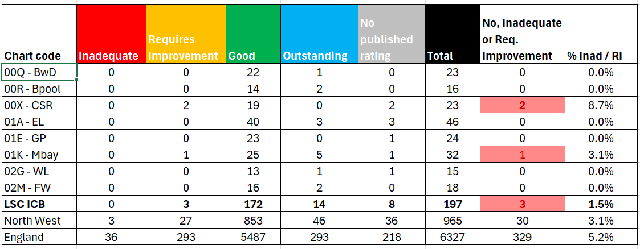
General Practice: CQC Ratings
Quality Metric | 6. GP CQC Ratings (no. practices inadequate or requiring improvement) : April 2025
 | Primary Care Commissioning Committee & Quality Committee / Primary Care Medical Services Group & Primary Care Quality Group
 | Group Chair: | Peter Tinson & Kathryn Lord | SRO: | Peter Tinson | Clinical Lead: | Dr Lindsey Dickinson
This metric measures: The data is provided by the Care Quality Commission (CQC) following inspections or review of GP surgeries. The focus on inadequate or requiring improvement ratings across the five CQC domains is an indicator of quality of service provided.
What does this tell us? Out of the 197 general practices in L&SC, three practices are currently reported as ‘requires improvement’ (RI) by the CQC; two in Chorley and South Ribble, and one in Morecambe Bay. A practice in Chorley & South Ribble, previously rated as ‘inadequate’ has recently been reviewed by the CQC and regraded as ‘Requires Improvement. The majority (186/197) of L&SC practices are rated as ‘good’ or ‘outstanding, with 8 practices having no published rating.
Actions: The ICB’s primary care place teams are engaging with the three practices currently rated as requires improvement to identify the improvements required, seek assurance of delivery and where relevant provide support. Within Chorley & South Ribble (CSR): Practice 1 – Ongoing support is being provided from the place team with another visit planned in June with support from ICB Quality colleagues. Practice 2 – The place team are in contact with the CQC and the Local Medical Committee (LMC) to determine how the ICB can offer further support. The Morecambe Bay place team has been in frequent contact with the practice following the initial CQC visit and the following reassessment. The Primary Care Manager and Clinical & Care Professional Lead have met with a GP partner to investigate if any further support could be provided by the ICB. No further support from the ICB is currently required as the practice is working on all necessary changes identified..
Risks: There is a risk that the practices do not meet the requirements of the CQC inspection reports however this is mitigated through the involvement of the ICB in liaising with the practices and providing support, as well as support provided by other bodies such as the local medical committee (LMC)
No. and percentage of practices rated as inadequate or requiring improvement):
National | North West | LSC | BwD | Bpl | CSR | EL | GP | MB | WL | FW
314 | 32 | 3 | 0 | 0 | 2 | 0 | 0 | 1 | 0 | 0
[4.9%] | [3.3%] | [1.5%] |  |  | [8.7%] |  |  | [3.1%]
Overall Practice CQC Ratings:

Slide 11
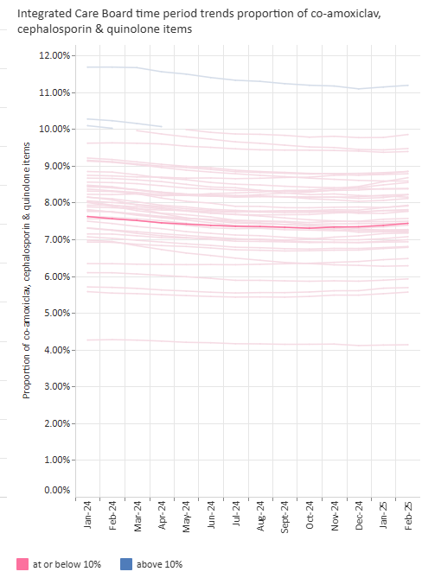
General Practice: Prescribing
Quality Metric | 7. S044b: Antimicrobial resistance: proportion of broad-spectrum antibiotic prescribing in primary care: 12 months to Feb-25
 | Quality Committee / Primary Care Quality Group & Antimicrobial Stewardship (AMS) Committee
 | Group Chair: | Kathryn Lord | SRO: | Andrew White | Clinical Lead: | Dr Felicity Guest
This metric measures: This data is collated from prescribing data and indicates quality of prescribing through responsible antibiotic stewardship. It measures the proportion of co-amoxiclav, cephalosporin and quinolone items prescribed; antibiotics linked to a higher incidence of C.difficle. A lower number represents more appropriate and higher quality prescribing.
What does this tell us? L&SC continues to perform well on this metric in aggregate with a steadily reducing trend below the 10% target. There is variation at sub-ICB, PCN and practice level, with the Morecambe Bay area seeing the highest proportion of prescribing of these antibiotics at 9.16%. This demonstrates a small increase from the last reporting period (+0.06%). Currently 22 practices are not yet delivering the 10% or below threshold, this is an increase of 1since the last reporting period.
Actions: The UK Government has developed a new Antimicrobial Resistance (AMR) 5 year national action plan, ‘Confronting antimicrobial resistance 2024 to 2029’, which builds on the achievements and lessons from the first national action plan with more challenging targets for:- optimise the use of antimicrobials reduce the need for, and unintentional exposure to, antibiotics support the development of new antimicrobials. An Antimicrobial Stewardship (AMS) Committee has been set up across the System to support how we manage AMS, including in primary care. The membership represents all providers in the System. An action plan has been developed and through the AMS Task and Finish Group is being delivered at Place, supported by the local Medicines Optimisation (MO) teams. Prescribing patterns are different in each Place linked to the population’s demographics, which means a slightly tailored response to delivery of the action plan. The recently agreed GP MO LES requires maintenance of national top quartile performance or at least 10% improvement from baseline, with outliers targeted. This should contribute to the ICB reaching the national target of less than 10%.
Risks: Former CCG antibiotic prescribing incentives creates a risk and potential inequality across the system. We are currently working towards one prescribing incentive scheme to address thiis. Patient expectation can be challenging to manage and there is a lack of central comms this year. As a mitigation the AMS Committee has developed quarterly rolling Campaign/Toolkit - promoting self-care and clinical excellence. Potential for performance to be affected by UTIs over the summer and Colds and Flu over up-and-coming winter months.
December 2024
LSC
7.34%
January 2025
LSC
7.38%
BwD (00Q) | Bpool (00R) | EL (01A) | CSR (00X) | GP (01E) | WL (02G) | FW (02M | Mbay (01K)
February 2025
LSC
7.43%
The number of practices in LSC below and above the threshold:
LSC Totals | No. Practices | % Practices
At or below 10% | 175 | 88.3%
Above 10% | 22 | 11.2%
LSC’s performance (bold line) compared to the other ICBs in the county →

Slide 12
General Practice: Prescribing
Quality Metric | 8. High Dose Opioids : Opioids with likely daily dose of ≥120mg morphine equivalence per 1000 patients: Feb-25
 | Quality Committee / Primary Care Quality Group & Medicines Safety Group
 | Group Chair: | Kathryn Lord & Nicola Baxter | SRO: | Andrew White | Clinical Lead: | Faye Prescott
This metric measures: This data is collated from prescribing data and indicates quality of prescribing through responsible prescribing of high dose of opioids per 1000 population. Provides an insight into prescribing and clinical quality. The definition of high dose is above 120mg morphine equivalent per day. There is little evidence that long term prescribing above this dose is helpful and risk of harm is present.
What does this tell us? The LSC February 2025 position for the prescribing of high doses of opioids is 1.03 per 1,000. This demonstrates a small increase from the previous reporting period (0.02%) patients and remains above the national average of 0.80. The prescribing of high doses of opioids is highest in Blackburn with Darwen, Blackpool, Fylde & Wyre and West Lancashire and Morecambe Bay. Three sub ICB areas (Greater Preston, East Lancashire and Chorley and South Ribble) are below the national average.
Actions/ updates : Development and mobilisation of the new general practice Medicines Optimisation Local Enhanced Services (LES) for 2025/26 which includes the reduction of opioid prescribing by practices. A monthly medicines of misuse group is led by an ICB Medicines Optimisation Lead. This group has a 3A report which currently goes to LSC ICB Medicines Optimisation Lead meetings. The Medicines Optimisation team have drafted a position statement on patient opioid contract and best interest opioid reductions – which will support risk assessment on initiation and dose reductions in complex. These documents have now been ratified and available as resources to primary care ICB’s Blackpool Population Health Lead along with local authority public health colleagues and Substance misuse services met and have discussed joint objectives and a whole system approach to working collaboratively in Blackpool. The group are progressing and marketing strategy to enhance primary care referrals to drug and alcohol services and social prescribing initiatives. Current communication related to MHRA prolonged released opioids is not aimed at primary care. This document is under review. A request has been made to add MHRA prolonged released opioids be added to the ICB Medicines Safety Group. The Pain Café in Millom is now live. The café aims to have individuals with lived experience supporting the café as well as the local CDAS (Cumbria addiction Advice Solution).
Risks: Sustained community and clinical action is required, but even when in place this will take time for impacts to be seen on prescribing rates. Medicines Optimisation and Practice Pharmacy Team capacity is limited but has recruited recently. Blackpool and Barrow areas are still ranked first and third in the UK for the highest rates of drug related deaths.
December 2024
National | LSC
0.78 | 1.01
January 2025:
National | LSC
0.80 | 1.01
February 2025:
National | LSC
0.80 | 1.03
← Line graph of LSC’s monthly performance(blue line) compared to England (orange line) since June 2019
Comparison of Place level performance against LSC ICB (dark grey) and England (orange line) →

Slide 13
General Practice: Checks
Quality Metric | 12. % of people aged 14 and over with a learning disability on the GP register receiving an AHC: Feb-25
 | Primary Care Commissioning Committee & Quality Committee / Primary Care Quality Group & Finance & Performance Group
 | Group Chair: | Peter Tinson | SRO: | Debbie Wardleworth | Clinical Lead: | Dr Lindsey Dickinson / Dr Felicity Guest
This metric measures: Annual Health Checks (AHC) being undertaken for patients on the Learning Disability register is a key focus for quality of care. This data is collated via the General Practice Extraction Service (GPES) every six months. This is a cumulative target which increases month on month and is aiming to achieve 76% by March 2025.
What does this tell us? LSC remains on track to deliver its 24/25 AHC targets, however, the ICB is below regional and national averages. All sub ICB areas report a significant increase in completed AHC’s since the previous reporting period. This is a cumulative target which increases month on month and is aiming to achieve 76% by March 2025. There is variation at sub-ICB (former CCG) level with performance to February 2025 ranging from 65.6% - 77%. Beneath this there will be further variation by PCN and practice. Blackpool is the only sub-ICB area that is below trajectory, and may not achieve 24/25 target, however, the ICB collectively looks likely to achieve target.
Actions: Shorter training continues to be offered to administrative practice staff to support their roles. Requests from practices for face to face training are scheduled. 43 practices who are part of LD champion co-produced model, and roll-out is phased to enable the team to support during the highest quarter of health check delivery. Excellent examples are being received from practices, who continue to develop initiatives to support patients with a learning disability. Each practice has an action plan. Feedback from breast screening officers are positive and the impact of a pilot (Central Lancs) to encourage females with LD to be prioritised is yielding results. Early stages of a project scope has been developed to support bowel screening. Over 1,485 people with LD, parents and carers have attended AHC workshops to demonstrate health checks. A schedule of workshops have been identified throughout the year supporting, men's and women's health. These continue to be effective in reducing barriers to attendance, and empowering people with a LD to question their health check. The number of Health Action Plans (HAP) continues to increase in the ICB. February 2025 data shows 837 more HAPs than at February 2024. These plans are essential for enabling individuals to manage their own wellbeing. ICB dashboard provides monthly data at practice and PCN level, allowing us to identify areas of concern and respond accordingly
Risks: Without ongoing messaging and work with practices and staff, lived experience and advocacy group, there is a risk that performance may always reduce to below target. Without constant communication and work with wider health colleagues to deliver key health messages in an accessible format, people with an LD will continue to be disadvantaged, and experience avoidable mortality. Without the ICB investment and BI team support to collate and produce monthly LD AHC dashboard,, and separate data searches targeted activity to address quality issues cannot continue. In Fylde and Wyre one practice has not renewed their data sharing agreement, and this impacts slightly upon our collation and comparisons within the ICB. However, the data for this report remains uncompromised. Within Morecambe Bay data was delayed due to an issue with EMIS LD register validation in Blackpool is not undertaken by the health facilitation team but by the CLDT.
December 2024
National | North West | LSC
52% | 55.1% | 50.5%
January 2025
National | North West | LSC
62.6% | 65.6% | 61.2%
February 2025
National | North West | LSC
73.5% | 76.0% | 72.6%

Slide 14
Dental: Activity
Activity Metric | 14. Units of Dental Activity delivered as a proportion of all Units of Dental Activity contracted : Feb-25
 | Primary Care Commissioning Committee & Finance & Performance Committee / Primary Services Dental Group
 | Group Chair: | Amy Lepiorz | SRO: | Amy Lepiorz | Clinical Lead: | Shane Morgan
How are we performing? The performance of the ICB has decreased slightly since the previous reporting period (-1.6%)and in Feb stands at 94.1% of the cumulative planned trajectory. Performance in Jan and Feb has declined when compared to the planned trajectory, for unknown reasons. A full analysis to understand this will be available following the national process of end of year reviews which is completed in June. To note, providers have 2 months to submit an FP17 on completion of a course of treatment which can affect when activity is reported. Contractors are required to deliver contracts over a 12 month period, April – March, which is not necessarily delivered in equal 12ths.
Actions: The ICB’s local Dental Access and Oral Health Improvement Programme was developed to enhance its understanding and management of oral health for LSC, and includes local and national initiatives :- Child Access and Oral Health Improvement Care Homes support Urgent Dental Care pathway Additional Treatments required following Urgent Care. Additional access to routine care is also offered through a specific pathway to patients who are within prioritised groups to ensure their oral health does not impact or prevent treatment for other conditions. commissioning of 110% of contracted UDA’s by allowing 10% over performance provider payments. In March 2024, the New Patient Premium (NPP) was introduced nationally to support anyone who had not been able to receive NHS dental care in the preceding 2 years. The ICB has undertaken the mid-year performance review; any contract with performance lower than 30% for months 1-6 is reviewed and performance action plans are developed by contractors. Where contractors can demonstrate how they will achieve their annual target and mutually agreed adjustment can be implemented. The ICB is working with 29 contractors as part of this process.
Risks: The focus of many of the above initiatives is on reducing health inequalities, and therefore the impact on improving dental access across the whole L&SC population may be minimal. The demand on the services are higher than pre-pandemic levels as the oral health of many patients declined during COVID due to restricted access during the pandemic, as a result many patients require more clinical time and a greater number of appointments to make them orally fit. Ongoing challenges in NHS Dental clinician recruitment and retention could further impact upon access to Dental Services and there is a risk that there will not be enough staff to deliver the core and additional / advanced services. Risk of under reporting: none of the activity provided under the New Patient Premium initiative is included in the actual UDA's delivered therefore activity will increase in future when reporting is improved.
This metric measures: The graph details the number of delivered Units of Dental Activity (UDA) in 2024/25, compared to phased trajectory of UDA delivery within the financial year.
LSC | January 2025 | 95.7%
LSC | February 2025 | 94.1%

Slide 15
Dental: Activity
Activity Metric | 15.1 Number of unique patients seen by an NHS dentist - adults : Mar-25
 | Primary Care Commissioning Committee / Finance & Performance Committee
 | Group Chair: | Amy Lepiorz | SRO: | Amy Lepiorz | Clinical Lead: | Shane Morgan
This metric measures: The number of unique adult (over 18 years) patients (i.e. individual patients) seen by an NHS Dentist on a 24 month rolling basis as a percentage of the total adult (over 18 years) population.
What does this tell us? 2024-25 NHS planning round required a quarterly plan for the number of unique adults (18+) with a postcode within each ICB who have received a course of treatment at any NHS dental contract within the past 24 months. It was the ICB’s ambition for 40% of the adult population to have seen an NHS dentist by March 2025. The LSC position at March 2025 is 39%.
Actions: The ICB has developed a local Dental Access and Oral Health Improvement Programme to enhance its understanding and management of oral health for the population of Lancashire and South Cumbria. As part of the programme a number of local initiatives have been developed to improve access for adults as follows: Care Homes support to increase the numbers of elderly patients accessing dental services. Urgent Dental Care pathway to increase access to approximately 20,000 additional appointments. Additional Treatments required following Urgent Care. Additional access offered to Pathway 1 patients who require additional treatment. Additional access to routine care is also offered through a specific pathway to patients who are within prioritised groups to ensure their oral health does not impact or prevent treatment for other conditions. The commissioning of 110% of contracted UDA’s by allowing the payment of 10% over performance to providers. This was offered across 5 geographical areas of the ICB with the greatest oral health and access need. In March 2024, the New Patient Premium (NPP) was introduced nationally to support anyone who had not been able to receive NHS dental care in the preceding 2 years A review of the data set adopted has been undertaken to ensure consistency and accuracy of data.
Risks: The risks for this indicator are as detailed on the previous slide (metric 14.) The increased number of repeat appointments for adults with complex dental issues arising during the covid pandemic are still impacting upon the performance of this metric.
Adults | Q4 Milestone = | 40% | Feb 25 Actual = | 38.8%
Adults | Q4 Milestone = | 40% | Mar 25 Actual = | 39%

Slide 16
Dental: Activity
Activity Metric | 15.2 Number of unique patients seen by an NHS dentist - children : Mar-25
 | Primary Care Commissioning Committee / Finance & Performance Committee
 | Group Chair: | Amy Lepiorz | SRO: | Amy Lepiorz | Clinical Lead: | Shane Morgan
This metric measures: The number of unique child (under 18 years) patients (i.e. individual patients) seen by an NHS Dentist on a 24 month rolling basis as a % of the total child (under 18 years) population.
What does this tell us? 2024-25 Planning required a quarterly plan for the number of unique children (under 18s) with a postcode within each ICB who have received a course of treatment at any NHS dental contract within the past 12 months. It is the ICB’s ambition for 60% of children to have seen an NHS dentist by March 2025. This has been achieved in June 2024 and the number of children seen by a NHS dentist has continued to grow each month and currently stands at 62.4%.
Actions: The ICB’s Dental Access and Oral Health Improvement Programme includes specific work streams for children's services this includes: Child Access and Oral Health Improvement commencing October 2024 Additional access to routine care is also offered through a specific pathway to patients who are within prioritised group (namely looked after children) to ensure their oral health does not impact or prevent treatment for other conditions. The Primary Dental Services Statement of Financial Entitlements (Amendment) (No2) Directions 2022 (SFE’s) also applies to children’s dental services. A review of the data set adopted for this indicator has been undertaken to ensure the consistency and accuracy of data.
Risks: The risks for this indicator are as detailed on the previous slide (metric 14.)
Children | Q4 Milestone = | 60% | Feb 25 Actual = | 61.7%
Children | Q4 Milestone = | 60% | Mar 25 Actual = | 62.4%

Slide 17
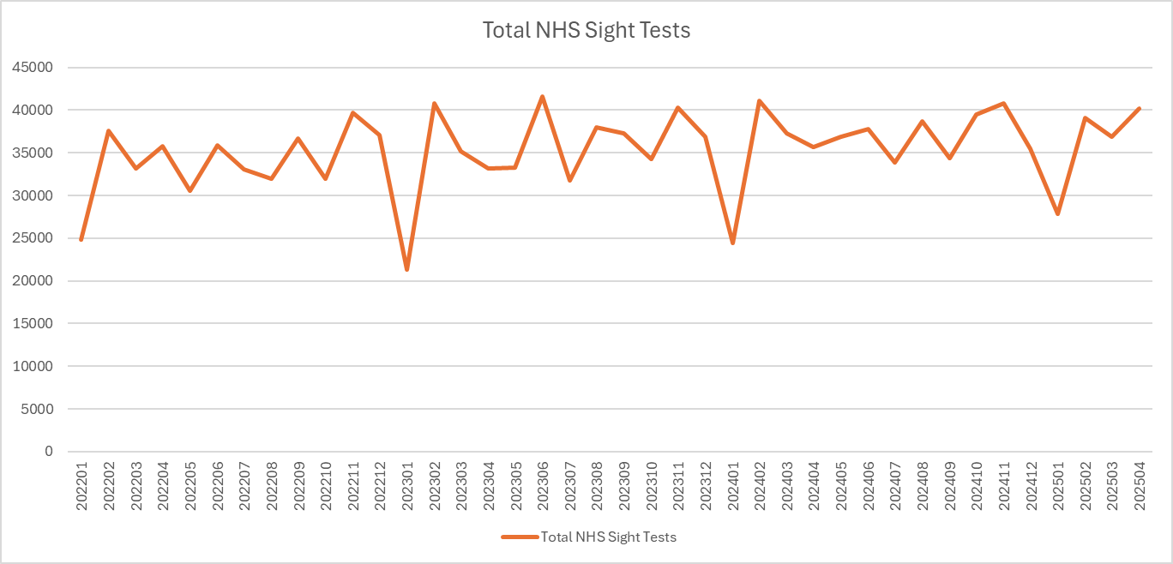
Optometry: Activity
Activity Metric | 16. Optometrist NHS Sight Tests: Apr 25
 | Primary Care Commissioning Committee / Primary Ophthalmic Services Group
 | Group Chair: | Dawn Haworth | SRO: | Dawn Haworth | Clinical Lead: | Tom Mackley
This metric measures: The total number of NHS general ophthalmic service (GOS) sight tests carried out in Lancashire and South Cumbria per month. This data will be subject to seasonal variation. NHS sight tests are free for restricted cohorts of the population which include children, people in full time education, those over 60years, those receiving certain benefits, and those with/a family history of specific health and eye conditions.
What does this tell us? The monthly volume of NHS sight tests has remained relatively static over the past 12 month period, with the number of tests being undertaken usually lying between 35,000 and 40,000 per month. In April, the number of sight tests performed increased (+8.4%) from the previous month. The graph demonstrates a dip in activity each January, with the number of tests then returning to normal levels or above, in February.
Actions: The contract for the Easy Eye Care​ initiative (which promotes sight tests for patients with learning disabilities and autism​) has been renewed until March 2026. The ICB is developing a local Sight Test Access Improvement Programme to improve access to NHS sight tests for eligible residents of Lancashire and South Cumbria. As part of the programme a number of local initiatives are being developed:-​ Homeless population – working with shelters and other VCSE groups to facilitate sight tests for people experiencing homelessness​ ‘Easy Eye Care’ – promoting sight tests for patients with learning disabilities and autism​ Special Schools – Implementing the national programme to make sight tests available for all pupils attending special schools following launch by the national team Reducing Inequalities – benchmarking geographies across the Lancashire and South Cumbria to promote sight tests in populations where uptake is low.​ There is a communications and engagement workstream as part of the programme which will develop material to support patients accessing eyesight tests (subject to available funding)
Risks: The focus of many of the above initiatives is on reducing health inequalities, and therefore the impact on improving access to NHS sight tests across the whole L&SC population may be minimal. The sight tests in special schools​ initiative has been launched by NHSE. The current GOS sight test provision allocation does not cover all special schools​​.
LSC NHS Sight Tests, current month: | 40,208

Slide 18
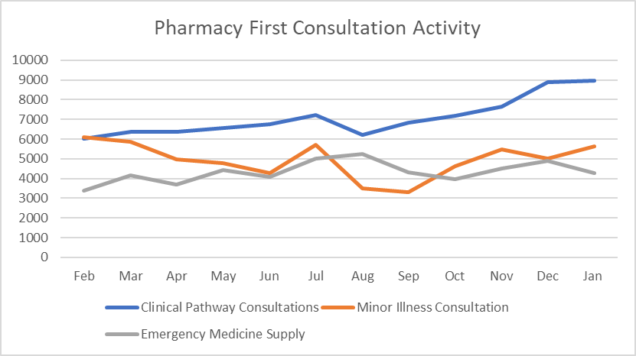
Community Pharmacy: Activity
Activity Metric | 17. Pharmacy First Consultations by Type : Jan – 25
 | Primary Care Commissioning Committee & Finance & Performance Committee / Pharmaceutical Services Group
 | Group Chair: | Amy Lepiorz | SRO: | Amy Lepiorz | Clinical Lead: | Amy Lepiorz
This metric measures: The activity being delivered as part of the new Pharmacy First Service launched on 31 January 2024, which built upon the existing community pharmacy consultations service. The service enables patients to be referred into community pharmacy for an urgent repeat medicine supply, minor aliments consultation, or for one of seven minor illnesses; acute otitis media, impetigo, infected insect bites, shingles, sinusitis, sore throat, uncomplicated UTIs. The Pharmacy First Consultation data reflects the number of claims made by community pharmacy for consultations delivered and funded by the NHS. The data is published by NHSBSA and is in the public domain on the NHSBSA website (Dispensing contractors' data | NHSBSA).
How are we performing? In January 2025 just under 19k pharmacy first appointments were delivered in LSC. January 2025 saw the highest number of clinical pathway consultations (8,966) delivered by LSC Community Pharmacies. Since the service started in January 2024 the number of consultations for the seven defined clinical pathways has remained relatively constant at between 6-7,000 per month, but greater activity levels have been noted since November. L&SC continue to have the highest number of referrals from GP practices in England. The scheme is currently delivered by 98% of pharmacies in L&SC and will transfers some lower acuity care away from general practice. Urgent Medicine supply consultations have been increasing during the year, with some fluctuations between months. This is most likely linked to seasonal variation attributed to the number of weekends, bank holidays and holiday patterns.
Actions: The ICB has developed a local Pharmacy Access Programme to support integration and use of the community pharmacy advanced services. A gap analysis has started, however the local intelligence regarding GP referrals at GP practice level is off track in some areas due to pressures within PaCC teams. There is a plan to work with the LPC to support the intelligence from GP practice using the PCN lead resources. ICB website redesign is ongoing, as well as the intranet site. There is an ongoing round of engagement with various GP practice stakeholders such as the PCN Assembly.
Risks: Recruitment of PCN leads is problematic leaving gaps in provision, there are presently plans being developed to address.
Activity Type | Jan 25 | % Total
Clinical Pathway Consultation | 8966 | 47.5%
Minor illness referrals | 5637 | 29.9%
Urgent medicine supply | 4,256 | 22.6%
Total | 18,859

Slide 19

Web lancashireandsouthcumbria.icb.nhs.uk | Facebook @LSCICB | Twitter @LSCICB

