Slide 1
Protecting our public from COVID
Our COVID-19 Vaccination Programme led a new model of delivery of Care Home Self Vaccinations, which saw COVID-19 vaccination uptake of residents increase from 259 in 2022 to 294 in 2023 and 6.24 times more care home staff vaccinated.
Further benefits were dramatically reduced staff absence due to COVID-19 (3 in 2023 compared with 130 in 2022), and no outbreaks in any of the four care homes in the pilot.

Slide 2

In Blackpool we have conducted extensive community engagement in five priority wards, with over 400 residents sharing their experiences.
From this work we have identified 14 key themes, including access to healthcare, the cost of living, and social isolation which we are working to improve.

Slide 3
Increasing digital inclusion
The Digital Support Service from January 2024 to August 2024 had 473 patient referrals with 22% of these were referred by medical practices across Lancashire and South Cumbria.
In 96% of cases, digital sessions improved client’s health and wellbeing. This work has been in partnership with community organisations.

Slide 4
Improving continuing healthcare
90% of CHC assessments are now completed within 28 days.
This follows the in-housing of more than 200 staff and a backlog of 4,500 cases which has resulted in improvements in achieving quality measures for the service.

Slide 5
Supporting people in our communities with diabetes
Between April 2023 and May 2024 we worked with voluntary and community partners to support 5,875 children and young people with knowledge and support around diabetes. Of those, 1,409 said that their knowledge of diabetes support which is available increased.

Slide 6
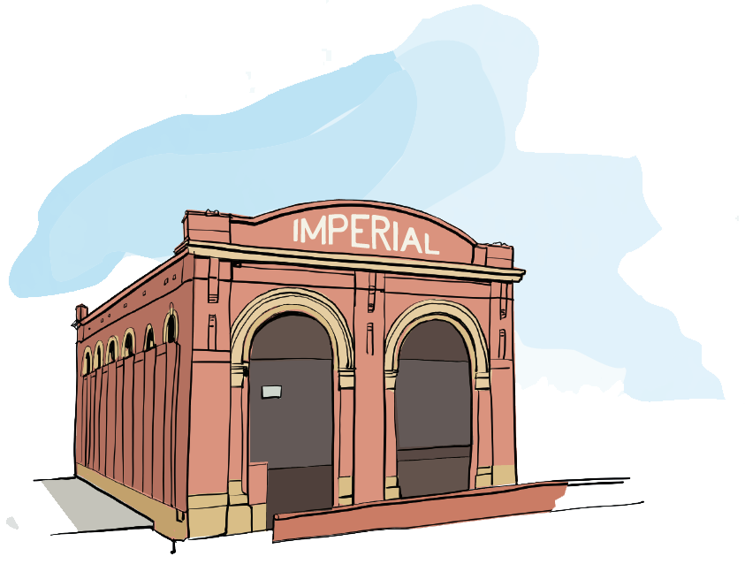
In Blackburn with Darwen we have established four family hubs offering comprehensive support from conception to age 19 (or 25 for those with special needs).
Services include midwifery, mental health, health visiting, and early language development to prepare children for school.

Slide 7
Increasing learning disability health checks
At end 22/23, 76% people age 14+ with a learning disability received a health check, compared with 64% in the previous year. Learning Disability health checks are important because it is an opportunity for doctors to find any problems early and conduct a medicines review.
342 practice staff have attended learning disability health check training to ensure these are undertaken based on best practice.

Slide 8
Supporting alcohol-dependent patients
Alcohol Care Teams are alcohol specialist clinicians, based in acute hospitals which provide specialist support, predominantly to alcohol-dependent patients.
Alcohol Care Teams in East Lancashire Hospitals NHS Trust and Blackpool Teaching Hospitals NHS Foundation Trust are saving the system collectively 3,000 bed days per year. This is an annual saving of £1.26million.

Slide 9
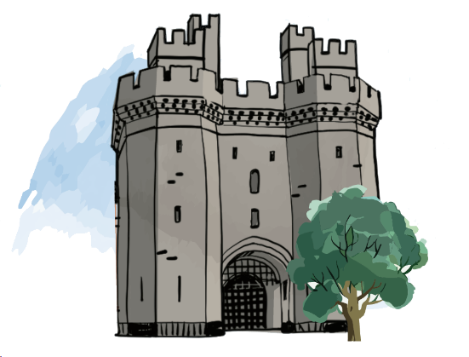
In Lancashire we have developed a new approach to reach disengaged patients in Morecambe Bay and Lancaster, offering health checks through trust-building outreach.
This means we have successfully
re-engaged patients who had not accessed healthcare for years.

Slide 10
Increasing dental access for children
Children in care and young people leaving care have been a priority for dental access. We have seen children in care across all local authorities with an up-to-date annual dental check doubled – with 571 referrals received since the pathway was implemented in March 2023.

Slide 11
Providing weight management support
The Digital Weight Management Programme, a 12-week online behavioural and lifestyle programme, saw practices in Lancashire and South Cumbria finish in the Top 10 ICBs in the country in 2023/24 for referrals, achieving 95% of the target for eligible referrals. This is directly providing support for local people

Slide 12
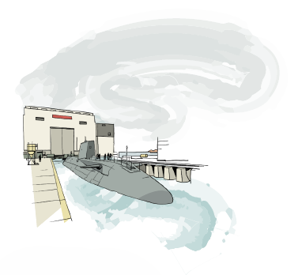
In South Cumbria we have supported a Poverty Truth Commissions in Barrow to address health and wellbeing in deprived areas.
We have also launched the Healthier Streets project, fostering community engagement and support in priority wards, with 10 local residents becoming 'community champions'.

Slide 13
Identifying and supporting people with hypertension
The proportion of patients in Lancashire and South Cumbria with hypertension treated to NICE quality standards increased from 59.7% in April 2023 to 72.5% in April 2024. This is due to great partnership working across our system and primary care.
327 community pharmacies in Lancashire and South Cumbria are providing blood pressure checks, and up to April 2024 this led to 114,300 blood pressure checks completed which is the best way to identify hypertension and prevent strokes and heart attacks.

