Slide 1
DRAFT
Health Inequalities Metrics
To be finalised and added to the ICB Website and referenced in the Annual Report in line with the NHS England Legal Statement related to the duty of ICBs to report on health inequalities under section 13SA of the National Health Service Act 2006.
Version: 17 July 2024
1

Slide 2
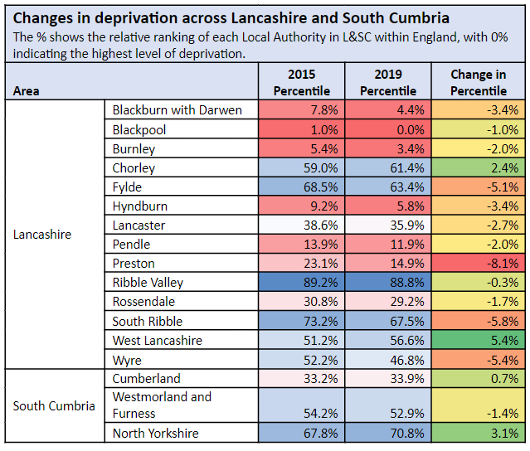
Introduction and overview
In November 2023, NHS England published a Legal Statement related to the duty of ICBs to report on health inequalities under section 13SA of the National Health Service Act 2006 including that “relevant NHS bodies should publish the information on health inequalities within or alongside the organisation’s annual report”. The data that is listed within the legal statement is included below and is referenced in our annual report. The annual report also includes more information of the work that is underway to understand and address these inequalities.
The ICB is working with its business Intelligence partner, Midlands and Lancashire Commissioning Support Unit, to increase functionality to report on inequalities metrics. This work is in progress but at this point some of the metrics listed in the legal statement are not yet available.
The ICB aims to achieve the national vision to ensure delivery of high-quality healthcare for all, through equitable access, excellent experience and optimal outcomes. One of our core duties is to tackle inequalities in health within our population. Our Joint Forward Plan describes our ambition and plans.
Some 1.8 million people are registered with Lancashire and South Cumbria GP practices and this number is expected to rise to 2.05 million by 2033. The health and wellbeing of our population varies. Deprivation and levels of inequality are rising, we have a significant number of people with complex long-term diseases and the demand for healthcare is rapidly increasing. Focused effort in conjunction with our wider partners is essential to tackle these challenges.
Almost a third of people in Lancashire and South Cumbria are identified as being within the most deprived areas of England, which has a huge impact upon their lives and health, with challenges meeting their basic needs including their ability to feed their families, heat their homes and support their children, this means that life is very difficult.
The percentage of children living in poverty across Lancashire and South Cumbria is higher than the national average. Added to this, the levels of disadvantage are increasing over time which means demand for health and care services is rising. Levels of disadvantage within L&SC increased between 2015 and 2019, for 14 of the 18 areas within L&SC. Five of these areas are within the bottom 10% nationally, Blackpool, Blackburn, Hyndburn, Burnley, and Barrow. Blackpool is one of the most deprived areas within England.
The Health Inequalities Dashboard – Lancashire and South Cumbria details a set of metrics that have been agreed by the Integrated Care Partnership as key indicators of health inequality and unwarranted variation. You can find the dashboard in Fingertips here; https://fingertips.phe.org.uk/indicator-list/view/fHZAGWx4oE This is an evolving piece of work and the metrics will develop over time to reflect the variation across our geography. The health and care partners across Lancashire and Cumbria Health Equity Commission, chaired by Professor Michael Marmot has helped to shape the ICB work programme. The report of the commission A Hopeful Future: Equity and the social determinants of health in Lancashire and Cumbria - IHE (instituteofhealthequity.org) sets out recommendations to achieve long-term reductions in health inequalities through action on the wider determinants of health.
Note: As ICB geographical boundaries of South Cumbria do not align with Local Authority boundaries, only a proportion of Westmorland and Furness, Cumberland, and North Yorkshire are within the ICB footprint

Slide 3
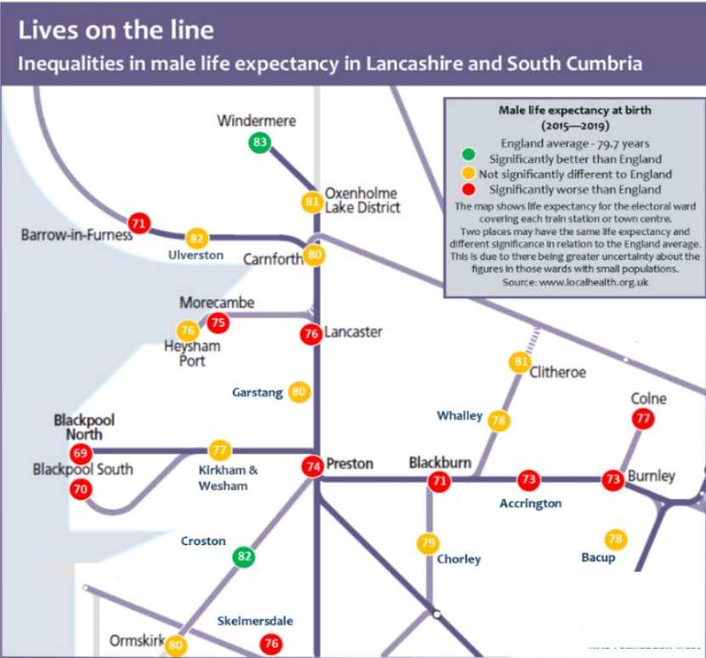
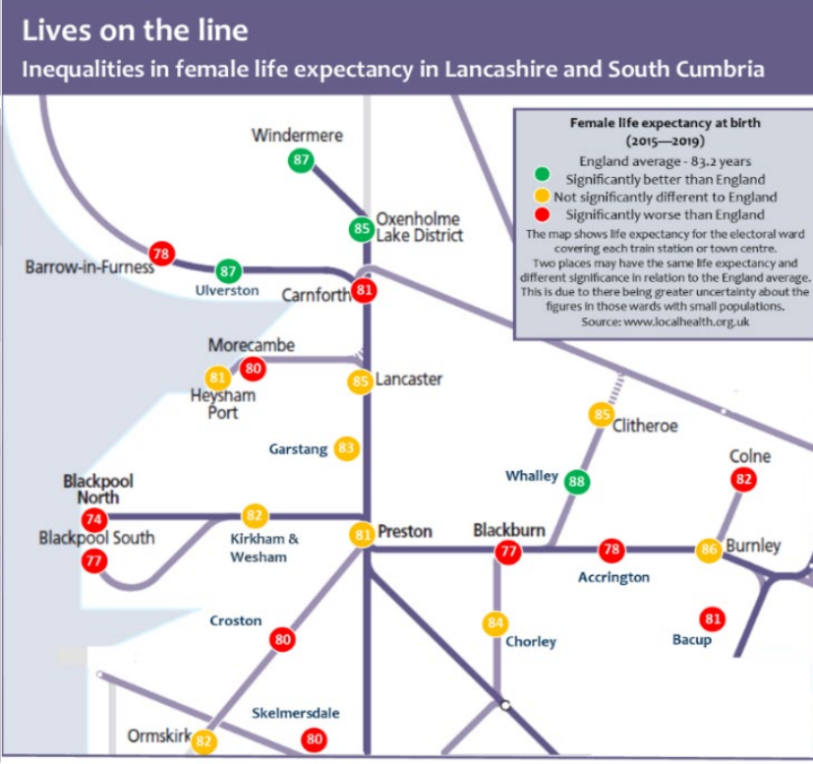
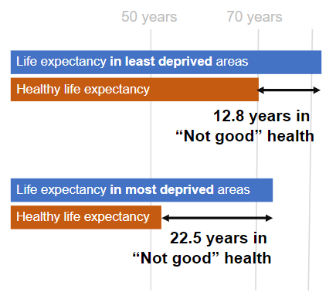
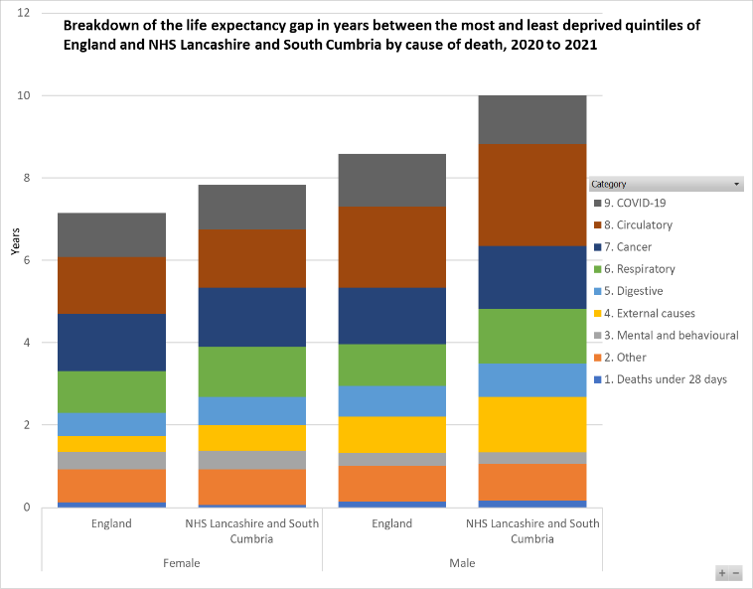
Inequity in life expectancy
Life expectancy within Lancashire and South Cumbria is lower than the national average – by almost a decade in some areas and there is also a large variation in healthy life expectancy, or the number of years people can expect to live in good health. This has a marked impact on the number of years our population lives in ‘not good’ health.
This is significantly affected by the socio-economic environment, including income, employment, education, housing, the quality of the living environment, crime, and digital exclusion. Almost a third of people in Lancashire and South Cumbria are identified as being within the most disadvantaged areas of England, which has a huge impact upon their lives and health, with challenges meeting their basic needs including their ability to feed their families, heat their homes and support their children.
Inequalities in life expectancy for males and females are rising within the North-West as shown within the 2024 Institute of Health Equity report. The diseases that contribute to the gap in life expectancy between the most and least deprived areas of L&SC for males and females, are circulatory diseases (ones that affect the heart and circulation, such as stroke), cancer, respiratory and digestive conditions. The gap in life expectancy within L&SC is higher than the average across England.
There are around 21,000 people across L&SC currently registered with GP practices as having five or more long-term health conditions (including cancer, conditions related to the heart and lungs, mental health, and conditions related to the brain and nervous system) and a disproportionate number of these are in our areas of greatest disadvantage. People in areas of disadvantage are also the least likely to have their condition identified early and have quick access to the appropriate treatment.

Slide 4
Elective Waiting List
The LSC Elective Recovery Programme reconstituted a provider collaborative “Elective Recovery Health Inequalities Network” meeting at the start of 24/25 to drive increasing awareness and improvement opportunities around existing and emerging health inequalities within the system elective waiting lists.
The network brings stakeholders together from across LSC to ensure health inequalities are identified, understood and actions being taken forward to address. It is a development space, allowing learning between providers and a consistent approach to shared challenges.
The monthly meeting includes expert membership from identified leads across Elective Recovery, ICB Public Health, Secondary care providers and BI support from the MLCSU with an agreed set of Terms of Reference.
The meeting has reviewed several health inequality data deep-dives to date, utilising several recognised data analysis methodologies, including provider and specialty level waiting list delineation by Core20 patient demographics including IMD, ethnicity, age and gender.
Whilst each methodology has presented some variance in considerations across the Core20 patient demographics at provider level, the consistent indication across each approach has been that there is no single ‘theme’ or shared challenge across LSC providers.
The Elective Recovery Health Inequalities Network has identified several key issues or considerations relating to the interpretation of waiting list HI datasets that require further work to mitigate. These include:
The objectives of the Elective Recovery Health Inequalities Network throughout 24/25 have been agreed to be:
Support provider leads to build identification and understanding of local areas of inequity in access, experience and outcomes and establish a consistent approach to Health Inequality reporting to Trust Boards.
Refresh Elective Recovery Programme governance to ensure that improving health equity is a consistent theme throughout Elective Recovery prioritised transformation programmes.
Establish Improvement Collaborative approach to embed and support the work across LSC.
Undertake deep-dive into the consequences of patient choice and use of independent sector and mutual support to understand impact in terms of equity of access, experience, and outcomes.
Increase visibility of the work within Trust, Provider Collaborative and ICB comms and help showcase areas of good practice and build an understanding that eliminating Health Inequalities is everyone’s business.
Ethnicity | Nationally, there are challenges around the completeness and accuracy of Ethnicity data captured within provider source platforms. This is also true of LSC with around 20% of patients ethnicity either unknown or not stated. This makes it very difficult to make any clear conclusions around true health inequalities vs data quality.
Context | Many of the datasets considered to date both within and external to the network have a single lens comparing the proportionality of Core20 status of activity on the waiting list/delivered however does not consider to what degree this is representative or otherwise of the population demographic for the respective localities. This could lead to a ‘false flagging’ effect on interpretation of these datasets and therefore needs further development.
Explainable Difference | Speciality level deep-dive reviews to date have identified the effect of operational and clinical service configuration differences on the data which have initially been identified as likely areas of health inequality. Locally contextualised data review is therefore more likely to identify true areas of existing waiting list health inequality.
Notes:
Very high level, doesn't show inequalities at ICB level but looking at provider level broken down by deprivation and ethnicity more obvious.
Closed vs open pathways
Detailed Waiting List analysis reviews / deep-dives have taken place to develop data that enables the system to explore inequalities in access at a system, trust and speciality level, including:
Pre- and post-COVID analysis to identify any population groups (age, ethnicity, gender and deprivation indices) that have been disproportionately affected by COVID in terms of waiting times for treatment.
Understand any inequalities in access happening now, using up-to-date data on open and closed RTT pathways.
Several approaches to the analysis have revealed no single ‘theme’ or shared challenge across LSC

Slide 5
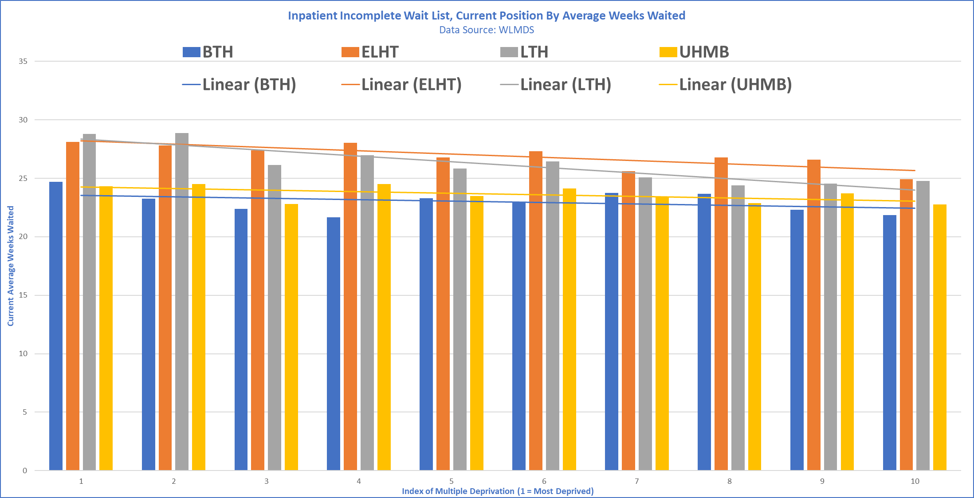
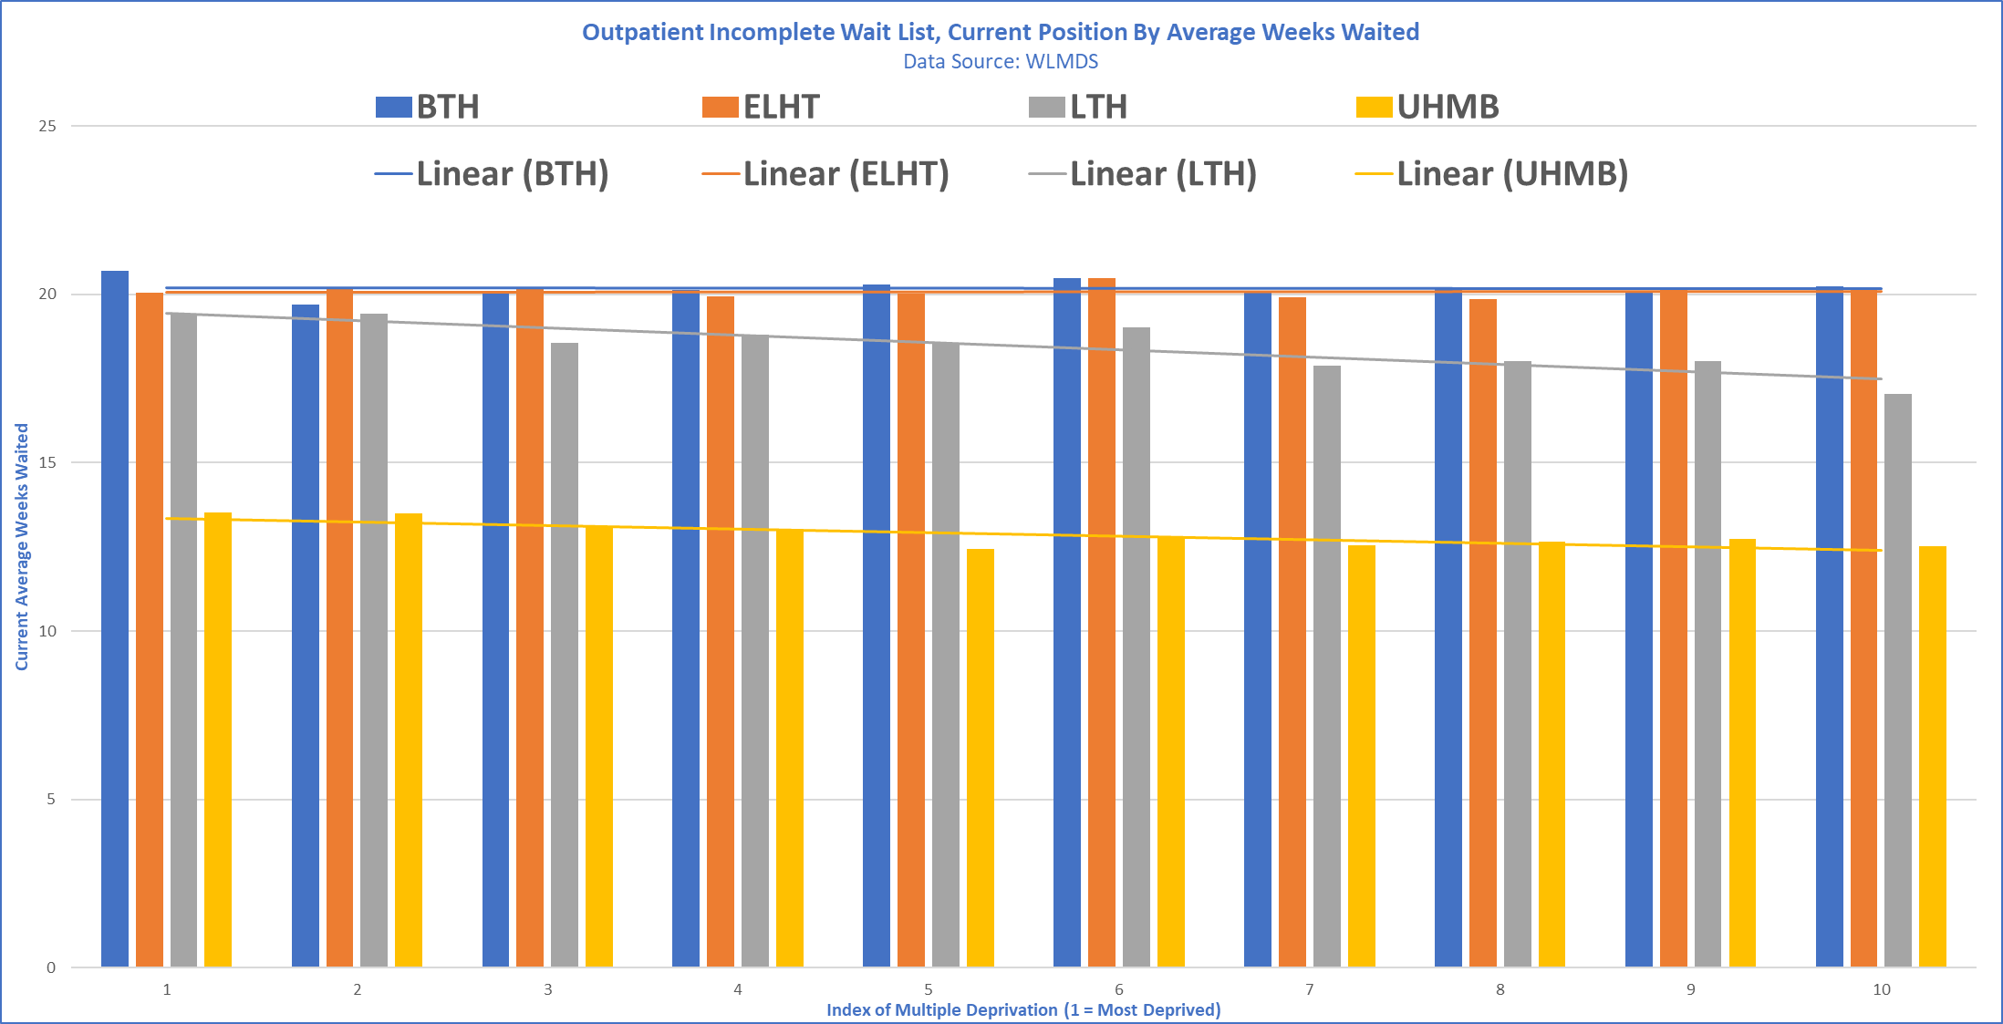
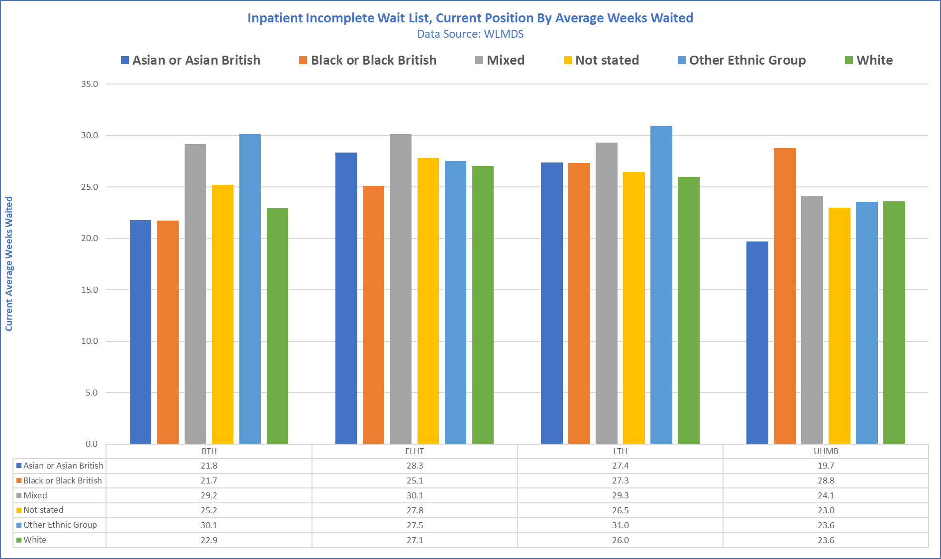
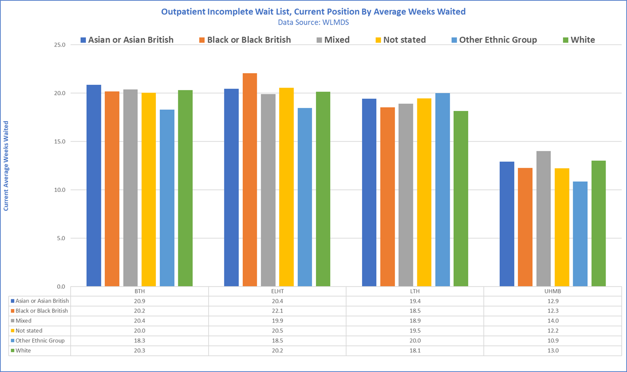
Elective Waiting List – Health Inequality Data Reviews
Examples of Health Inequality deep-dive outputs have included variable trends in average waiting times by IMD & Ethnicity across admitted & non-admitted pathways.
IMD
Ethnicity
Notes:
Very high level, doesn't show inequalities at ICB level but looking at provider level broken down by deprivation and ethnicity more obvious.
Closed vs open pathways
Detailed Waiting List analysis reviews / deep-dives have taken place to develop data that enables the system to explore inequalities in access at a system, trust and speciality level, including:
Pre- and post-COVID analysis to identify any population groups (age, ethnicity, gender and deprivation indices) that have been disproportionately affected by COVID in terms of waiting times for treatment.
Understand any inequalities in access happening now, using up-to-date data on open and closed RTT pathways.
Several approaches to the analysis have revealed no single ‘theme’ or shared challenge across LSC

Slide 6
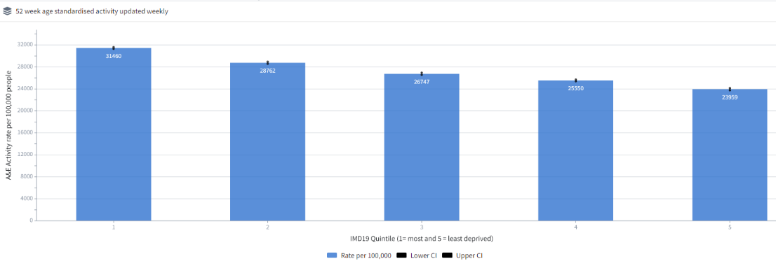
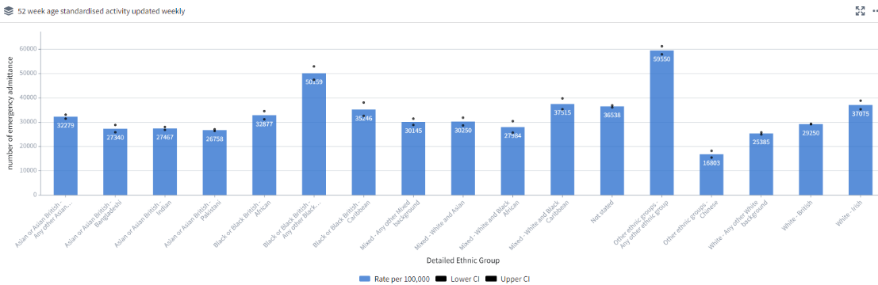
Emergency attendances
Age standardised activity rates with 95% confidence
This slide includes all A&E attendances including those not admitted.
The top chart shows a direct correlation between the index of multiple deprivation (IMD) score of an electoral ward and the rate of unplanned hospital admissions.
In general terms, the more disadvantaged the ward, the greater the rate of admission.
Analysis originally undertaken by NHS Right Care and Prof. Chris Bentley in 2018 identified that within this overall pattern there is a level of variation, suggesting that this pattern could be influenced. Electoral wards with a high level of deprivation but relatively low levels of unplanned hospital admission were termed exemplar wards and those with very high rates of admission were termed priority wards.
Th slide below summarises our work on this.

Slide 7
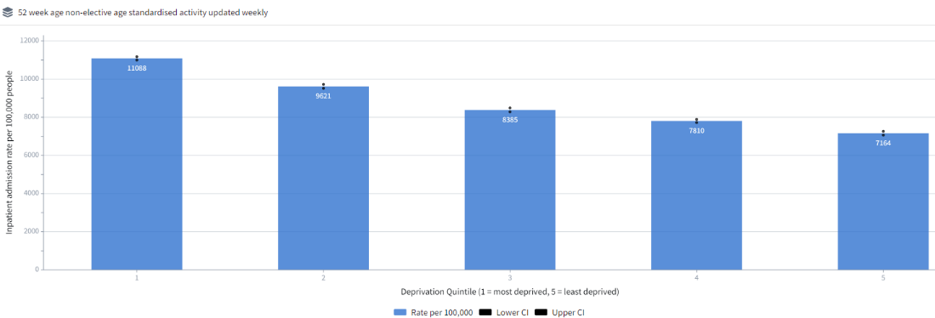
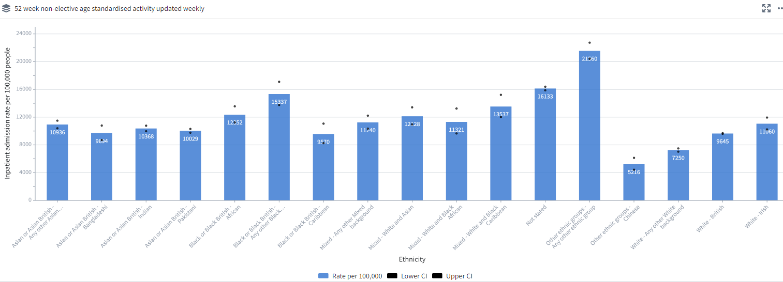
Non-elective activity
Age standardised activity rates with 95% confidence intervals

Slide 8
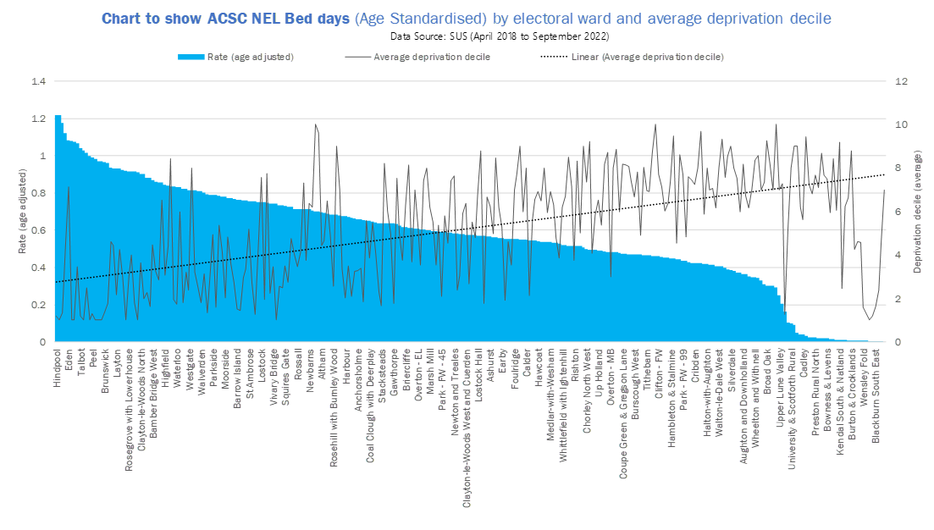
Priority wards
Across L&SC we have undertaken work to understand these variations in access to emergency care in “Priority Wards” using a range of data sources. We have also funded work led by VCFSE organisations and Healthwatch to engage residents, community groups and wider organisations working in these areas to gain a deeper understanding of the causes and what could make a difference.
We are currently working with others across the NHS and with local partners to take this work further by building new approaches to working with communities, increasing the impact of what is already available and developing plans to improve access to more proactive care.
Summary of Insights generated
Population
Lack of awareness from people in Priority Wards about existing services
Confidence in population to manage symptoms independently
Alignment between service provision and population need
People do not understand staff roles in particular Social Prescribers and Reception staff
Prevalence of depression is high and exacerbated by cost of living crisis
High concentration of PLUS communities with challenges due to language and cultural barriers
Service
Access to Primary Care was highlighted as a barrier
Varying levels of community facilities with travel required to access ‘hub’ type models of care
Fragmented service provision with hand off between services making it difficult to navigate
Data informed case finding and proactive care less common place than in pre covid years
People struggle to access MH services in timely way.
Wider determinants
The wider determinants of health including housing, employment, the condition of streets, levels of antisocial behaviour and crime were strong themes across data and community insight

Slide 9
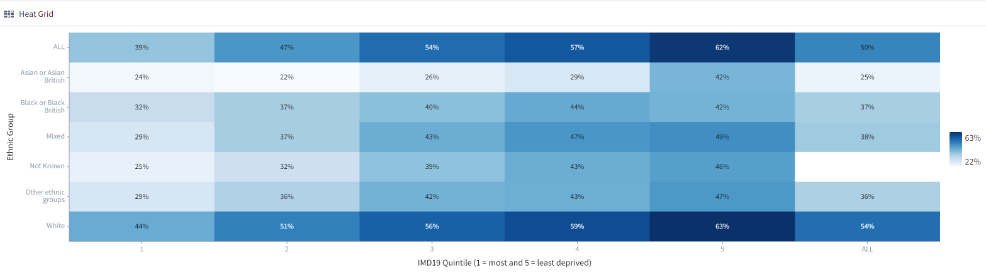
Uptake of vaccination for respiratory disease by sociodemographic group
Flu Vaccine
In the 2023/24 season, just over half a million people across Lancashire & South Cumbria received their flu vaccine, which is just under half of those who were eligible. GP’s vaccinated the largest number of patients but community pharmacy was also a popular choice, particularly for those aged over 65.
Deprivation and being of an ethnicity other than white consistently contribute to inequalities in uptake rates. In the most disadvantaged areas (IMD deciles 1 and 2), uptake rates are lower than in the more affluent areas and those identified as of Asian ethnicity (Pakistani, Indian or Bangladeshi) for example, have uptake rates of half those of the White British/Irish population.
Age is also a factor – the over 65 aged cohort consistently achieves the highest uptake rate (77.5% in 2023/24) – with all the younger cohorts seeing lower uptake rates. In those aged 2 and 3, a key cohort due their status as flu ‘super spreaders’, uptake remains lower than the peak rates achieved during the pandemic (36.5% and 40.3% respectively in 2023/24). Of more recent concern are the falling rates of uptake in those aged under 65 and ‘at risk’ which includes those who have diabetes, are immunocompromised or have chronic heart, kidney or liver disease. Uptake in this cohort fell by a further 7% in 2023/24 season to 39.6% .
Uptake by pregnant women is at the lowest rate since they became eligible for the vaccine (26% in 2023/24) although some Places saw signs of improvement in 2023/24.
Pneumococcal Polysacchariade Vaccine (PPV):
All adults aged 65 and over are eligible to receive one dose of the PPV vaccine to protect against pneumococcal disease. For all those aged over 65, uptake in Lancashire and South Cumbria was 71.0%. (data to 31 March 2023). In those newly eligible, ie those turning 65 in the previous year, uptake was 31.7%. In those that have been eligible for longer, uptake rates had increased to 71.9% in those aged between 70 and 74, and 83.1% in those aged 75 and over.

Slide 10
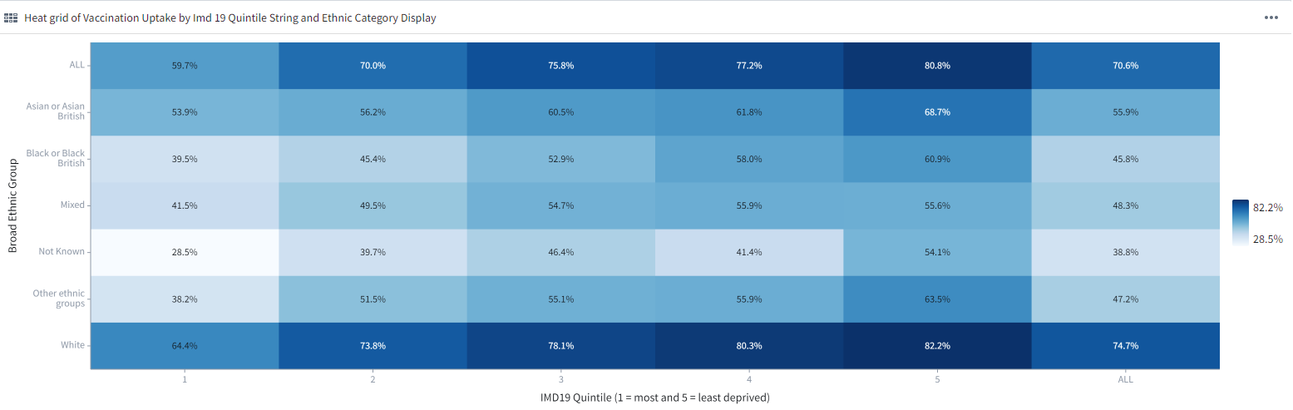
Uptake of COVID vaccination by demographic group
The chart above shows a high degree of variation in uptake rates both in relation to ethnicity and IMD.
The COVID team set their target at 60% vaccination rate based of previous year’s activity, but we are currently falling short of this for people of all ethnicities other than white.
The Vaccination Health Inequalities Group (HIG) was set up to understand the population's needs and develop a strategy to promote and increase vaccinations.
An increase in vaccine hesitancy in Black, Asian, including Indian, Pakistani and Bangladeshi communities is multifactorial (SAGE 2020) and L&SC’s approach ensured that the Health Inequalities Group addressed these factors directly. Our strategic approach was influenced by the NHS Race and Health Observatory’s finding on how to maximise vaccine uptake in ethnic minority groups (NHS RHO 2021)

Slide 11
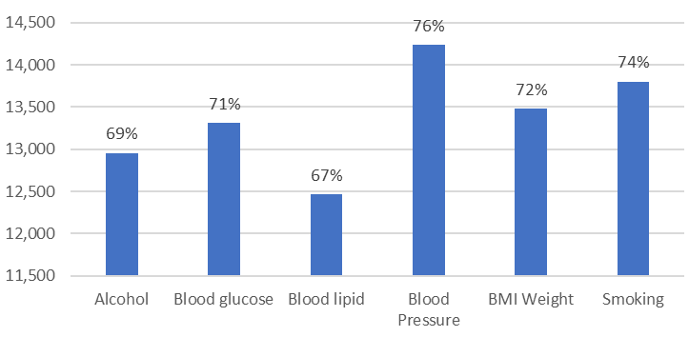
Improving health for people with Serious Mental Illness
Overall number of SMI physical health checks
ICB steering group leads on the physical health checks for people on SMI registers
65% of registered people received a full health check in 2023/24
Detailed action plan developed and agreed by steering group
Procurement underway (July 2024) to select delivery partner for outreach service to target the hardest to reach populations & groups
Education and information scheme in development to help promote the requirement for health checks in 2024

Slide 12
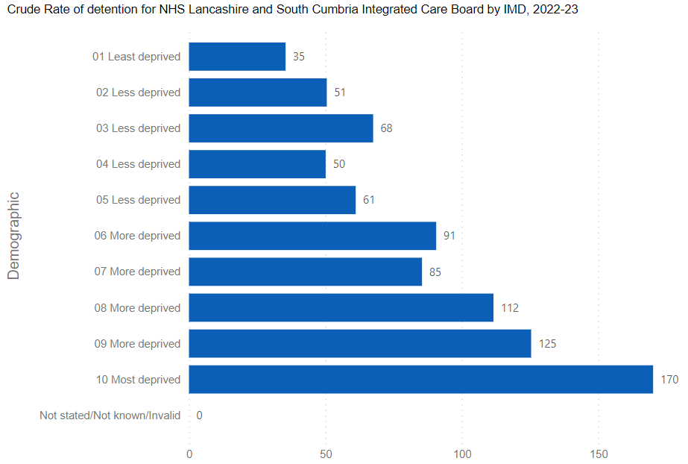
Rates of total Mental Health Act detentions – by IMD
A Mental Health Act (MHA) assessment may be arranged when a person is thought to be suffering from a mental disorder and may pose a threat to themselves or others.
Prior to making an assessment other provision ought to be considered including input from community MH or crisis teams, a review of social care needs or help from GPs or other services.
People should only be detained if their care/treatment can no longer be provided safely in the community.

Slide 13
Rates of total Mental Health Act detentions – by ethnicity
The ICB is focusing on prevention and early intervention in mental health service delivery.
Detaining someone in hospital is due to significant risks that individuals pose to themselves or others.
Detention under the Mental Health Act should only occur after alternatives have been thoroughly and independently considered.
The ICB goal is to ensure recovery from a mental health crisis and that people can live in their community with required support.

Slide 14
Number of restrictive interventions
Restrictive interventions are management of a challenging situation in order to minimise the immediate risk.
It is recognised that de-escalation techniques and positive behaviour support is used throughout any intervention.
When restrictive interventions are used techniques and methods must be proportionate, the least restrictive possible to meet the need and that the level of force utilised matched the severity of the circumstances.
Aftercare arrangements are developed and implemented to maximise recovery and minimise any trauma caused.
The data is suggesting that there have not been any restrictive interventions for people from Black and Minority Ethnic communities. The data is being verified but it is possible that this is because of the small numbers of restrictive interventions undertaken.
Data withheld in national reporting due to low numbers

Slide 15
NHS Talking Therapies (formerly IAPT) recovery
Recovery rate target is 50% (NHS England)
ICB services are consistently achieving or exceeding this
Further work is underway to improve recovery rates for ethnically and culturally diverse populations and other underrepresented groups underway
An audit of access for Black and Minority Ethnic communities has been completed (2024)
An action plan has been developed and is now being implemented (2024)
There is ongoing work to ensure appropriateness of referrals via education & engagement work

Slide 16
Children and young people’s mental health access
Rates per 100,000
Core 20+5 ambassador has been appointed for the ICBs children and young people’s mental health commissioning team
Information is collated and reviewed through schedule 6 reporting mechanism
Plans are in place to review and analyse data trends to support service improvements
Deprivation trends/data have been central to target areas for new MH support teams to support schools in those areas

Slide 17
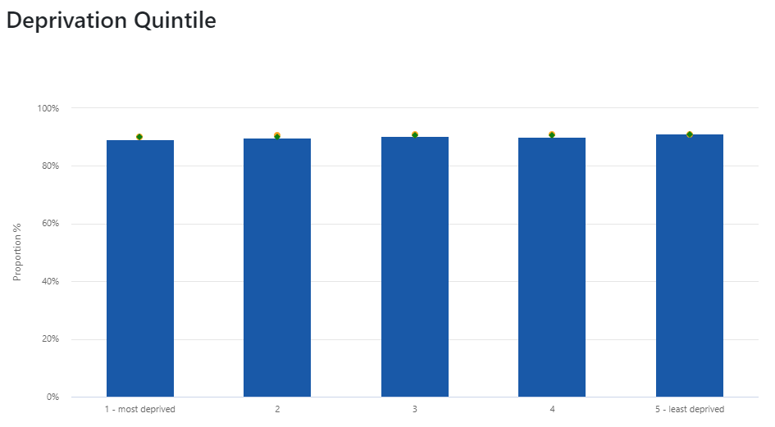
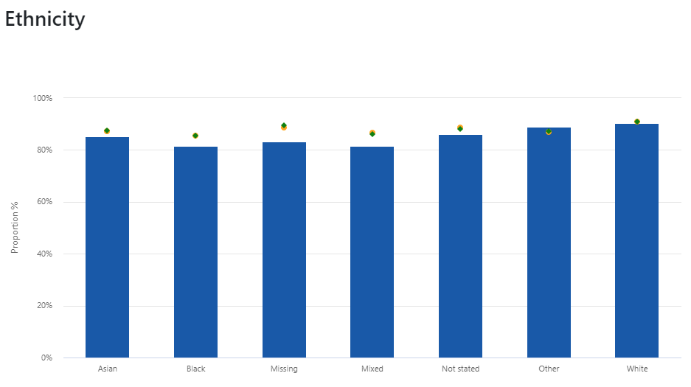
Atrial Fibrillation
Percentage of patients with atrial fibrillation (AF) and a record of a CHA2DS2-VASc score of 2 or more, who are currently treated with anticoagulation drug therapy
CVDP002AF
The target for AF treatment within the Long Term Plan, is 90% by March 2029. L&SC are currently showing as 89.92% (Dec 23). Our rich Aristotle HI data has identified a number of wards that would benefit from early intervention and prevention of hypertension, therefore we have a number of case finding initiatives planned, which will support the identification of further AF cases using a MECC approach (pulse before pressure).
Our markers for deprivation and ethnicity show no outliers have been identified for AF currently, however we will continue to monitor this as they may become more apparent as we proceed with case finding.

Slide 18
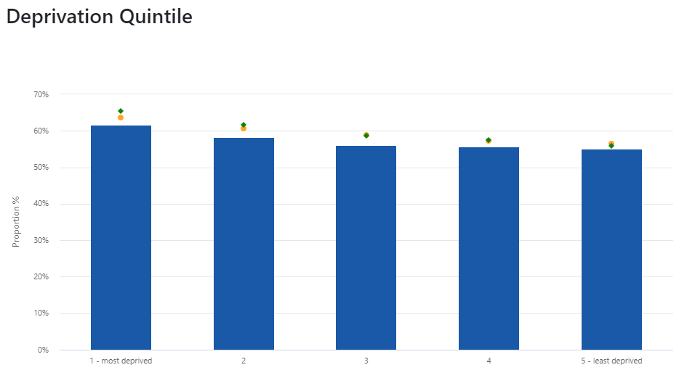
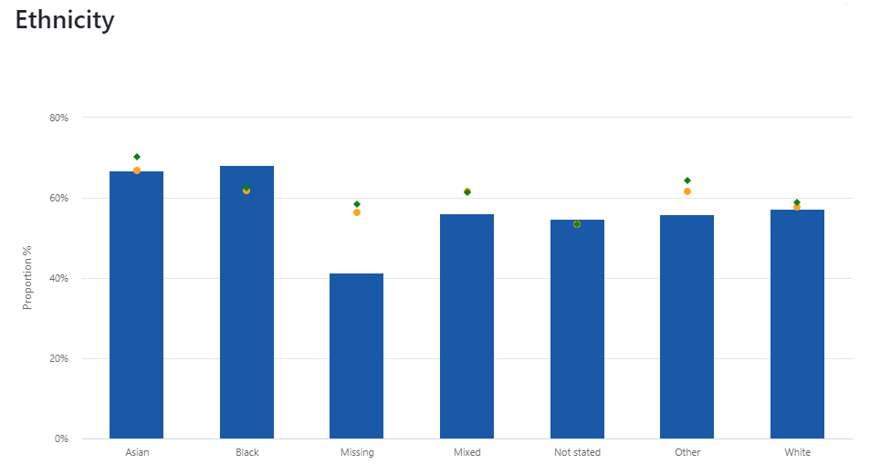
Cholesterol
Percentage of patients no recorded CVD and a QRISK score of 20% or more on lipid lowering therapy CVDP003CHOL
The national target for cholesterol treatment, is 65% by March 2025. L&SC are currently showing as 58.93% (Dec 23). The above shows that we are recording ethnicity quite well, with our 'missing' element is very low, but there is room for improvement. Males aged 40-59 males are a particular cohort requiring focus and work to target this group is underway through NHS Health checks. We are interrogating local data on Lipid Lowering Therapies uptake and correlating that data with health inequalities markers, to provide focussed cohorts to work with going forward and to identify where general practices and Primary Care Networks might welcome support.

Slide 19
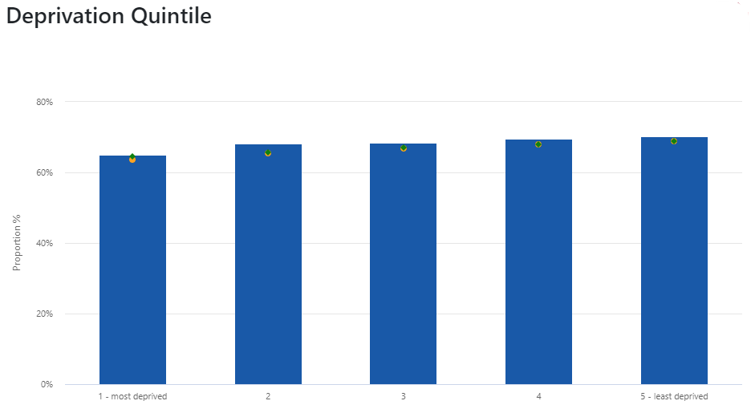
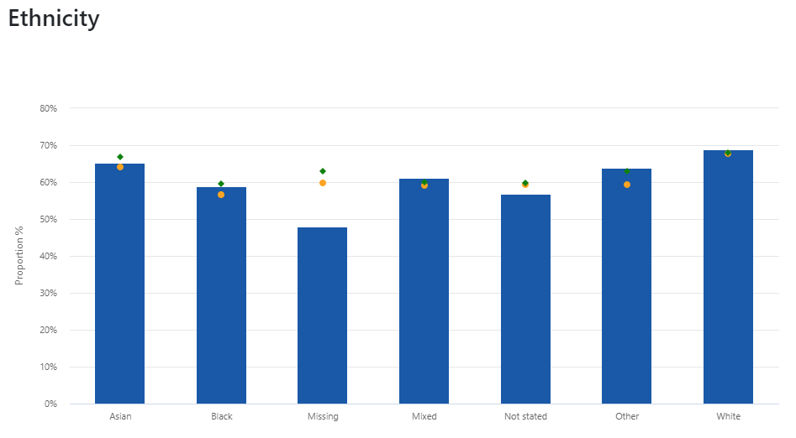
Treatment of hypertension
Percentage of patients recorded hypertension with BP below threshold
CVDP007HYP
The target for Hypertension treatment within is 80% by March 2025. L&SC are currently showing as 67.87% (Dec 23 CVDPrevent data) however our local data, which is more uptodate puts us at 72.6% (Apr 24). Our data has identified a number of electoral wards that have uncharacteristically low hypertension prevalence rates and 31 other indicators, and could benefit from early intervention and prevention of Hypertension. Wards that are outliers in 6 main markers – deprivation, age, preventable mortality rates, emergency admission rates (for both Myocardial Infarcation and Coronary Heart Disease), Ethnicity and over 65's living alone – will be our focus.
We are continuing to support our PCNs/Practices, as well as increasing our case finding based on health inequalities. The more cases we find, the more of a challenge it will be to achieve the 80% target.

Slide 20
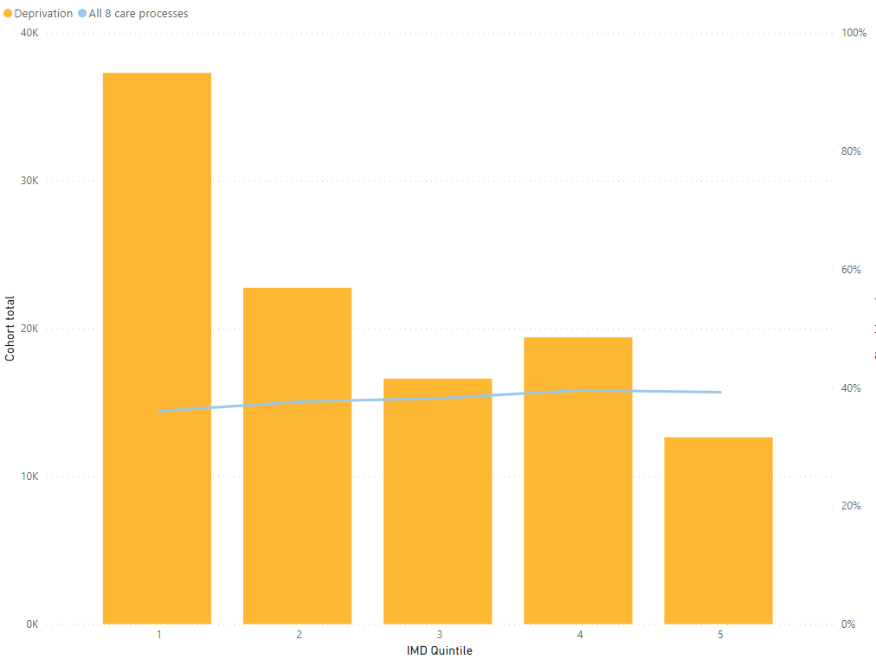
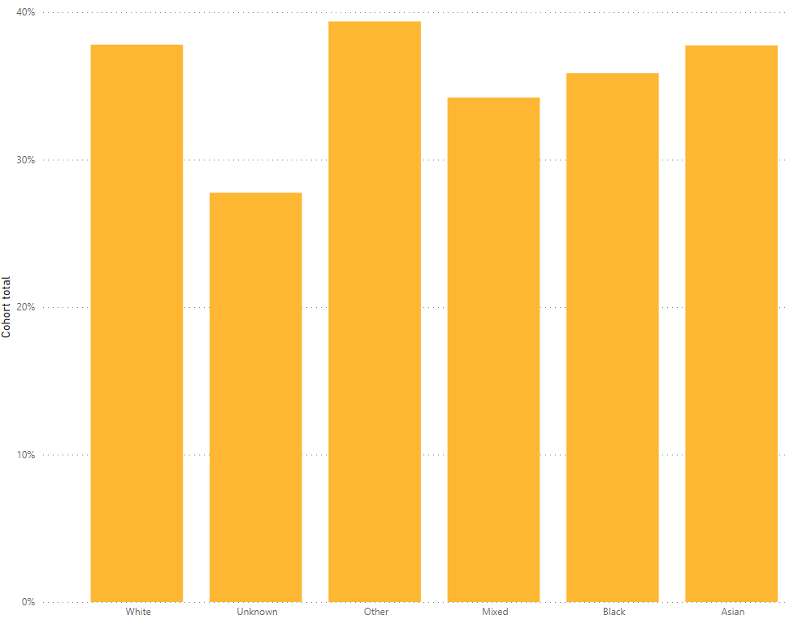
Type 1 Diabetes
Variation in the proportion of patients with Type 1 receiving all 8 care processes
Variation in delivering the 8 Care process is monitored via the Diabetes Delivery Board. Schemes to improve delivery include:
Enhanced service review of existing variable requirements to ensure standardisation and consistent requirements across PCNs.
Practice learning time and peer support, to share learning, outcomes. Review of support for practice staff to access training and DSN support.
Consolidate Diabetes messages and information into one place on the Primary care intranet, as a one place access point for support and information
Development of Integrated Neighbourhood approach to manage patients with LTCs, including holistic approach, MDT care planning and population health approach to identifying patients that need additional support to access services.
Reducing waiting times for Podiatry as part of reducing Community Waiting times

Slide 21
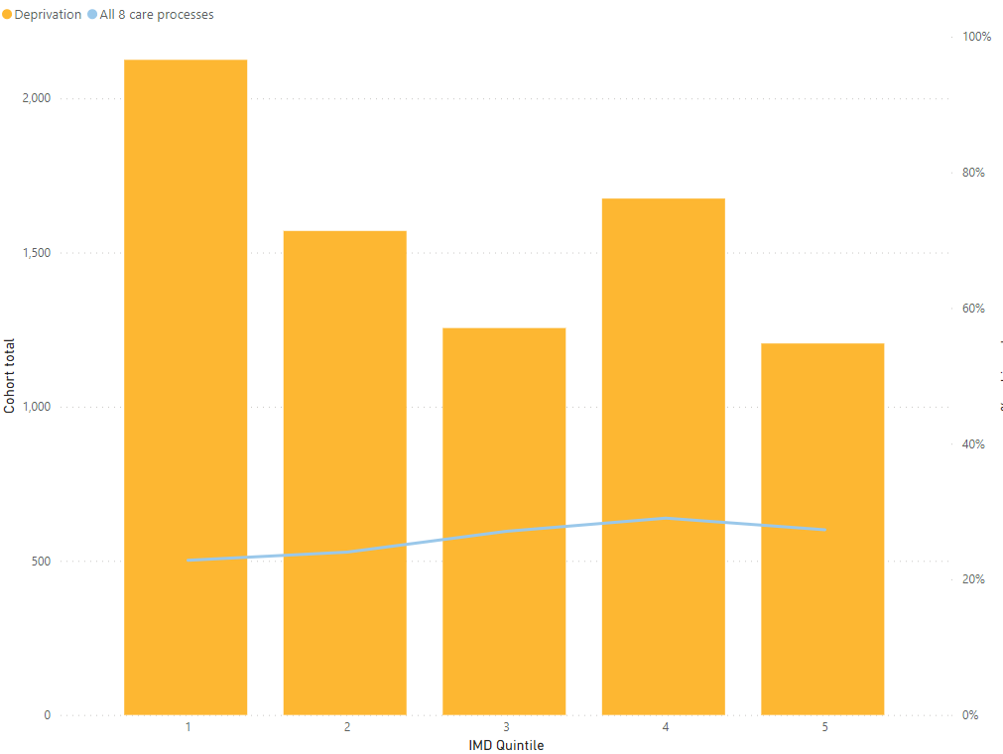
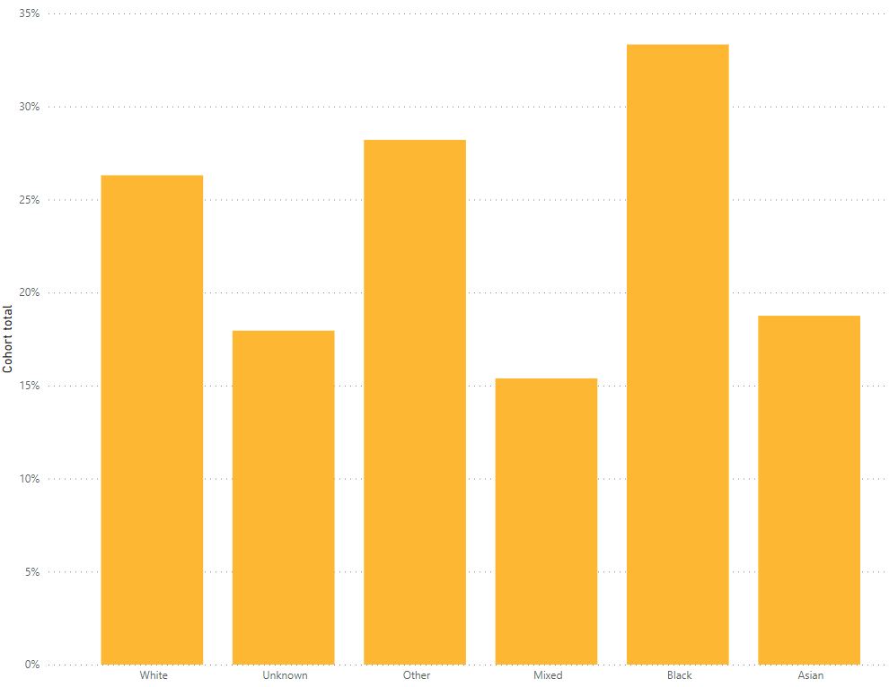
Type 2 Diabetes
Variation in the proportion of patients with Type 2 receiving all 8 care processes

Slide 22
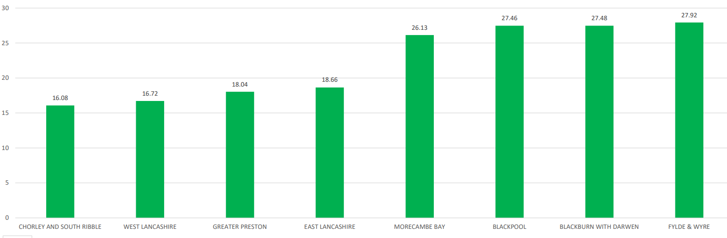
Type 1 & 2 Diabetes
Percentage of patients with Type 1 or Type 2 diabetes who meet all three treatment targets:
- HbA1c below 58mmol/mol
- Blood pressure below 140/80
- Prescribed a statin for prevention

Slide 23
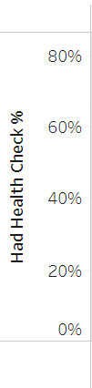
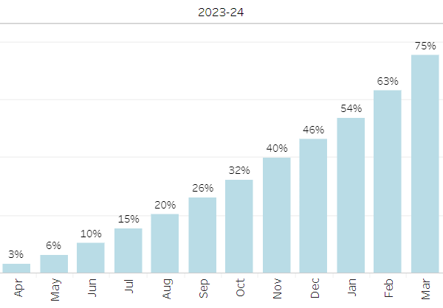
The number of learning disability annual health checks
For AHCs our trajectory is 75% to be completed in 23/24 and 76% in 24/25. Our data at end March 2024 suggests we have hit our target.
This will not be confirmed until we have received the official NHSE figures, as our data includes a fluctuating LD register count each month due to population changes and other variables. The NHSE data identifies a LD register count for each ICB at one set point and counts completed health checks from the QOF register whereas ours is through EMIS.
Therefore, although we are hopeful that we have achieved the target for 23/24 of 75%, until official NHSE figures are received we cannot confirm this, as each year our data is 1-2 percentage points different from NHSE.
According to our data, at the end of March 2024 we delivered 7144 health checks (+33 on March 2023) and 6794 health checks with a health action plan (+187 on March 2023). In addition, 327 people have been added to our Learning Disability register.

Slide 24
Adult mental health inpatient rates for people with a learning disability
The Long-Term Plan states that by March 2024 (now altered to March 2025) that there should be a maximum of 30 adults per million population in a mental health or specialist bed. To meet this target, our trajectories for inpatient numbers for 23-24 are:
At the end of 2024 we had 79 in-patients which is 5 more than we had planned. To meet the Long-Term Plan targets by March 2025, we will need to have reduced our in-patient population to 40 people.
The target for CYP mental health inpatients is 5, and in March 2024 the number was 1.
Q1 | Q2 | Q3 | Q4
87 | 83 | 78 | 74

