Slide 1


Lancashire and South Cumbria
NHS Impact and Community Transformation Event

Slide 2




Housekeeping
Located below the Balcony Room
Located at the bottom of Barton C, to the left of the Buffet
No Tests planned for today
Consent to Vignettes / Interviews for Social Media

Slide 3
Welcome & Introductions
Councillor Damien Talbot
  Lancashire & South Cumbria Integrated Care Partnership Chair; Blackburn with Darwen Borough Council
Tony McDonald
  Director of Community Transformation, Lancashire & South Cumbria Integrated Care Board; Executive Director of Integrated Care, Partnerships & Resilience, East Lancashire Hospital Trust
Louise Taylor
  Director of Health & Care Integration, Lancashire & South Cumbria Integrated Care Board; Executive Director, Adult Services, Lancashire County Council
Hamad Saleem
  Healthwatch Representative; Public Governor, Lancashire & South Cumbria Foundation Trust; Panel Member, East Lancashire Hospital Trust
Sarah O’Brien
  Chief Nursing Officer, Lancashire & South Cumbria Integrated Care Board; Senior Responsible Officer for Transforming Community Care

Slide 4
Welcome & Introductions
Working Better Together
Understanding our Residents’ Needs
Providing the Best Possible Care

Slide 5
Welcome & Introductions
What is your ambition in your new role?
For this to work well what do you think we need to do?
What do we need to do to keep residents, their views and experiences, at the forefront of this?
What do you think the opportunities and challenges will be for front line staff from this work?
Notes:
Hamad asks Tony – What is your ambition in your new role?
Tony asks Louise – For this to work well what do you think we need to do?
Louise asks Hamad – What do we need to do to keep residents, their views and experiences, at the forefront of this?
Hamad ask Sarah - What do you think the opportunities and challenges will be for front line staff from this work?

Slide 6
‘All aboard a journey to community centred care’
Healthwatch Together

Slide 7


All aboard
Our journey to transforming community care

Slide 8


Let’s get started:
Our current location
Disagree
Agree somewhat
Agree

Slide 9
I understand what community care is available in my area
1.

Slide 10
2.
I would feel comfortable for myself or my loved ones to access community care that is available now

Slide 11
3.
Community services in my local area work well together to keep people safe and well at home

Slide 12
4.
Community care in my area is inclusive and accessible for all

Slide 13
Our services actively listen to feedback
5.

Slide 14
6.
Our services learn and act on feedback that is provided by people

Slide 15



Out and about
What are we hearing from our local passengers?

Slide 16


What themes can we draw from this?

Slide 17


Final Destination

Slide 18
Thank you

Slide 19

If you would like to tell your story,
get in touch with us today.
Healthwatch Lancashire
www.healthwatchlancashire.co.uk
Healthwatch Blackpool
www.healthwatchblackpool.co.uk
Healthwatch Blackburn with Darwen
www.healthwatchBlackburnwithDarwen.co.uk
Healthwatch Westmorland and Furness
www.healthwatchwestfurn.co.uk

Slide 20
Transformation in Action
Dr Andy Knox

Slide 21

Population Health – Tackling Health Inequity
3-4-5-6-7
Dr Andy Knox
Associate Medical Director, Population Health

Slide 22
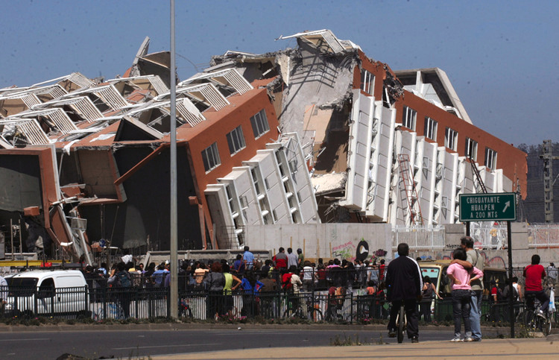

Slide 23
Getting to WHY?!
Economical
Psychological
Sociological
Political
Structural
Spiritual/Communal

Slide 24
“Society is a manifestation of our values and who or what we value”
Prof Mariana Mazzucato and Prof Bev Skeggs

Slide 25
Stigma
Structural
Systemic
Organisational
Environmental
Individual

Slide 26


Slide 27
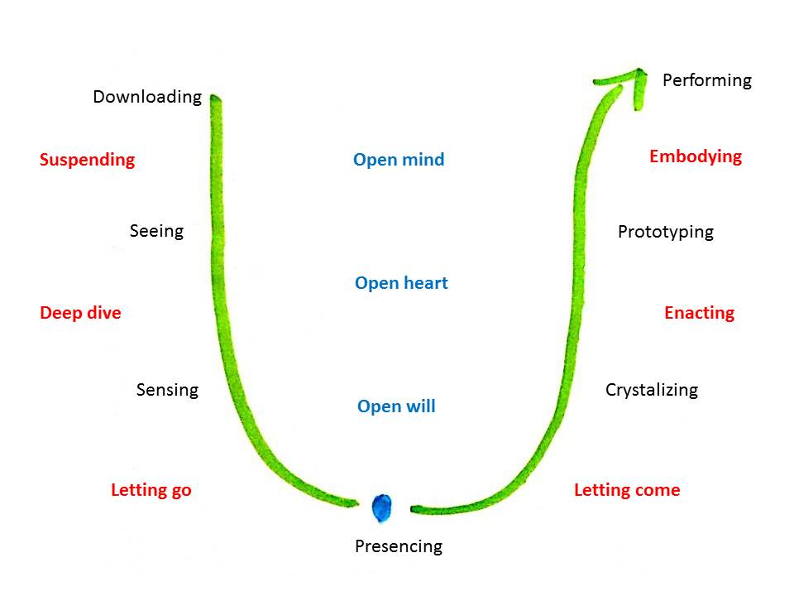
Theory U
Otto Scharmer

Slide 28


Slide 29
Transformation Requires (the right kind of) Leadership!
Curious
Humble
Inclusive
Compassionate
Kind
Empowering
Nurturing
Don’t Be a Cock be a Chicken!

Slide 30
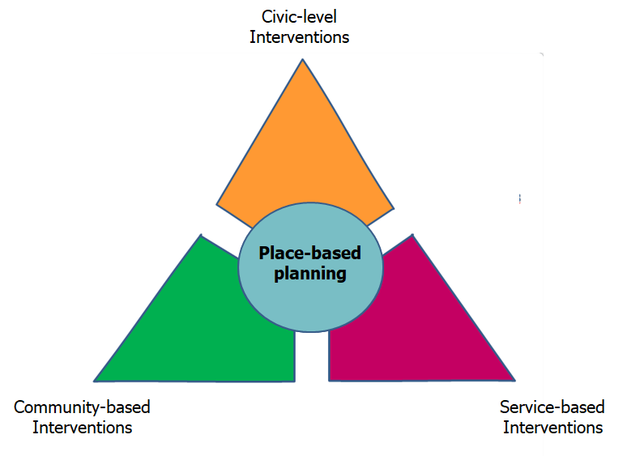
3-4-5-6​-7
The Population Health Intervention Triangle
Legislation; regulation; licencing; by-laws
Fiscal measures: incentives; disincentives
Economic development and job creation
Spatial and environmental planning
Welfare and social care
Communication; information; campaigns
Major Employer
Strengthen community action
Improved integration of services
Delivering intervention systematically with consistent quality and scaled to benefit enough people.
Reduce unwarranted variation in service quality and delivery
Reduce unwarranted variability in the way the population uses services and is supported to do so.
The assets within communities, such as the skills and knowledge, social networks, local groups and community organisations, as building blocks for good health.
Better community engagement
Bentley/PHE 2019

Slide 31

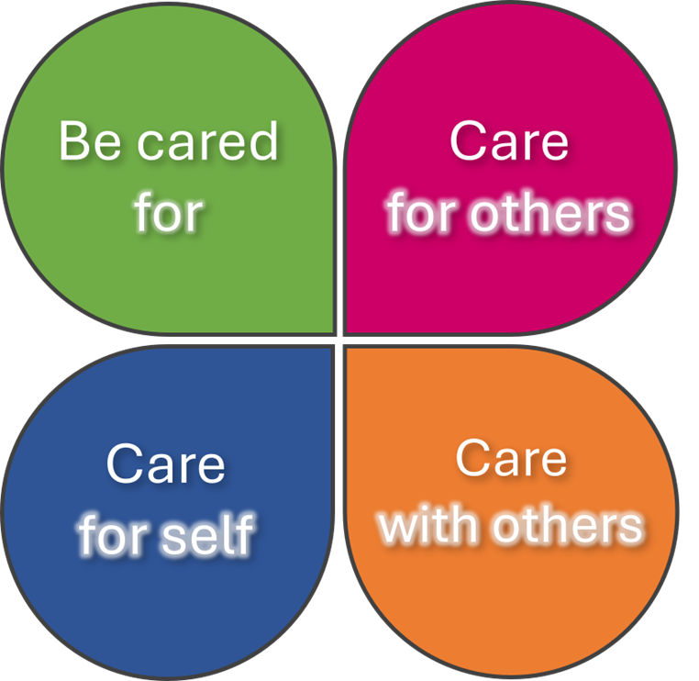




3-4-5-6​-7
The Four-Fold Practice

Slide 32
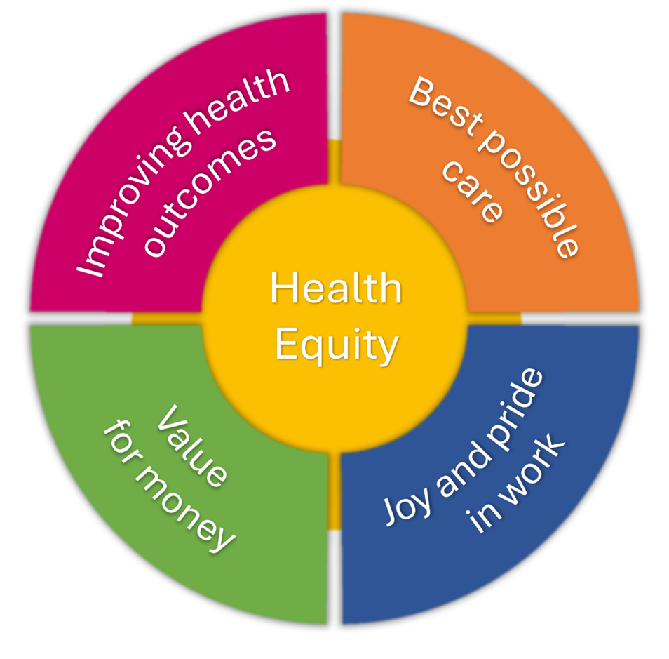
3-4-5-6-7
The Quintuple Aim

Slide 33
3-4-5-6​-7
The Population Health Hexagons
Predict – Using data, insight and ongoing dialogue with communities to identify early issues likely to lead to ill health
Create
Working in partnership with people, communities, businesses and public sector organisations to create the circumstances and conditions in which people thrive
Predict
Prevent
Detect
Protect
Manage
Recover
Work together with a sense of curiosity, humility, inclusivity, compassion, kindness, joy and trust to improve the health of our population through the tackling of health inequity
Recover – Working with people and carers to enable those recovering from illness to live as full a life as possible, or receive excellent and equitable palliative care
Prevent – Taking action with people and communities to improve lifestyles, social circumstances and our environment to improve health and wellbeing
Manage – Ensuring equitable access to the best possible healthcare at the earliest opportunity
Detect – working proactively in integrated teams to find people who have a condition which increases their risk of ill health
Collaborate
Protect – Working with people with known conditions/risk factors to reduce their risk of ill health
Data and Intelligence
Community participation
Resource (Finance, Skills, People)

Slide 34
3-4-5-6-7
The 7 I’s of Improvement
Improve
Insight
Invest
Involve
Innovate
Impact
Implement
Interpret

Slide 35
Examples and a Story
Earlier Cancer Diagnosis – St Matthew’s Ward (Preston)
Respiratory Admissions in Priority Wards (Barrow-in-Furness)
Enhanced Health Checks (Blackpool North, Barrow & Millom, Bay, Blackburn, Bridgedale, Carnforth, Ribblesdale, Rossendale, West Lancashire)
Loneliness and mental health - Community garden (Blackpool North)
Cervical Screening – (Blackpool Central)
Family obesity (Chorley East)
Eat to Beat Diabetes (Preston North & East)
Homelessness, prison leavers, substance misuse and poverty (Hyndburn)
Working with foodbank – recipes and nutrition, hypertension, weight management, first aid and mental health (Bridgedale)
Frail elderly, mental health, children and young people and priority wards (Barrow & Millom)
Town Hall Warm Hub health checks, homelessness and loneliness at Manna House and young people's mental health (Kendal)
Vaccination and screening, frailty, COPD and obesity (Bay)
Cardiovascular disease (Lancaster)
Hypertension (Blackburn)

Slide 36


Slide 37
NHS Impact and L&SC
David Fillingham
https://www.midlandsdecisionsupport.nhs.uk/knowledge-library/long-term-trends-in-gp-practice-consultation-rates/

Slide 38


NHS IMPACT
Improving Patient Care Together
David Fillingham CBE
Chair of the NHS National Improvement Board

Slide 39

This session:
What is NHS Impact and what is it for?
What do we need to do to transform community based services?
How can NHS Impact help us do this?

Slide 40
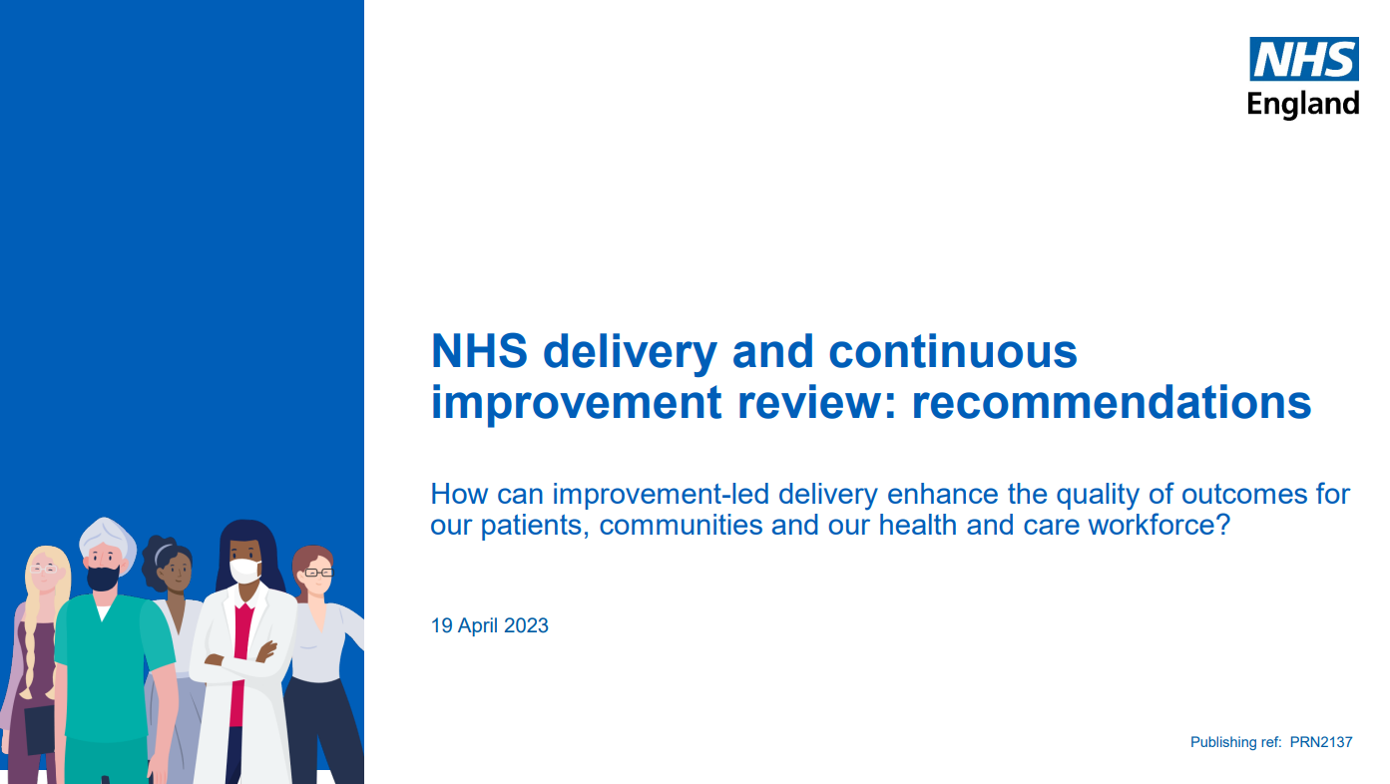
The Delivery and Continuous Improvement Review
Every NHS provider that has achieved a rating of “outstanding” from the CQC has a systematic approach improvement…and the best healthcare organisations in the world all do this.
NHS Impact was launched to help this happen everywhere across the NHS

Slide 41
NHS Impact ‘Improving Patient Care Together’
NHS Impact is not :
A single way of doing improvement that everyone must use
Just “yet another NHS national programme”
Only for the NHS
It is :
A movement that aims to support improvement locally, regionally and nationally
It does this by helping organisations and places develop “ the DNA of an improvement culture”
For the NHS and all its partners and the patients and communities we serve

Slide 42
NHS Impact ‘Improving Patient Care Together’
Five components form the ‘DNA’ of all evidence-based improvement methods:
Building a shared purpose and vision
Investing in people and culture
Developing leadership behaviours
Building improvement capability and capacity
Embedding improvement into management systems and processes

Slide 43






NHS Impact ‘Improving Patient Care Together’
Create a vision and shared purpose in an inclusive and transparent way ensuring meaningful input from all, including those with lived experience. Involve communities and people with lived experience as partners in the design of the vision and shared purpose.
Find ways to ensure the vision and shared purpose are lived everyday by its people and are underpinned by core values.
Ensure all improvement work is focussed on the shared purpose and vision and question any work which does not align to these.
Engage with people who work in healthcare roles and organisations and those with lived experience to design and implement the improvements based on what matters to them.
Facilitate opportunities for people to visit other systems and organisations to understand different ways of operating and different organisational cultures.
Invest and support people to understand and own their work enabling them to make improvements on their day-to-day operations.
Understand current leadership styles and approaches through board development sessions identifying strengths and gaps for each individual and as a team.
Create leadership stability and continuity of approach
Support leaders across the system to live and breathe the values and behaviours of the organisation and hold leaders to account for behaviours, not just improvement outcomes
Clearly agree and outline the support which is in place for people to improve their own services
Identify or create an improvement methodology to use across your entire organisation, ensuring a local and systemic way of practising improvement.
Give all people access to improvement training and support, so that everyone can run improvement projects and continuously improve their daily work
Determine how success will be measured at an early stage, use appropriate tools and frameworks, and include feedback from people working at the point of care and people with lived experience
To establish and sustain an effective management system requires a system and providers to have developed, or at least be developing, all the other four components.
Put systems in place to identify and monitor early warning signs and quality risks with clear processes of how to respond to these.
Set up the management system as a way of operating that enables ongoing continuous improvement of access, quality, experience, and outcomes.
Building a shared purpose and vision
Investing in People and Culture
Developing Leadership Behaviours
Building Improvement Capability and Capacity
Embedding into Management Systems and Processes

Slide 44
NHS Impact …our long term goals…
Every provider, place and ICS will have their own culture and system for improvement… every staff member will improve the work they do every day.
We will combine the small steps of continuous improvement with the big leaps of radical transformation.
All improvement work will be powered by people with lived experience and by communities
We will deliver improvements in all the ‘Quadruple Aim’ measures locally and nationally.

Slide 45
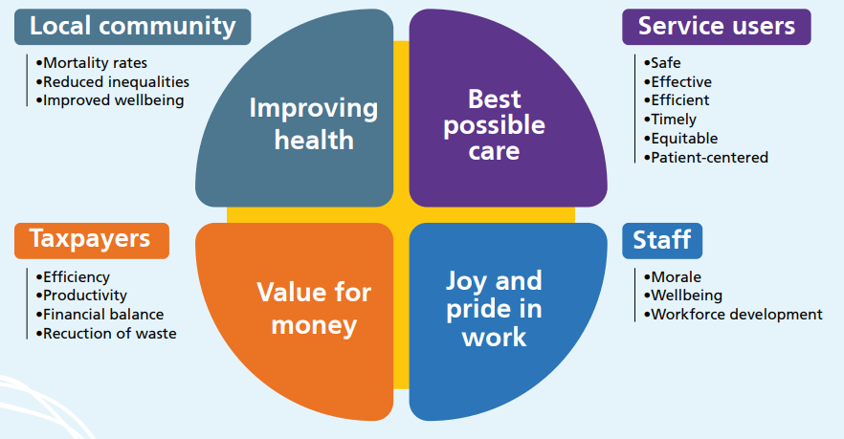
Quadruple Aim
A framework for thinking and a compass to guide us
Colleagues

Slide 46
Making Community centred care a reality
Root the work in a deep understanding of place….its history, culture, diversity, needs and strengths.
Develop truly joined up teams to deliver services ….”sharing the milk”
Listen to communities and work together to reshape services and make improvements…small steps and big leaps
Make the connections….housing, education, jobs, public amenities, crime and safety
Get “back upstream…and stop people falling in the river in the first place”

Slide 47
How can NHS Impact help ?
Create a truly shared purpose and vision….across all partners in the place
Invest in developing colleagues from all partners together as place based teams
Develop system leaders….at all levels
Use a wide range of improvement approaches…. ‘ABCD’, design methods, population health improvement tools, community engagement
Embed this in all partnership arrangements and in daily work

Slide 48
NHS Impact and L&SC
Andrea Stewart and Liz Huntbach

Slide 49
How will we use NHS Impact to support and accelerate community transformation?
Each of the tables has been allocated one of the NHS Impact themes to consider
The purpose of this exercise is to think about how can we use the NHS Impact framework to ensure that our community transformation programme makes a real difference for citizens, reducing inequalities and inequities:
To ensure maximum participation we will divide the time between individual, pairs and table discussion time
How could the NHS Impact theme be used to support
and accelerate delivery of community transformation
(2 mins individual thinking)
Share your ideas with a partner (6 mins in pairs)
Share your ideas and discuss as a table
(20 mins)
Agree 3 things we can commit to do differently
(10 mins)
Facilitators capture outputs from the table
Feedback will be collated and displayed for the afternoon session
NHS Impact Themes
Building a shared vision and purpose
Investing in people and culture
Developing leadership behaviours
Building Improvement capability and capacity
Embedding improvement into management systems and processes

Slide 50
How will we use NHS Impact to support and accelerate community transformation?
Tables | Impact Theme | Impact Question Prompts
1, 6, 11 | Building a shared vision and purpose | How will we ensure what we do makes an impact and tackles the inequalities and inequity that currently exists? OR How will we ensure that the vision and purpose of our community transformation programme is clear and well communicated for everyone to understand?
2, 7, 12 | Investing in people and culture | How will we enable everyone to contribute to transforming our communities? OR How will we change behaviours and attitudes?
3, 8, 13 | Developing leadership behaviours | How do we need to act as leaders or how do we need our leaders to act to progress our work?
4, 9, 14 | Building improvement capability and capacity | How will we assess our improvement capability and capacity?
5, 10, 15 | Embedding improvement into management systems and processes | How will we make sure that our work is embedded in the way we work and make our decisions? OR How will we share and spread learning and good practice?

Slide 51
Our Delivery Plans
David Fillingham and Louise Taylor

Slide 52
Our Delivery Plans
Apply thinking and approach
Getting serious about delivery
Using framework to support

Slide 53
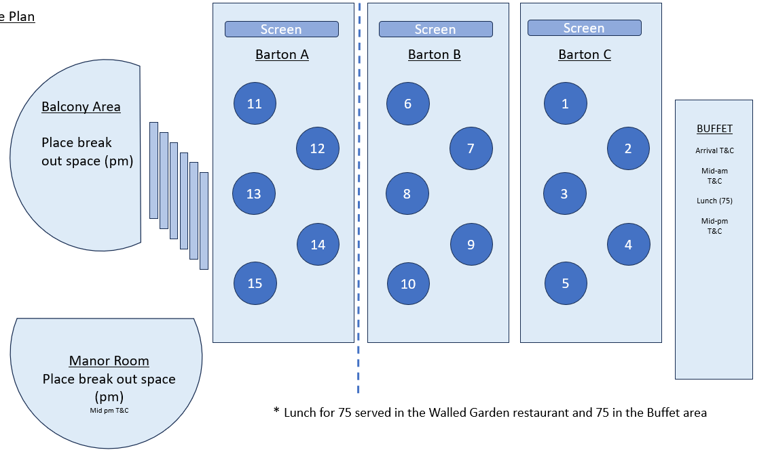
Lunch
Tables 1 – 8 Buffet
Tables 9 – 15 Walled Garden restaurant

Slide 54
Room Configuration
North Lancashire – 1, 2 & 3
East Lancashire – 4 & 5
Central Lancashire – 6 & 7
Blackpool – 11, 12 & half of table 13
BwD – 9 & 10 (move to Manor Room for afternoon activity)
South Cumbria – half of table 13, tables 14 & 15 (move to Balcony area for afternoon activity)

Slide 55

Accelerating Place Plans - Feedback
Lancashire (North) - Heather Woodhouse
Lancashire (Central) - Sarah James
Lancashire (East) - Jackie Moran
Blackburn with Darwen - Claire Richardson
South Cumbria - Nathan Hearn
Blackpool - Karen Smith

Slide 56
Reflections and Wrap-up
Tony McDonald, Louise Taylor, Hamad Saleem, and Sarah O’Brien

Slide 57
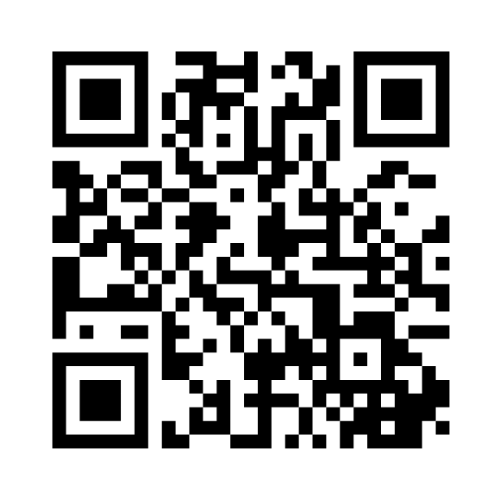

Feedback & Reflections
Please scan the QR code or follow the link sent to your email address today

